Slide 1
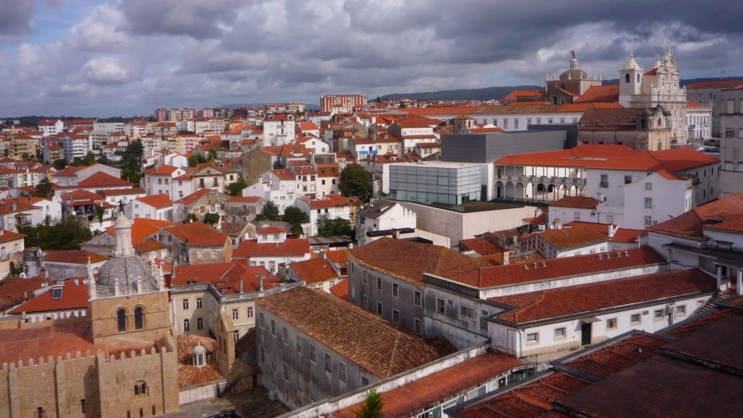
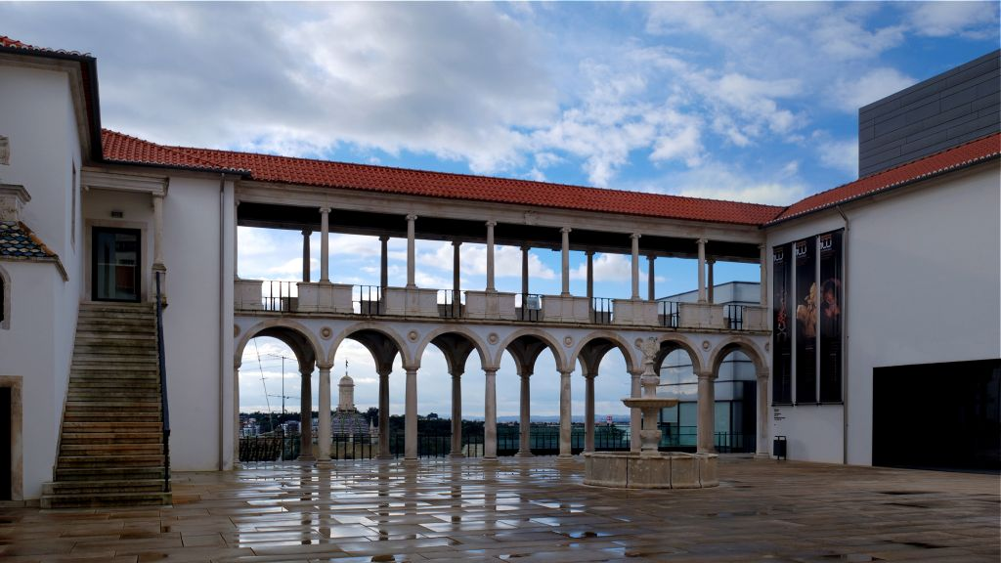
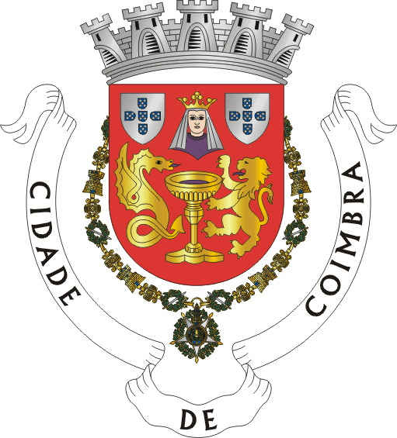

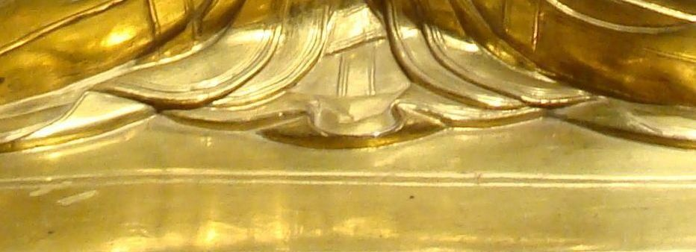
7
Coimbra
http://www.authorstream.com/Presentation/sandamichaela-1965713-coimbra7/
Museu Machado de Castro

Slide 2
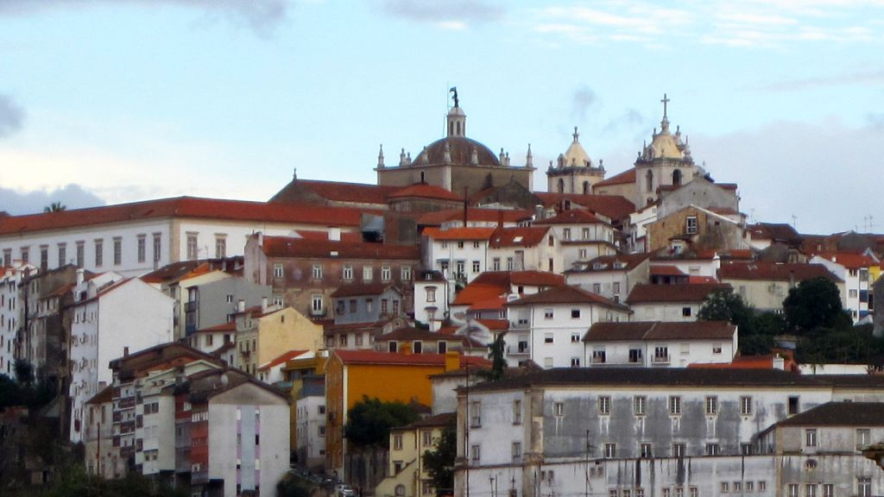

Slide 3
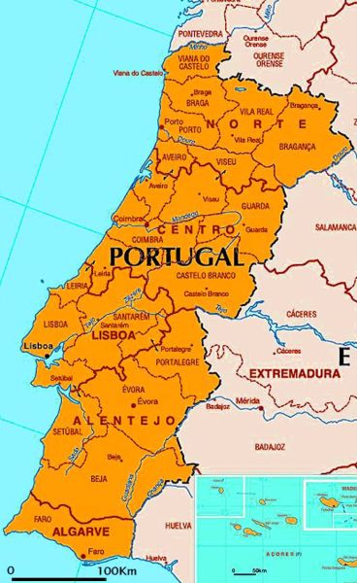
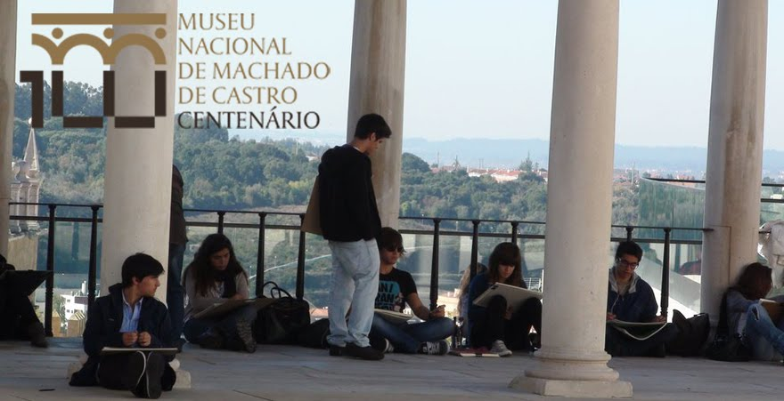
The Machado de Castro Museum was declared a national monument in 1910 and became a national museum in 1965. The former Bishop’s Palace was built on top of the cryptoporticus – the foundation of the forum of the Roman city of Aeminium. Dating from the 1st century AD, this is the most important surviving Roman building in Portugal.

Slide 4
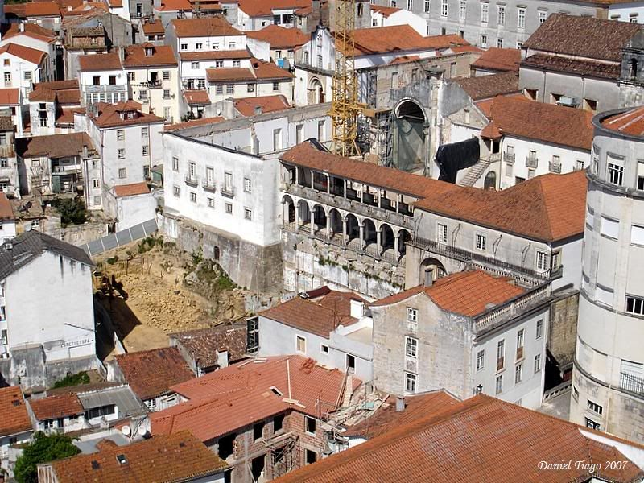
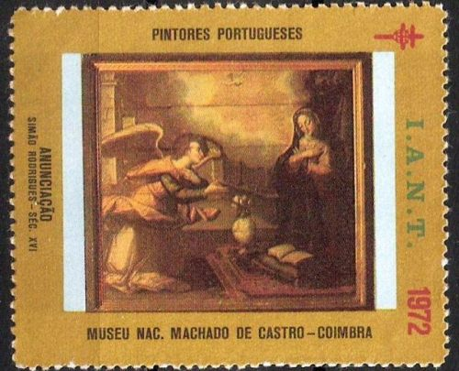
The collections of jewellery, painting, ceramics and textiles are also important and representative of both importation and national production. As a result of a recent refurbishment and expansion, it is now possible to visit one of the most remarkable works of Roman architecture in Portugal - the cryptoporticus

Slide 5
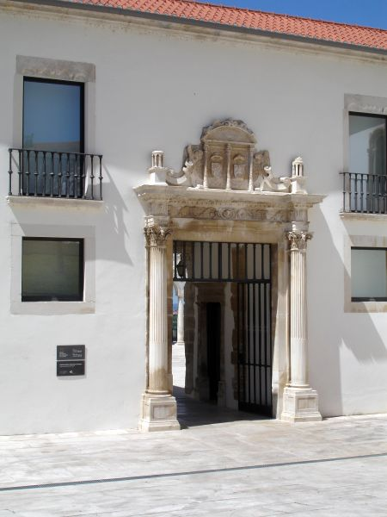
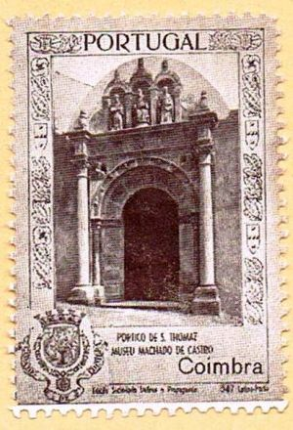
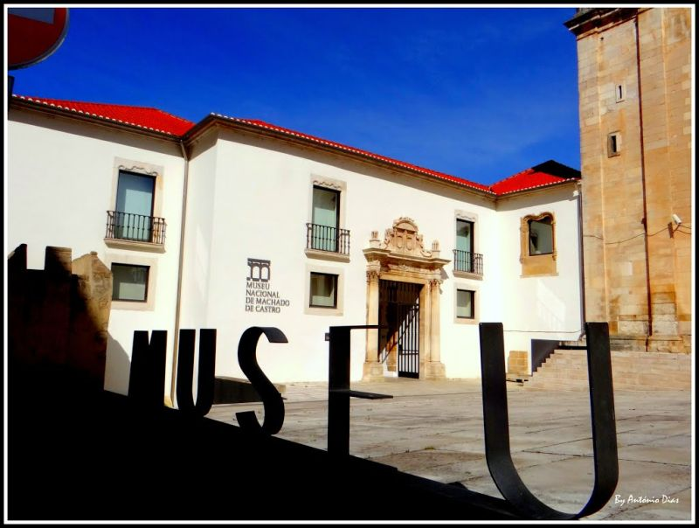
Aeminium was the ancient name of the city of Coimbra, in Portugal.

Slide 6
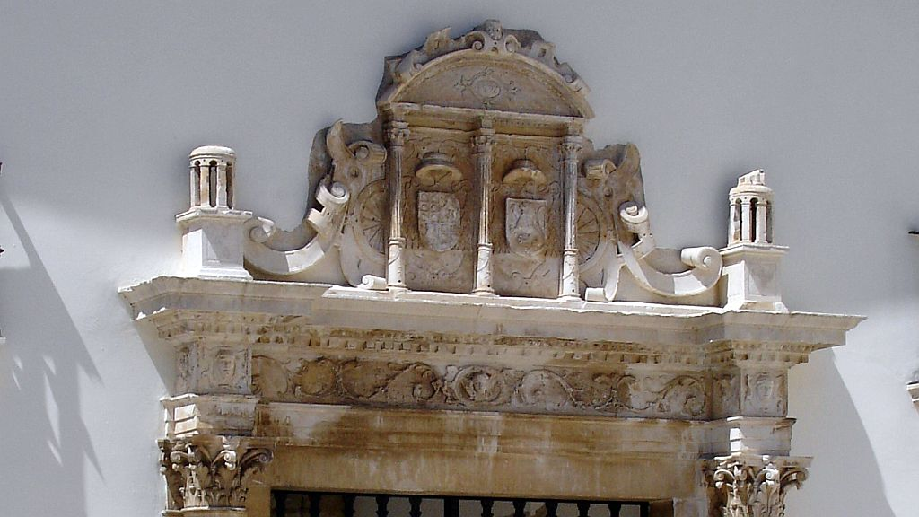

Slide 7
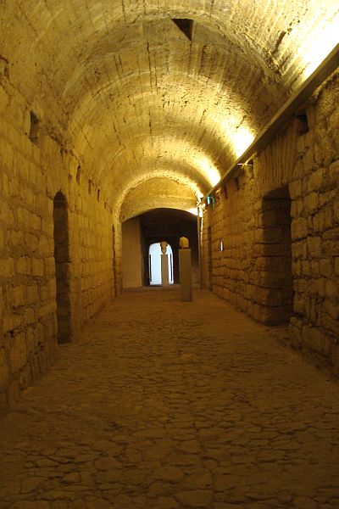
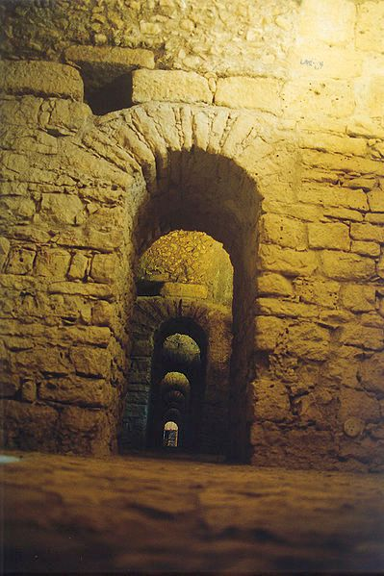
The Romans founded the civitas of Aeminium in this place at the time of Augustus, which came under the protection of nearby Conimbriga situated some 15 km away to the south.
The Roman city was encircled by a wall, and followed an orthogonal plan, with the cardo maximus and decumanus maximus crossing at the Forum. An aqueduct existed, the remains of which were incorporated into a latter medieval renovation. Locations for the theater and amphitheater were also proposed, but still unconfirmed by archeology. A triumphal arch is documented, but was destroyed in 1778.

Slide 8
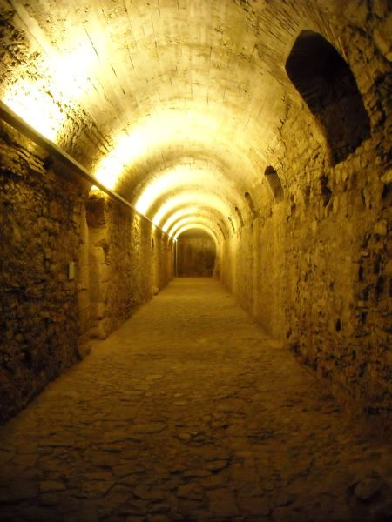
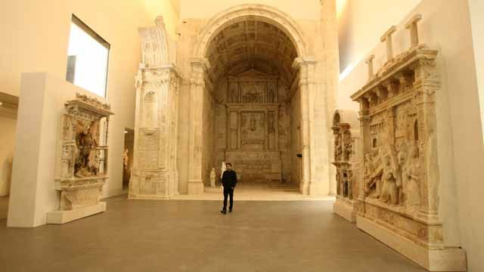
Also a necropolis was located to the east of the city.
The Sueves razed the nearby township of Conimbriga in 468. Its inhabitants, who had meanwhile fled to Aeminium, kept the original name of their town.
In modern Coimbra there are few remains from ancient Aeminium. The most important is the cryptoporticus, an underground gallery of arched corridors built in the 1st or 2nd century AD to support the forum of the city. Gaius Sevius Lupus was probably the architect.

Slide 9
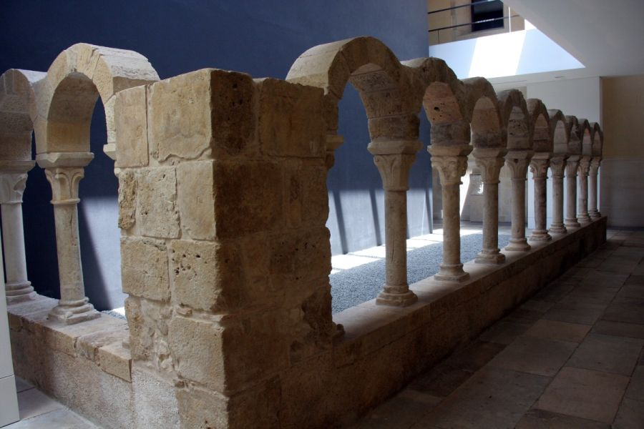
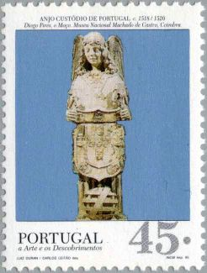
During the Middle Ages the bishop's palace, now turned into the Machado de Castro Museum, was built over the forum; the cryptoporticus is located under it. The cryptoporticus can be visited through the museum.

Slide 10
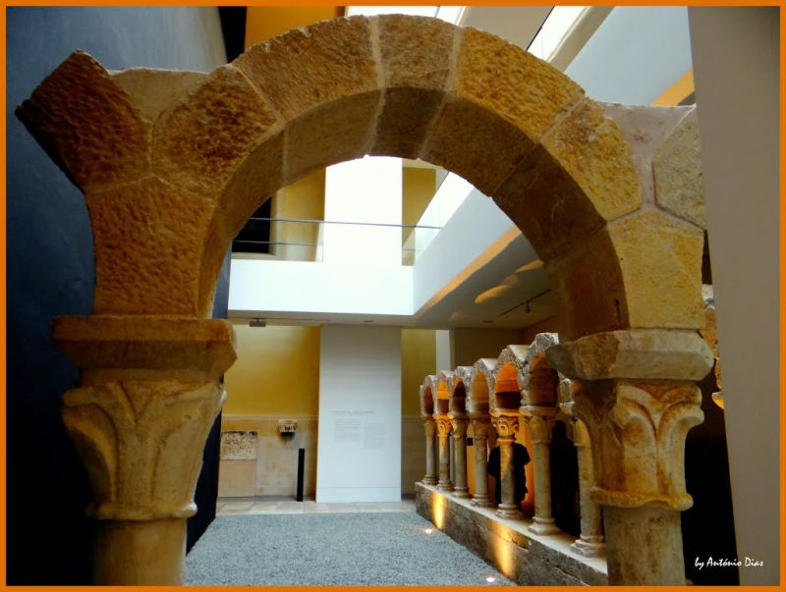
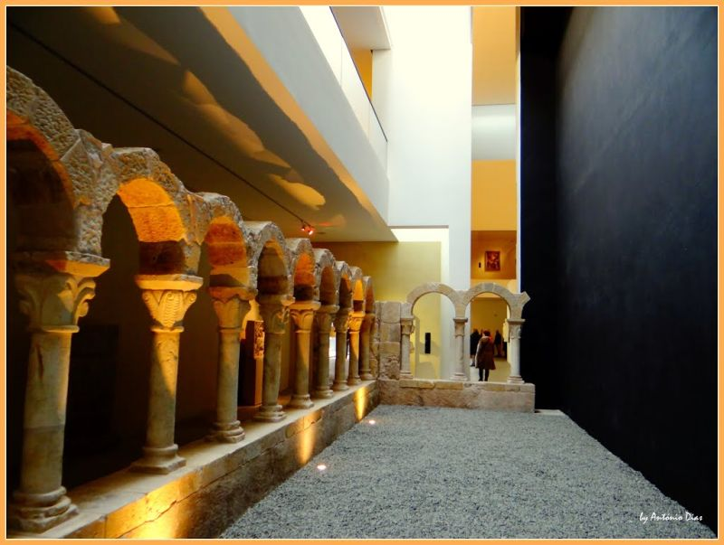
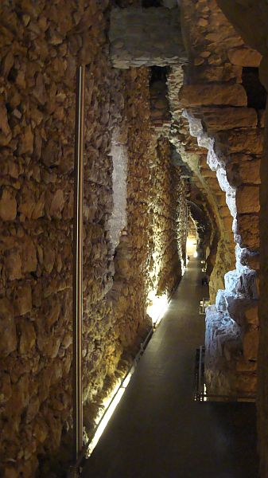

Slide 11
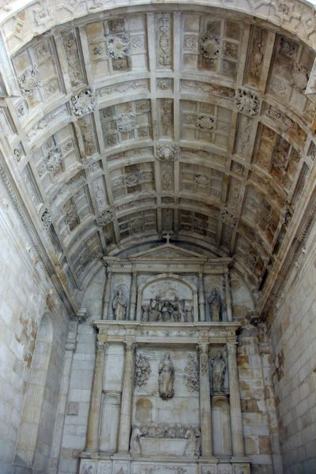
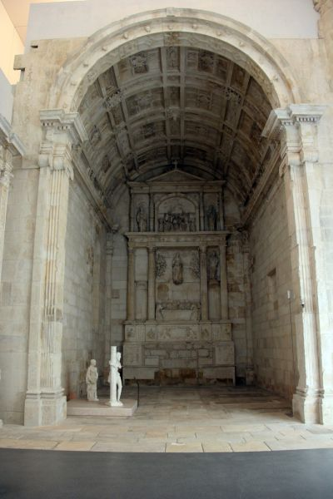
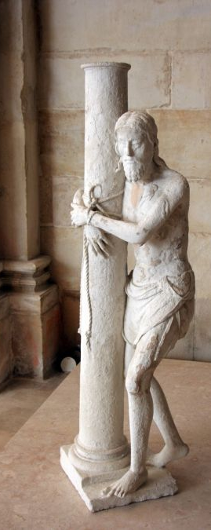

Slide 12
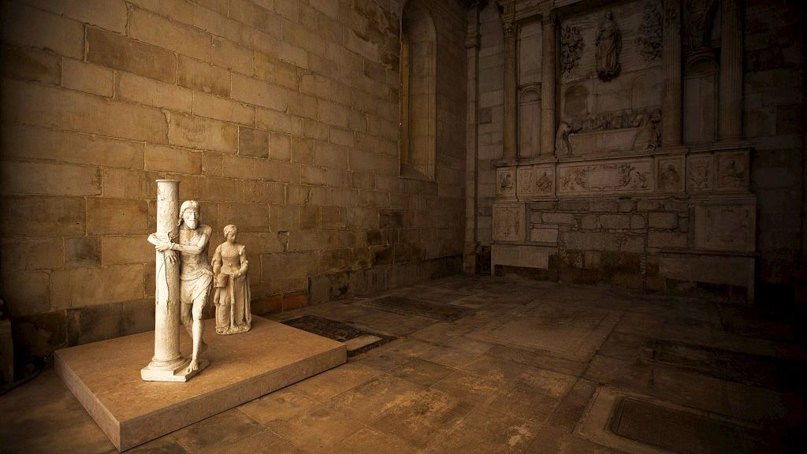

Slide 13
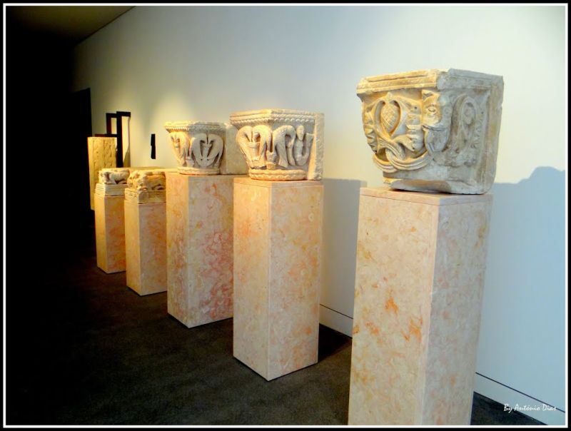
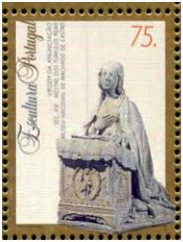
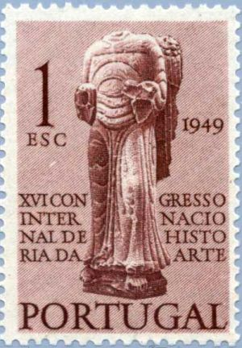

Slide 14
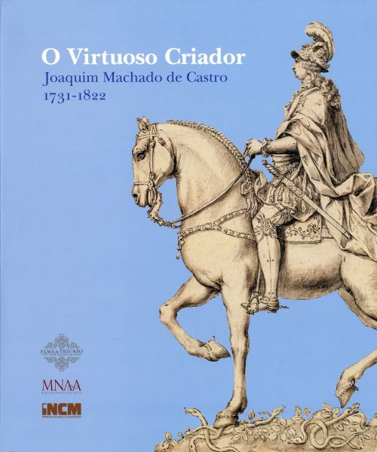
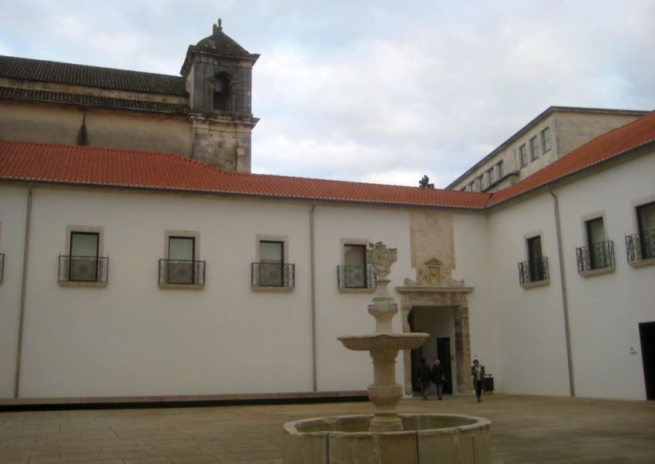
The museum’s name is an homage to one of the greatest Portuguese sculptors, Joaquim Machado de Castro (1731-1822), who was born near Coimbra.
He wrote extensively on his works and the theory behind them, including a full-length discussion of the statue of D. José I entitled Descripção analytica da execucão da estatua equestre, Lisbon 1810. This bronze statue remains one of Lisbon's most important monuments, and dominates one of the major squares of Europe, the Praça do Comércio or Terreiro do Paço.

Slide 15
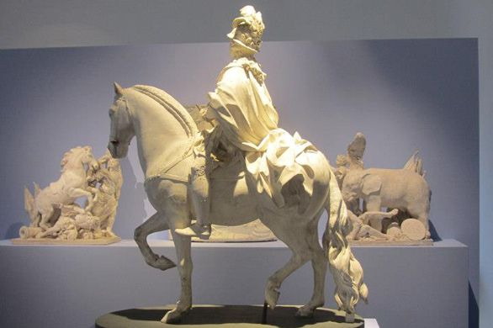
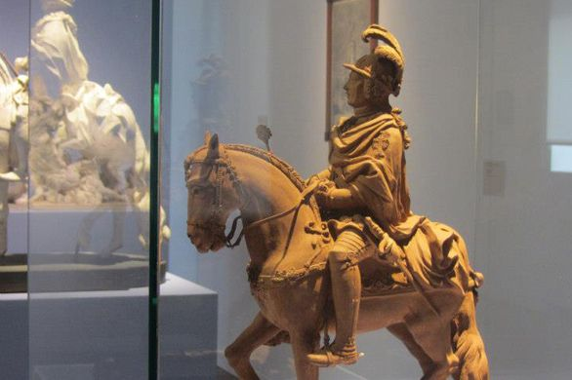
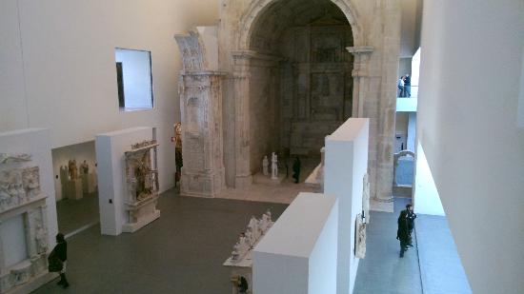
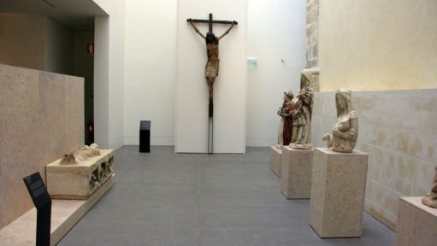
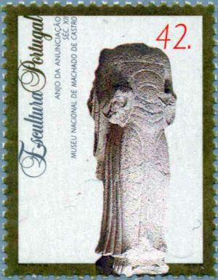

Slide 16
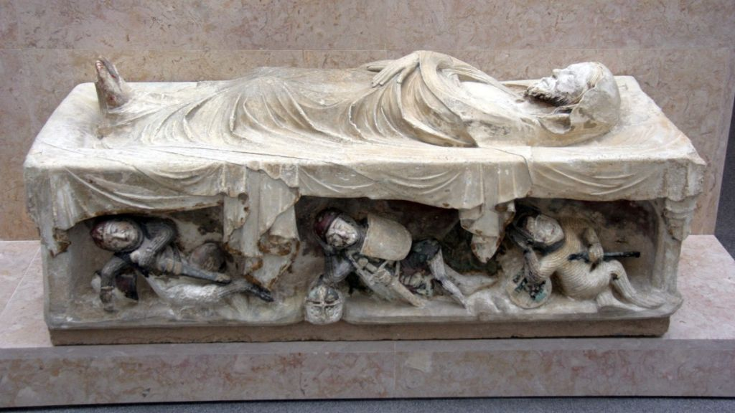

Slide 17
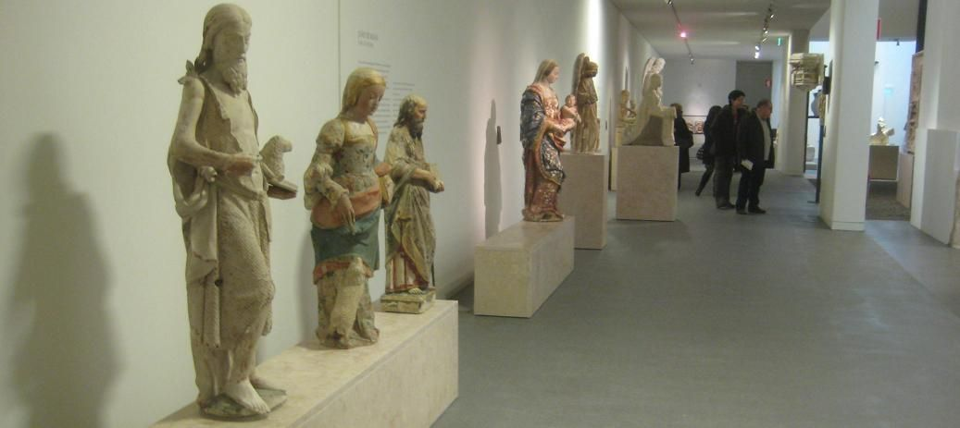
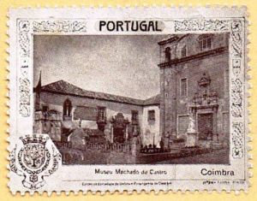
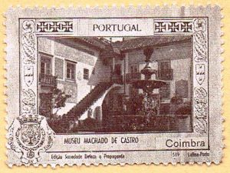
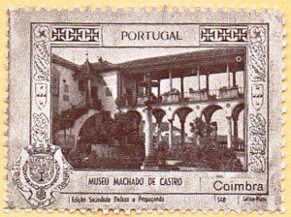
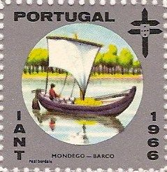
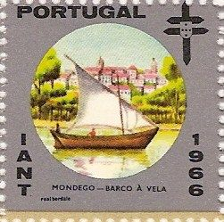
The Machado de Castro Museum

Slide 18
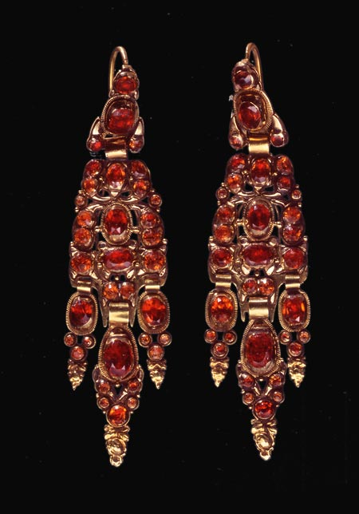
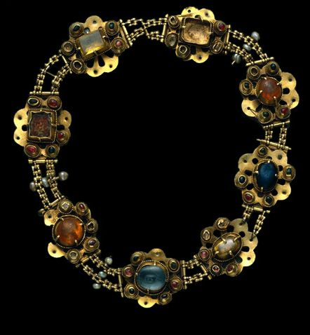

Slide 19
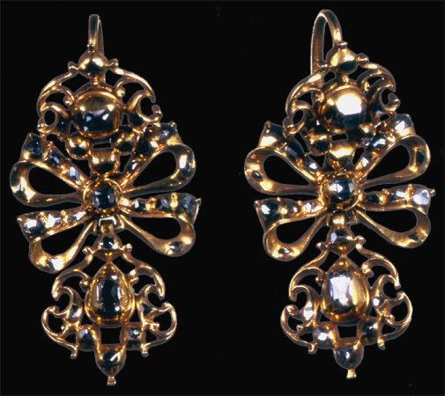
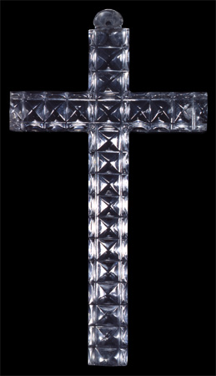

Slide 20
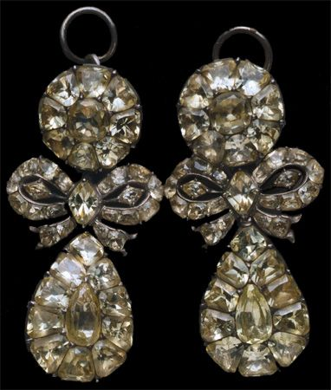
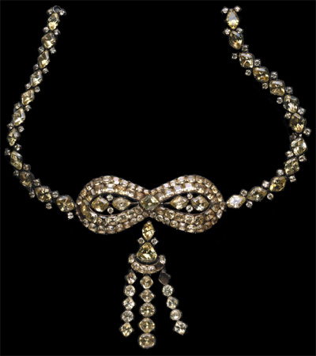

Slide 21
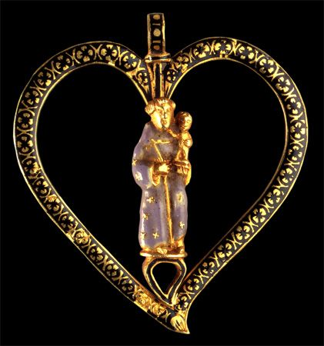


Slide 22




Slide 23


Chalice 12th cent

Slide 24



Slide 25



Slide 26




Slide 27


Medieval knight 14th cent

Slide 28



Slide 29




Slide 30



Slide 31



Slide 32


Portuguese crown 1550

Slide 33



Slide 34



Slide 35

Originally in the Refeitorio do Mosteiro de Santa Cruz
Last Supper by Hodart, made in 1530-34, is composed by 13 figures

Slide 36


Slide 37


Slide 38


Slide 39



Agripina Maior Século I d.C

Slide 40


Slide 41




Slide 42



Slide 43



Slide 44






Slide 45


Slide 46




Slide 47


Slide 48


Deposição no Túmulo Séc. XVI

Slide 49


Slide 50


Slide 51



Slide 52



Slide 53

Tríptico da Aparição de Cristo à Virgem 1531

Slide 54




Virgin and Child 1505

Slide 55


Master of Sardoal (Vicente Gil?) The Assumption

Slide 56



Adoracao dos magos de Vicente Gil (work from 1498 to 1518)
Senhora da Rosa (séc. XV)

Slide 57


Santa Isabel
O Milagre das Rosas, Anónimo, XVI

Slide 58




Slide 59


Slide 60


Slide 61



Slide 62



Slide 63


Slide 64


Slide 65


Slide 66



Slide 67


Slide 68


Slide 69


Slide 70


Slide 71

Jardim da Manga, also known as the "Cloister da Manga", it is located very close to the beautiful church of Santa Cruz. The original, somewhat deteriorated building was built by Joao de Ruão. It is said that it once stood at the center of one of the three cloisters of the Santa Cruz Monastery. Now there is a restaurant behind the cloister

Slide 72


Parque de Santa Cruz, popularly known as the Mermaid's Garden, was declared as public interest on June 3th, 1970

Slide 73




The entrance to the garden, which is made by the Republic Square, contains three statues representing Faith, Hope and Charity, culminating in a waterfall.
Going up the stairs, we find the Fountain of Nogueira with a statue representing a triton opening his mouth to a dolphin, from which the water flows to the fountain, hence the popular name of the "Mermaid's" Garden.

Slide 74

Azulejos Parque de Santa Cruz,

Slide 75




Praça João Paulo II

Slide 76


Azulejo in homage at the house in Coimbra, where José Afonso, O Zeca, lived. Known as the troubadour of liberty.

Slide 77



Text & pictures: Internet
Copyrights of the photos belong to each photographer
Presentation: Sanda Foişoreanu
www.slideshare.net/michaelasanda
Sound: José Afonso - Maria Faia
Notes:
Coimbra fado is different from Lisboa fado. Illustrating the traditional university student fado, Samaritana tells the legend of the water girl that one day made Christ blush, by the fountain (Jacob's well). Lyrics:
Dos amores do Redentor
Não reza a história sagrada,
Mas diz uma lenda encantada
Que o bom Jesus sofreu de amor.
Sofreu consigo e calou
Sua paixão divinal,
Que assim, como qualquer mortal,
Um dia de amor palpitou.
Samaritana,
Plebéia de Sicá.
Alguém espreitando,
Te viu Jesus beijar,
De tarde quando
Foste encontrá-lo só,
Morto de sede,
Junto à Fonte de Jacó.
E tu, risonha, acolheste
O beijo que te encantou...
Serena, empalideceste,
E Jesus Cristo corou!
Corou, ao ver quanta luz
Irradiava da tua fronte,
Quando disseste: "Ó meu Jesus!
Que bem eu fiz, Senhor, em vir à fonte."
Eis mais uma homenagem a Coimbra, ao seu lindíssimo fado, às suas fontes, aos estudantes, às serenatas (as monumentais e as outras) e, já agora, à Samaritana, cuja lenda nos relembra o lado humano de Cristo

