Slide 1
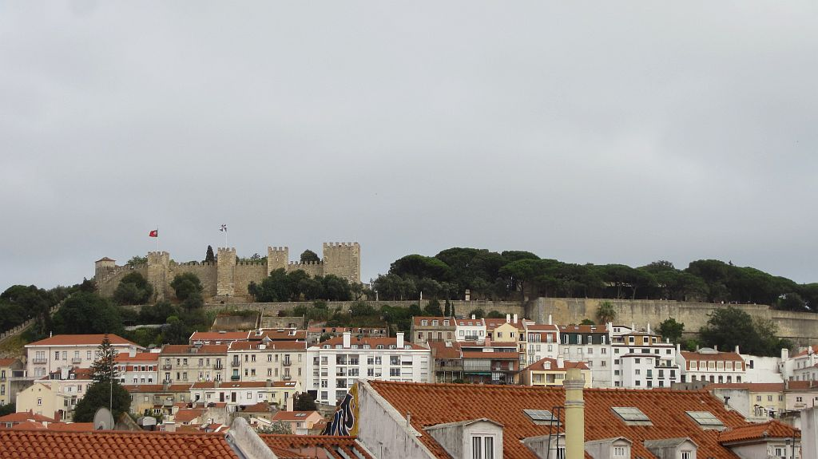

Vamos passear
http://www.authorstream.com/Presentation/sandamichaela-2009017-lisboa21/

Slide 2
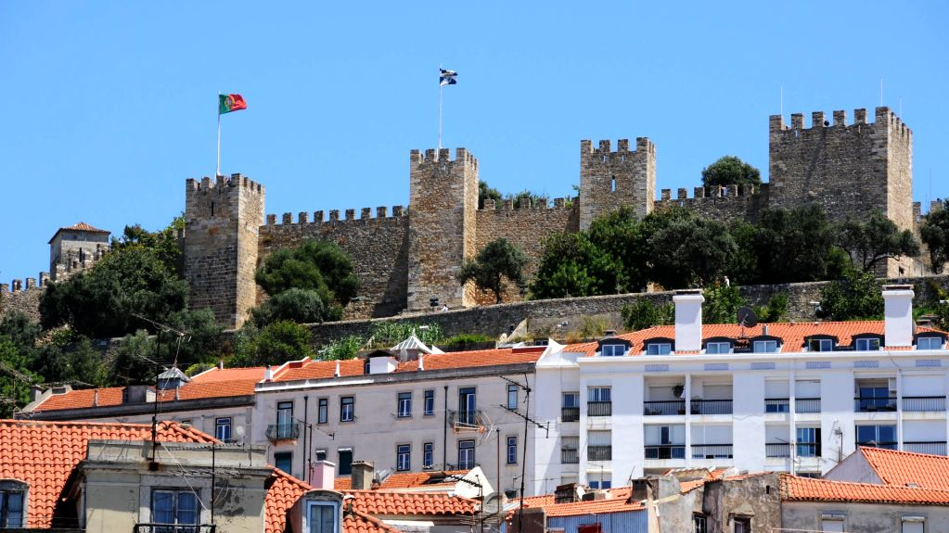
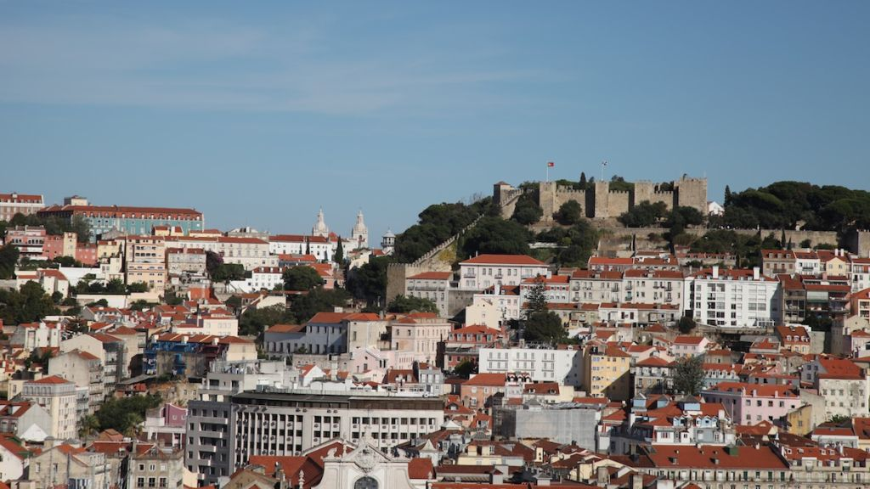

Lisboa
21

Slide 3

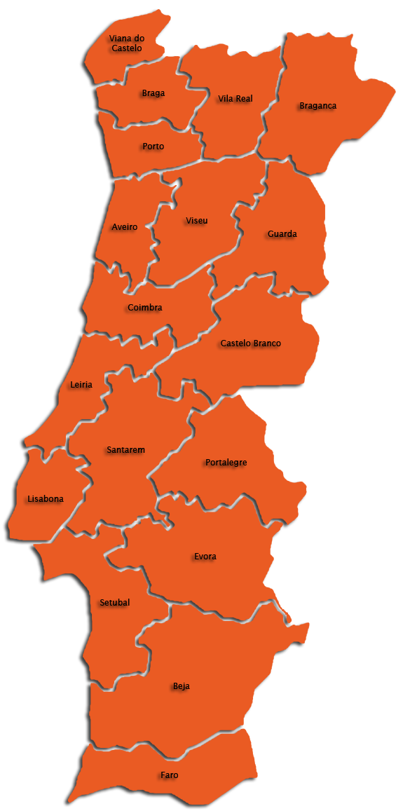
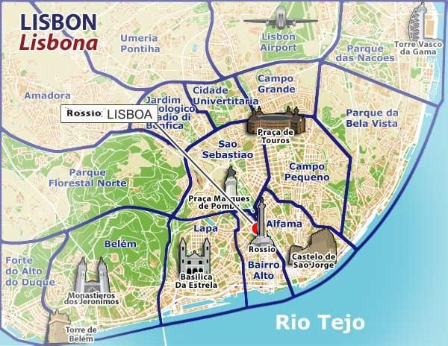

Slide 4
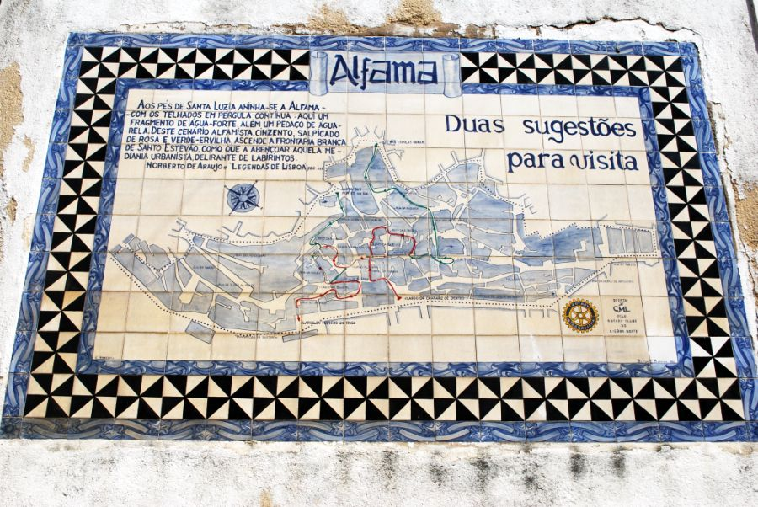
Alfama is the oldest district of Lisbon, spreading on the slope between the São Jorge Castle and the Tejo river. Its name comes from the Arabic Al-hamma, meaning fountains or baths. It contains many important historical attractions, with many Fado bars and restaurants

Slide 5
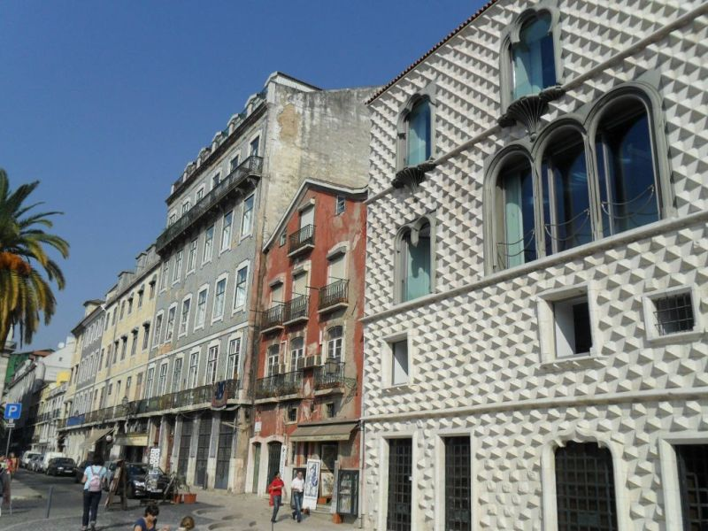
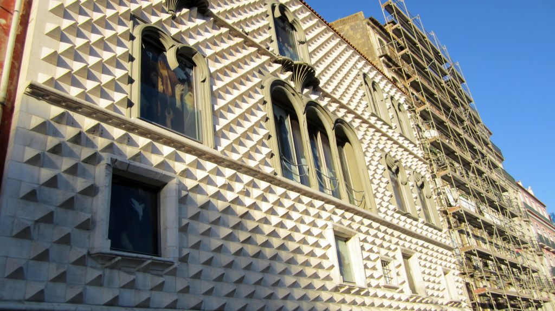
The Casa dos Bicos (House of the Spikes: a total of 1125) is a historical house built in the early 16th century in the Alfama neighbourhood, with a curious façade of Renaissance and Manueline influence. It has survived the disastrous 1755 Lisbon Earthquake that destroyed much of the city.

Slide 6
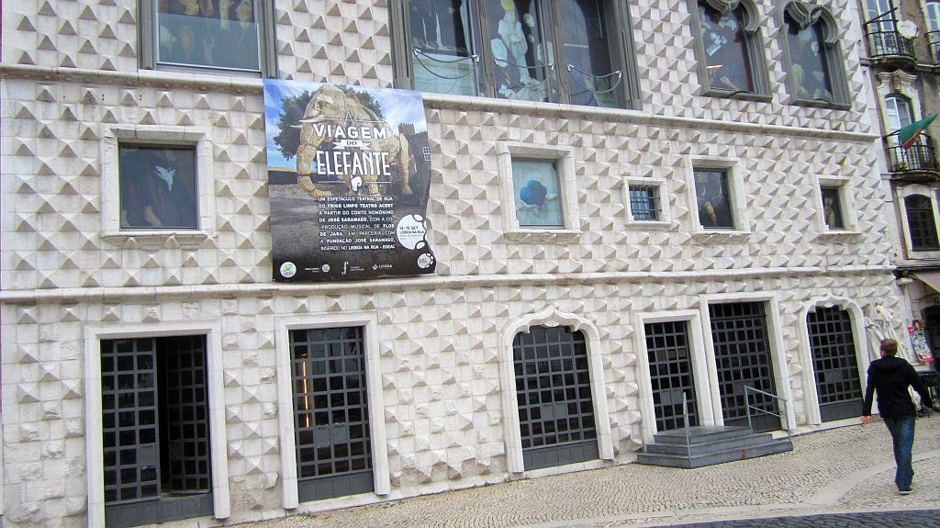
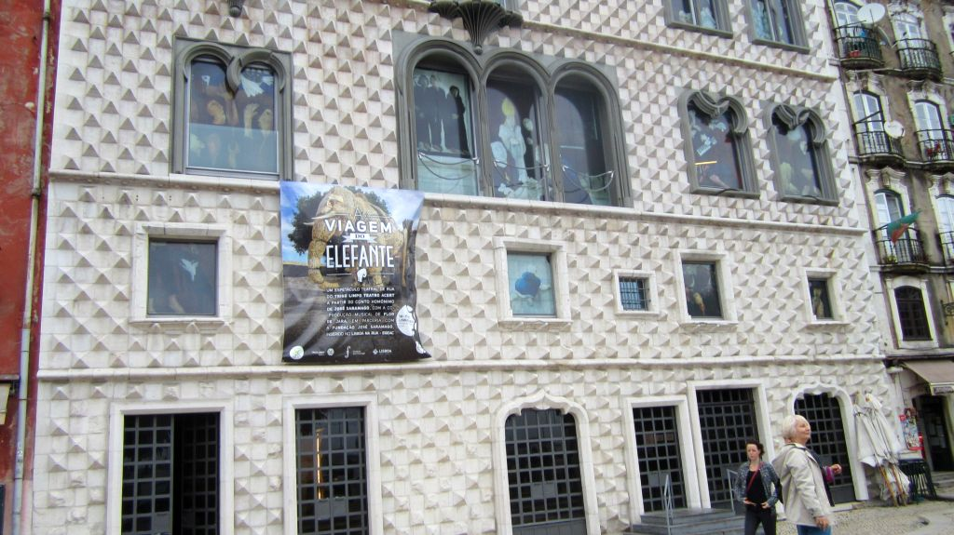

Slide 7
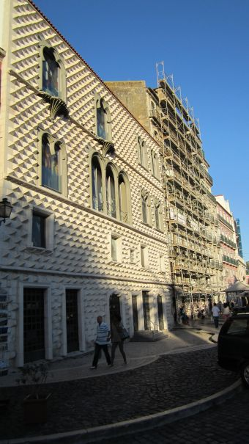
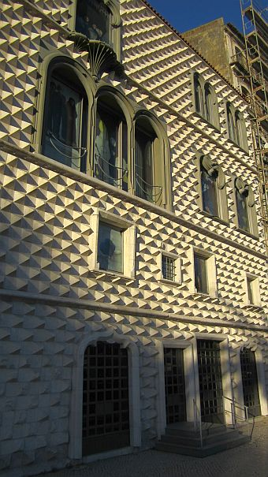
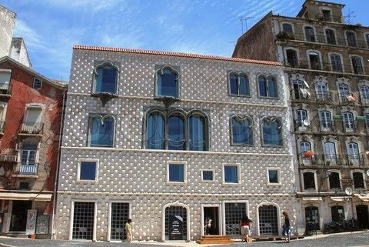
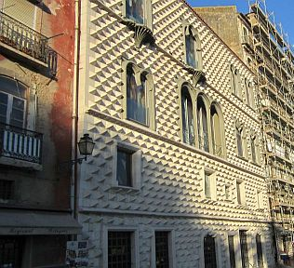

Slide 9
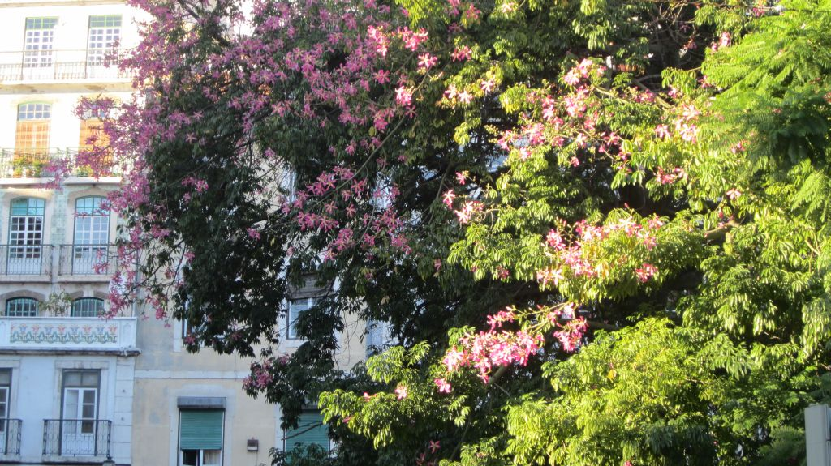

Slide 10
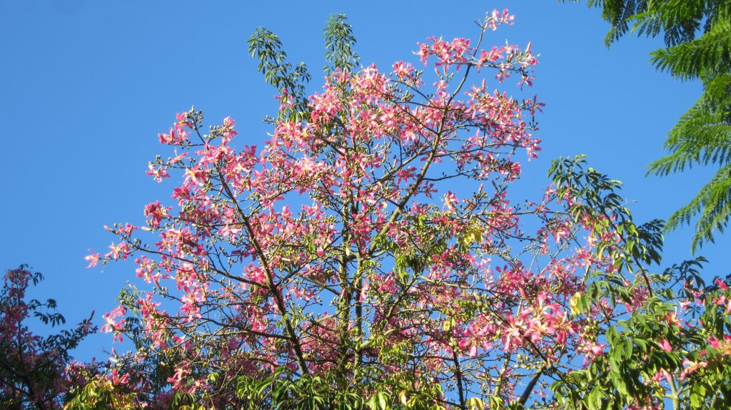
The silk floss tree (Ceiba speciosa, formerly Chorisia speciosa)

Slide 11
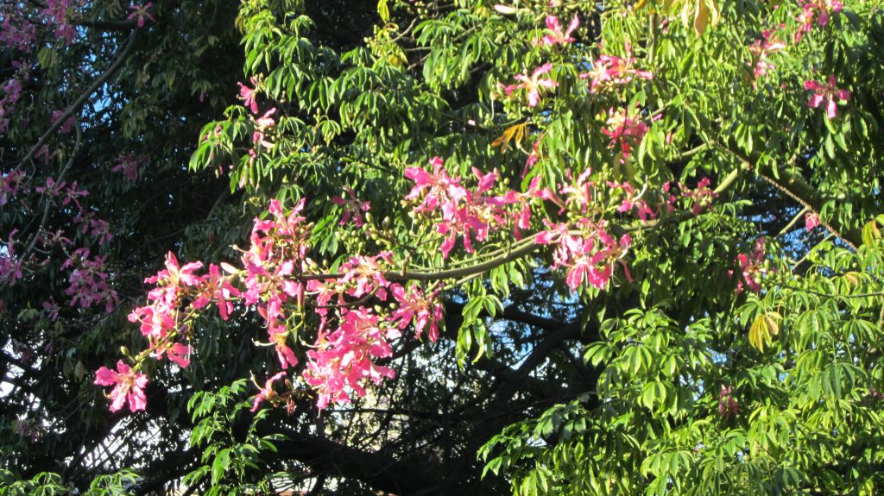

Slide 12
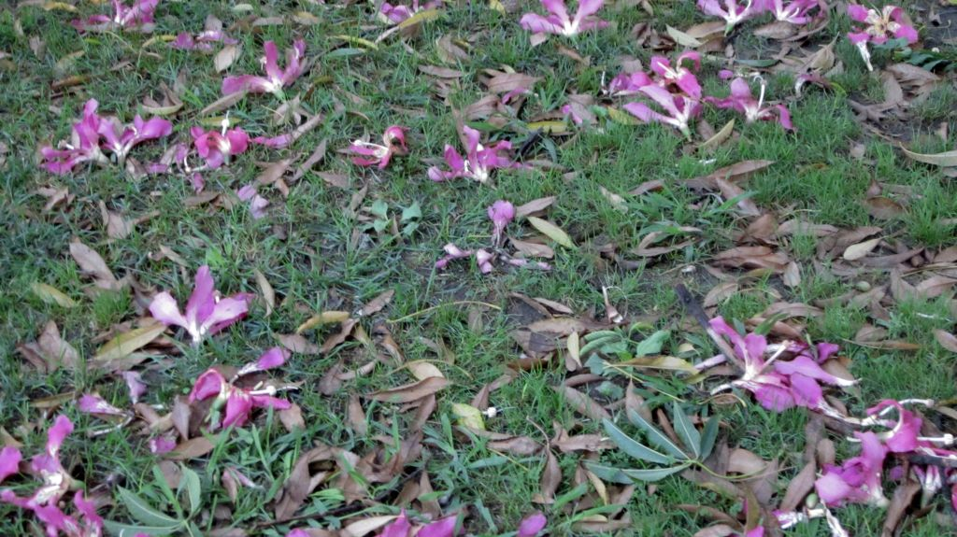
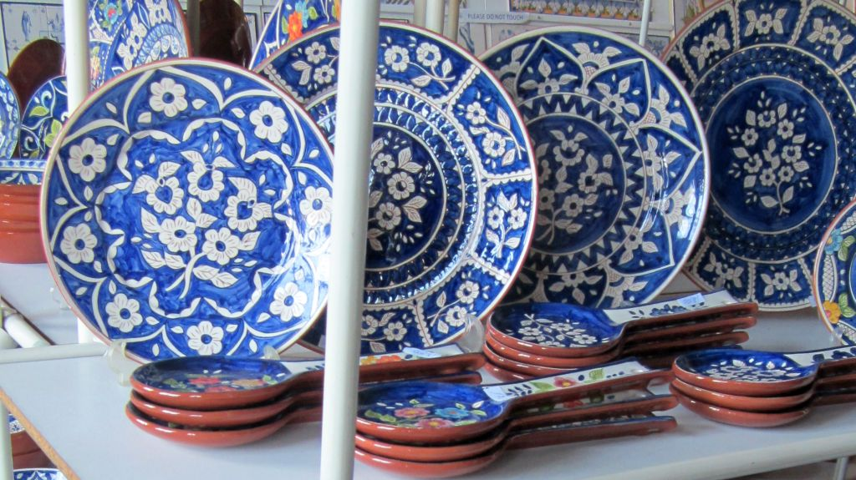
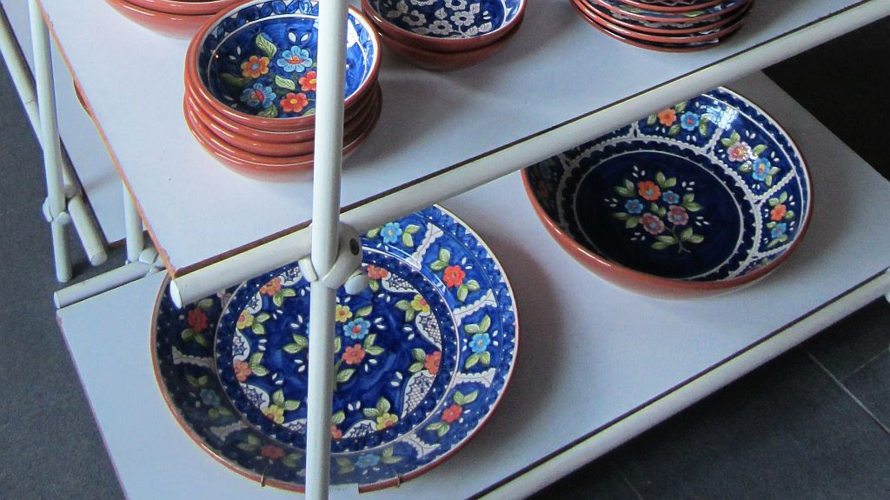
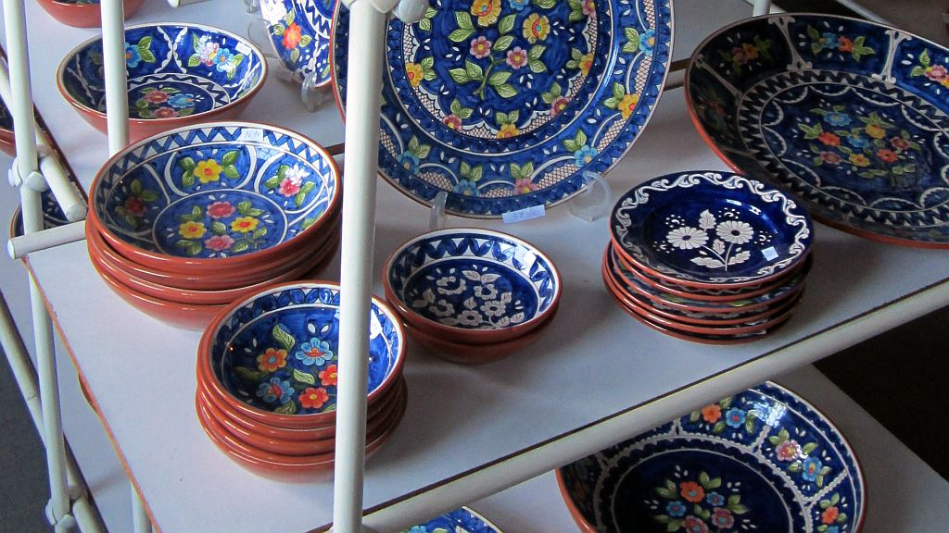

Slide 13
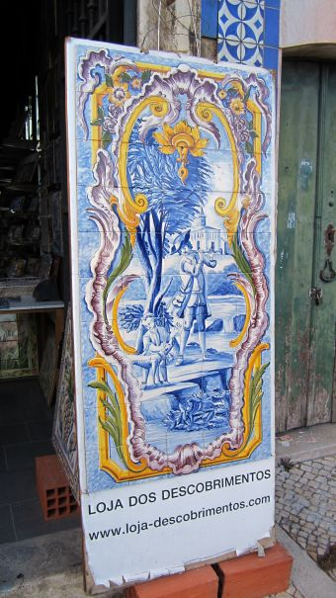
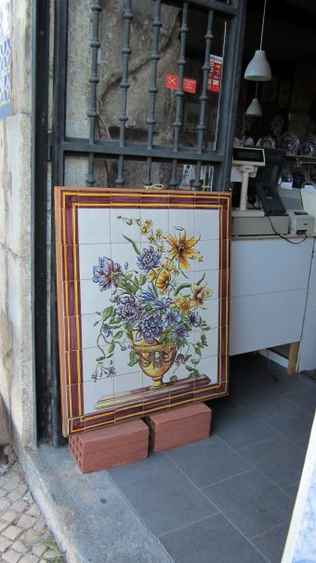
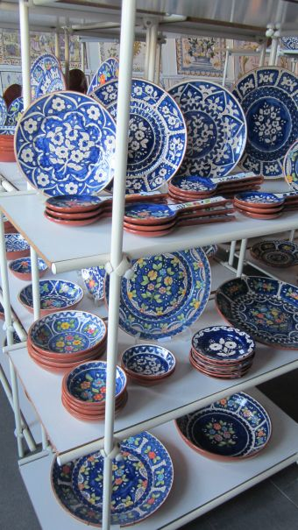

Slide 14
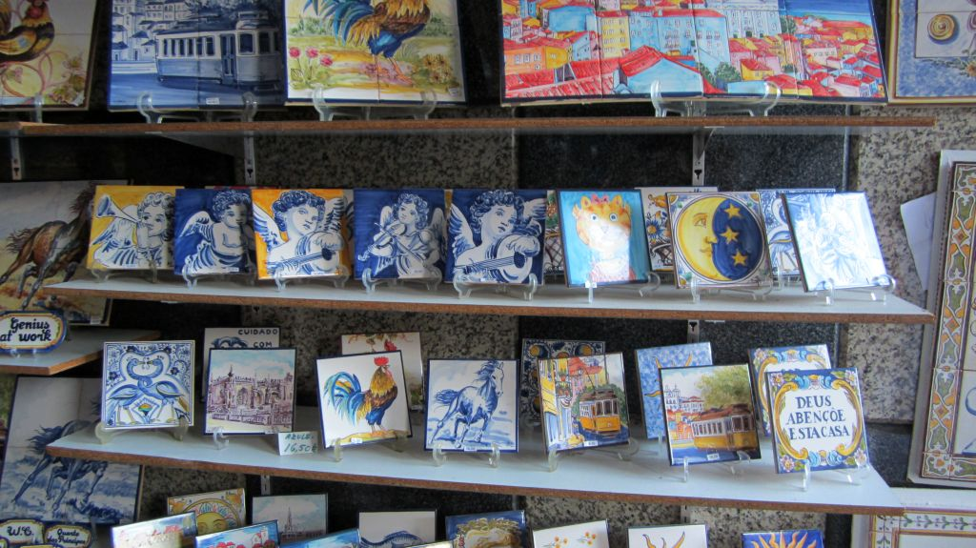

Slide 15
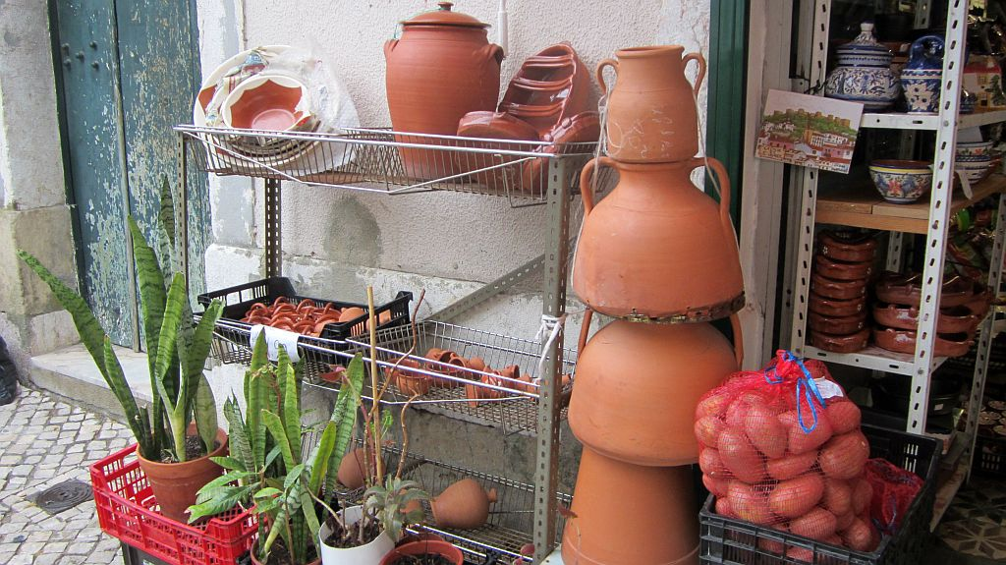

Slide 16
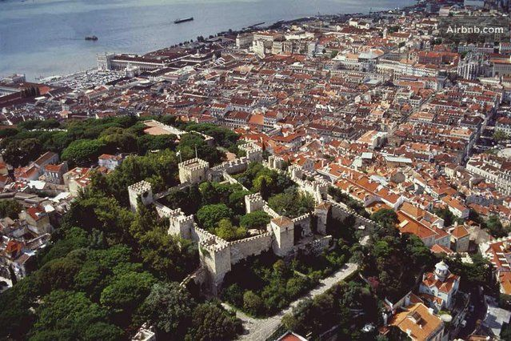
The Castle of São Jorge (Castelo de São Jorge) is a Moorish castle occupying a commanding hilltop overlooking the historic centre of the Portuguese city of Lisbon and Tagus River.

Slide 17
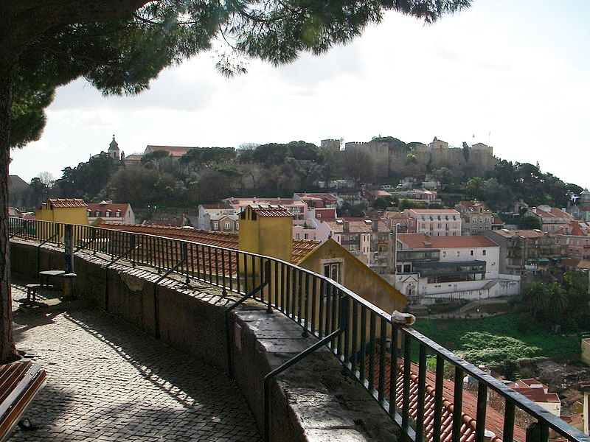
The strongly fortified citadel dates from medieval period of Portuguese history, and is one of the main tourist sites of Lisbon.
The Castle of São Jorge view from Miradouro da Graça

Slide 18
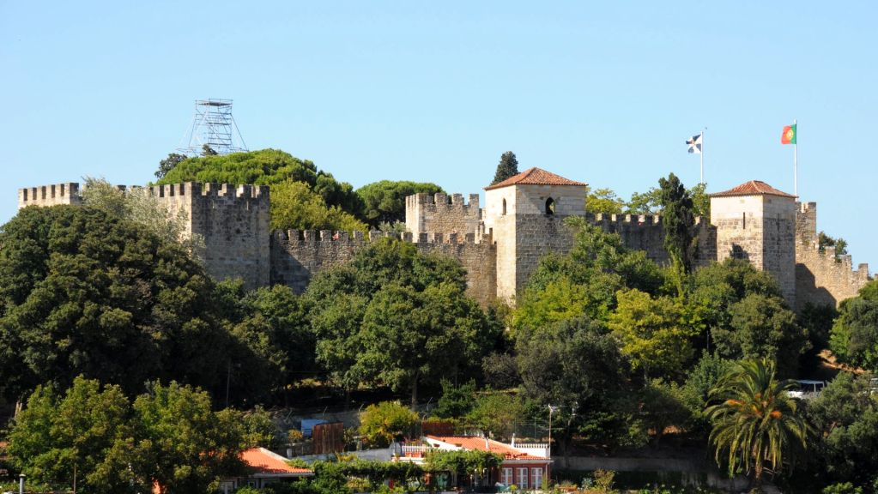

Slide 19
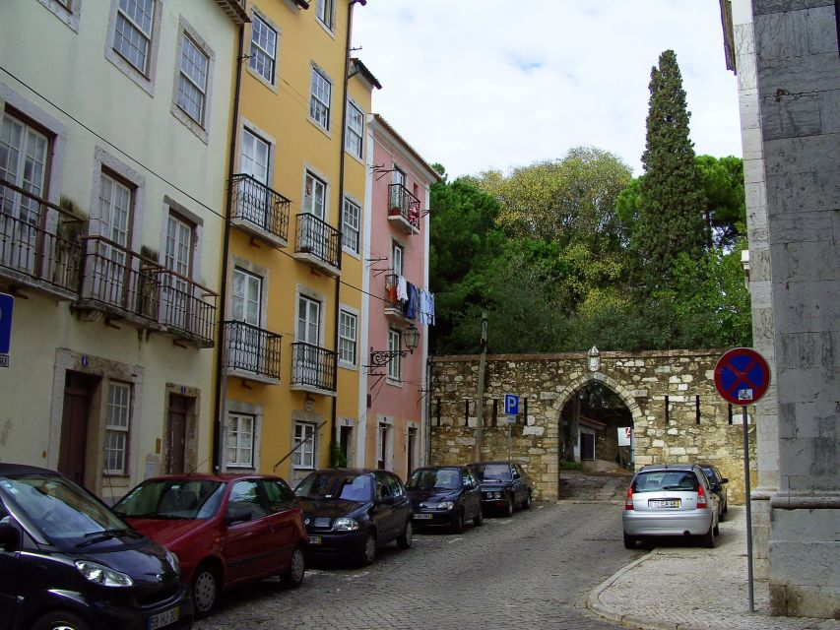
In the context of the Christian Reconquista, the castle and the city of Lisbon was conquered from Moors by Afonso Henriques, assisted by northern European knights during the Second Crusade: the Siege of Lisbon, which took place in 1147, was the only notable success of that failed crusade.
When Lisbon became the center of the Kingdom, in 1255, the castle acted as the alcáçova: a fortified residence for Afonso III, in his role as governor. It was extensively renovated around 1300 by King Denis I, transforming the Moorish alcáçova into the Royal Palace of the Alcáçova

Slide 20
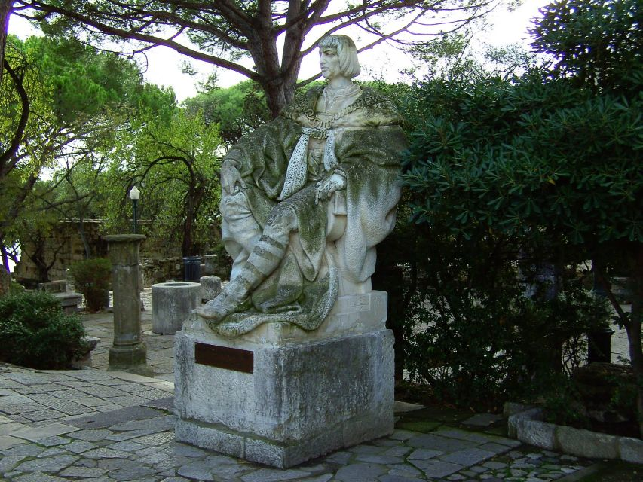
As Royal Palace, the castle was the setting for the reception for the navigator and national hero, Vasco da Gama, who had returned from discovering a maritime route to India: King Manuel I received him at the castle in 1498.
D. Manuel I

Slide 21
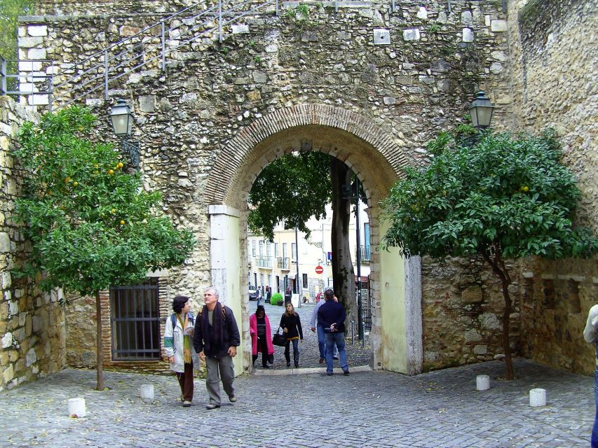
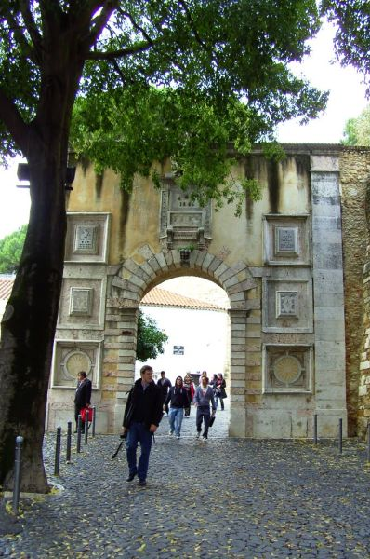
Entrada do Castelo de São Jorge

Slide 22
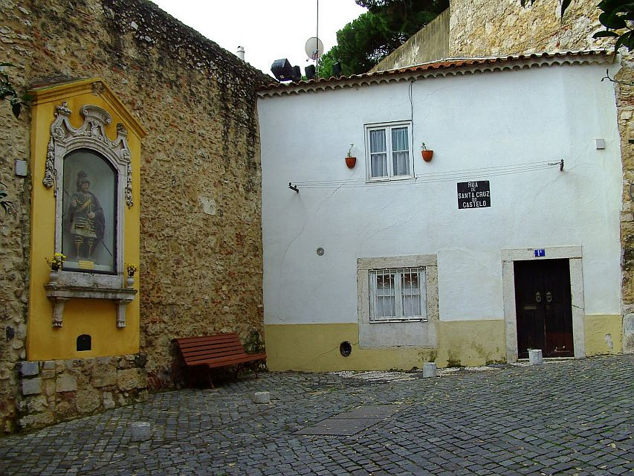
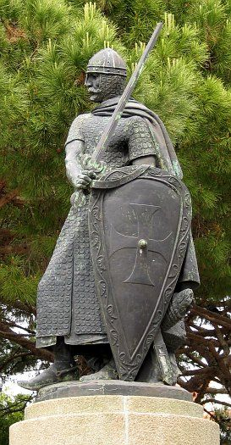
King Afonso Henriques

Slide 23
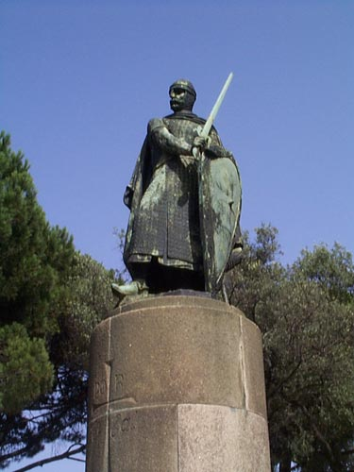
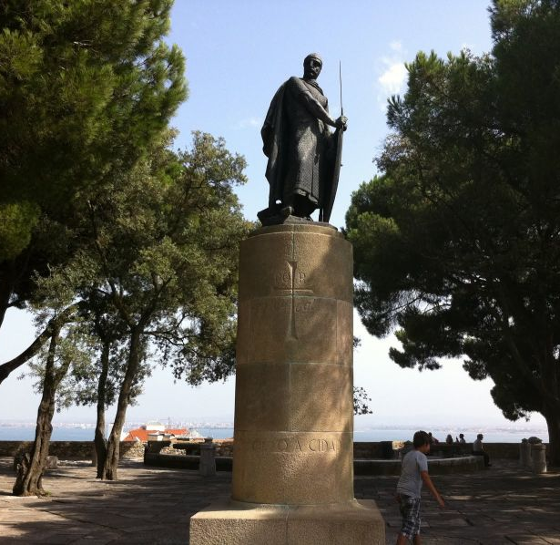
King Afonso Henriques, the Portuguese monarch who took the castle from the Moors

Slide 24
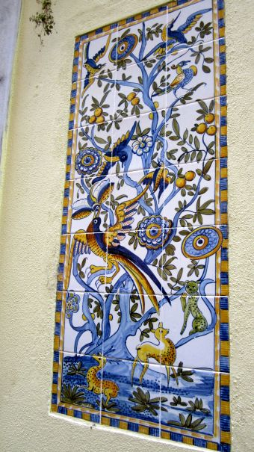
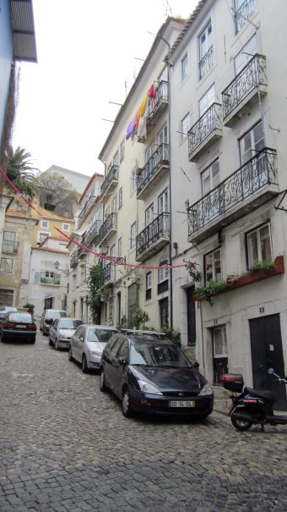
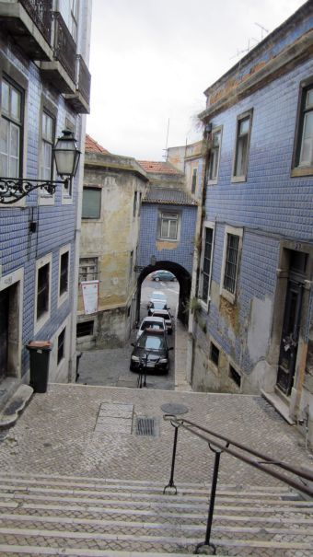

Slide 25
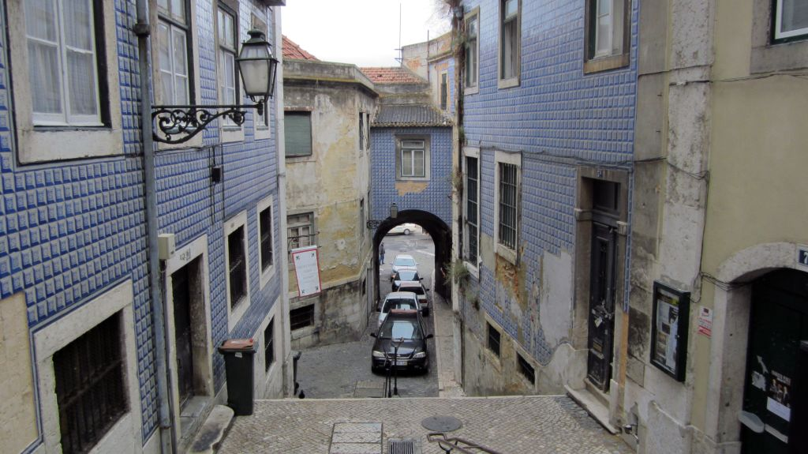

Slide 26
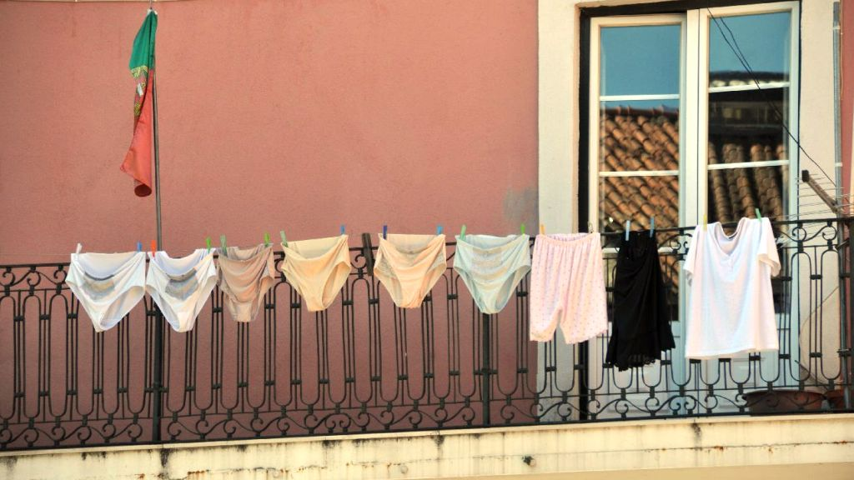

Slide 27
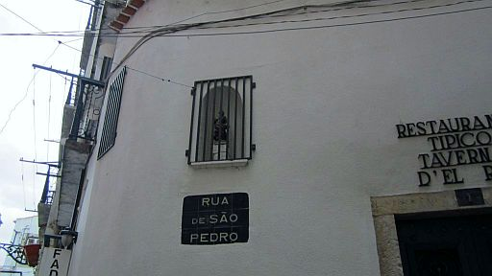
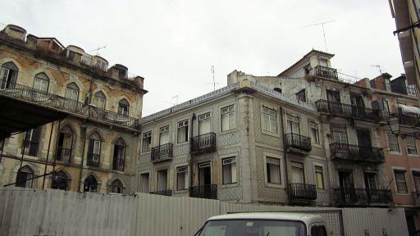
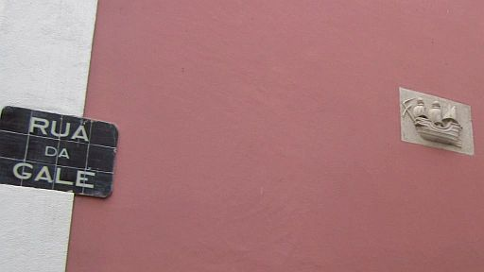
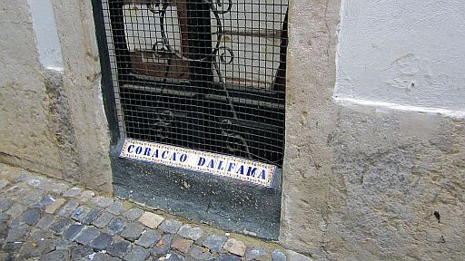

Slide 28
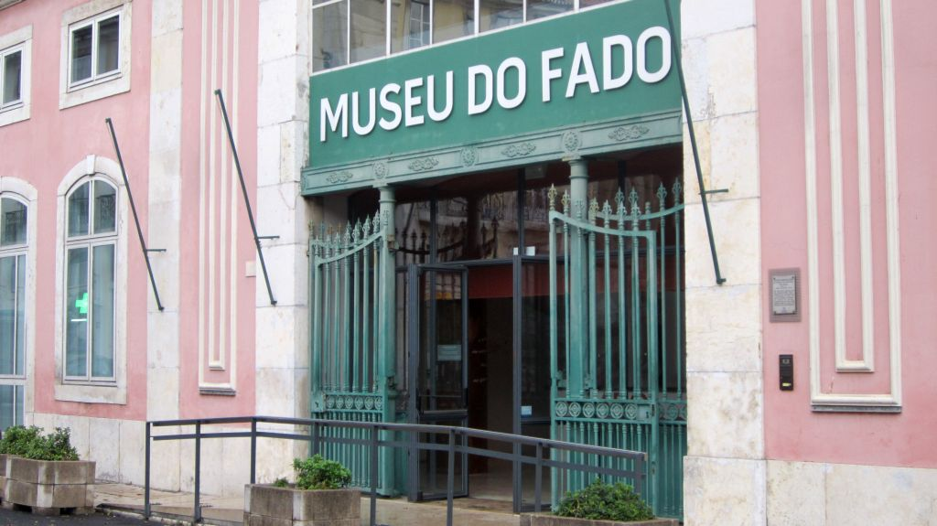

Slide 29
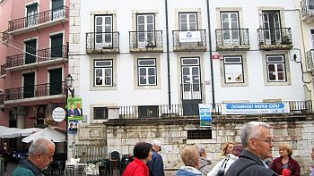
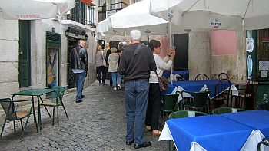
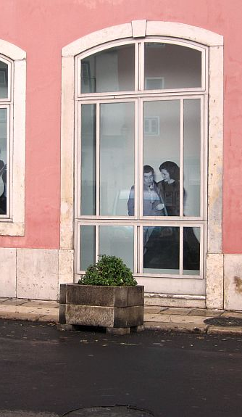





Slide 30






Slide 31


The Fado Museum explains the evolution and the passion behind Portugal's famous musical expression with audiovisual presentations, multilingual information panels, and musical archives.
It presents the cultural and social influence of Fado since its origins, from its use in cinema through the impact of censorship in the 20th century. It also explains the technical and historical development of the Portuguese guitar and the so-called "Fado Houses.“

Slide 32



Slide 33



The Portuguese guitar (most notably associated with fado) is a plucked string instrument with twelve steel strings, strung in six courses comprising two strings each.

Slide 34


Slide 35


Slide 36


Lisboeta, óleo sobre tela,
Cãndido Costa Pinto, 1952

Slide 37


Slide 38


Portugal has a diverse musical culture - from the French Provençal strain in the folk music of the north of the country, to Fado, the country's national musical treasure. There are two basic styles of Fado: Lisbon and Coimbra. In Lisbon it is always sung by a solo performer, while in Coimbra it is often performed by groups of male university students. They are accompanied by two guitarists, one playing the melody on a twelve-stringed Portuguese guitar (descendant of the English guitar introduced into Portugal by the British community in Porto in the 19th century), and the other supplying the rhythm on the six-stringed viola.

Slide 39

The fado emerged as a bohemian art form in Lisbon's working-class districts of Alfama and Mouraria in the late 18th century, and gradually moved up-market.
O Marinheiro,
by Constantino Fernandes, 1913

Slide 40

Fado became popular with the singer Maria Severa, who died at the age of 26 and later became the subject of Portugal's first sound movie in 1931. To this day, female performers wear a black shawl in her memory and her life story has been the influence of several Fado songs, poems, novels, and plays.
But it was Amalia Rodrigues in the 20th century who made Fado known beyond Portugal, performing all over Europe, Japan, South America, and even in the United States, in New York's "La Vie en Rose" in the 1950s. She's been credited with defining the style of the music, and when she died in 1999, the government declared three days of national mourning and awarded her a state funeral. As a national icon, she is buried in Lisbon's National Pantheon.

Slide 41


Fado, Lisbon’s mournful song and the Portuguese most traditional music genre, was added to UNESCO’s list of World’s Intangible Cultural Heritage. According to UNESCO, intangible heritage includes traditions and skills passed on within cultures.

Slide 42

The UNESCO’s committee of experts, unanimously praised Fado as an “example of good practices” that should be followed by other countries.
On its website, UNESCO describes Fado as the ”urband popular song of Portugal”
Sculpture of a fado singer

Slide 43


Malhoa, Jose (1855-1933) - O Fado, 1910

Slide 44


O fado de Paula Rego

Slide 46








Slide 47


Slide 48


Slide 49



Text: Internet
Pictures: Sanda Foişoreanu
Gabriela Cristescu
Internet
Copyrights of the photos belong to each photographer
Presentation: Sanda Foişoreanu
www.slideshare.net/michaelasanda
Sound: Amália Rodrigues - Antigamente; Fado nocturno; Ai Mouraria

