Slide 1
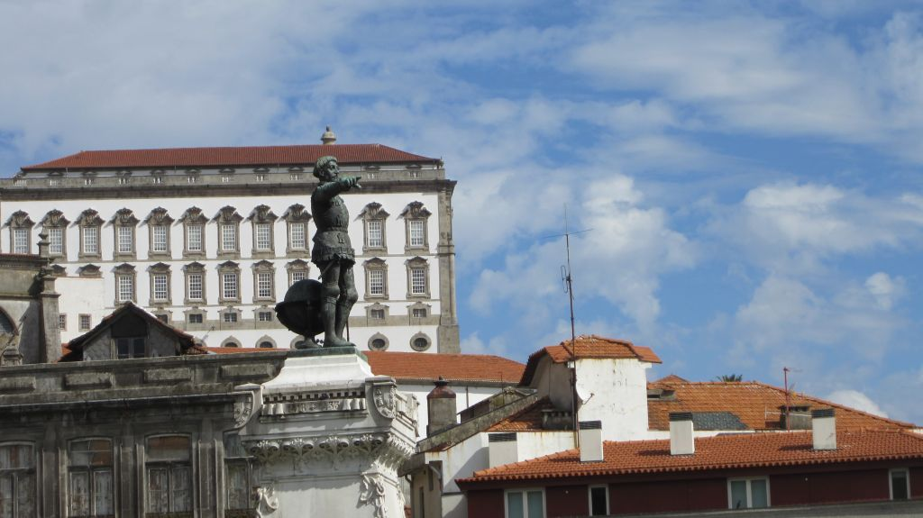
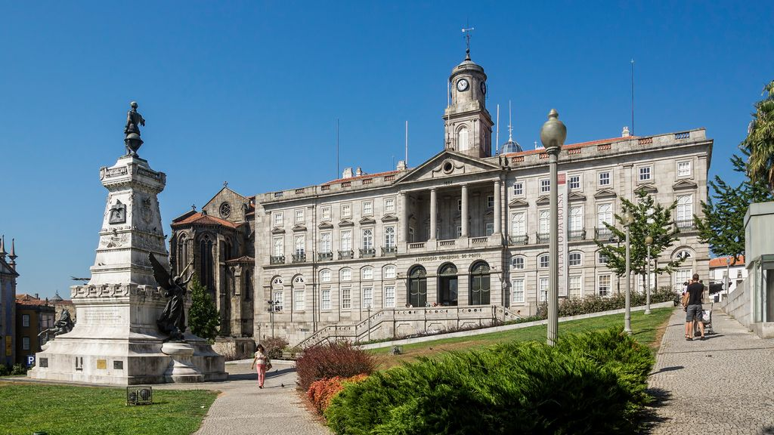


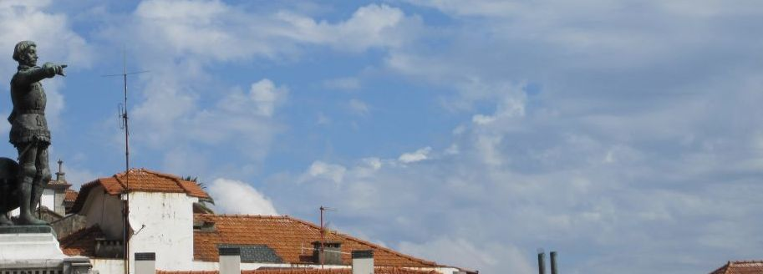
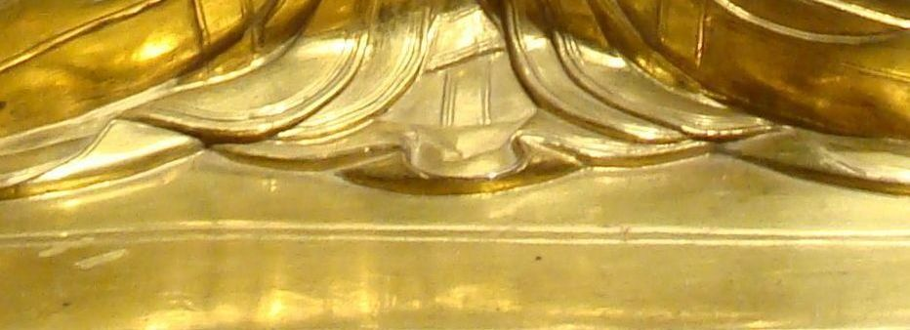
1
Porto
http://www.authorstream.com/Presentation/sandamichaela-1978927-porto1/

Slide 2
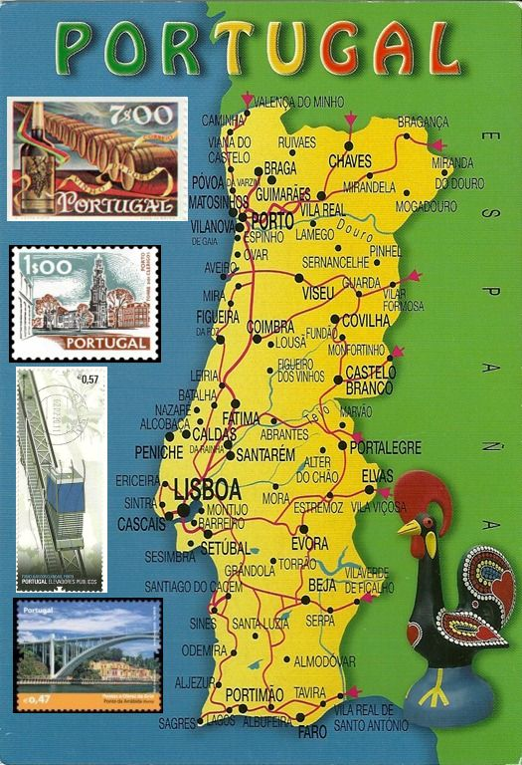

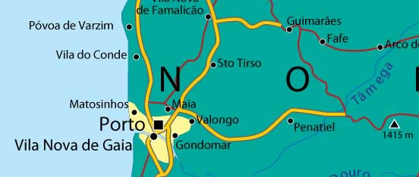
Porto (occasionally also known as Oporto in English) is the second-largest city in Portugal, after Lisbon, and one of the major urban areas in Southern Europe and the capital of the second major great urban area in Portugal. The Porto Metropolitan Area includes an estimated 2 million people. Located along the Douro river estuary in northern Portugal, Porto is one of the oldest European centres. One of Portugal's internationally famous exports, port wine, is named for Porto, since the metropolitan area, and in particular the adegas of Vila Nova de Gaia, were responsible for the production and export of the fortified wine.
The Palácio da Bolsa (Stock Exchange Palace) is a historical building in Porto. The palace was built in the 19th century by the city's Commercial Association (Associação Comercial) in Neoclassical style. It is located in the Infante D. Henrique Square in the historical centre of Porto, designated World Heritage Site by UNESCO in 1996.

Slide 3
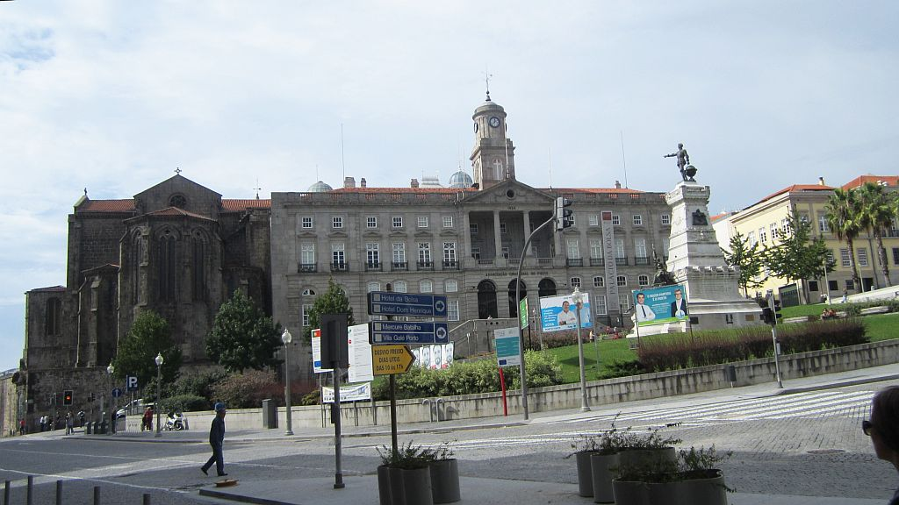

Slide 4
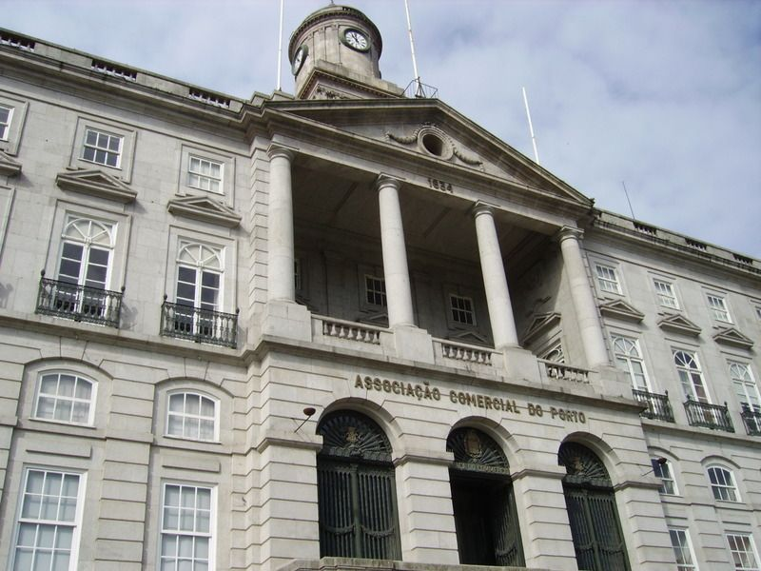
The Palácio da Bolsa is located beside the St Francis Church of Porto, which was once part of the St Francis Convent, founded in the 13th century. In 1832, during the Liberal Wars, a fire destroyed the cloisters of the convent, sparing the church. In 1841, Queen Mary II donated the convent ruins to the merchants of the city, who decided to use the spot to build the seat of the Commercial Association.
Building work began in 1842 following the plans of Porto architect Joaquim da Costa Lima Júnior, who designed a Neoclassical palace of Palladian influence, inspired by previous structures built in the city.

Slide 5
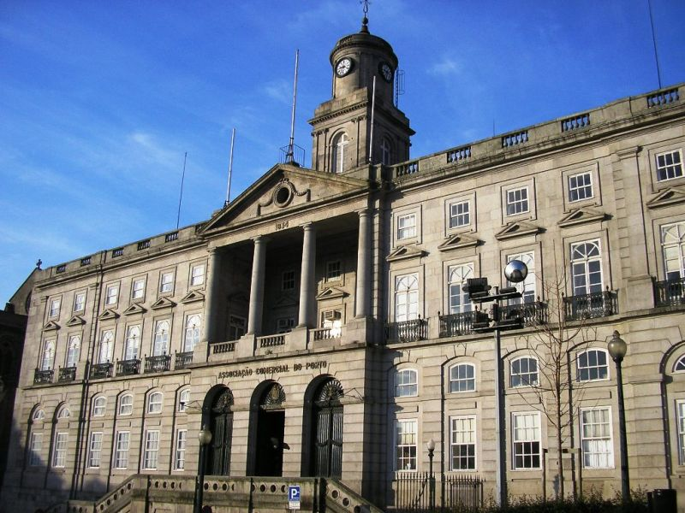
This pompous 19th-century building with a vast Neoclassical façade is the former stock exchange that was built to impress and earn the credibility of European investors.
Inside it could be mistaken for a royal place, especially the ornate Arab Room, an oval chamber that attempted to copy Granada's Alhambra Palace. It is now "the grand reception room" of the city where heads of state and other luminaries are received on a visit to Oporto.

Slide 6
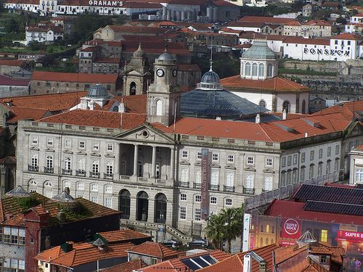
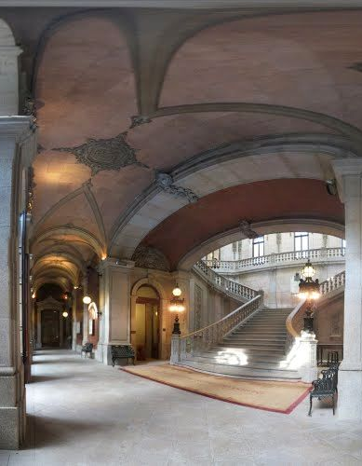
Most of the palace was finished by 1850, but the decoration of the interior was only completed in 1910 and involved several different artists
A remarkable grand staircase with two bronze chandeliers

Slide 7
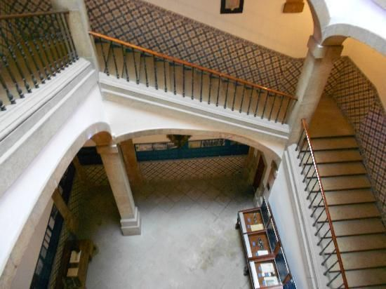
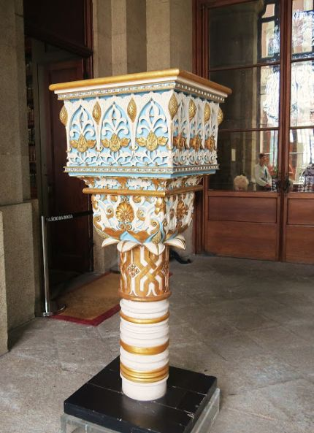
Staircase
Entrance

Slide 8
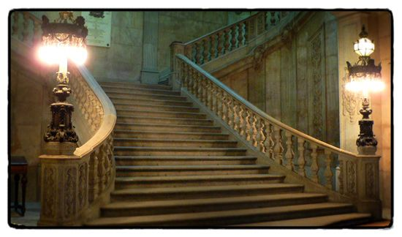
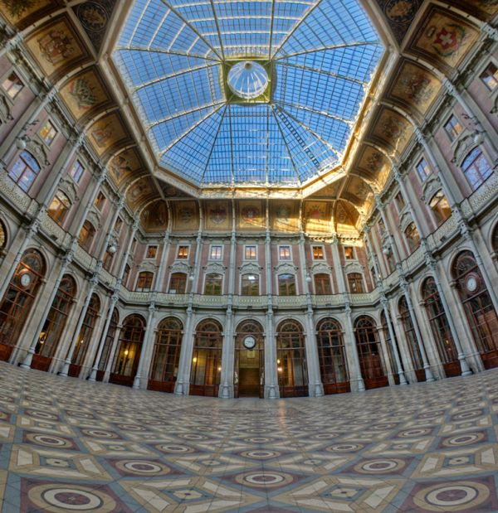
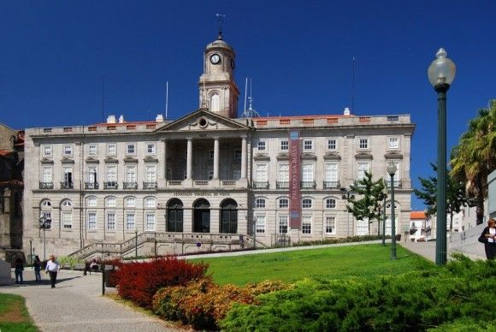
Pátio das Nações

Slide 9
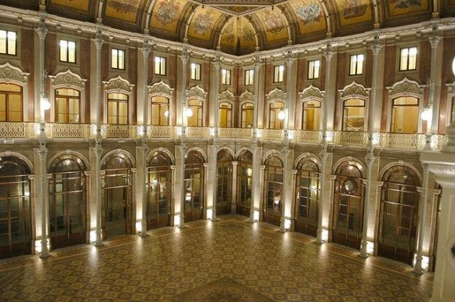
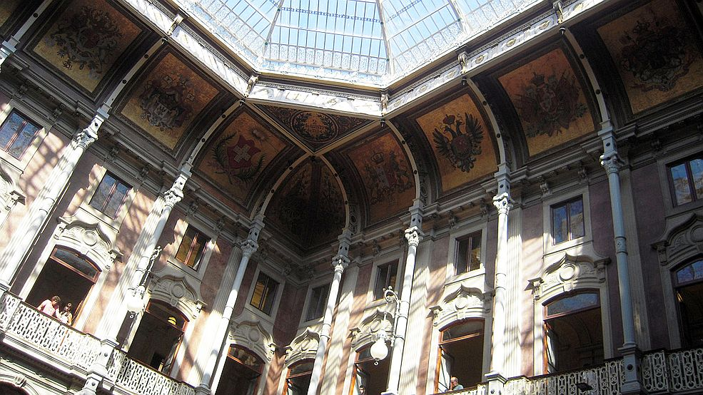
Another noteworthy room is Pátio das Nações, lit by a large skylight that is a magnificent example of iron architecture. Flags of most of the countries that had trade relations with Oporto are represented here

Slide 10
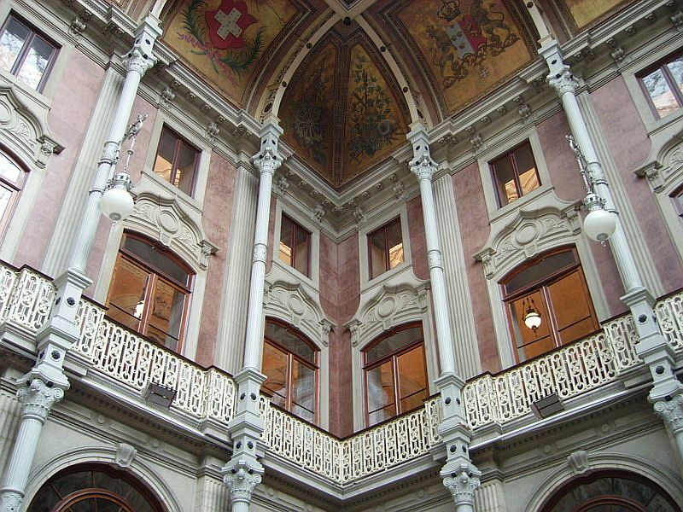
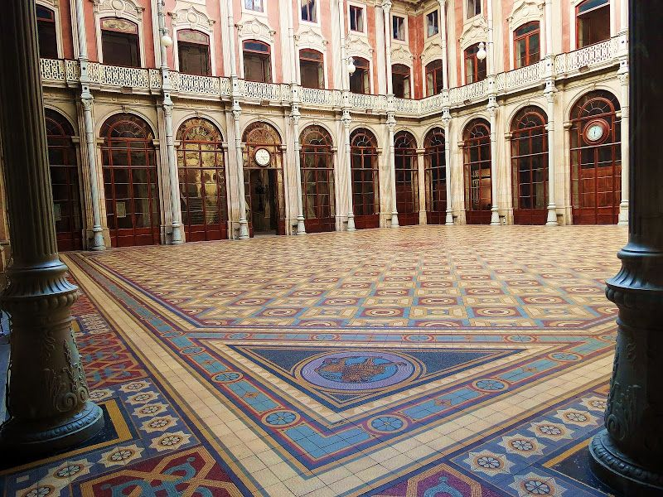

Slide 11
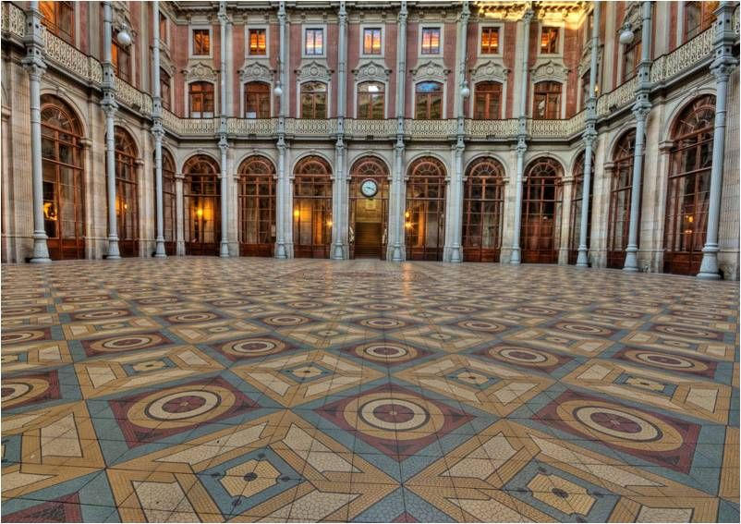
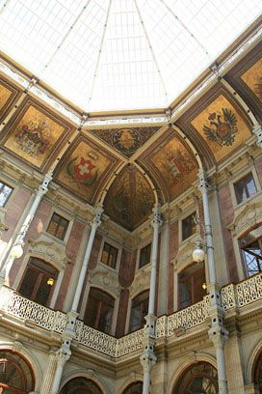

Slide 12
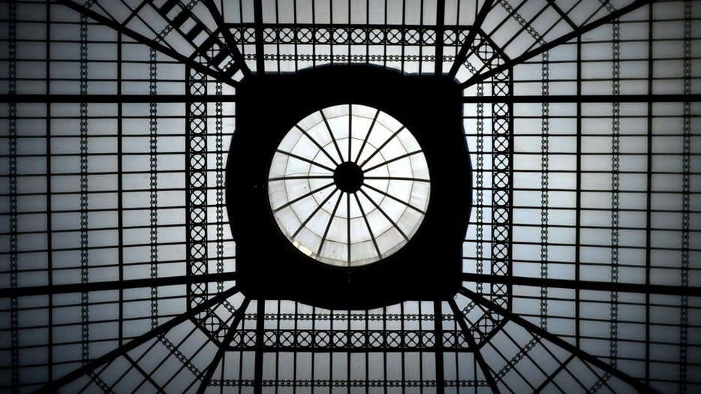

Slide 13
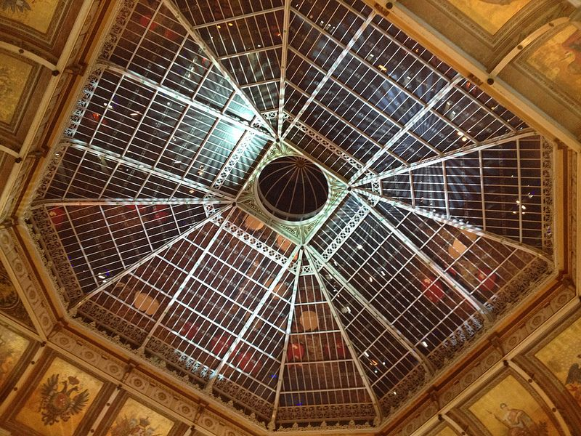
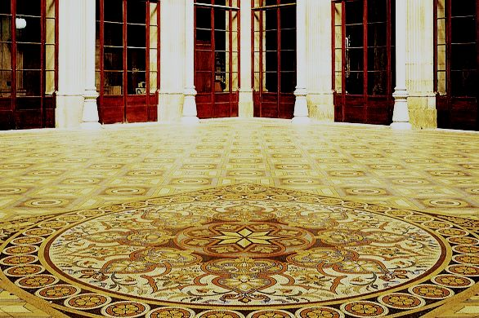
The central courtyard (Nations' Courtyard - Pátio das Nações) is covered by a large metallic, octagonal dome with glass panels, designed by Tomás Soler and built after 1880.

Slide 14
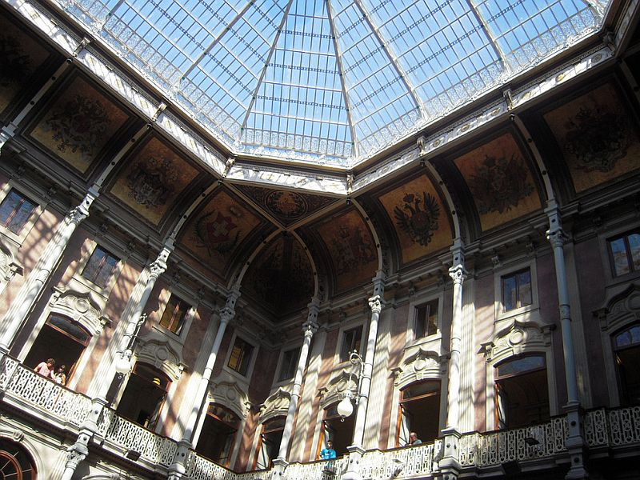
The lower part of the dome is decorated with the painted coats-of-arms of Portugal and the countries with which Portugal had commercial relations in the 19th century.

Slide 15
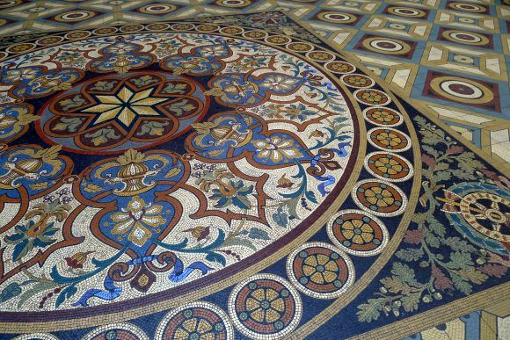
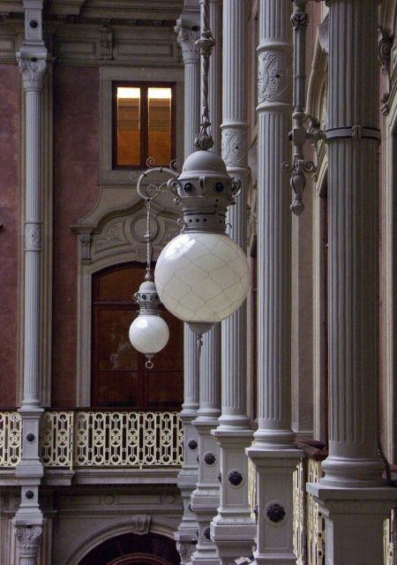

Slide 16
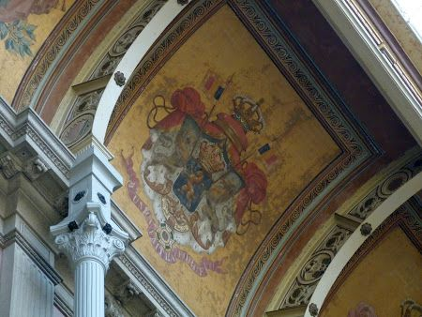
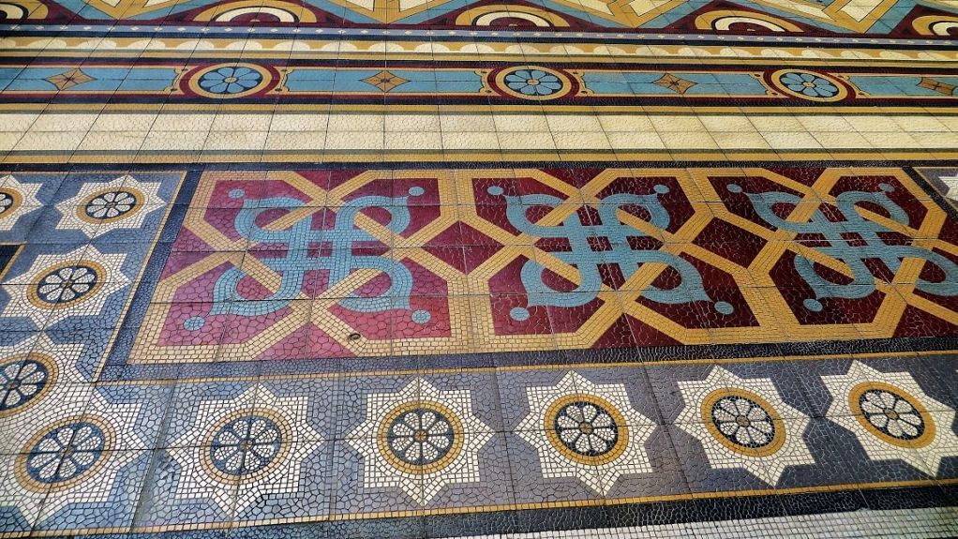
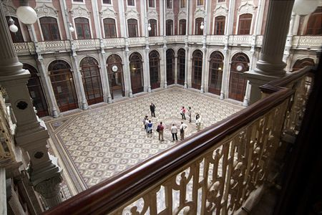

Slide 17
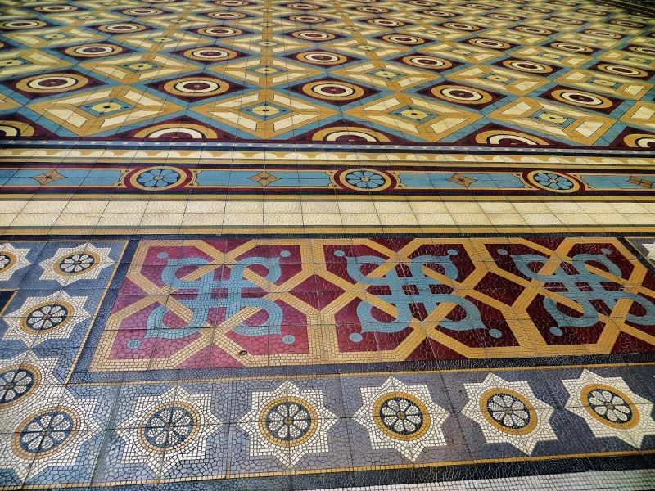
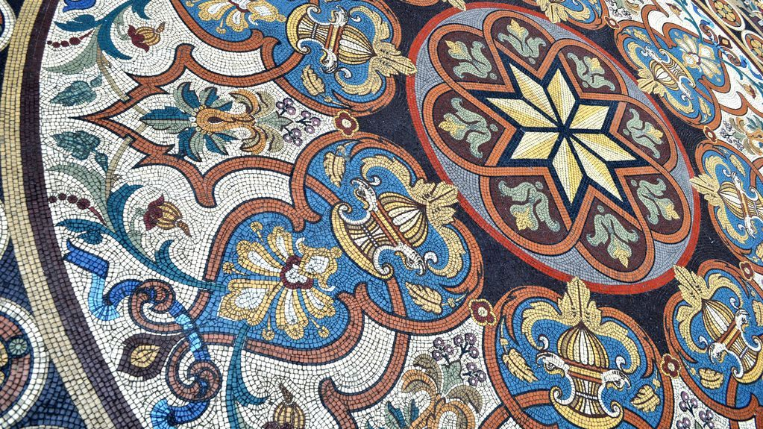

Slide 18
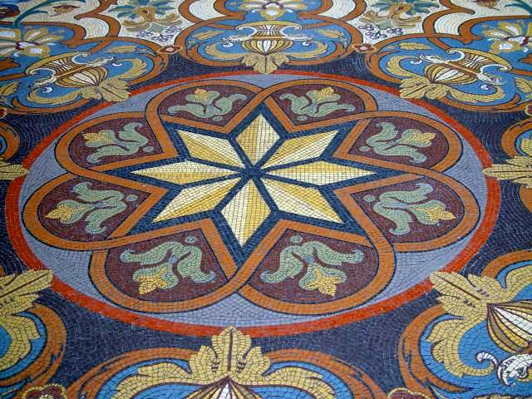

Slide 19
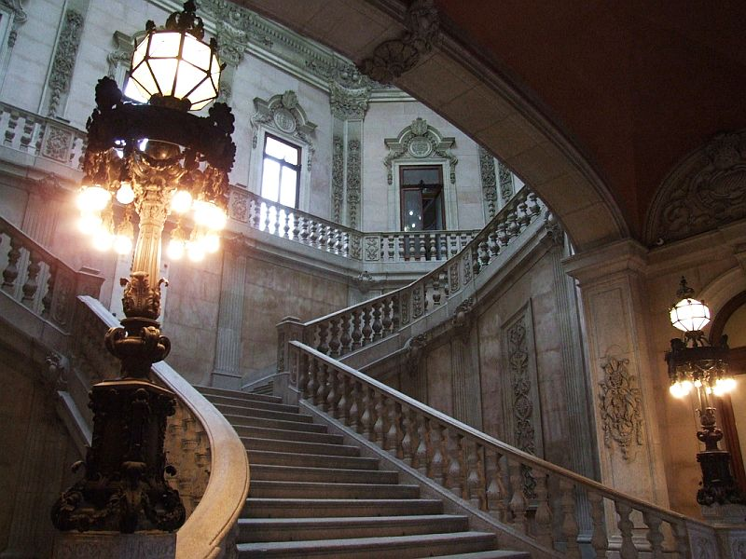
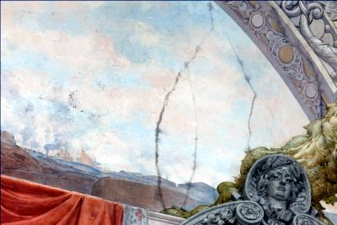
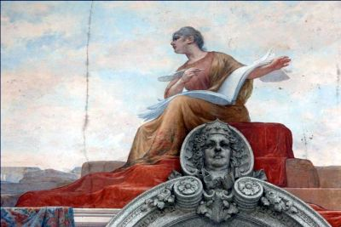
The magnificent granite stairway is adorned by busts done by sculptors Antonio Soares dos Reis, and Antonio Teixeira Lopes. The frescoes on the ceiling were done by Antonio Ramalho.

Slide 20
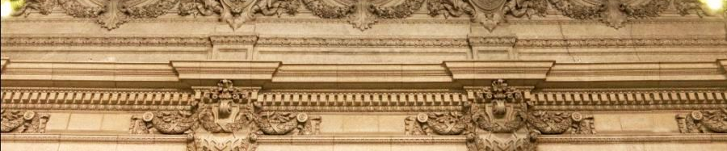
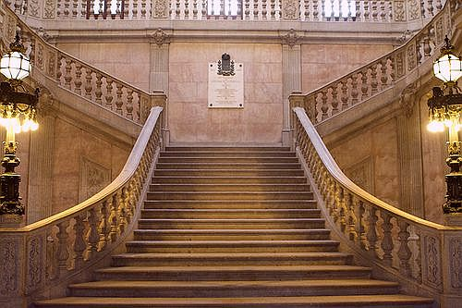
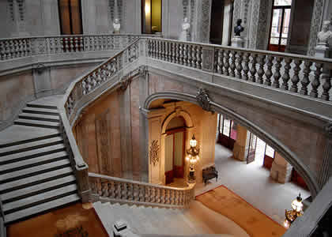

Slide 21
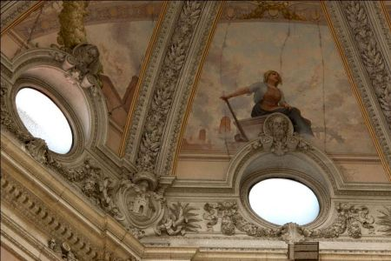
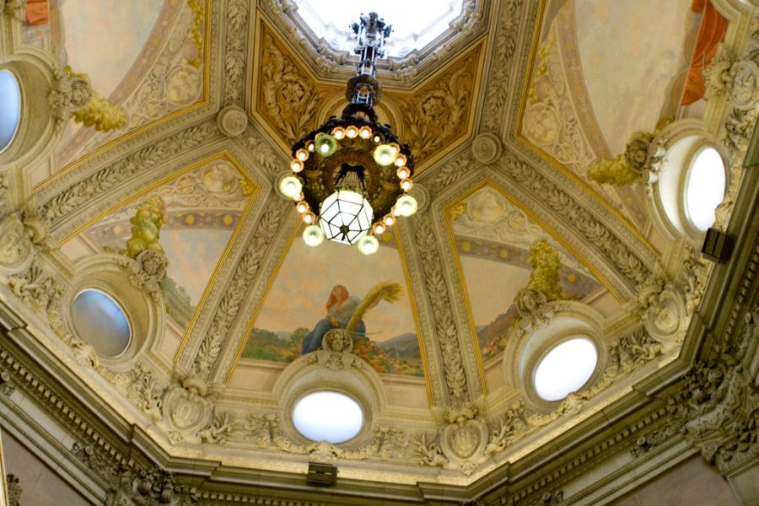
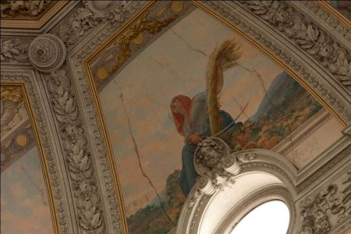
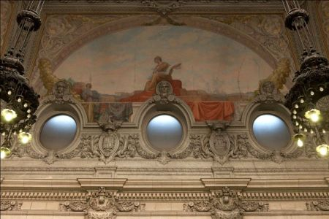
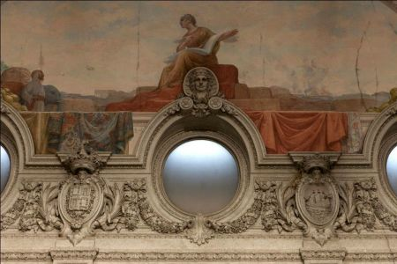
The sumptuous stairway, built in 1868 by Gonçalves e Sousa, leads to the upper storeys The ceiling frescoes were painted by António Ramalho.

Slide 22
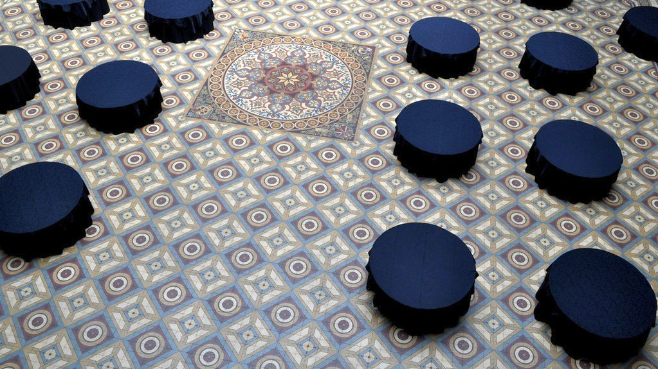

Slide 23
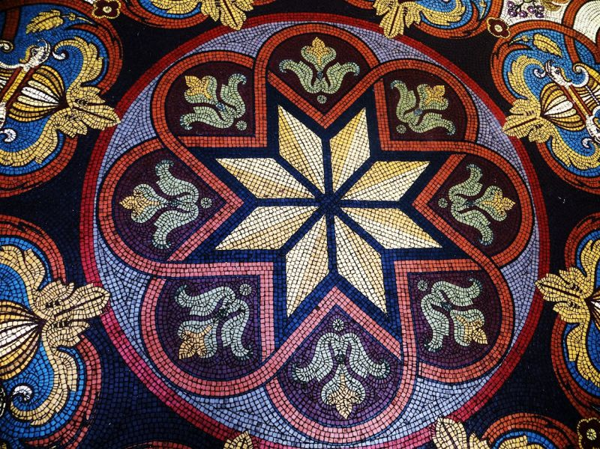

Slide 24
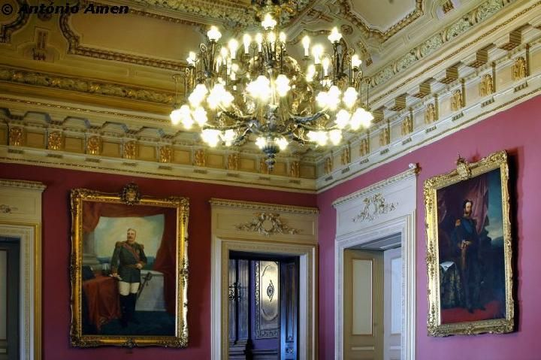
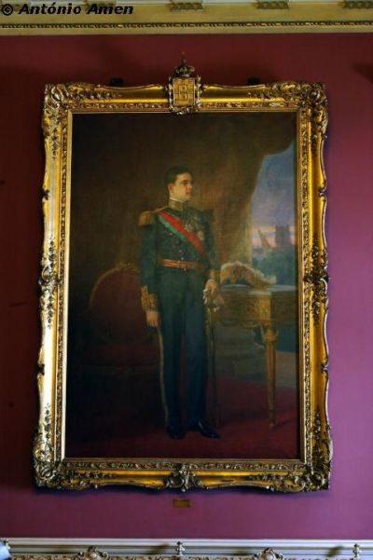
Decorated in Luis XVI style, the Portrait Room pays homage to the last six kings of the Bragança dynasty, which came to power immediately after the restoration of the monarchy, on the 1st December 1640, with the acclamation of D. João, the Duke of Bragança, as the King of Portugal.

Slide 25
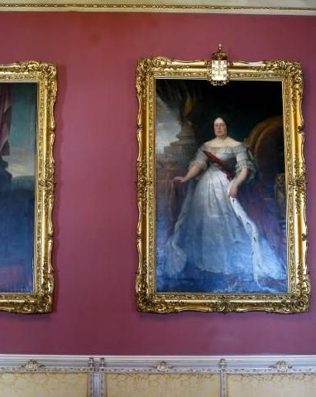


The Portrait Room (Sala dos Retratos )

Slide 26

The Court Hearing Room, as its name suggests, is another masterpiece of the Palace where the former commercial court functioned in the 19th century. The room’s initial draught was devised by Joel da Silva Pereira and later drafted by the architect Marques da Silva, whose intervention mainly centred on the stained glass windows and furniture.

Slide 27



It is magnificently decorated in French renaissance style, which gives it a strong eclectic feel and a certain atmosphere of austerity that is perfectly suited to the function for which it was conceived.
The Commercial Court Room

Slide 28

The Commercial Court Room

Slide 29

The Commercial Court Room

Slide 30



Jurors Room (Medina Room) The Court Hearing Room has a small chamber where the jurors used to meet when court sessions were taking place
Biblioteca

Slide 31

The Golden Room (Sala Dourada)

Slide 32

The Golden Room (Sala Dourada) recreates, in its entirety, the imperial style, with its ceiling lavishly decorated in stucco and covered in gilded foliage. This blends quite freely with elements of other artistic periods. It is designed in a singular combination, including three circumferences decorated with plant motifs and many others in repetitive patterns of floral motifs.

Slide 33

Sala das Assembleias Gerais is the room where the general assembly of the Porto Trade Association meets annually. It was designed by Thomaz Augusto Soller and was later altered by José de Macedo Araújo Júnior. Of all the rooms, this is the most classical and seems like a project taken from the neoclassical age

Slide 34




General Assembly Room

Slide 35

General Assembly Room

Slide 36

To get to the Chairman’s Room one must first pass through a small antechamber where one can see the painted portrait of D. Fernando od Saxe Coburg-Gotha, D. Maria II’s husband. This work is by Francisco José Resende paying homage to the Royal Portuguese House

Slide 37

The Chairman’s Room has direct access to the adjoining balcony of the main body of the Palace’s façade, providing an outstanding view overlooking the old part of the city.

Slide 38

Arabian Room

Slide 39



The Arabian room is unique and exclusive. This is because of its unusual richness and undisputed symbolism. It is recognized as the jewel in the crown and the most emblematic of all the Palace’s rooms, embodying the clearest expression of neo-moorish art in Portugal.

Slide 40




Slide 41


Slide 42



Armas do Porto in Arabian Room. Its construction began in 1862, as a result of symbiosis between an interpretation of Arabian ornament grammar and the fertile imagination of the engineer/architect, Gustavo Adolpho Gonçalves e Sousa. It was only completed in 1880 and inaugurated on the 12th June of the same year

Slide 43


Slide 44




Slide 45


Slide 46



This luxurious room was inspired by the Palace of Alhambra in Granada. Many also refer to it as stately because of the evident signs of abundance and opulence. This invokes fascination, a feeling of splendor and bedazzlement in those who visit this room.

Slide 47



Slide 48



Slide 49


You can take a half-hour tour of the Palacio da Bolsa
Price per person €7 / Seniors and Students: 4€ All the year round
The highlight of the Palace is, however, the Arab Room, built between 1862 and 1880 by Gonçalves e Sousa. The room is decorated in the exotic Moorish Revival style, fashionable in the 19th century, and is used as reception hall for personalities and heads of state visiting Porto

Slide 50


Slide 51


Slide 52



Text: Internet
Pictures: Internet
Sanda Foişoreanu
Gabriela Cristescu
Copyrights of the photos belong to each photographer
Presentation: Sanda Foişoreanu
www.slideshare.net/michaelasanda
Sound: Katia Guerreiro – Asas; Asa de vento

