Slide 1
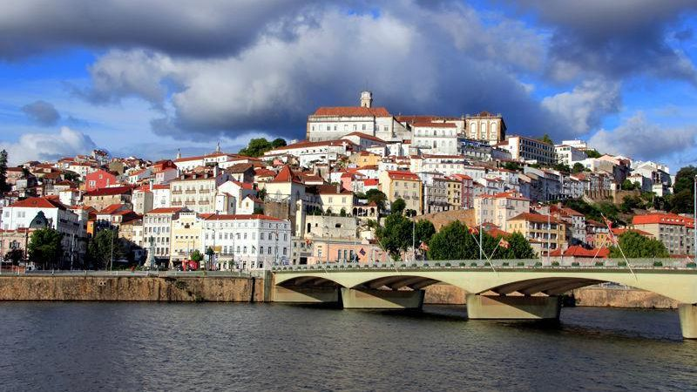

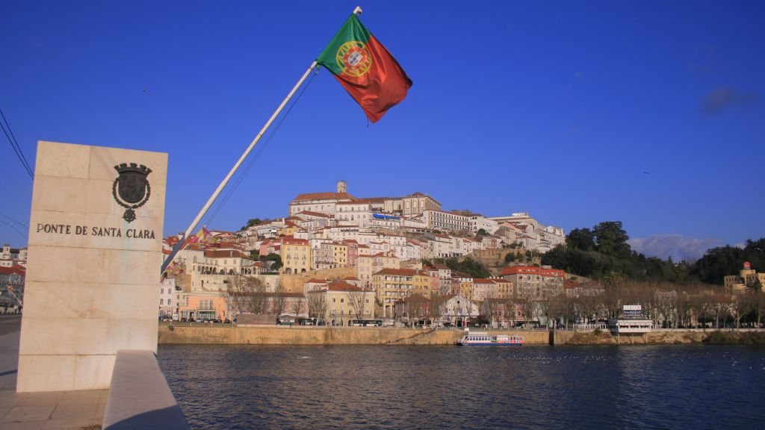

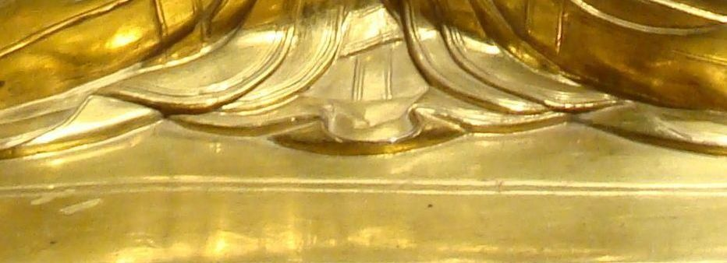
4
Coimbra
http://www.authorstream.com/Presentation/sandamichaela-1960666-coimbra4/

Slide 2
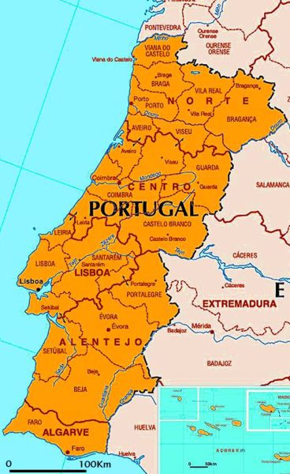
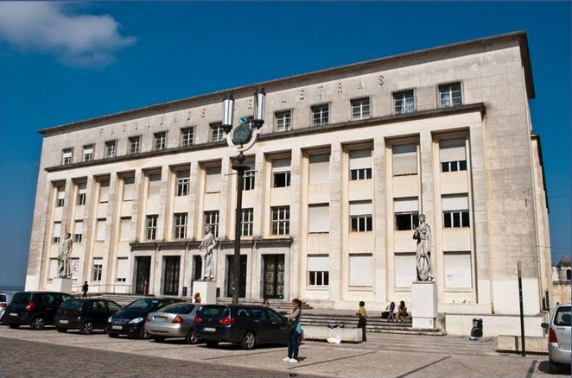
Coimbra has been called A cidade dos estudantes (The city of the students) or Lusa-Atenas (Lusitan-Athens), mainly because it is the site of the oldest and one of the largest universities in Portugal – the University of Coimbra, a public university whose origins can betraced back to the 13th century. On June 22, 2013, UNESCO added The University of Coimbra to its World Heritage List

Slide 3
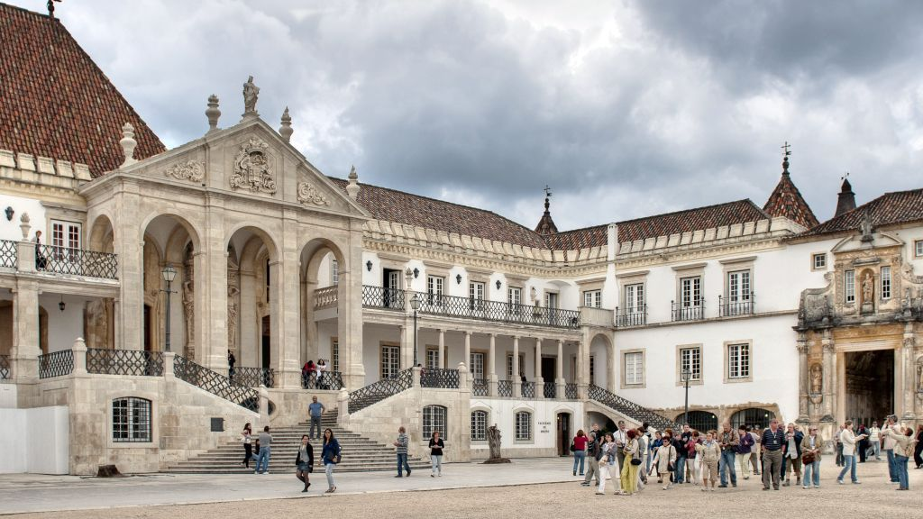

Slide 4
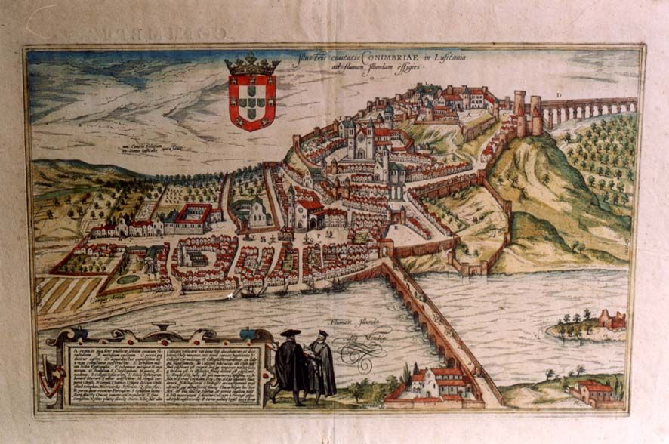
The University was definitively transferred to the premises of Coimbra Royal Palace in 1537 by King John III. Since then, the city life has revolved around the state-run university.
Notable university buildings include the 12th century Cathedral of Santa Cruz and a number of 16th century colleges, the Royal Palace of Alcáçova, which has housed the University since 1537, the Joanine Library with its rich baroque decor, the 18th century Botanical Garden and University Press, as well as the large “University City” created during the 1940

Slide 5
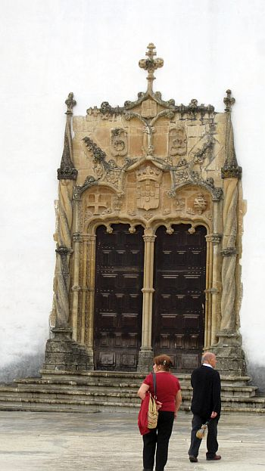
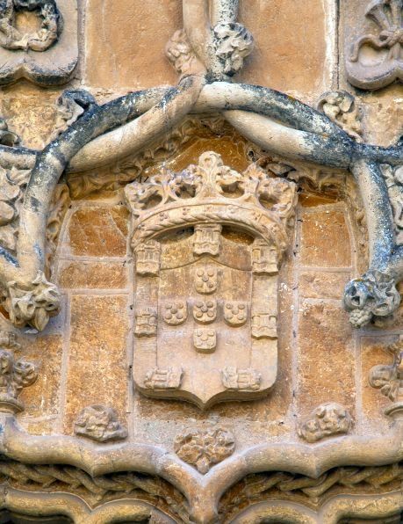
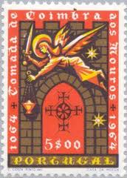
St Michael's Chapel was planned by Marco Pires between 1517 and 1522. The Chapel has a Manueline doorway; entry is by a side door in neo-classical style.

Slide 6
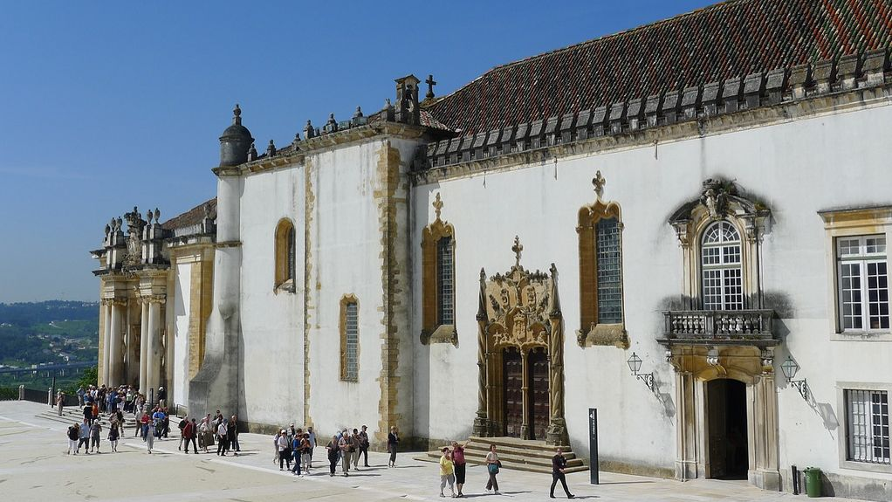

Slide 7
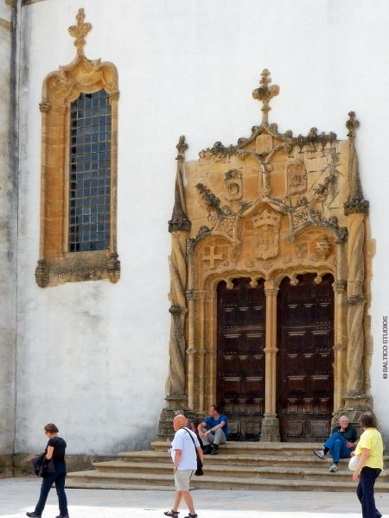
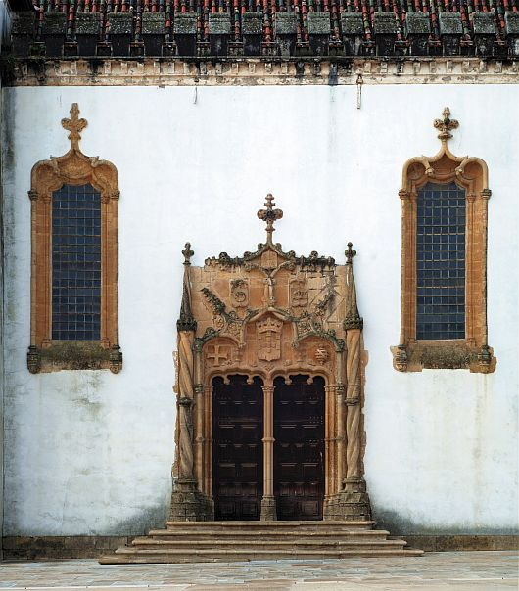

Slide 8
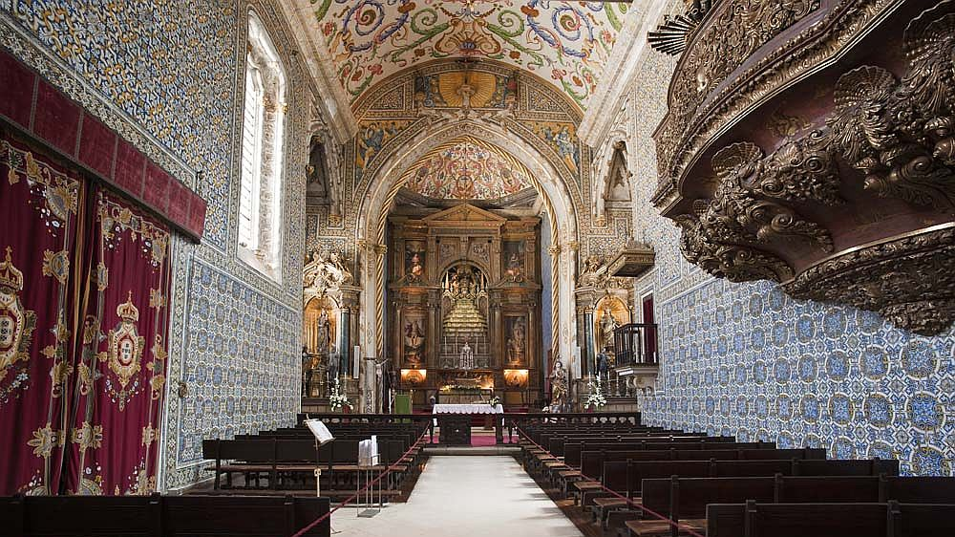

Slide 9
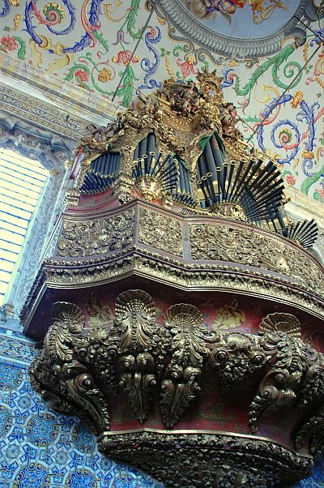
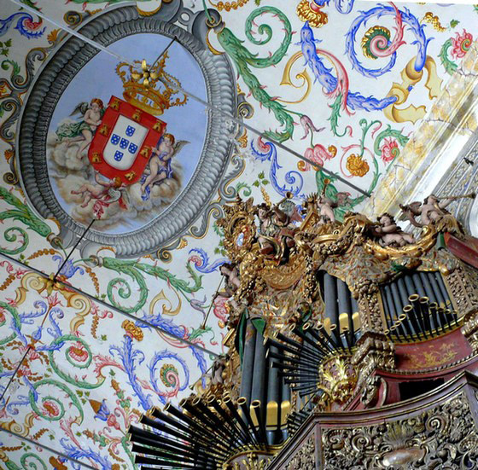

Slide 10
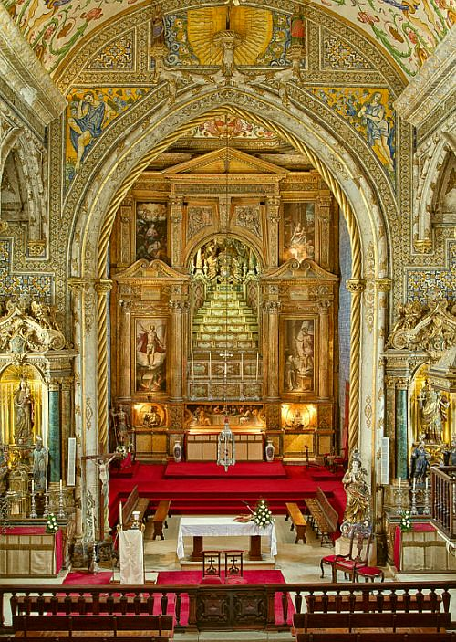
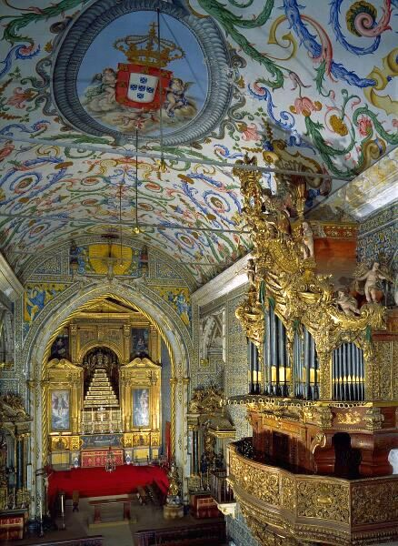
The St. Michael’s Chapel has a splendid Baroque organ dated 1733
In 1737 painter Gabriel Ferreira da Cunha decorated it with carving and chinoiserie in the style of João V.
The walls of the nave and the chancel are lined with 17th- and 18th-century carpet-style tiles. The main altarpiece, in Mannerist style, dates from 1605.

Slide 11
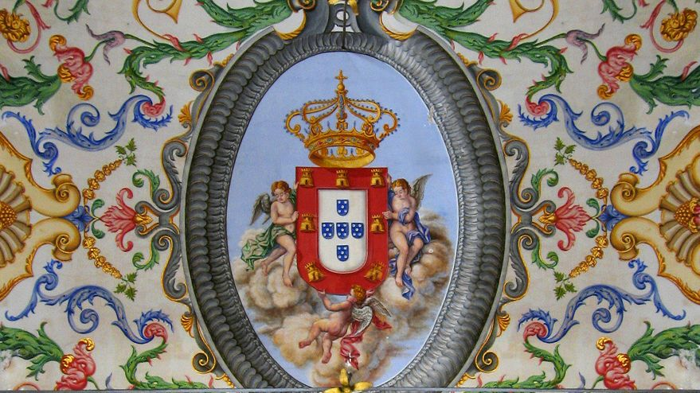
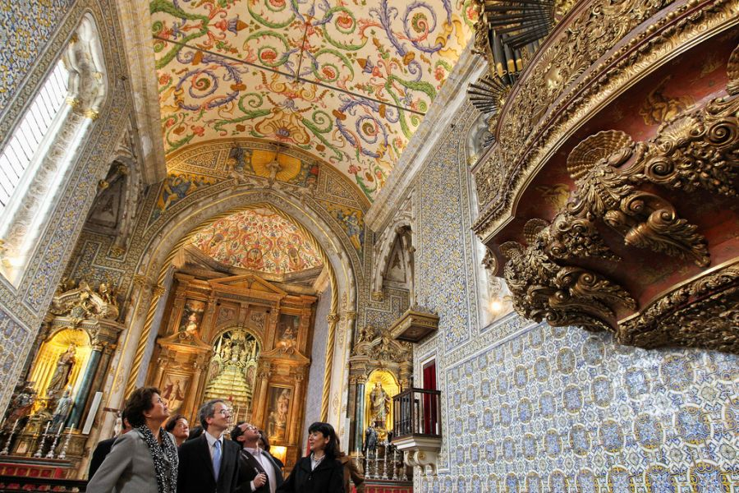

Slide 12
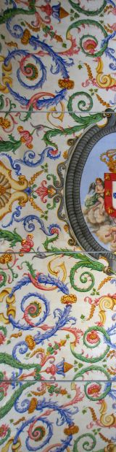
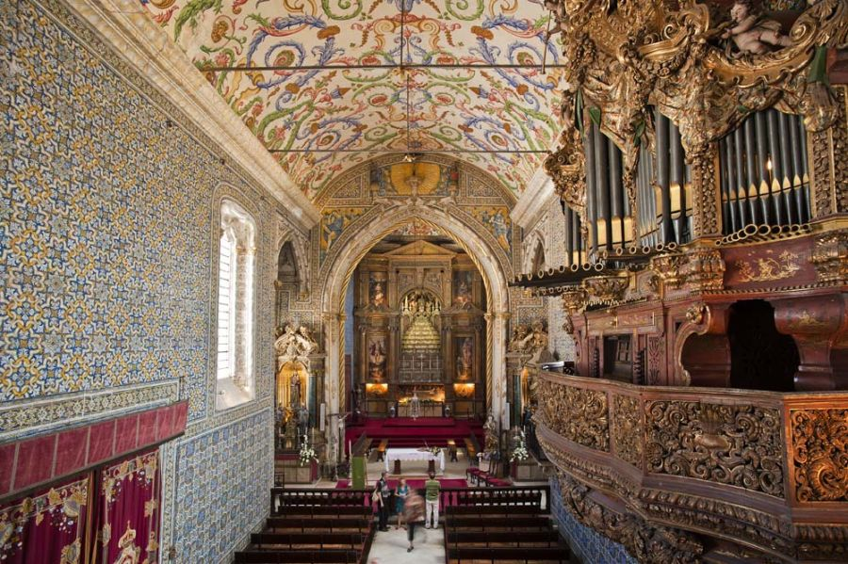

Slide 13
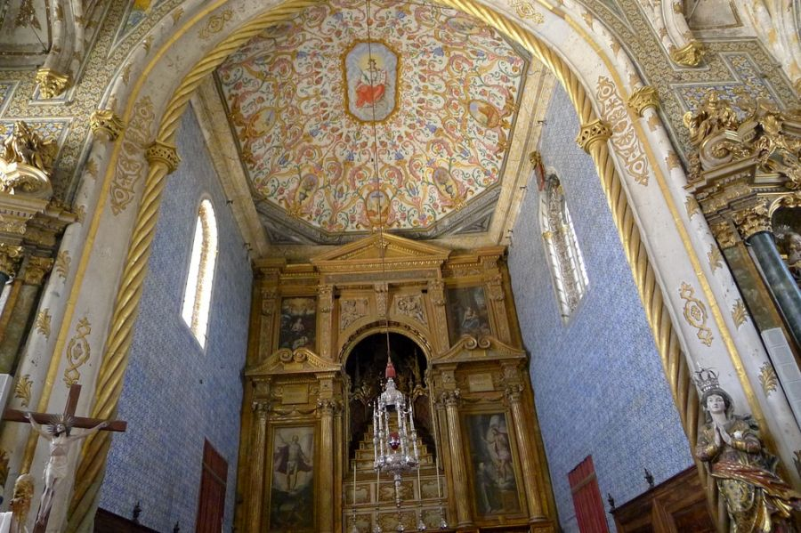
Simão Ferreira made the lamp of this church in 1597 and the cup between 1601 and 1602
In 1684 Manuel Ramos did the pulpit.

Slide 14
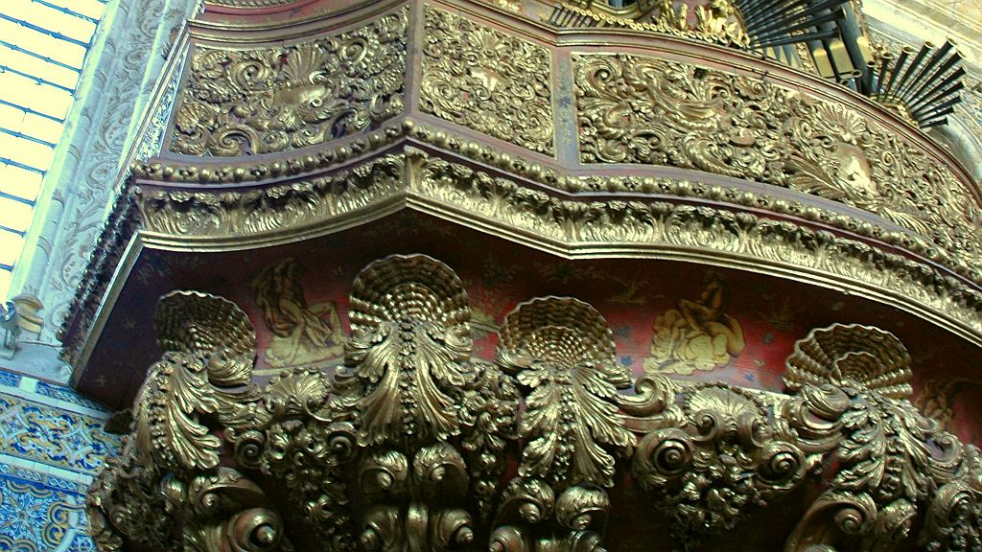
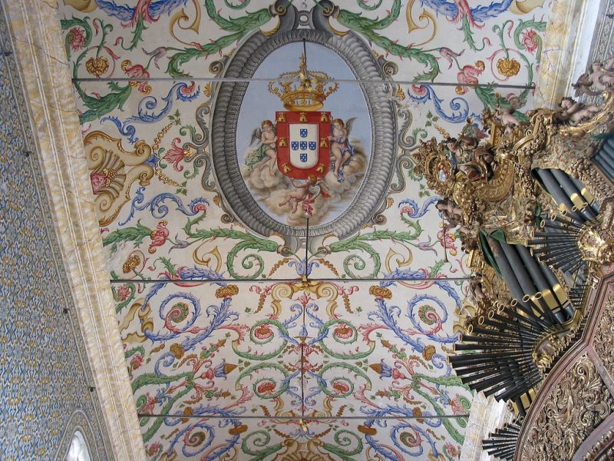

Slide 15
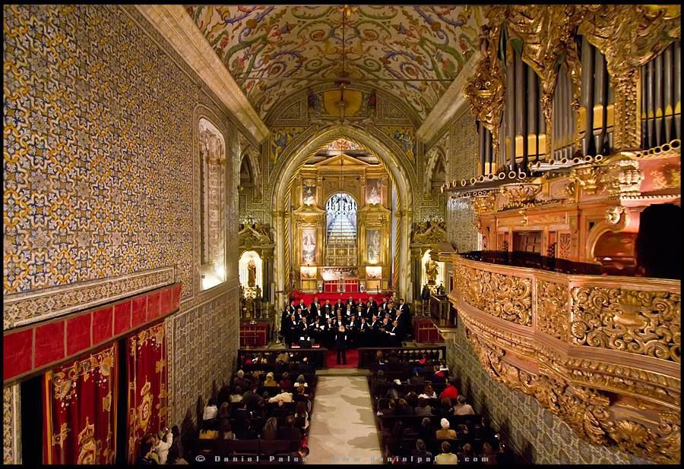
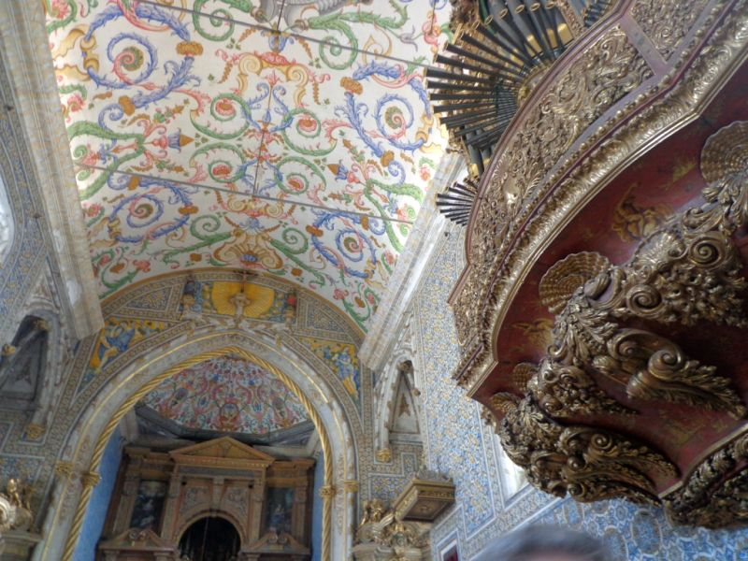

Slide 17
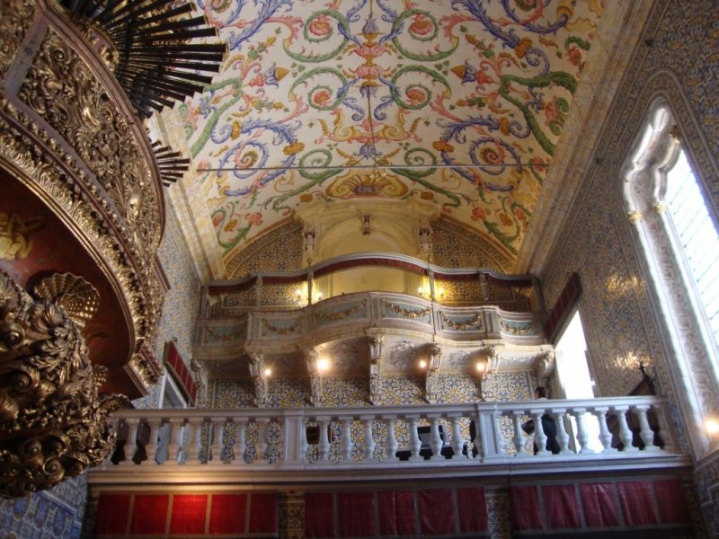

Slide 18
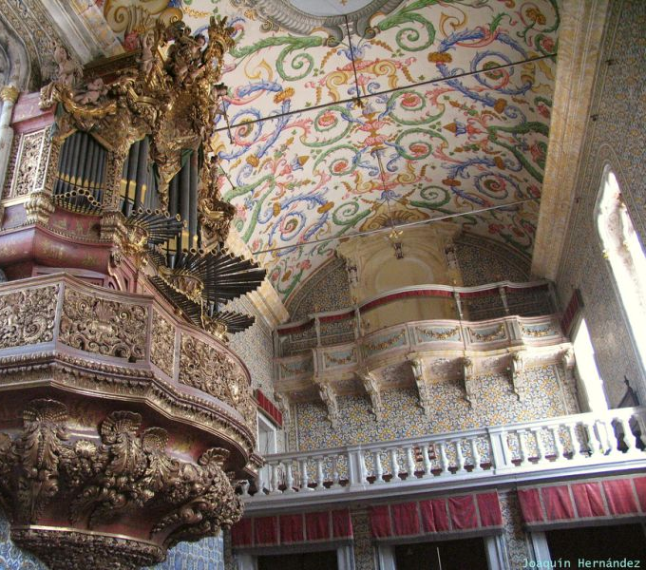
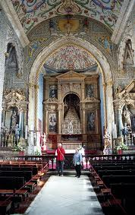

Slide 20
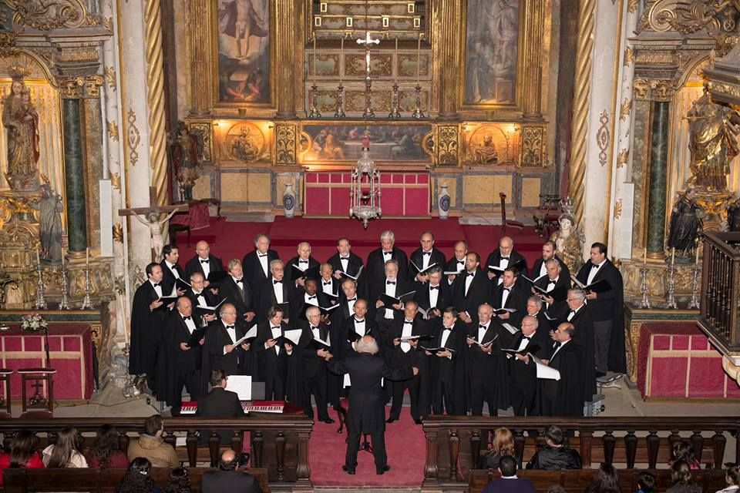
The chapel is a tourist attraction of the university old quarter in upper Coimbra. It has a choir, Coro da Capela da Universidade de Coimbra, that performs in the church.

Slide 21
Although Coimbra University teaching and administrative staff has priority, São Miguel Chapel rents its spare time and space to any person outside the university community and is a popular place for catholic weddings in the town, even among couples with loose or absent connections to the university itself.

Slide 22
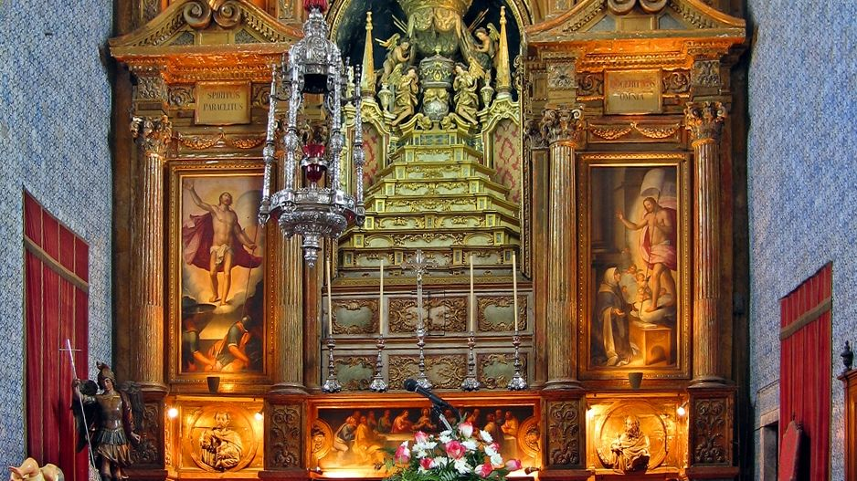

Slide 23
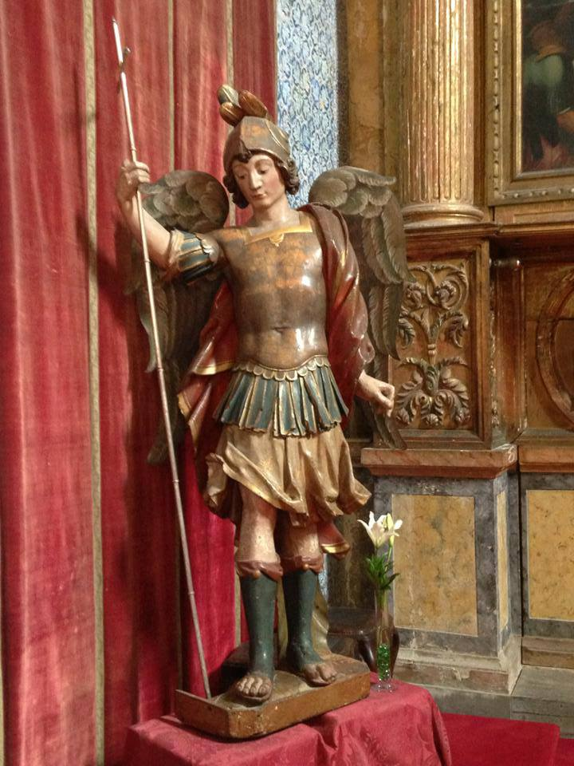
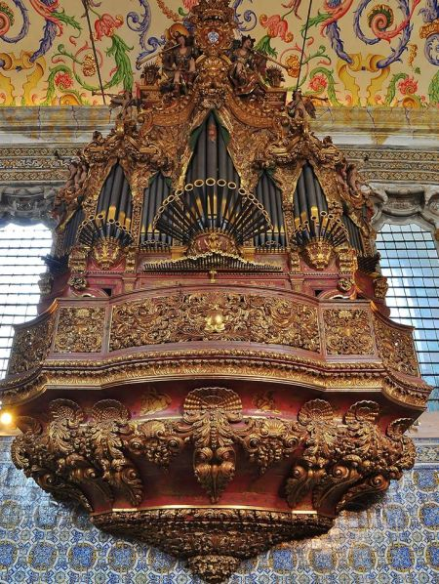
The organ dating from 1732

Slide 24
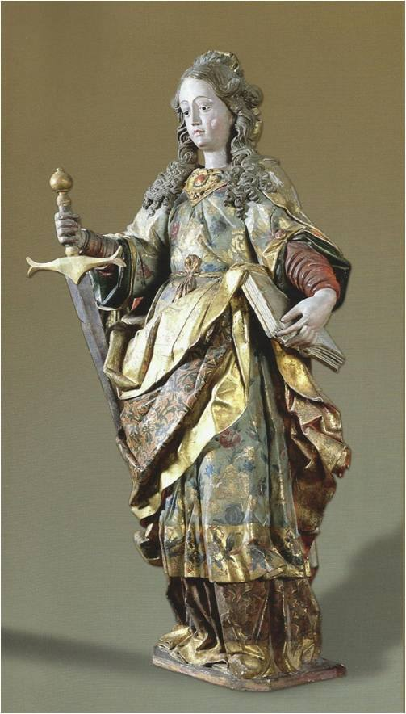
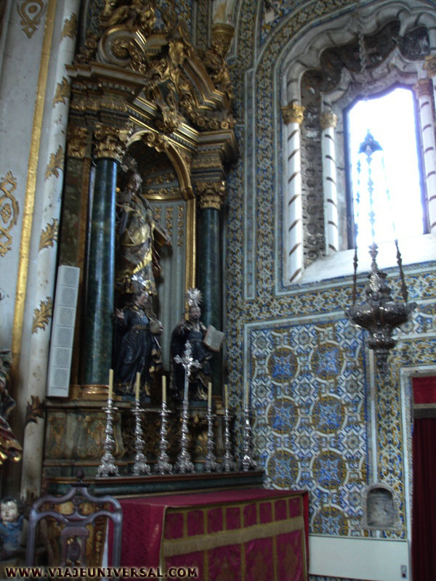
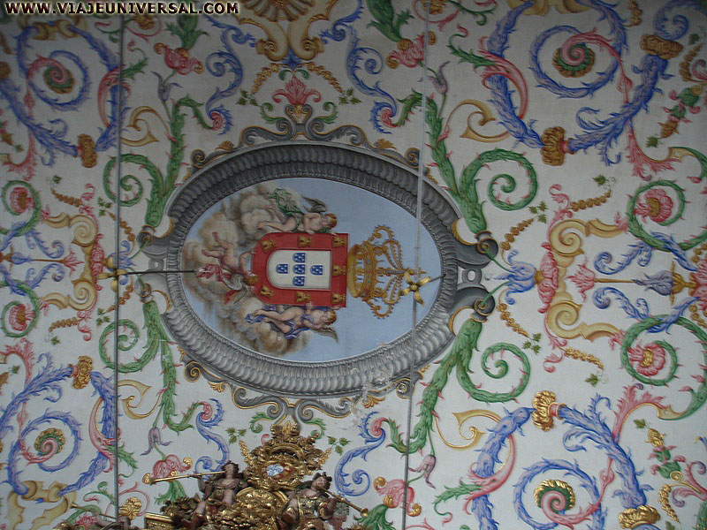

Slide 25
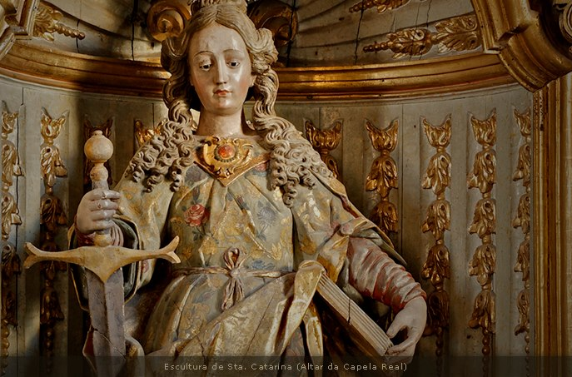
Santa Catarina

Slide 26
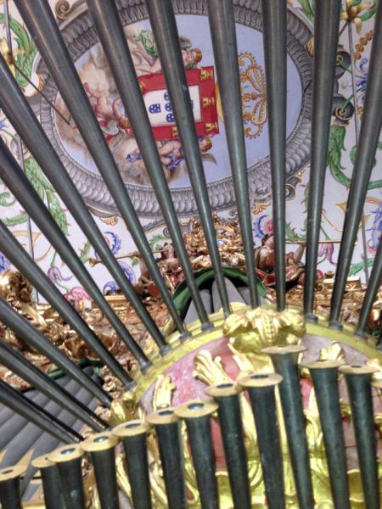

Slide 27
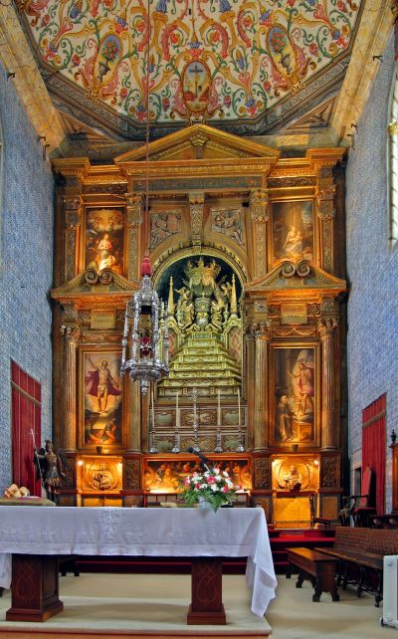
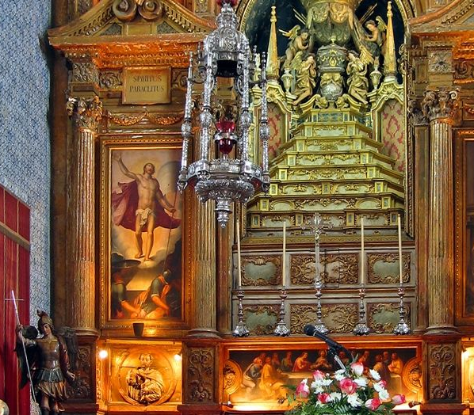

Slide 28
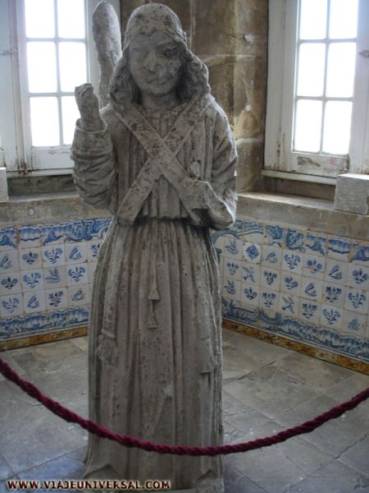
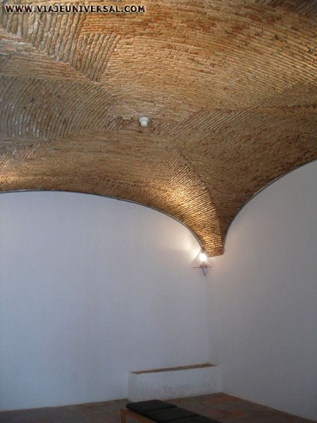
Medieval & Academic Prison
As the University had its own private law court, it had to have a prison for convicted students and scholars, which functioned from 1782 until the court was abolished in 1832. Situated on the lower floor of the Joanine library, it consisted of small vaulted rooms with no direct light, and was considered unhealthy by the prisoners.
Arcángel São Miguel

Slide 29
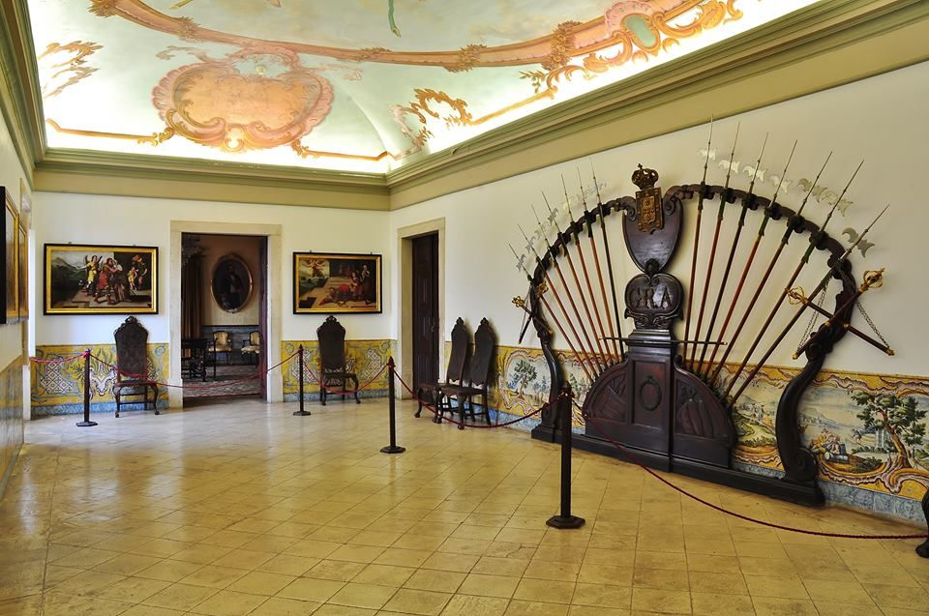
Coimbra University
sala das armas

Slide 30
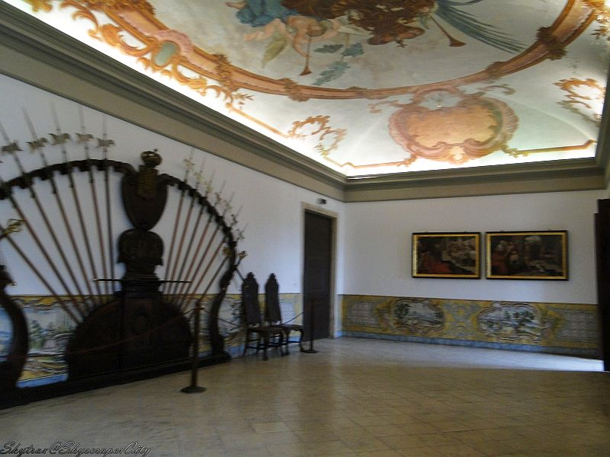
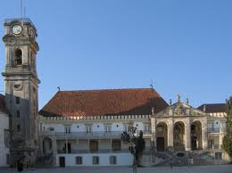
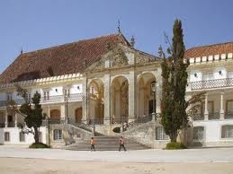
Coimbra the University
Decoration interior sala das armas

Slide 31
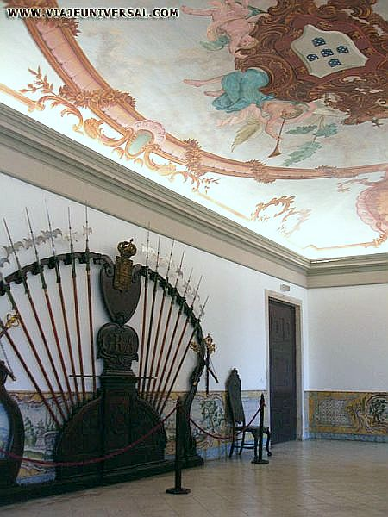
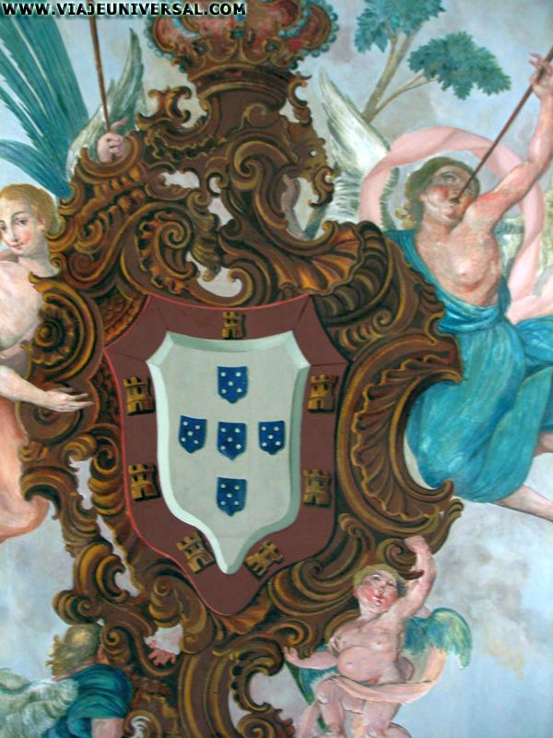
Coimbra University
Decoration interior sala das armas
The roof structure, dating from the 19th century, has at the center, the Royal Arms of Portugal.

Slide 32
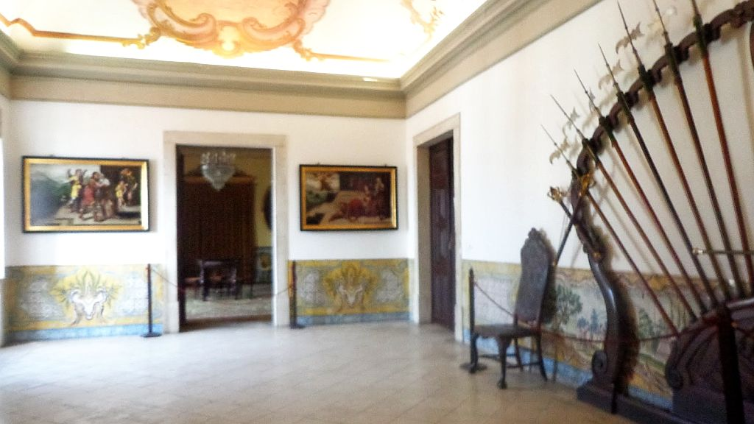

Slide 33


The Weapons Room (Sala das Armas)
This was part of the royal wing of the former palace. It contains a display of weapons (halberds) of the Royal Academic Guard, still used today by the University Guards on ceremonial occasions.

Slide 34

The set of arms (halberds) of the Academic Royal Guard displayed are still used by the Archers (guards) in the formal academic ceremonies (solemn doctotare sessions, "honoris causa", investiture of the Rector, the solemn opening of the school year).

Slide 35


Slide 36


Coimbra the University decoration
Interior
sala das armas and Escalera interior

Slide 37



The University of Coimbra is one of the oldest in Europe. Founded in Lisbon by King Dinis in 1290, it was finally transferred to Coimbra in 1537, occupying the buildings of the medieval royal Palace.

Slide 38


During the reigns of João V and José I the university was extensively restructured, not only in its teaching but also by the construction of new buildings in Baroque or neo-classical style.
Rectoria

Slide 39


The Yellow Room, next to the Armory, has walls lined with yellow silk alluding to the Faculty of Medicine. The paintings on the walls are of 19th century Rectors of the University.

Slide 40
It was, indeed, in this room that the "congregation of the Faculty of Medicine" met (meeting of the constituent bodies of the Faculty).

Slide 41


Sala do exame privado
The Blue Room is also a room of this former Royal Wing that can be visited. The color evokes the Faculty of Science and Technology and, as the previous one, it also displays paintings of former Rectors.

Slide 42

Private Examination Room
In this room, up to the 2nd half of the 19th century, the private examination, which preceded the doctorate, was held. Alterations were carried out in 1701/1702. The 18th-century blue and white tiles covering the lower part of the walls were made locally.

Slide 43


Slide 44



Slide 45

Private Examination Room
The paintings show the University rectors from the 16th to the 18th centuries

Slide 46
Private Examination Room
On the ceiling and above the doors are the emblems of the various faculties.

Slide 47

Grand Hall - Sala dos Capelos

Slide 48


Grand Hall - Sala dos Capelos
It is in this hall that the most important University ceremonies take place, such as honoris causa doctorates, the investiture of the Rector and the official opening of classes. Originally it was the throne room of the royal palace; its present appearance is the result of rebuilding work in the 2nd half of the 17th century. In the early 18th century the panelling was refurbished and the upper walls decorated with paintings of the kings of Portugal, while the lower walls were covered with carpet-style tiles from Lisbon. The panelled ceiling, painted with garlands and grotesques, bears the date of 1655

Slide 49

Grand Hall - Sala dos Capelos
The panelled ceiling, painted with garlands and grotesques, bears the date of 1655

Slide 50


Slide 51


Slide 52

Grand Hall - Sala dos Capelos
Originally it was the throne room of the royal palace

Slide 53


Coimbra the University Places included in the visit:
– Joanine Library
– Medieval & Academic prison
– Weapons Room*
– Sala dos Capelos*
– Private Examination Room*
– St Michael’s University Chapel
* Visit depending on use of the rooms

Slide 54



Text And pictures: Internet
Copyrights of the photos belong to each photographer
Presentation: Sanda Foişoreanu
www.slideshare.net/michaelasanda
Sound: Grupo de Fados de Coimbra Canto d'alma - As nossas capas

