Slide 1
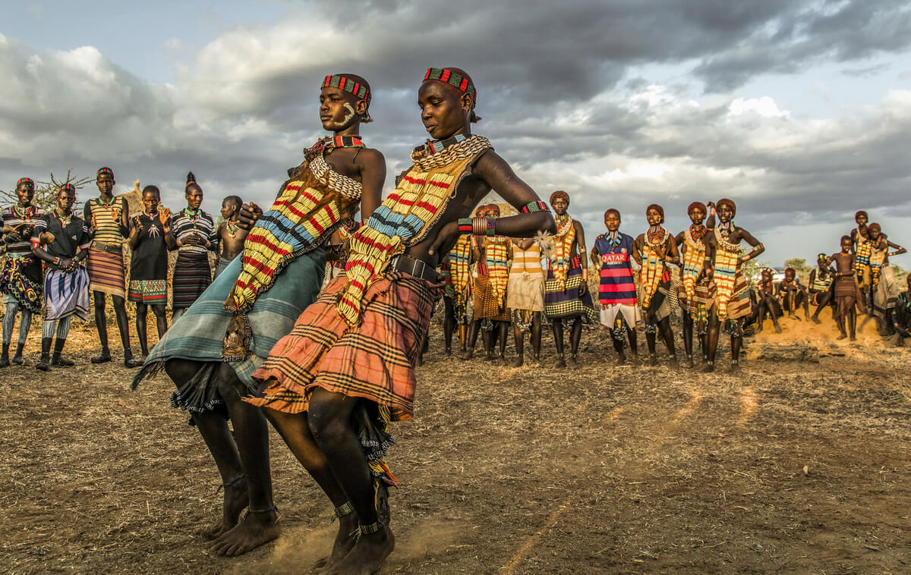

All About Photo Awards 2020

Slide 2
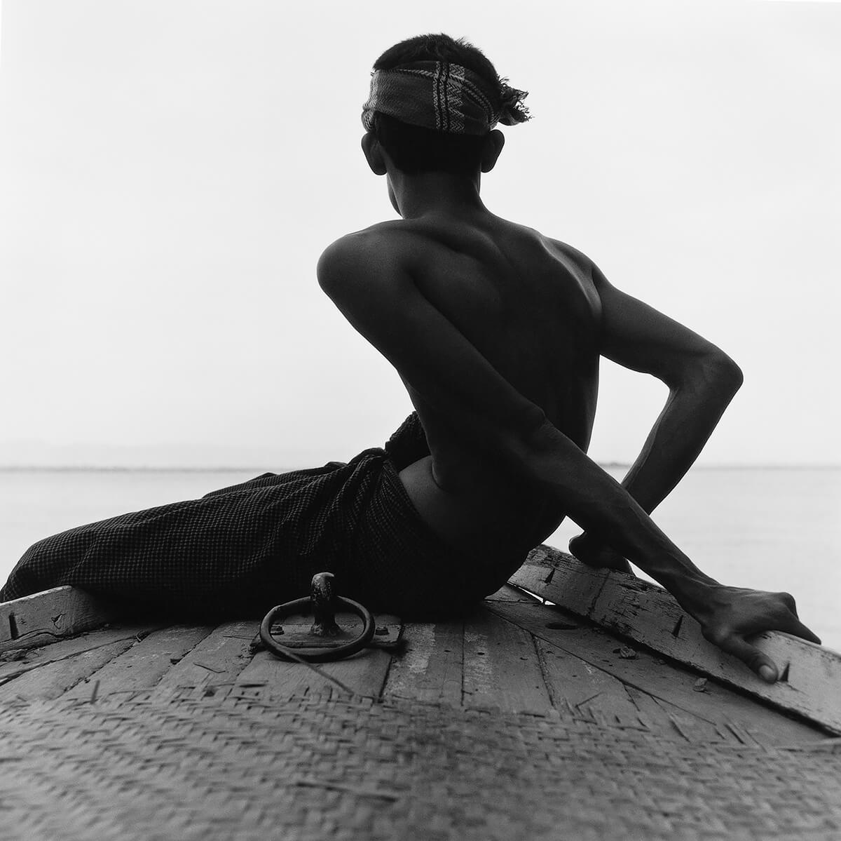
All About Photo Photographer of the Year 2020
Across the River, Burma © Monica Denevan (USA)

Slide 3

Second Place Winner
Avery Skipalis (33), outside of her house, posing together with all the firearms she owns, Tampa, Florida © Gabriele Galimberti (Italy)

Slide 4
Avery Skipalis (33) – Tampa, Florida / THE AMERIGUNS - In the States there are more guns than people. “120.5 registered firearms for every 100 residents” and the statistic doesn’t count “not-registers firearms”. As an European, I started wondering if owning many weapons by a single person or family is a common habit in the US. I traveled across the US and created a series of 45 portrait of families or single individuals, including all races and beliefs, together with their fireams.

Slide 5
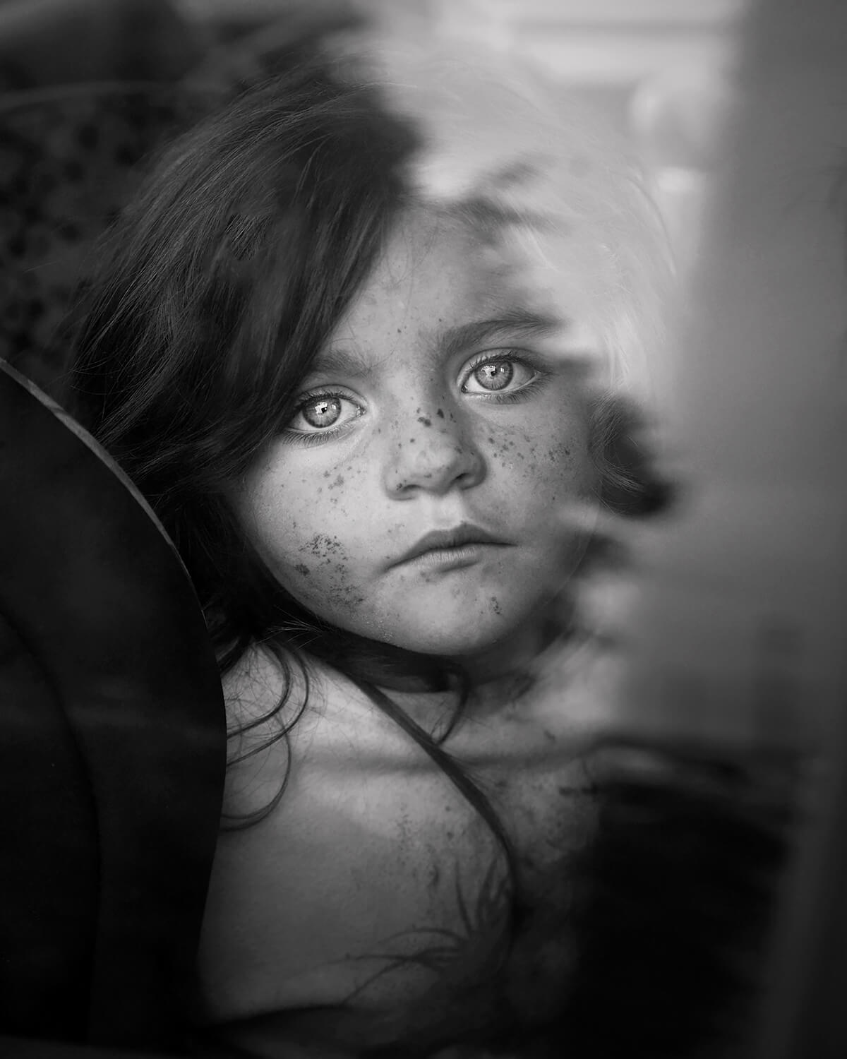
Third Place Winner
Philomena © Rebecca Moseman (USA)

Slide 6
A little Irish Traveler girl looks out of her family car before going home to her family's Illegal encampment.

Slide 7
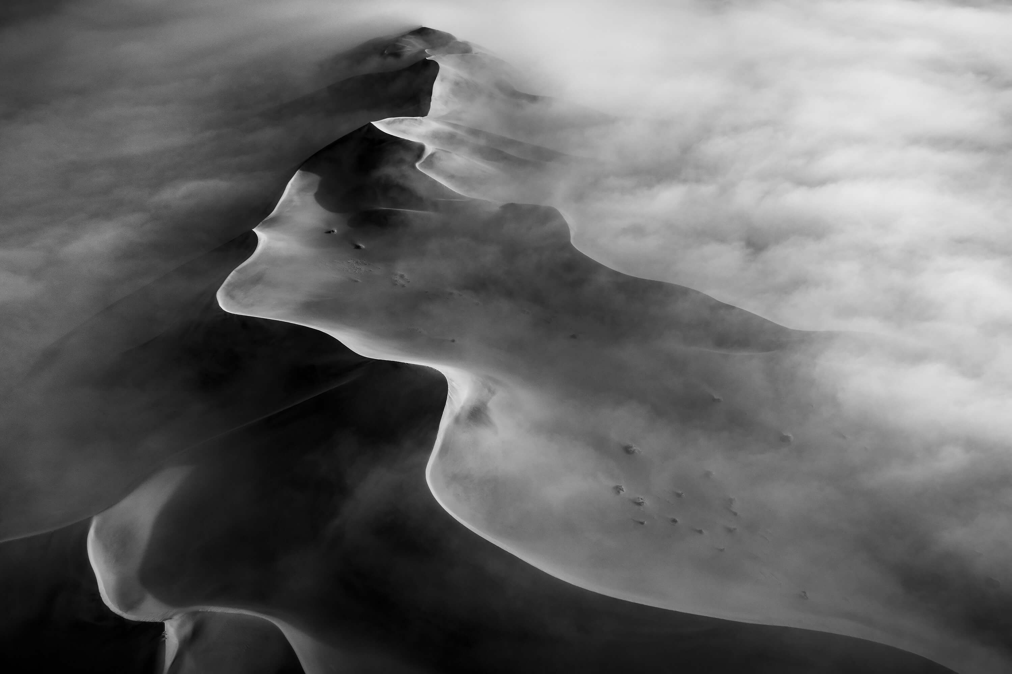
Fourth Place Winner
Sustenance 4© Nadia De Lange (Switzerland)

Slide 8
Desert: “a waterless, desolate area of land with little or no vegetation, typically one covered with sand.” And yet, there is life in the desert. More than most people realise. In the Namib this is thanks to the wonderful miracle of fog – the clouds that roll in from the Atlantic Ocean bring with them moisture that sustain the fauna and flora living in this beautiful, harsh landscape.

Slide 9
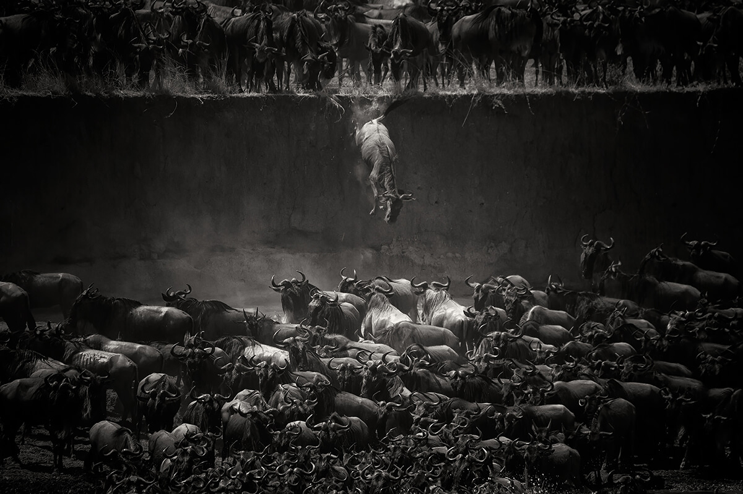
Fifth Place Winner
Jump of the wildebeest © Nicole Cambre (Belgium)

Slide 10
Annual migration of the wildebeest at Northern Serengeti, Tanzania. This wildebeest did not wait for its turn and jumped on top of the others.

Slide 11
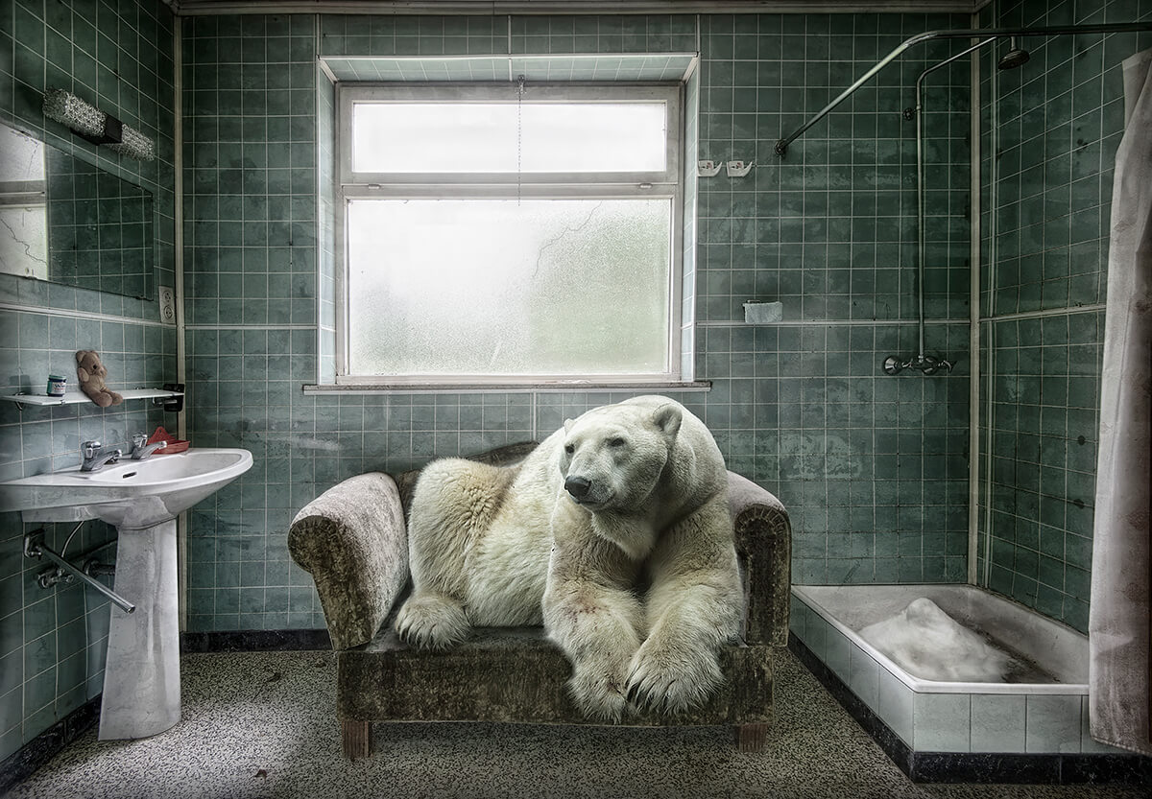
Particular Merit Mention
Polarbearpet © Marcel van Balken

Slide 12
Climate change, and the loss of sea ice habitat, is the greatest threat to polar bears. More and more polar bears are being forced ashore, away from their sea-ice hunting grounds. But it does not make sense to make your home (or bathroom) available as a haven for the polar bear. It's better to spread awareness about the real and pressing threat of climate change.

Slide 13
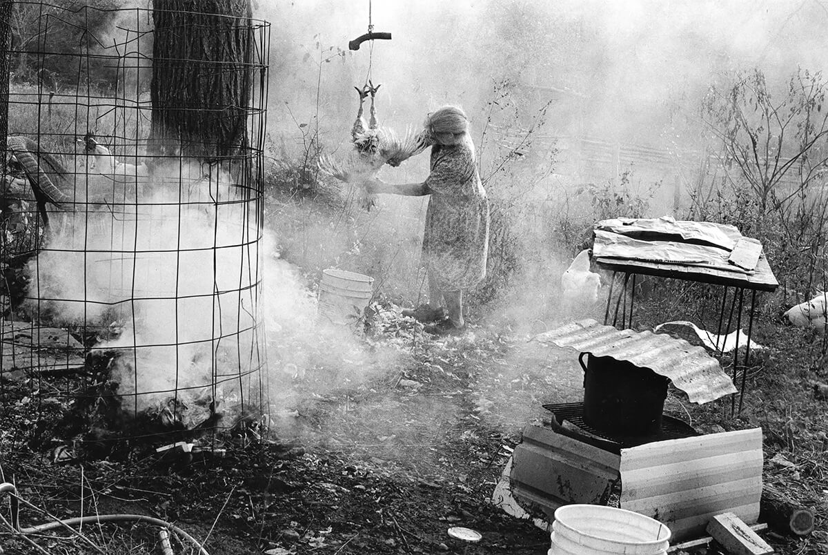
Particular Merit Mention
Woman Plucking a Chicken © Beverly Conley
Life in the Ozarks

Slide 14
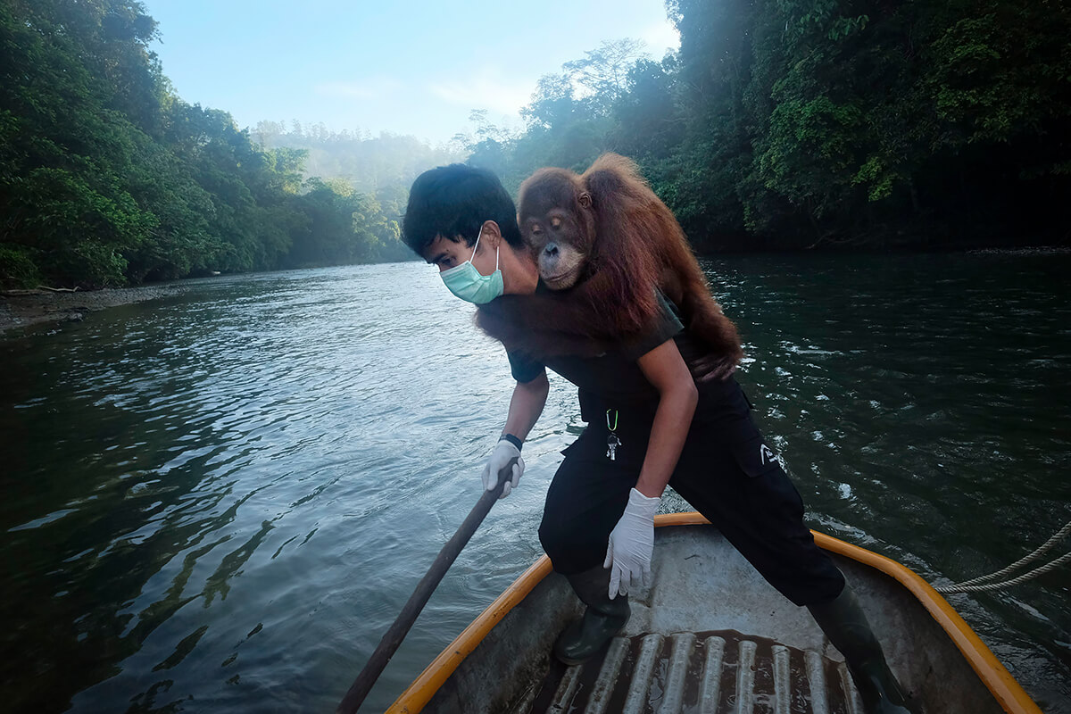
Particular Merit Mention
Saving Orangutans 72 © Alain Schroeder

Slide 15
Indonesia, Sumatra, Aceh province, Jantho Reintroduction Centre located in the Jantho Pine Forest Nature Reserve. At dawn, veterinarian Pandu crosses the Krueng Aceh river in a small boat carrying Diana, an 8-year-old female orangutan, for a final release.

Slide 16
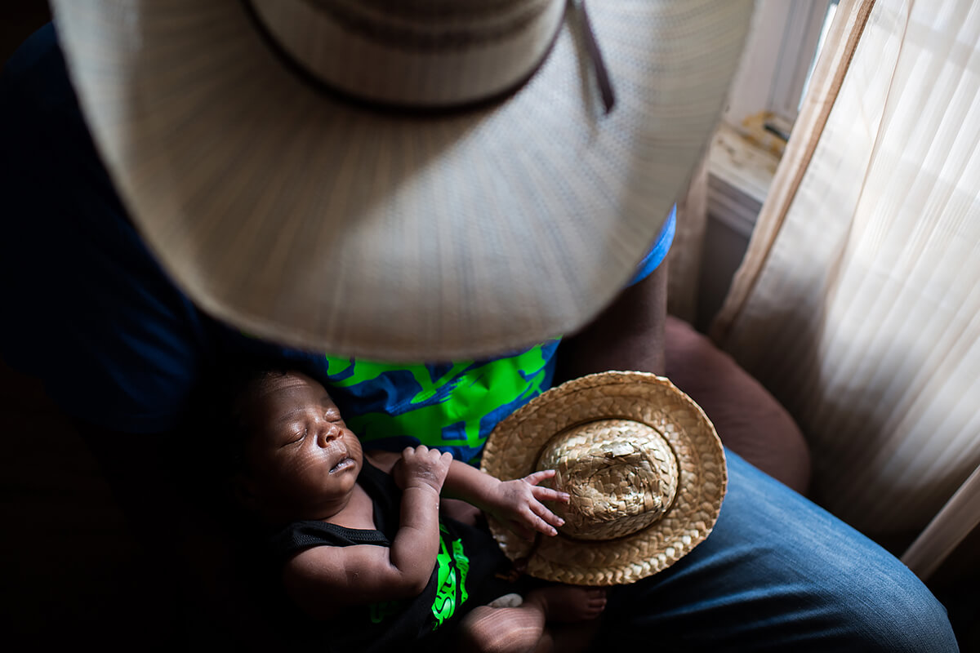
Particular Merit Mention
Newest Cowboy in Town © Rory Doyle

Slide 17
Newborn Jestin Brown is held by his father, Jessie, at their home in Cleveland, Mississippi on July 2, 2018. This photo is part of my ongoing project about the overlooked subculture of African American cowboys and cowgirls where I live in the rural Mississippi Delta.

Slide 18
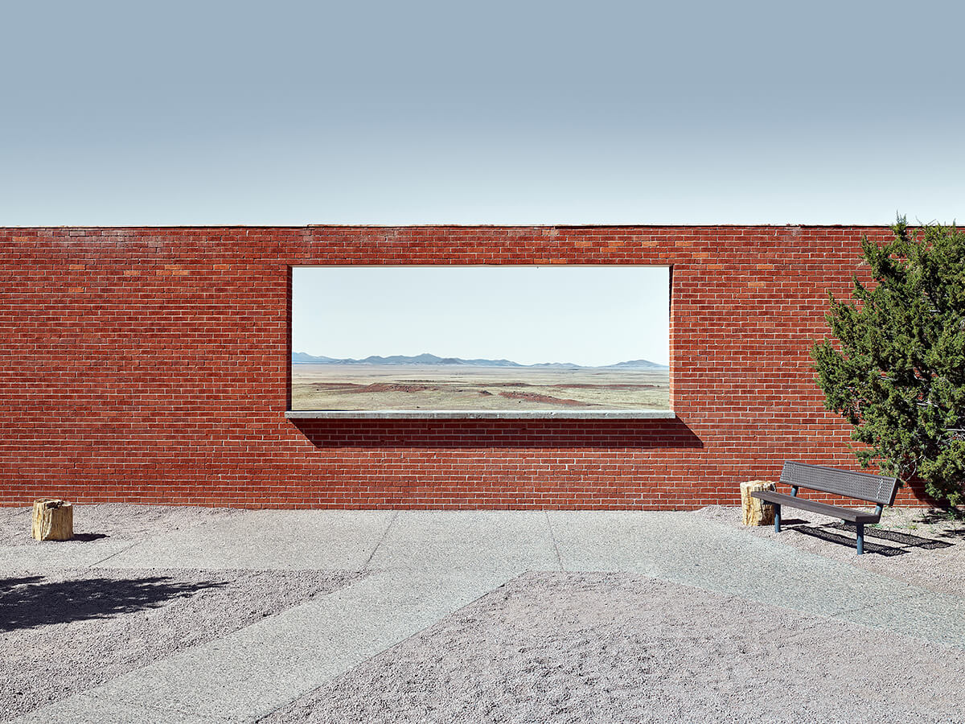
Particular Merit Mention
The Wall Frame, Arizona © Matthew Portch

Slide 19
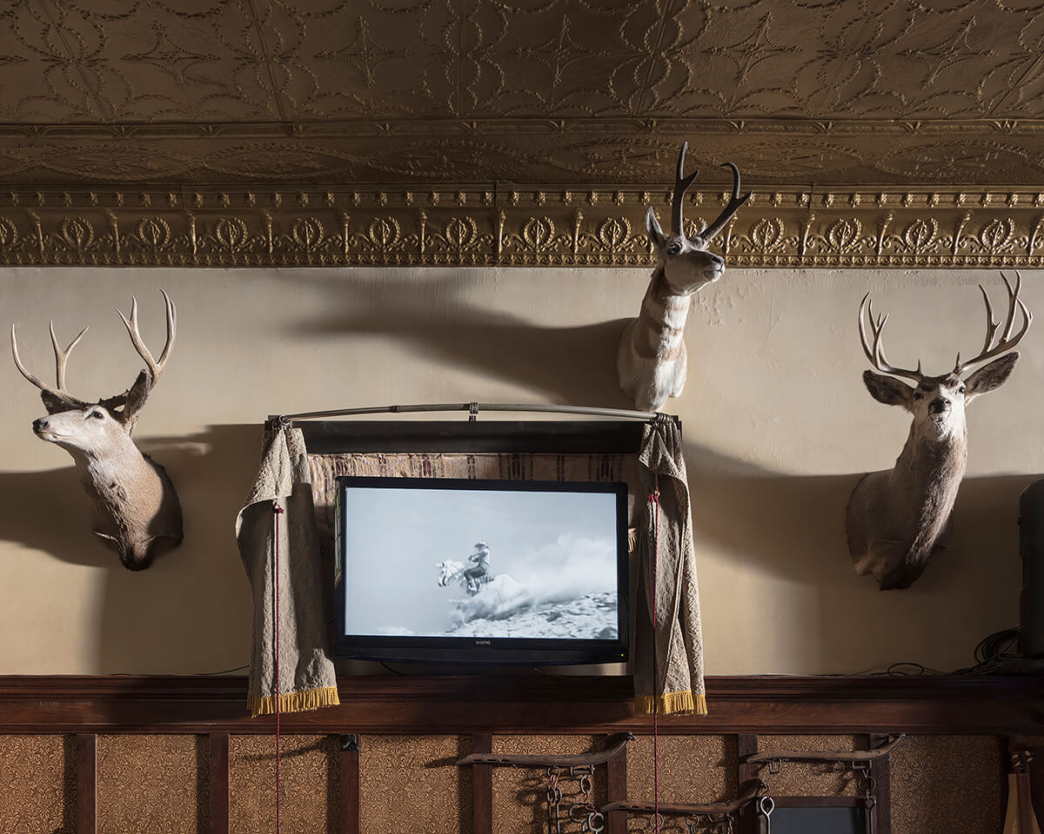
Particular Merit Mention
Untitled - Man on a White Horse, Buffalo, WY © Jennifer Garza-Cuen

Slide 20
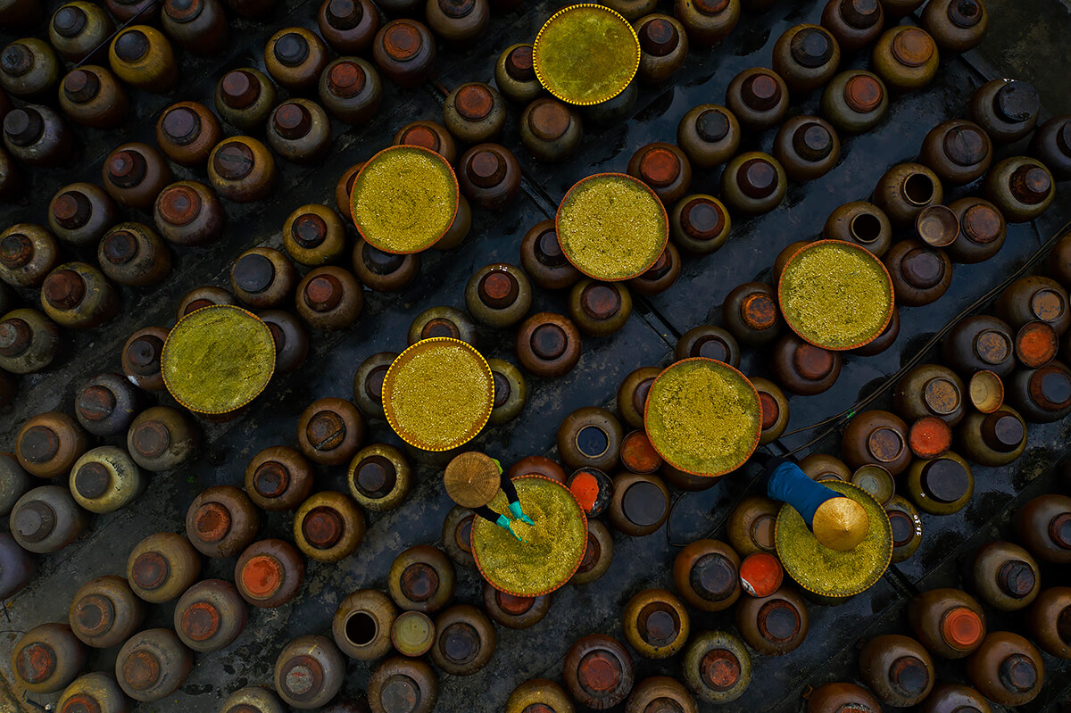
Particular Merit Mention
Making soy sauce © Azim Khan Ronnie

Slide 21
Cu Da village in Hanoi’s, Vietnam been making soy sauce since its founding more than 400 years ago. In the past, every local household stored several jars of soy sauce to use all year round. Today, soy sauce is made not only for villagers's own use, but to sell outside the village. The soy sauce is made from glutinous rice, salt, soybeans, and water. The sauce is more delicious if it is made with rain water. The rice should be ‘Nep cai hoa vang’, a special variety of sticky rice of high quality.

Slide 22
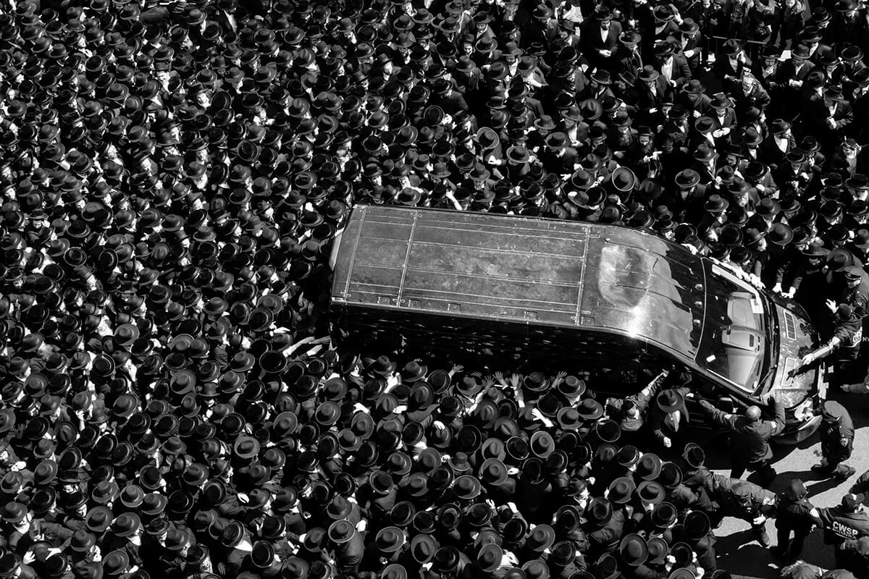
Particular Merit Mention
The Grand Procession 2 © Lori Hawkins

Slide 23
Mourners walk alongside the car carrying the casket of the Skulener Rebbe, Rabbi Yisroel Avrohom Portugal, a popular Brooklyn Rabbi who survived the Holocaust on April 2, 2019 in Borough Park, New York.

Slide 24
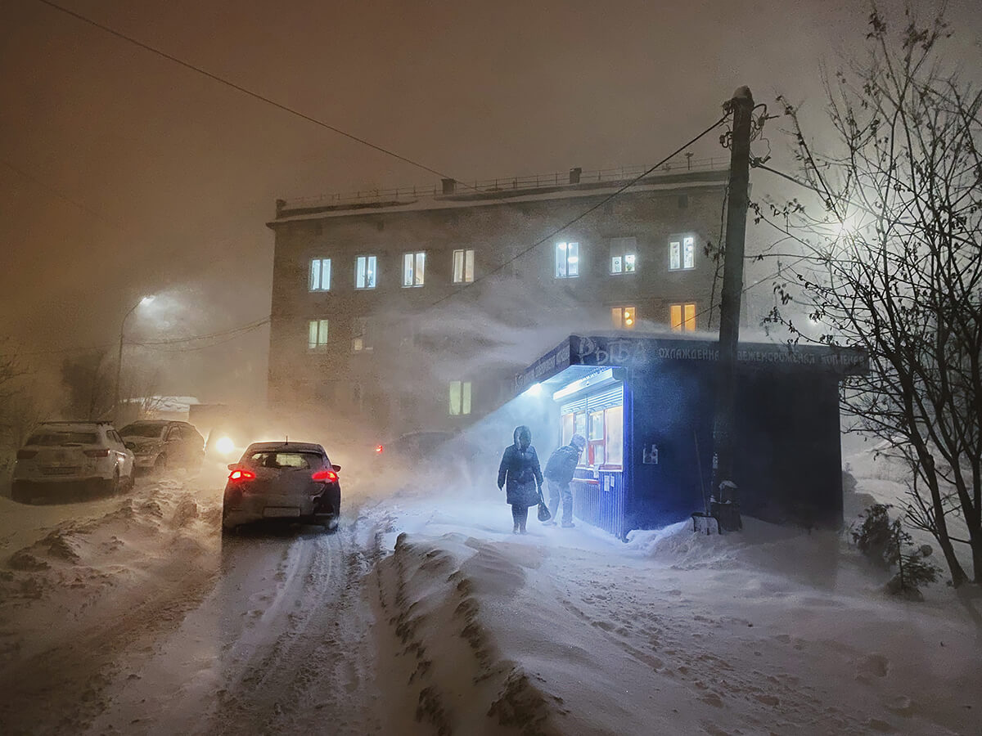
Particular Merit Mention
The Polar Night © Amos Chapple

Slide 25
It looks like the darkness of evening but this is 14:25 in the afternoon during the long polar night in Russia's arctic capital city Murmansk.

Slide 26
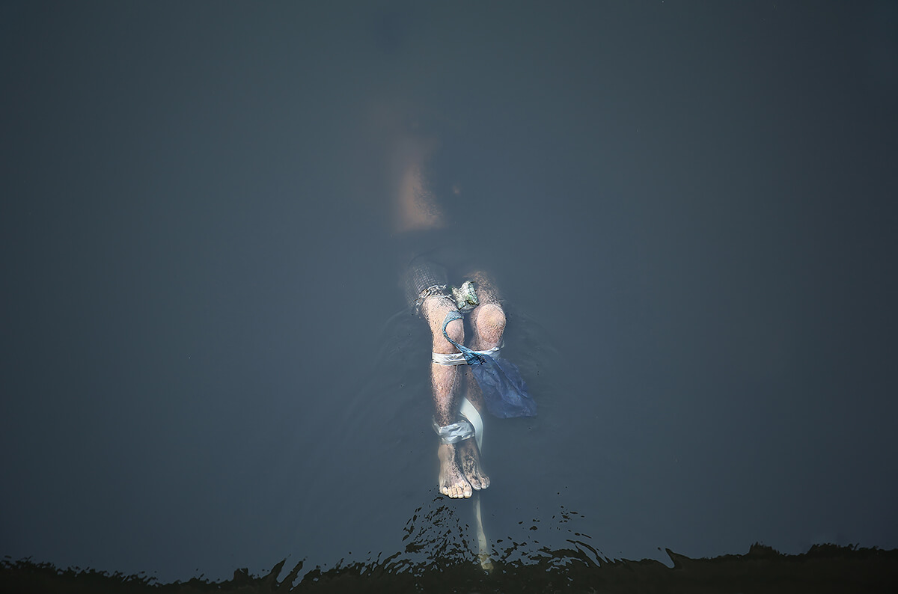
Particular Merit Mention
Buried Justice © Lynzy Billing

Slide 27
The body of Ferdinand Santos floats, Christ-like, in Manila's Pasig river —weighted down to a concrete filled pail with shackles. In 2016 President Rodrigo Duterte launched a nationwide anti-drug campaign killing thousands of poor people suspected to be linked to drugs. Today, human rights organisations estimate a death toll as high as 30,000.

Slide 28
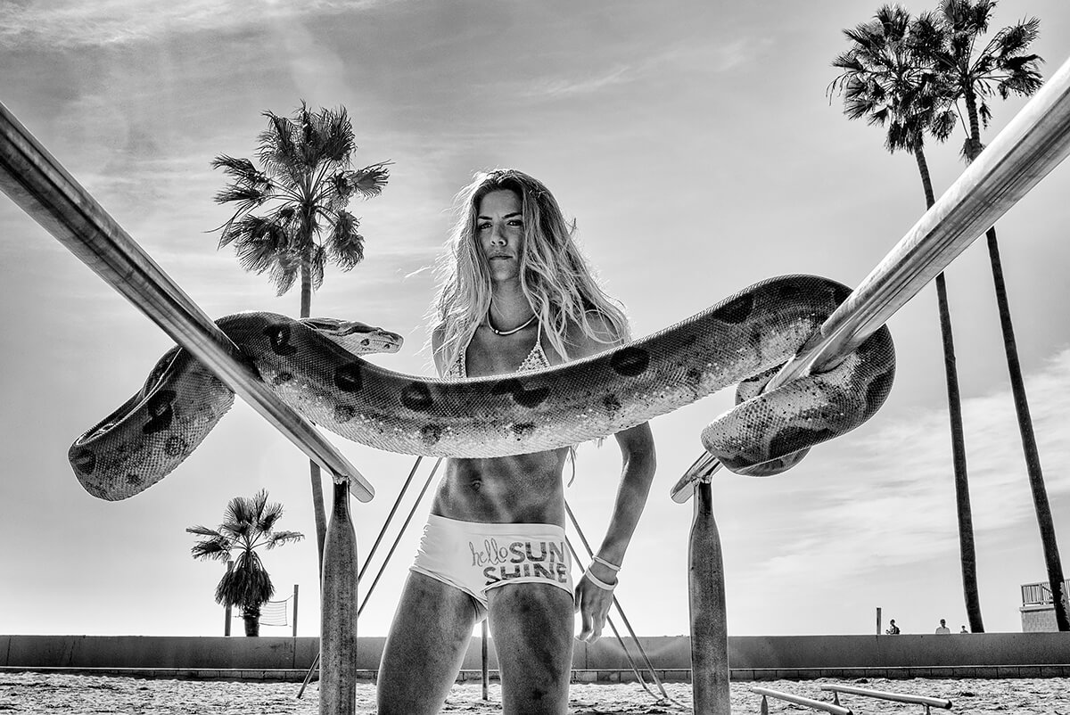
Particular Merit Mention,
Hello Sunshine © Dotan Saguy

Slide 29
Jenna carefully watches two giant boa constrictors that their owner—a street performer she barely knows—entrusted to her. She is careful to keep the snake wrapped around exercise bars to prevent a wound in the animal’s mouth from touching the sand and getting infected. Jenna is a single mom on disability. She suffers from failed back surgery syndrome, acquired from a violent car accident she had as a teenager. She and her young son Jackson can be found most afternoons on the beach.

Slide 30
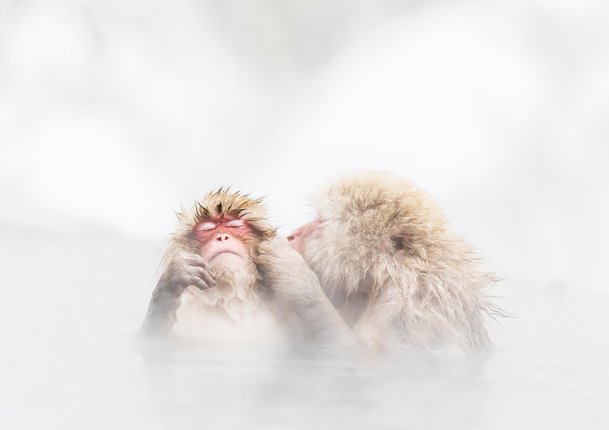
Particular Merit Mention,
A monkey entering a Japanese hot spring © Kosuke Kitajima

Slide 31
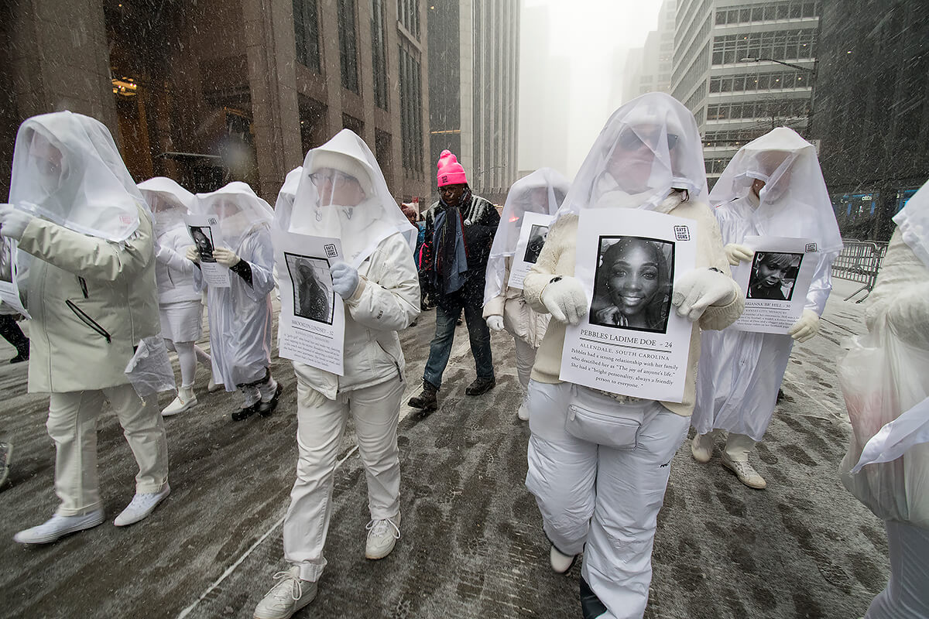
Particular Merit Mention
2020 Women's March, New York City © Margaret McCarthy

Slide 32
Memorial for women of color, victims of violence, 2020 Women's March, New York City, 1/2020

Slide 33
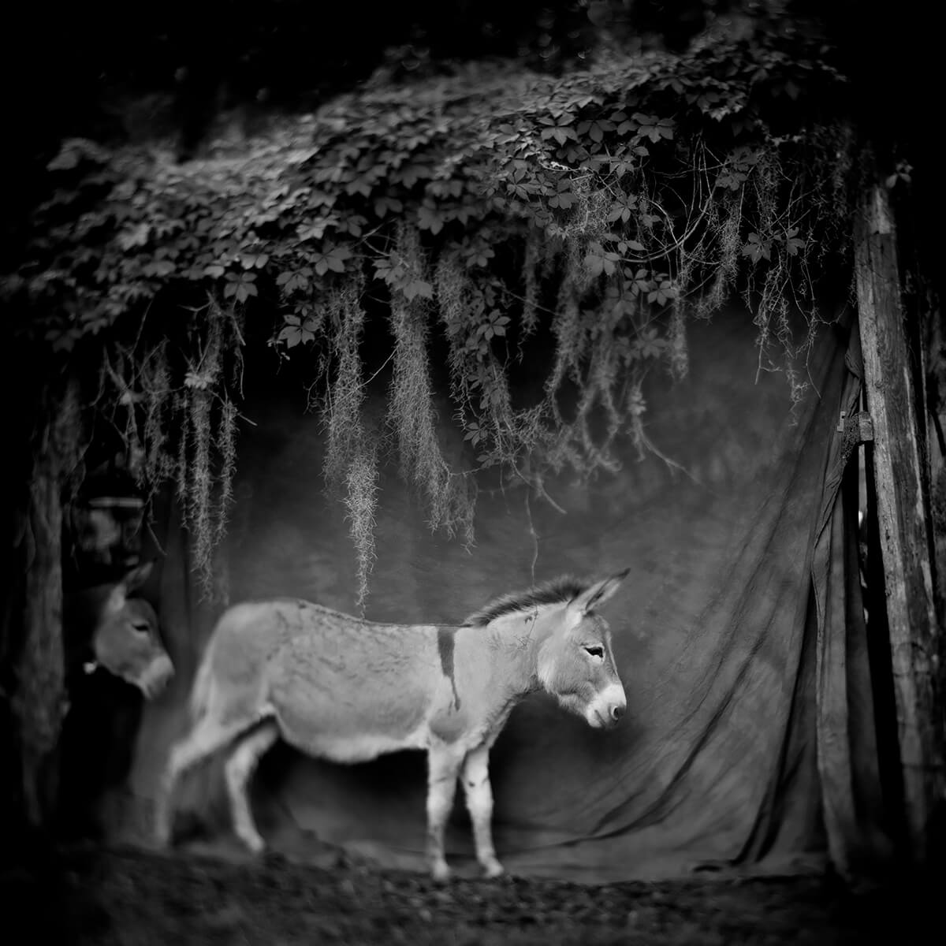
Particular Merit Mention,
Woman Donkey Parade © Anne Berry

Slide 34
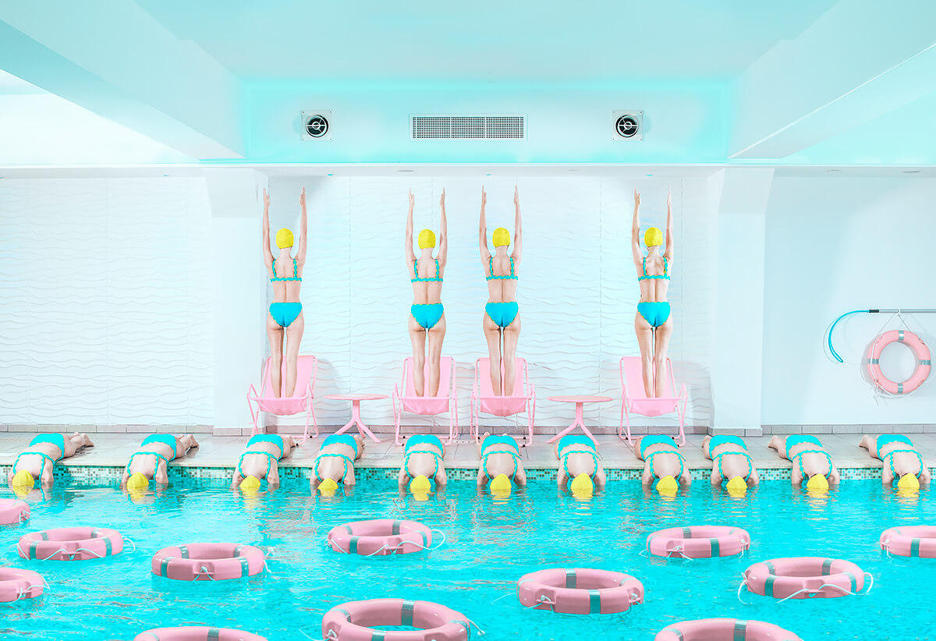
Particular Merit Mention
The Lost Swimmer © Elena Paraskeva

Slide 35
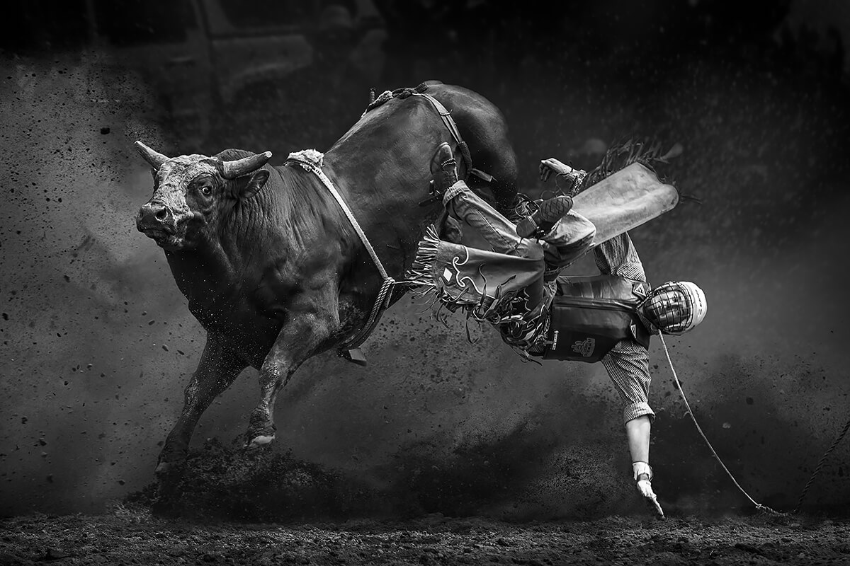
Particular Merit Mention
Break away © Tony Law

Slide 36

Particular Merit Mention
Windows Of Our Soul © Hardijanto Budiman

Slide 37
Let there be many windows to your Soul That all the glory of the world may beautify it! I love anything related to Surreal World and This picture represented my actualization about Surreal Art in Photography.

Slide 38
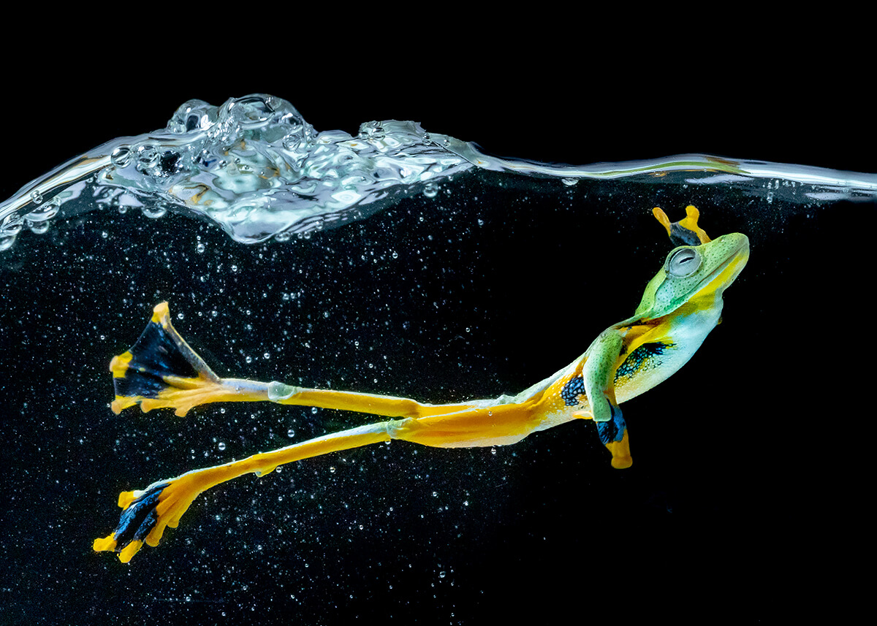
Particular Merit Mention
The Wallace’s Flying Frog © Chin Leong Teo

Slide 39
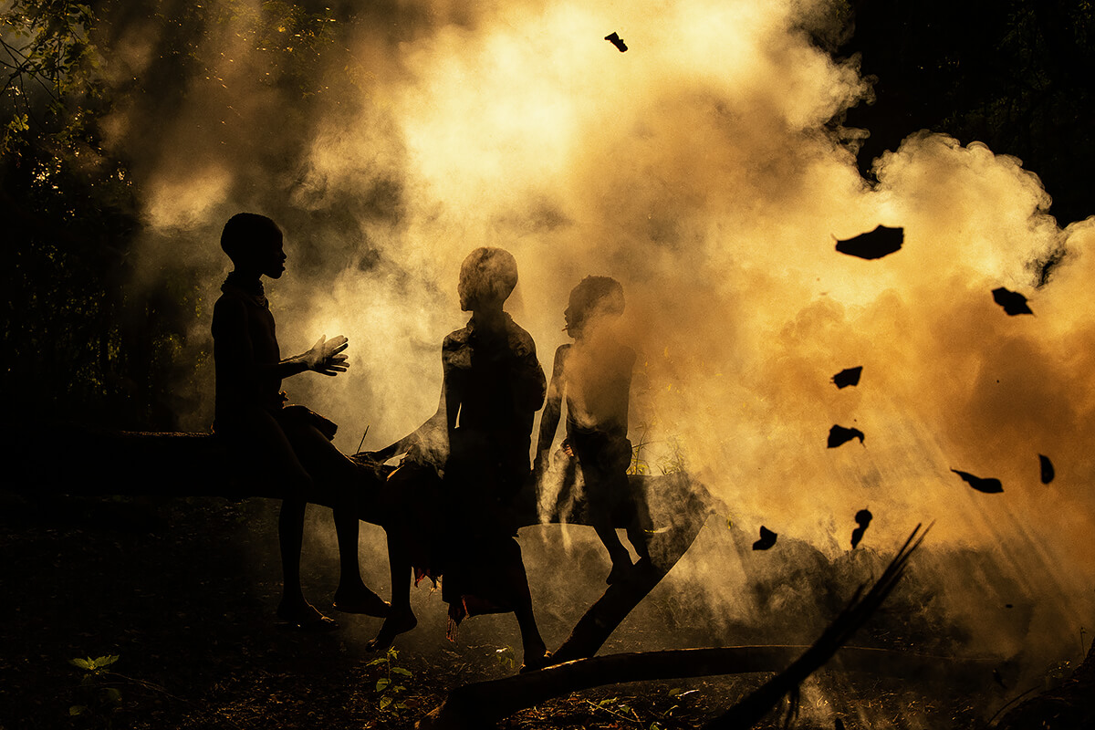
Particular Merit Mention
The Story Teller © Donell Gumiran

Slide 40
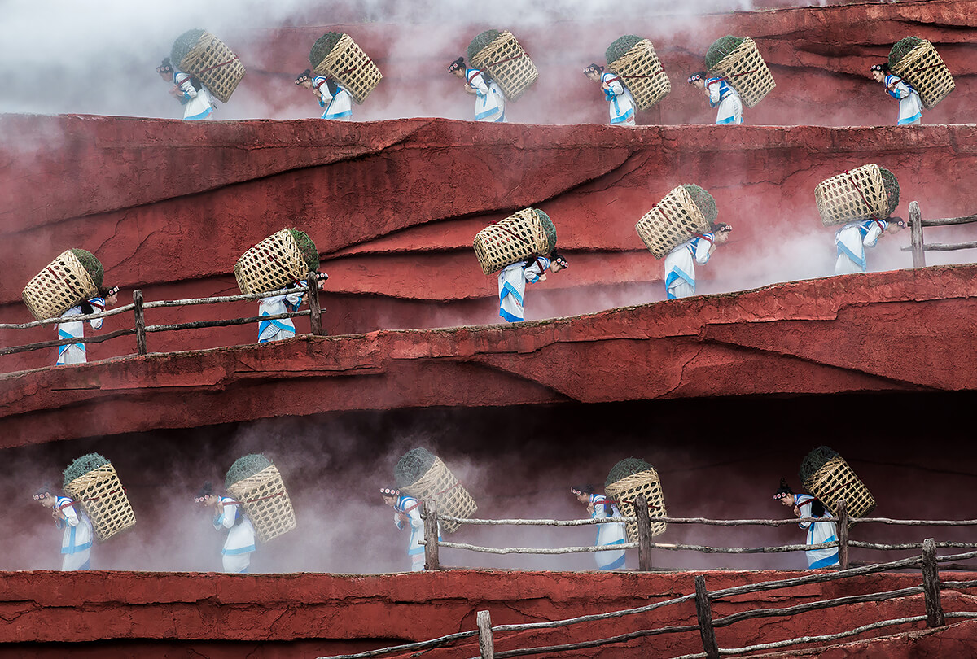
Particular Merit Mention
Step by Step © Mustafa AbdulHadi

Slide 41
Impression Lijiang is a cultural show which demonstrating the traditions and lifestyle of local Naxi, Yi and Bai ethnics of the area. It is the second outdoor production of famous film director, Zhang Yimou which debuts an open-air performance at the foot of Yulong Xueshan (Jade Dragon Snow Mountain) about 3500 metes above sea level. The performance stage is specially designed to showcase the mountain as the best backdrop of the show. More than 500 local people from ten ethnic groups

Slide 42
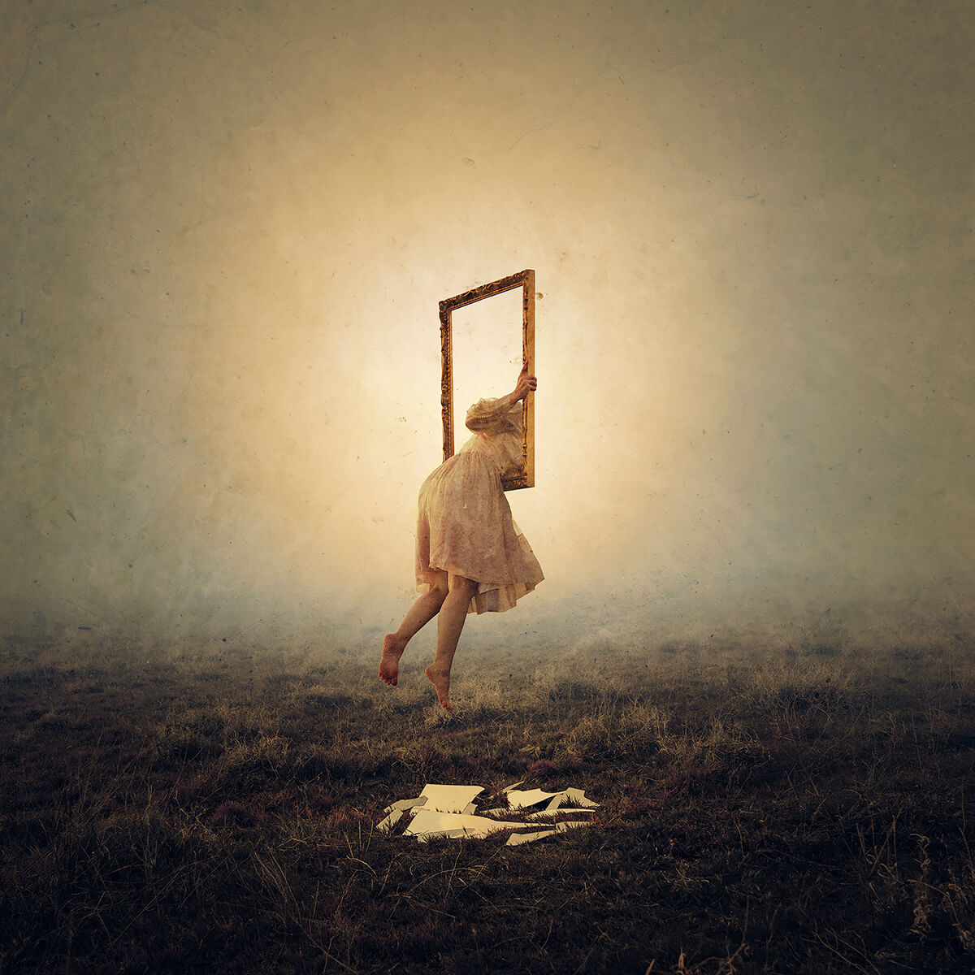
Particular Merit Mention
Reflection: Departed © Brooke Shaden

Slide 43
The frame is a symbol for our frame of reference, the way we frame ourselves, and inaccuracy of depiction. Here she climbs through the frame only to disappear through the other side.

Slide 44
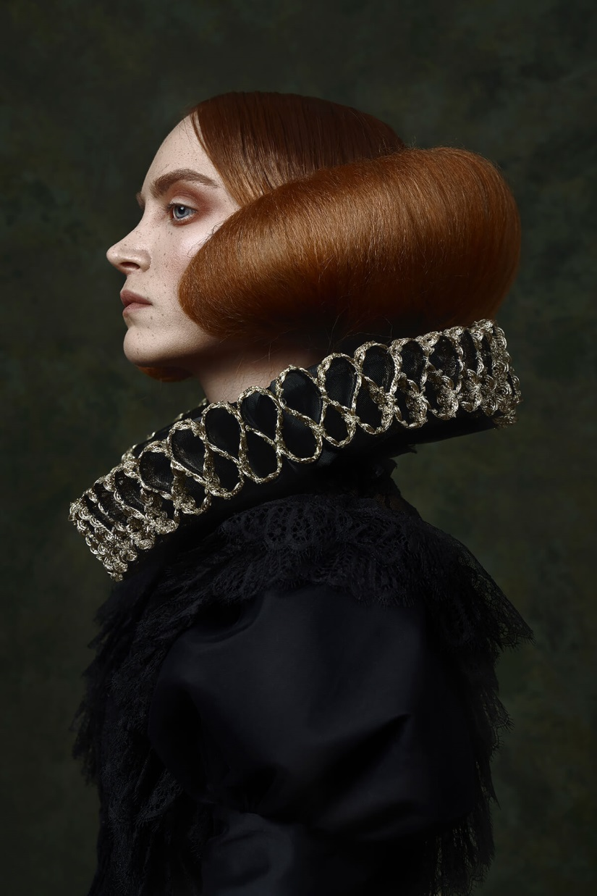
Particular Merit Mention
Portrait of Lorca © Peyman Naderi

Slide 45
It is the story of a girl who lived through a period of history but was never seen, and though she was a very artistic, she always hid herself from others until one day her identity was revealed. She was still trying to keep his identity a secret until she was satisfied to register herself in history. This girl's name is Lorca, and I have been trying to portray her face with the story she has in my mind so that the whole world can touch her feelings.

Slide 46
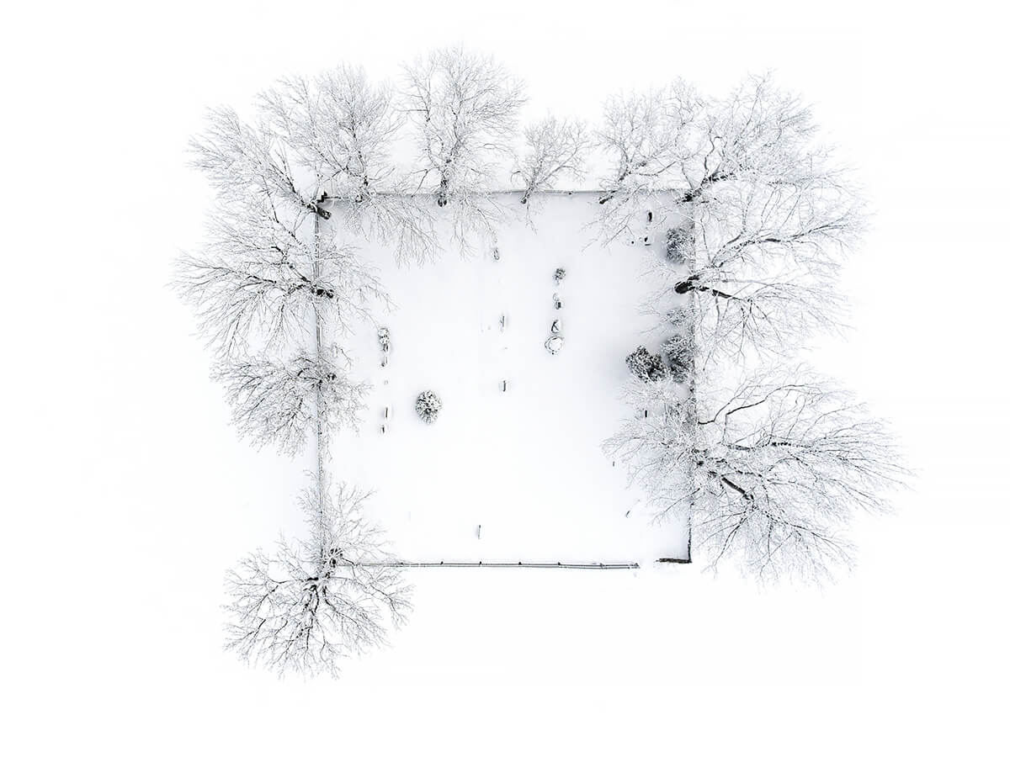
Particular Merit Mention
Untitled - Cemetery © Tomas Neuwirth
Small cemetery in winter outside of a village named Rejvíz in Jeseníky Mountains, Czech Republic.

Slide 47
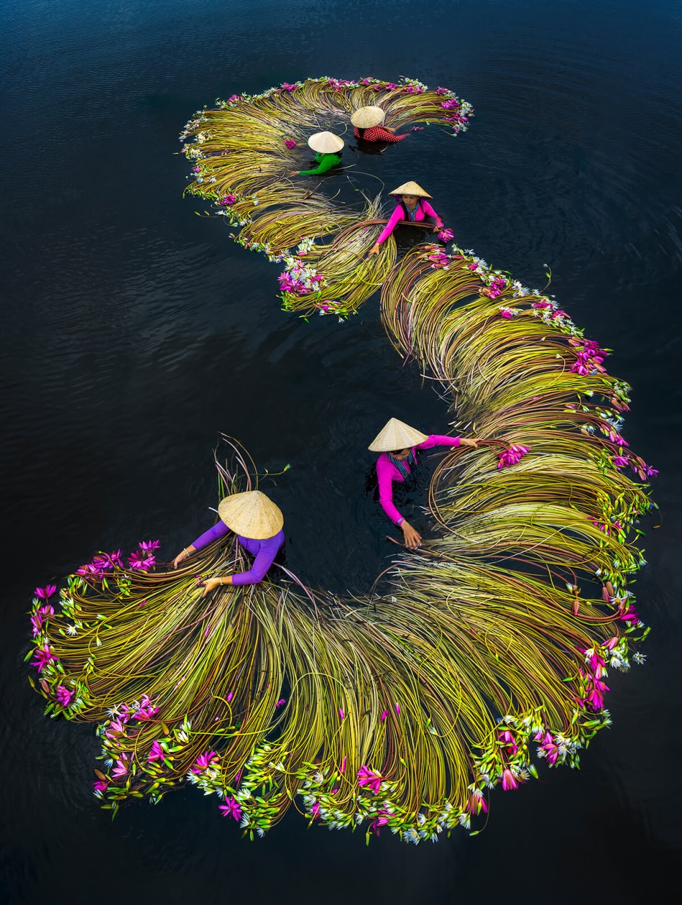
Particular Merit Mention
Waterlilies harvesting © Trung Pham Huy
Farmers are washing waterlilies and packing before sending off to market in Mekong delta, Vietnam, in flood season.

Slide 48
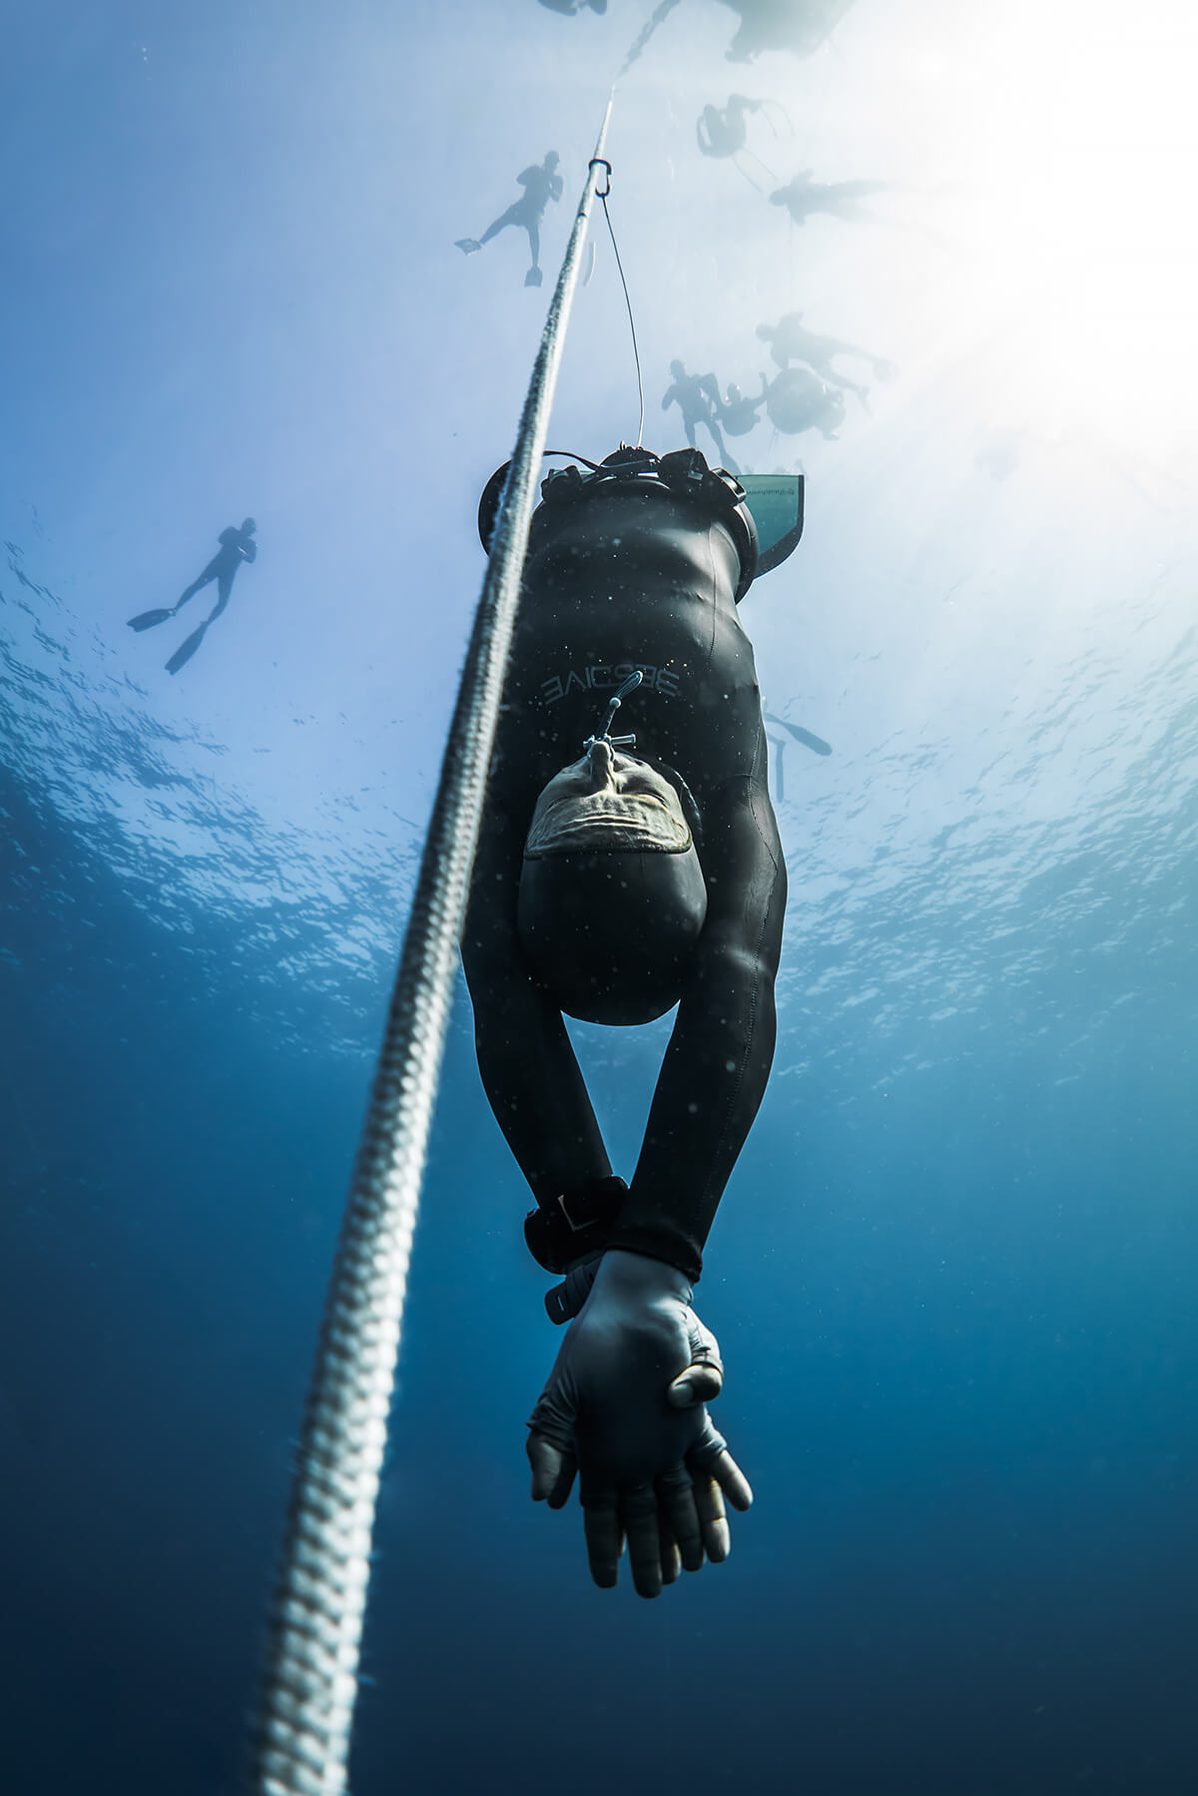
Particular Merit Mention
The Now © Kohei Ueno

Slide 49
They say 90% of freediving is mental. The brain consumes a lot of oxygen in the body especially when processing visuals. Diving without masks helps a freediver not having to waste air to equalise their masks, but also as a way to remove any visual distractions that may deter him from the present. Here is a South African freediver diving to depth of 64m for the National Record, taken at the AAS Freediving Depth Championships in 2019.

Slide 50
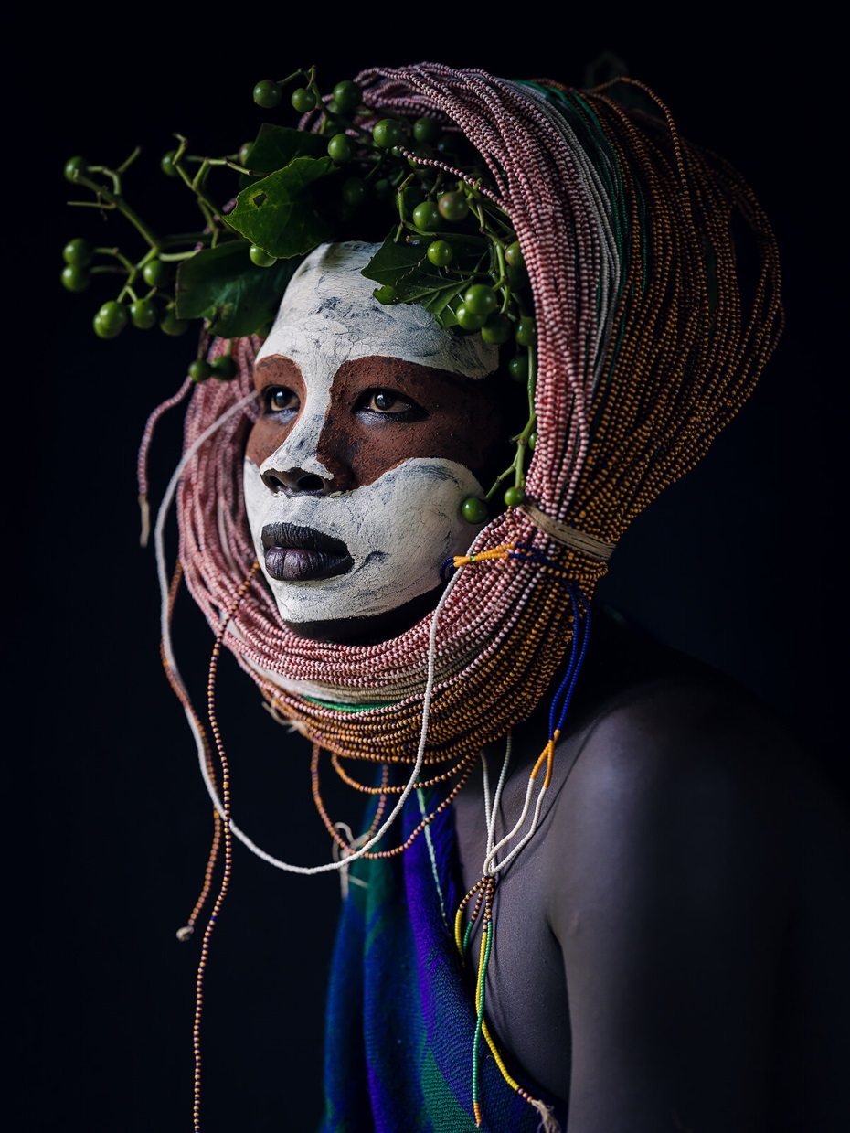
Particular Merit Mention
© Yoni Blau

Slide 51
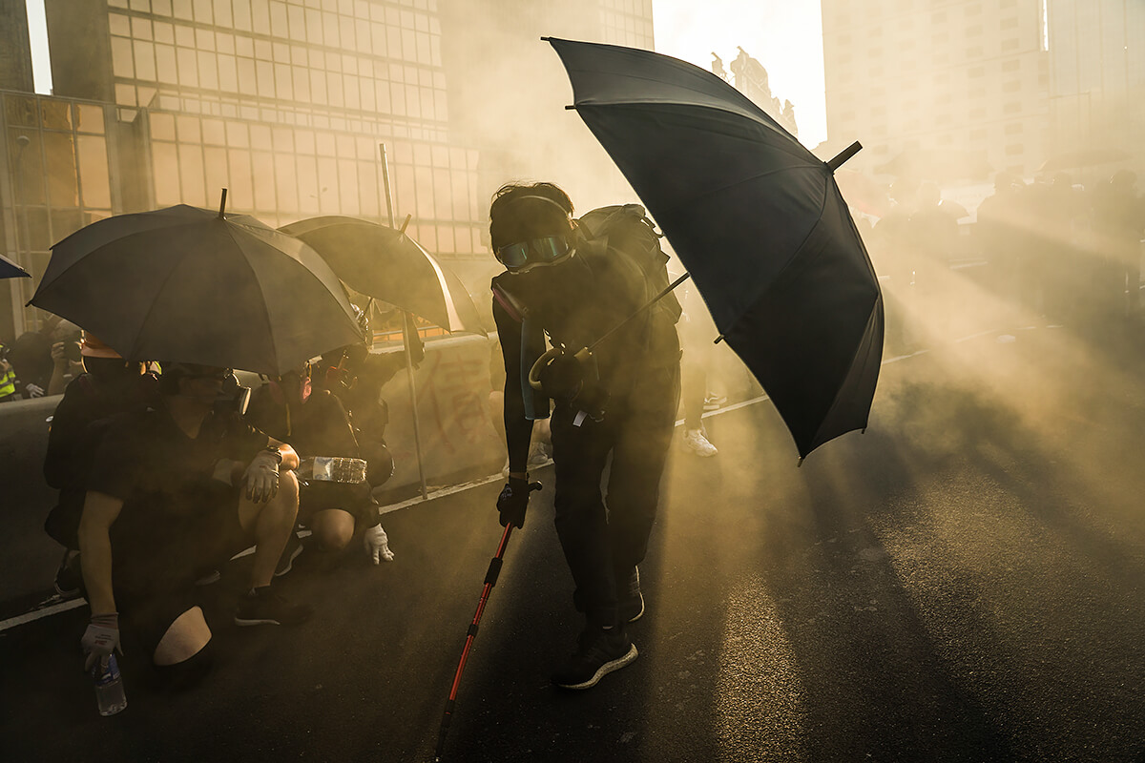
Particular Merit Mention
In the fog of teargas © Go Nakamura

Slide 52
Anti-government protesters are seen in in the fog of teargas which was deployed by riot police force during confrontation outside of Central Government Complex in Central District of Hong Kong on September 15, 2019 Protesters use umbrella, gas mask, and goggles to protect them self from tear gas and water canon.

Slide 53
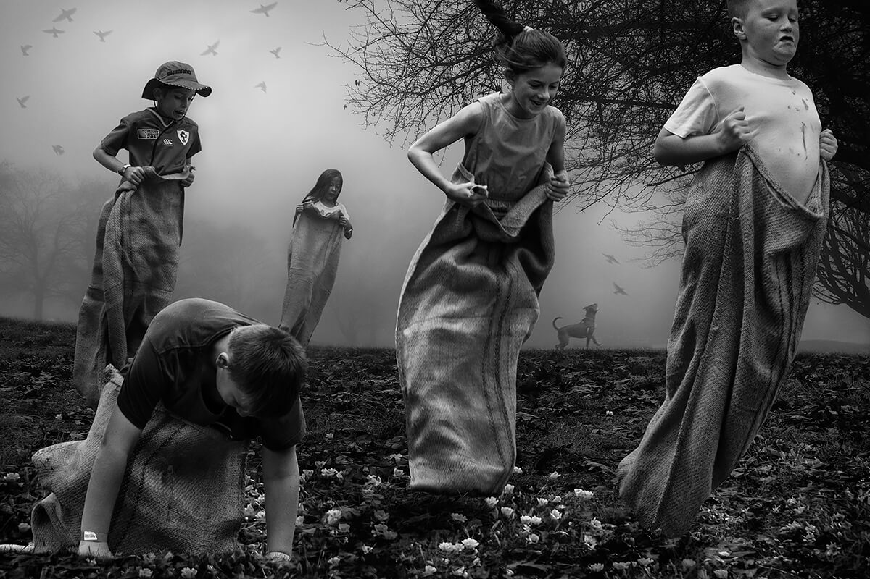
Particular Merit Mention
The Sack Race 1 © Francisco Diaz & Deb Young

Slide 54
From the series - The Playground Series - wherein the mystery of children at play is explored.

Slide 55
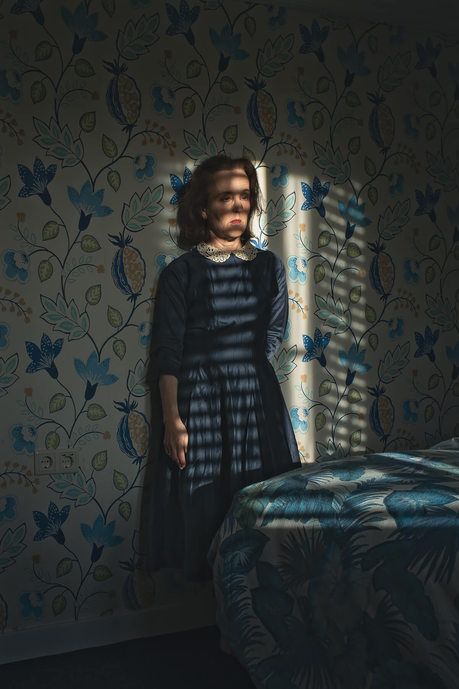
Particular Merit Mention
© Jo Ann Chaus

Slide 56
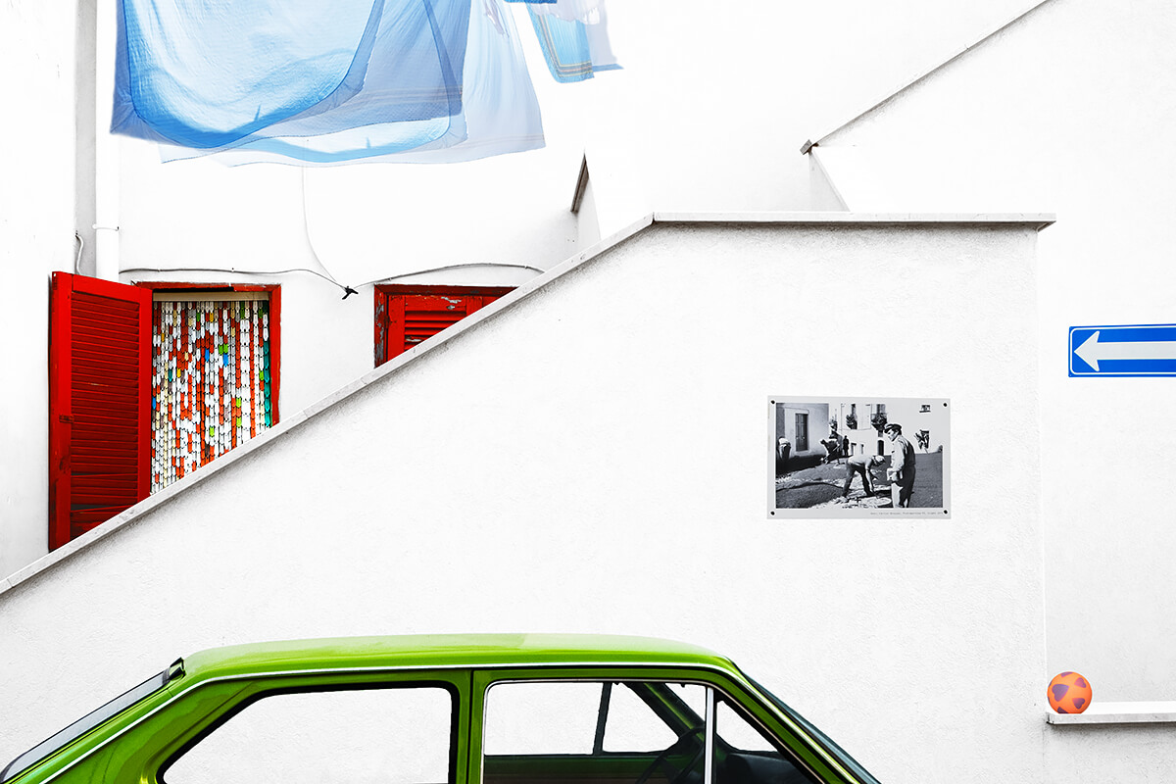
Particular Merit Mention
Beyond the wall © Francesco Pace Rizzi

Slide 57
This photo is intended as a small tribute to a great Master: Henri Cartier Bresson, the one who first knew how to show me the reality of ever with new eyes: more human, artistic, poetic. His photos taken between the 1950s and 1970s in Basilicata (my homeland) and around the world have changed the perspective of things in me, creating a fantastic "imprinting" and becoming a source of great inspiration.

Slide 58
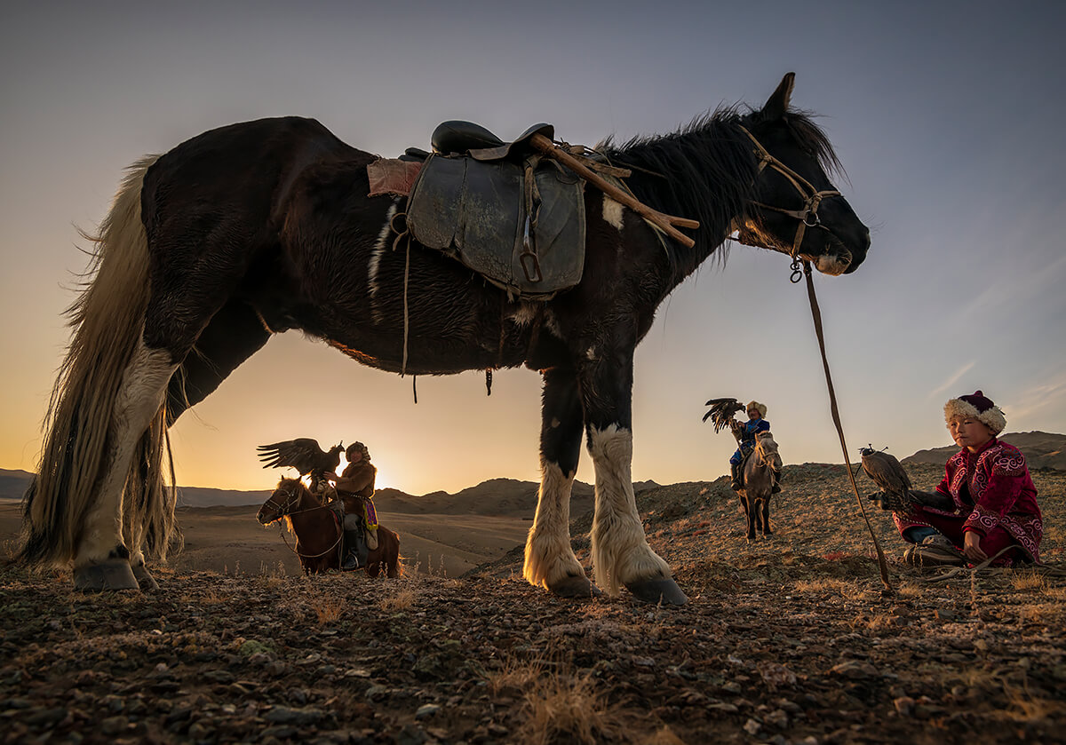
Particular Merit Mention
Inheritor of Eagle Hunting © Zay Yar Lin

Slide 59
Elders training the kid for hunting with eagles at a hill nearby Bayan Olgii. There are an estimated 250 eagle hunters in Bayan-Olgii, which is located in the Altai Mountains of western Mongolian. They maintained ancient practice of hunting with golden eagles on horseback, and they primarily hunt red foxes and corsac foxes.

Slide 60
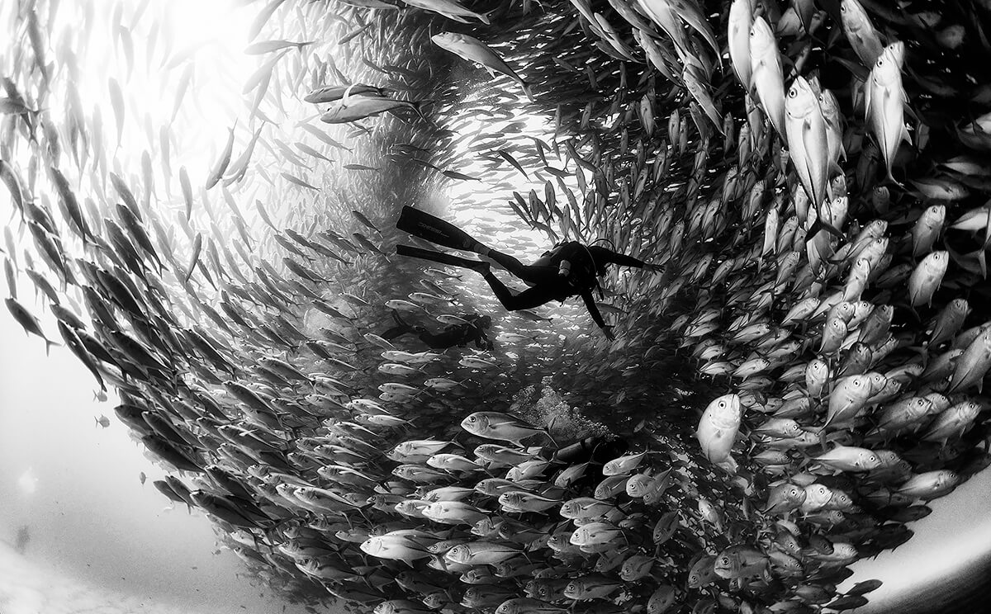
Particular Merit Mention
Eye sea © Anuar Patjane
A school of Bigeye trevaly and divers at Cabo Pulmo National Park, Mexico.

Slide 61
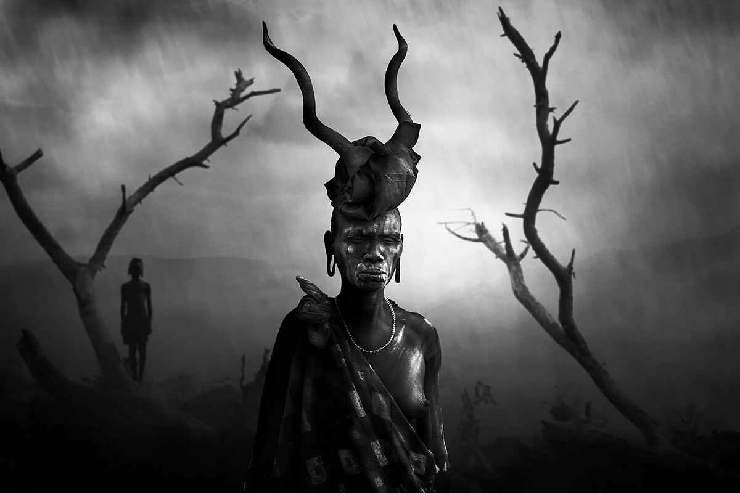
Particular Merit Mention
Woman Mursi © Svetlin Yosifov

Slide 62
The Mursi tribe are an African tribe from the isolated Omo valley in Southern Ethiopia near the border with Sudan. The photo is part of the album "Ethiopian tribes expedition" 2018

Slide 63
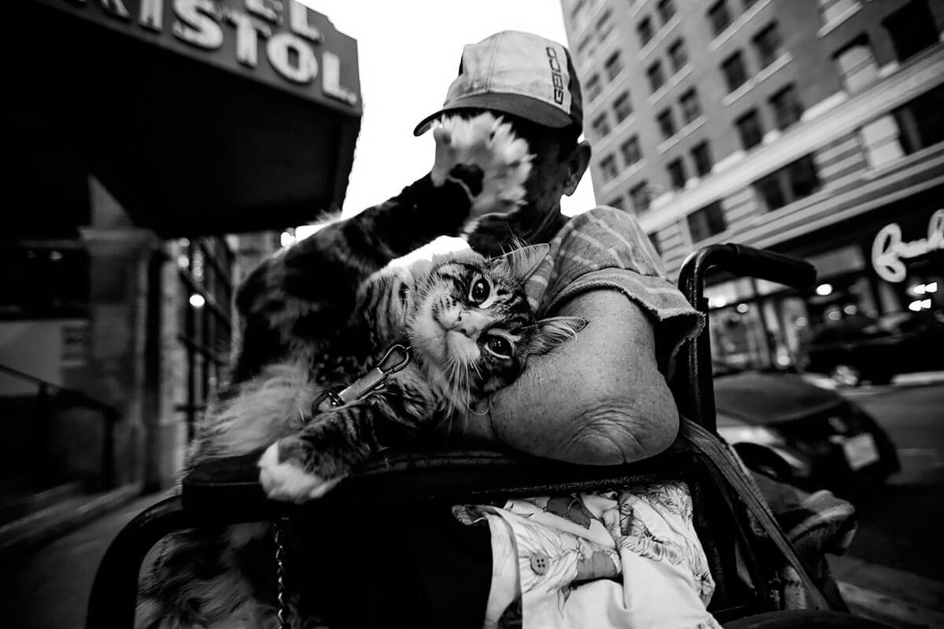
Particular Merit Mention
Perfect Binding © Andre Fonseca

Slide 64
A women and her cat wonder through the streets of Los Angeles, I placed myself below so that I can get a photo of the cat, when I did this, the cat did something of a blink of a eye. The cat put his paw up showing off its claws and the way I was positioned made it seem as the cat was covering its owners face. I've created this image to show the unique relationship between the women and the cat.

Slide 65
April 13, 2020 王文堯 Kaohsiung Taiwan R.O.C
All photos were taken from All-About-Photo..
Sound: Justin Timberlake - Mirrors
Particular Merit Mention
Happy Dancer © Xiangli Zhang
THE END

