Slide 1
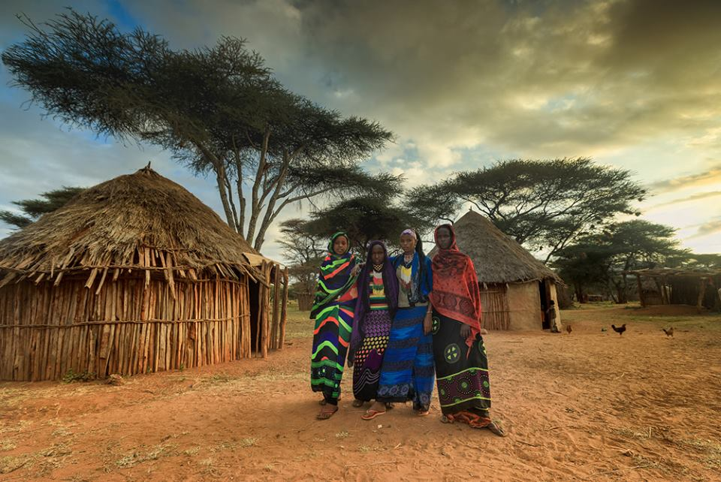


Slide 2
Africa Geographic Photographer of the Year 2018

Slide 3
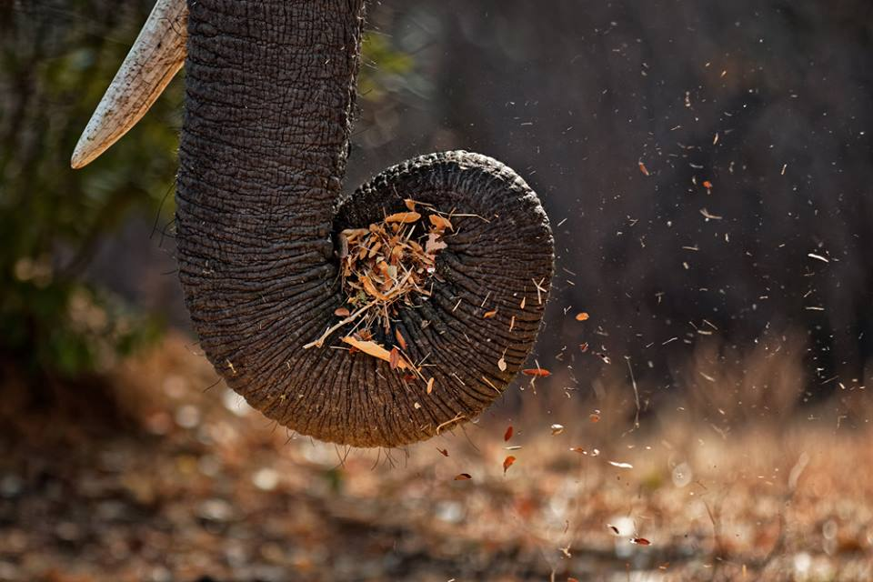
An elephant's trunk in Mana Pools National Park, Zimbabwe © Giovanni Frescura

Slide 4
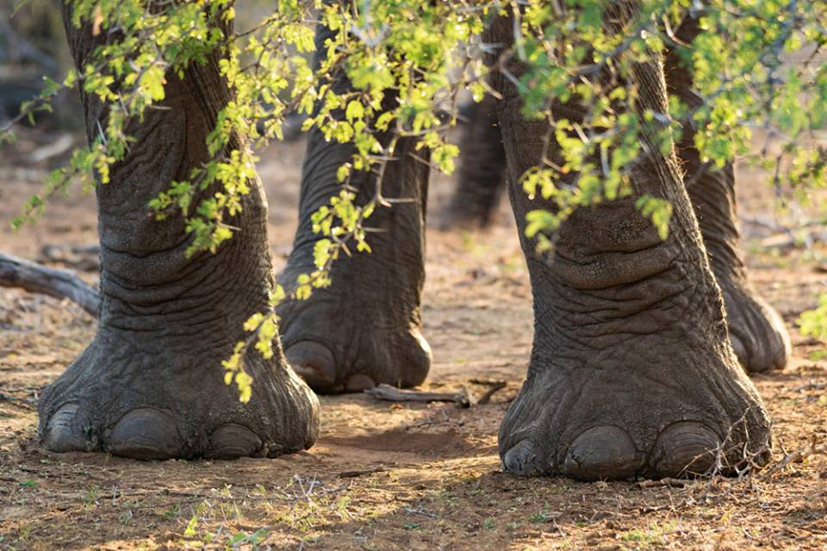
Elephant feet in Kruger National Park, South Africa © Tessa Barlin

Slide 5
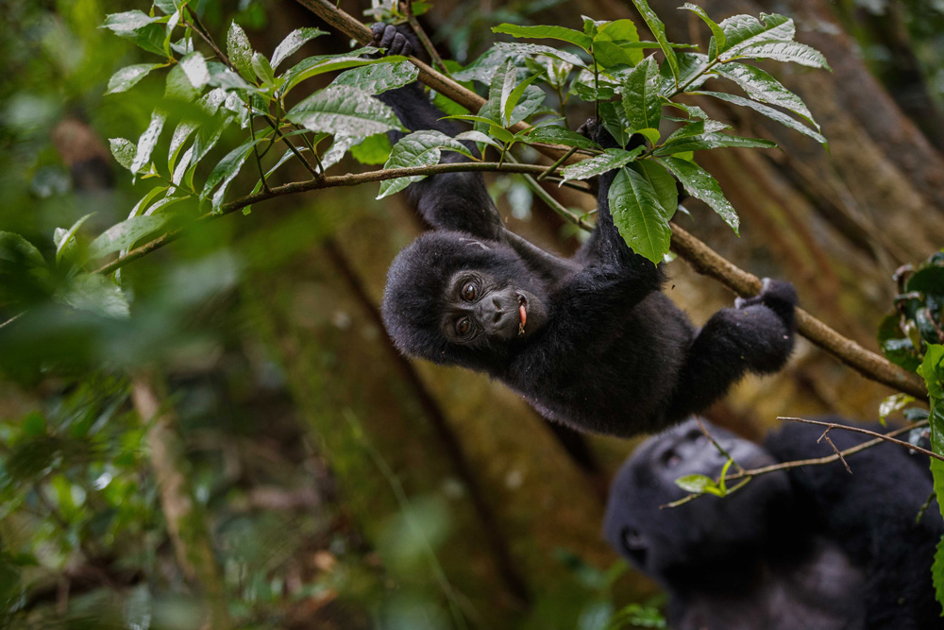
A young mountain gorilla hangs around in Bwindi Impenetrable National Park, Uganda © Thorsten Hanewald

Slide 6
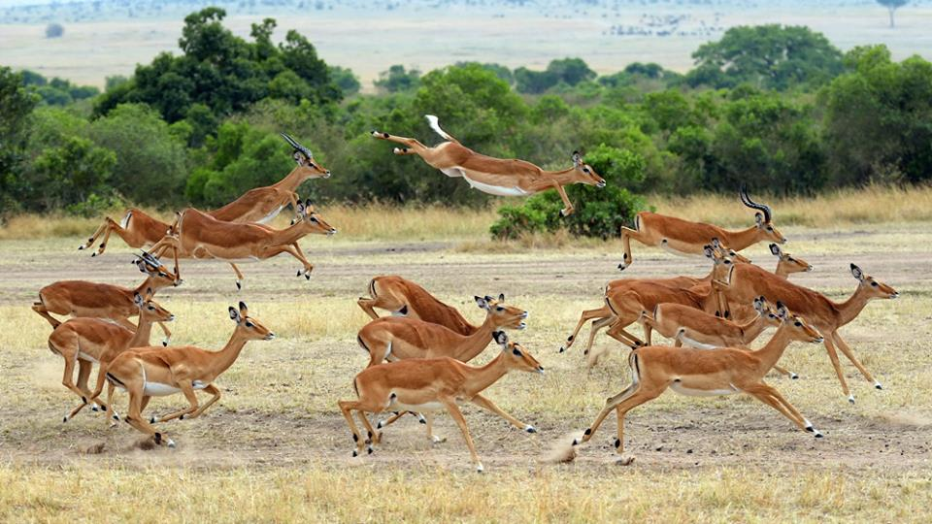
Impala on the run in Maasai Mara National Reserve, Kenya © David Hartmann

Slide 7
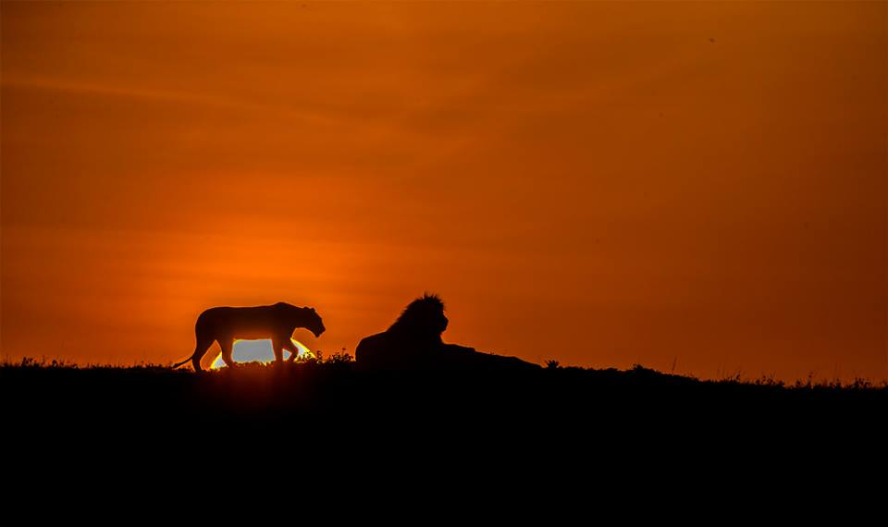
'Lion sunrise' in Maasai Mara National Reserve, Kenya © Chandrashekar Kalyanasundaram

Slide 8
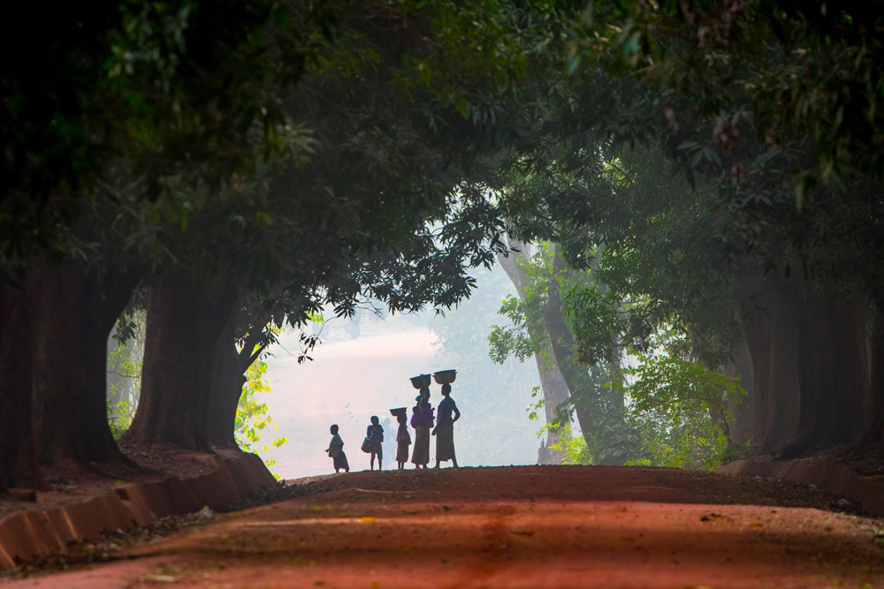
Early morning chores in a mango plantation, near Moundou, Chad © Inger Vandyke

Slide 9
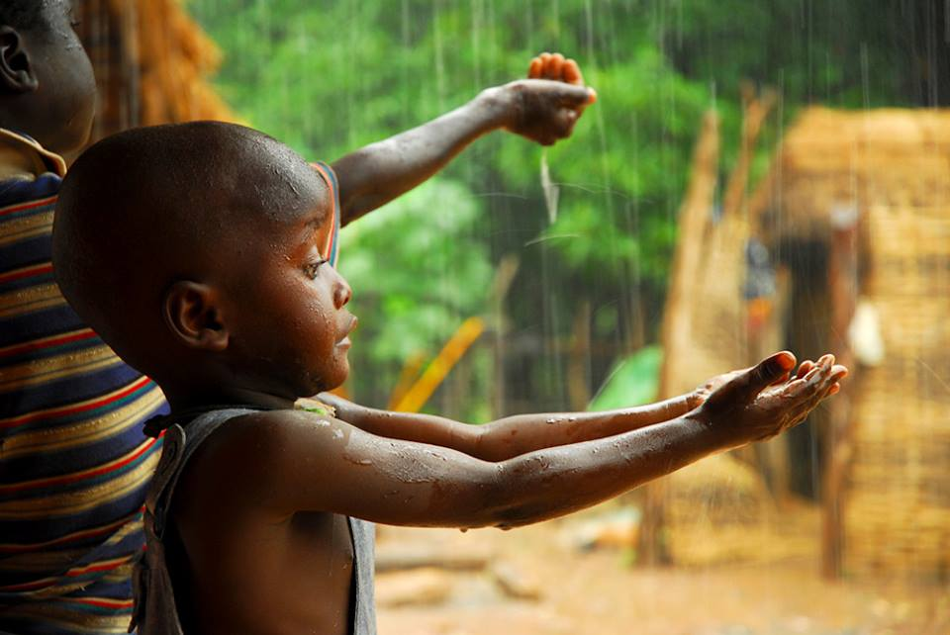
'Rain' - a Bassari tribe child catches the long-awaited rain at the harvest season in eastern Senegal © Enrique Lopez-Tapia

Slide 10
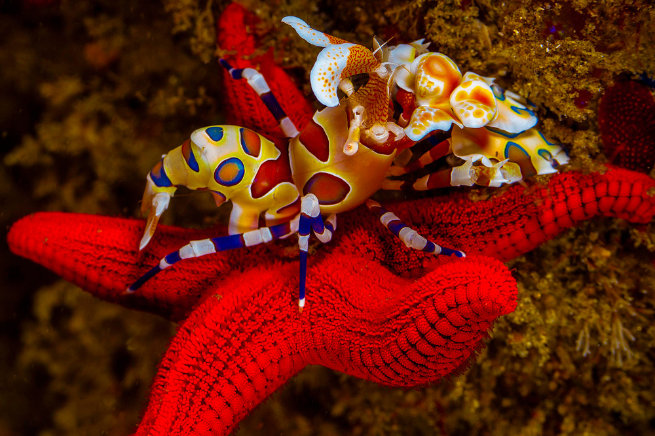
'The hunter and the hunted' – a harlequin shrimp feeds off a sea star in Rocktail Bay, iSimangaliso Marine Park, South Africa © Peet J. van Eeden

Slide 11
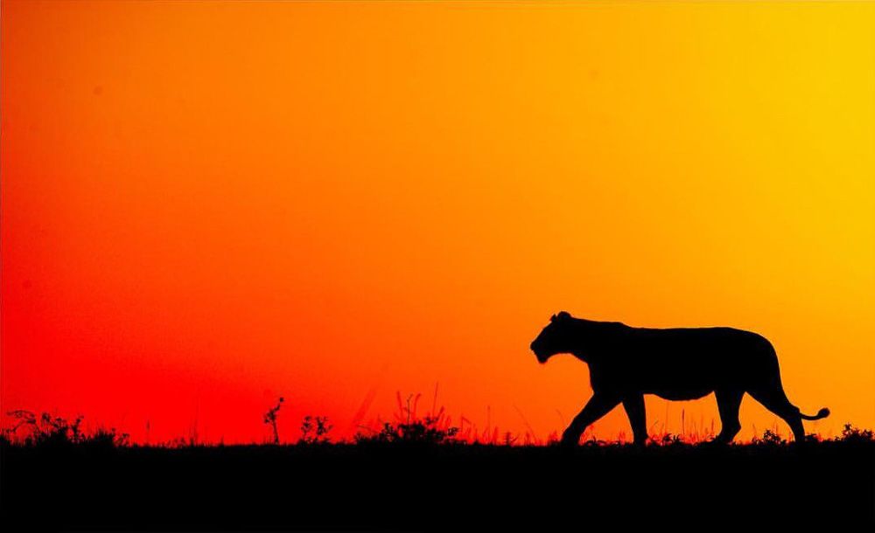
A lion at sunrise in Maasai Mara National Reserve, Kenya © Andrew Campbell

Slide 12
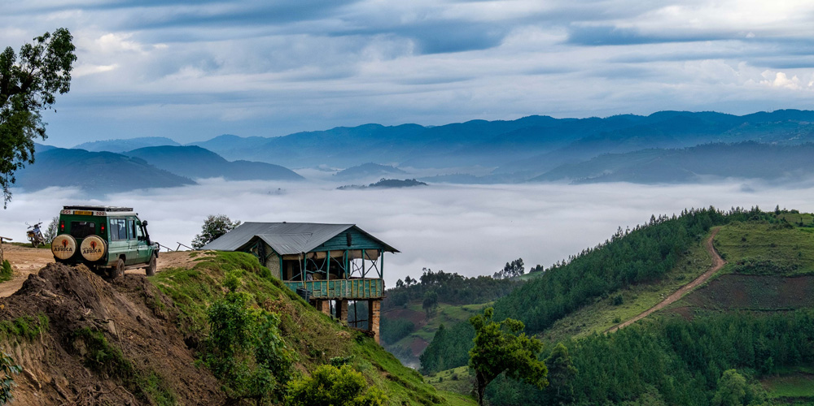
'Rainforest in the mist' in Bwindi Impenetrable National Park, Uganda © Thorsten Hanewald

Slide 13
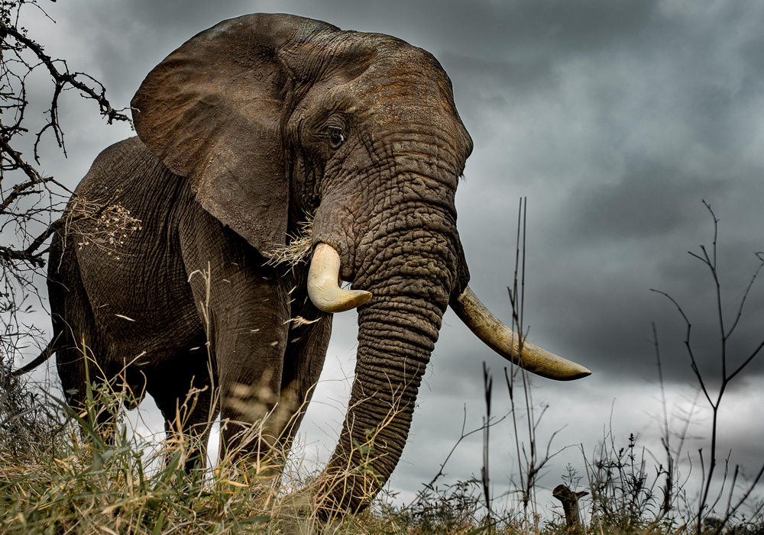
'Before the storm' – a lone bull elephant in Kruger National Park, South Africa © Annemarie du Plessis

Slide 14
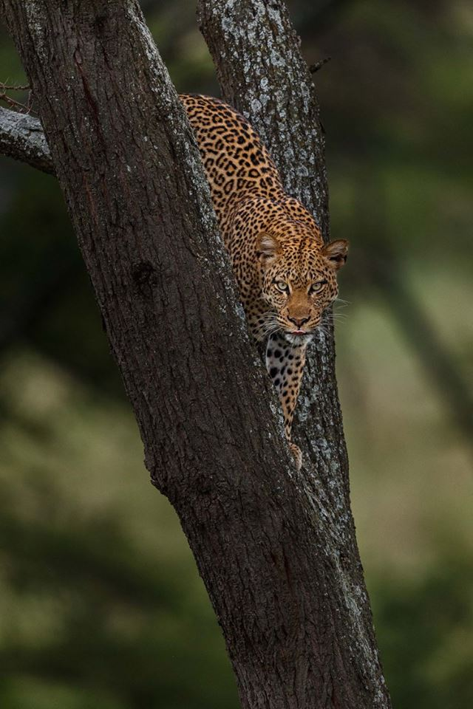
'Looking for you' in Queen Elizabeth National Park, Uganda © Thorsten Hanewald

Slide 15
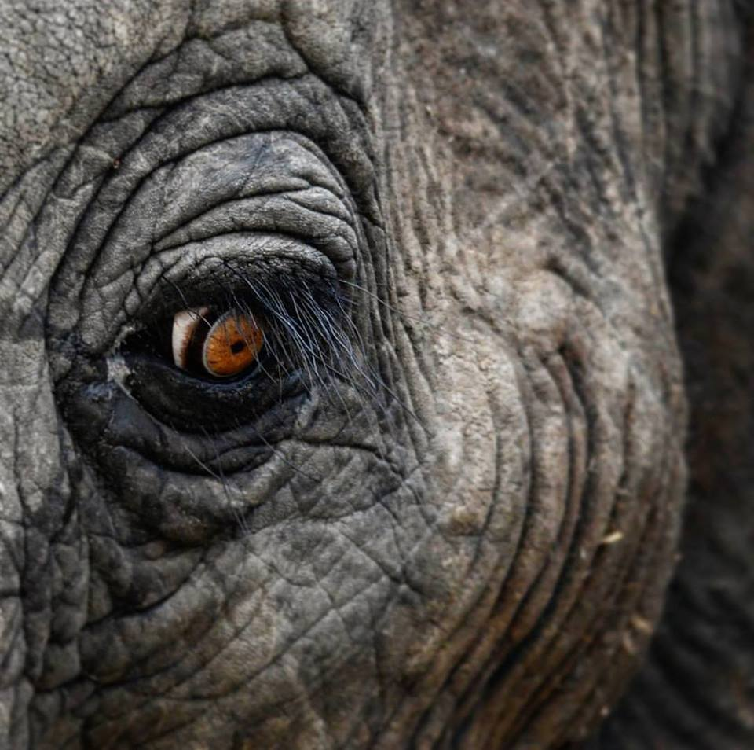
An elephant's eye in Kruger National Park, South Africa © Ryno Vosloo

Slide 16
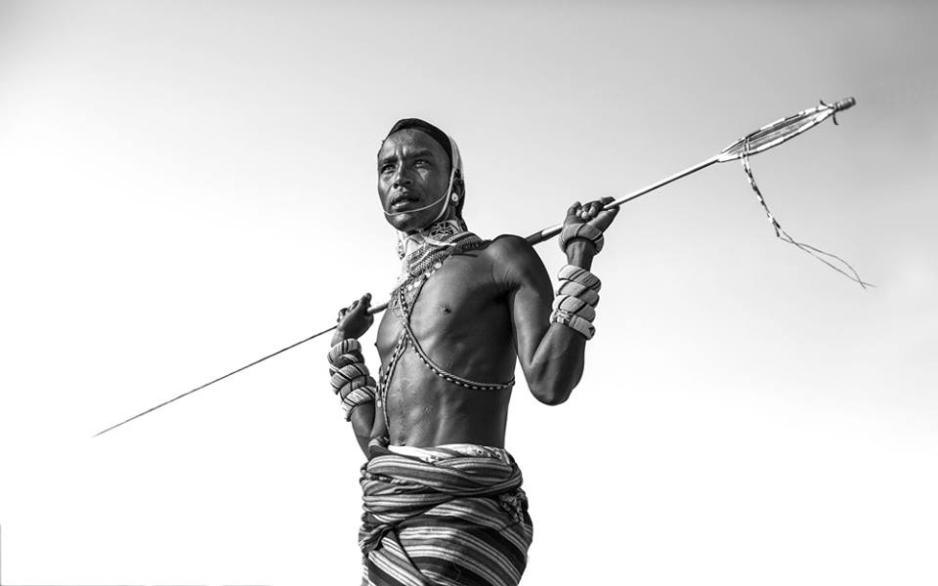
'Warrior' in northern Kenya © Natalia Mroz

Slide 17
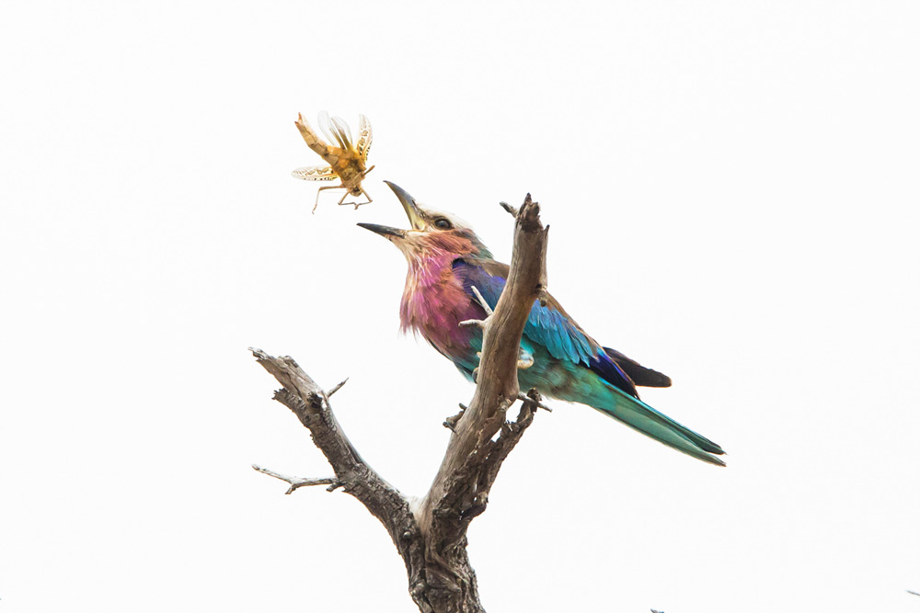
A lilac-breasted roller catching grasshopper, Selous Game Reserve, Tanzania © Sepp Friedhuber

Slide 18
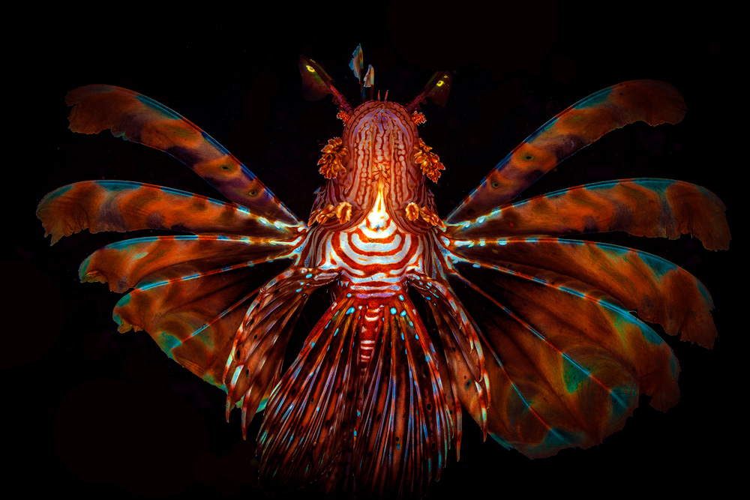
'The winged soldier' – a devil firefish in northern Zanzibar © Peet J. van Eeden

Slide 19
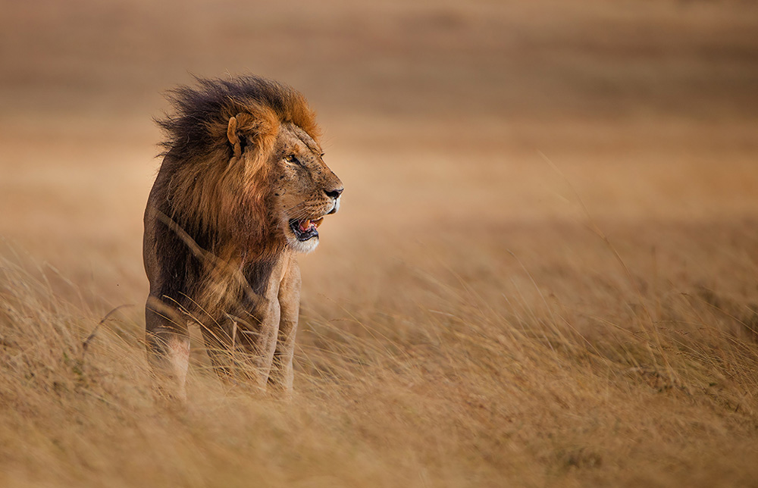
'Lion King' in Olare Motorogi Conservancy, Maasai Mara National Reserve, Kenya © Andy Howe

Slide 20
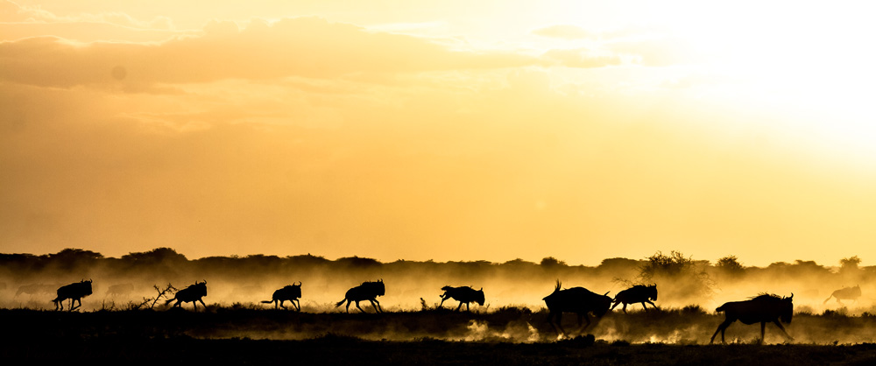
African wild dogs hunting the wildebeests as the sun sets, Maswa Game Reserve, Tanzania © Vianney Jacob Kabwine

Slide 21
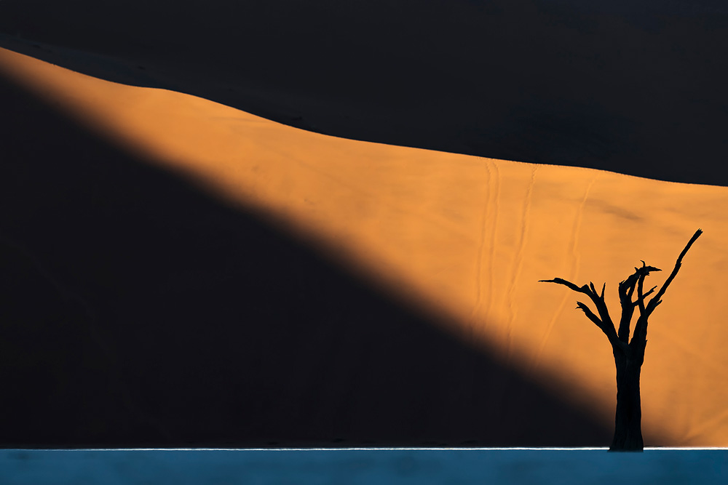
'The Dead Silence' – The sunrise lights up the dunes in the background, Deadvlei, Namibia © Shishir Kumar Jain

Slide 22
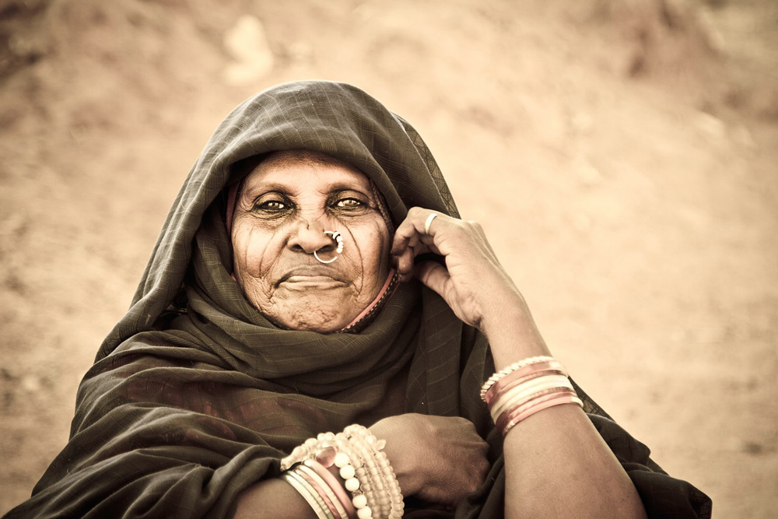
A nomad woman in Kassala, Sudan © Rene Bauer

Slide 23
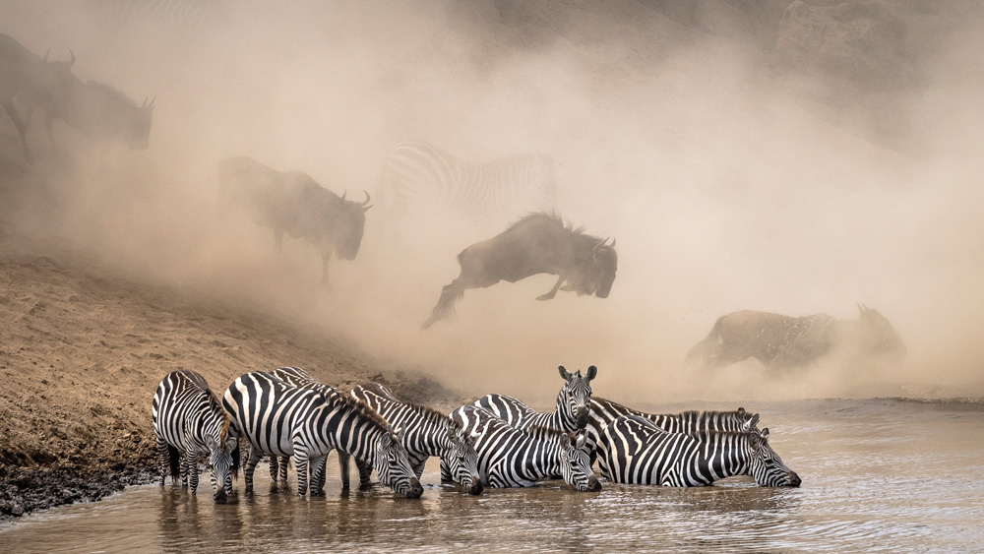
'Chaos and calm' in Mara Triangle, Maasai Mara National Reserve, Kenya © Ketan Khambhatta

Slide 24
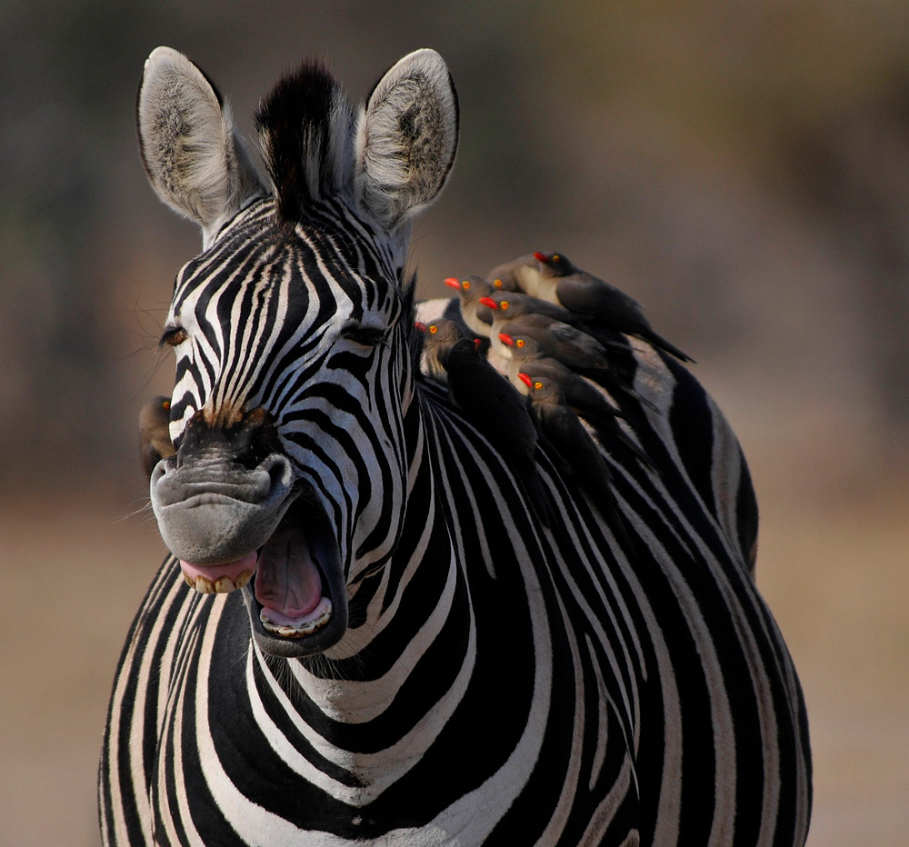
Zebra grinning with the oxpeckers perched on its back in Kruger National Park, South Africa © Christopher Graupner

Slide 25
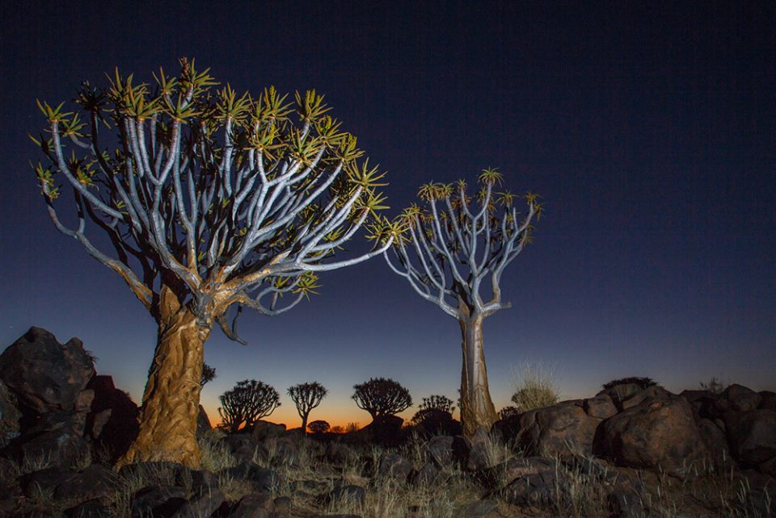
Quiver trees at sunset in Keetmanshoop, Namibia © Monique Adams

Slide 26
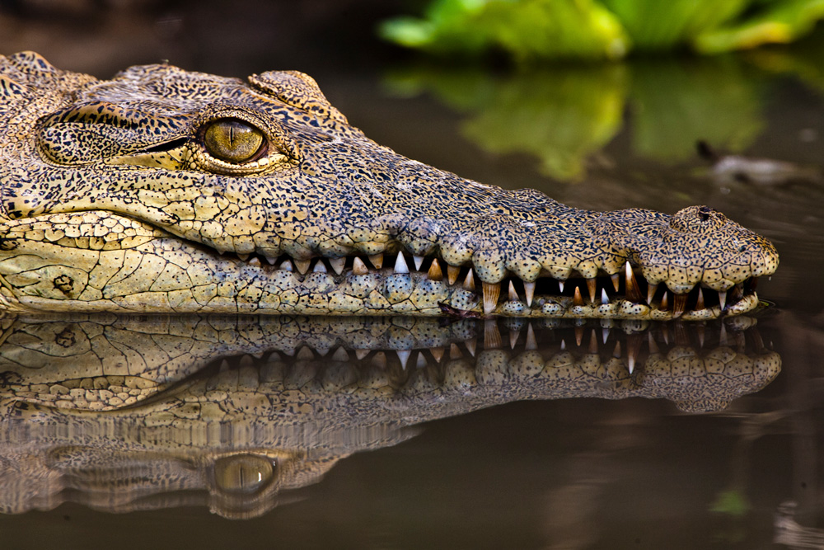
Crocodile in Selous Game Reserve, Tanzania © Sepp Friedhuber

Slide 27
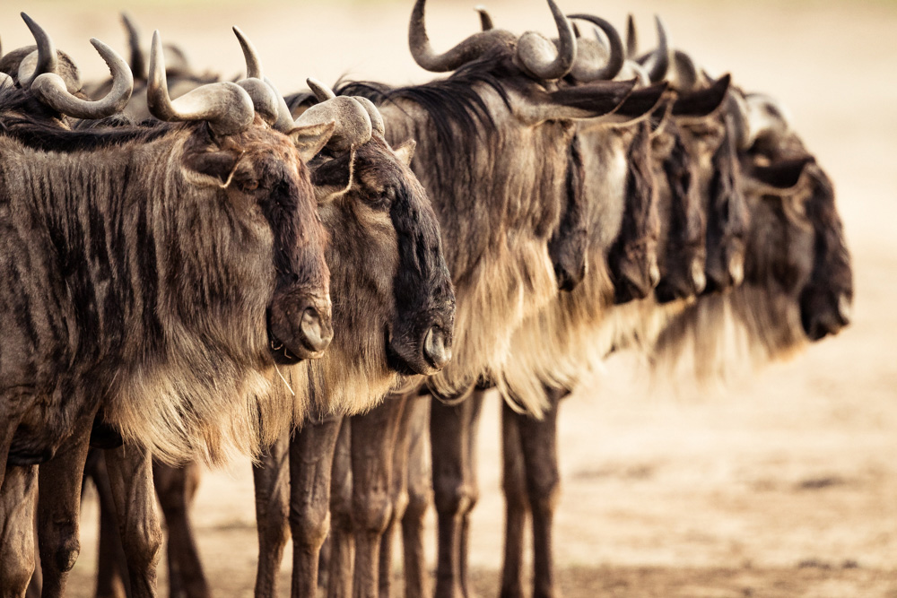
'Who's going first?' – wildebeest line up in front of the Mara River in Maasai Mara National Reserve, Kenya © Jacques-Andre Dupont

Slide 28
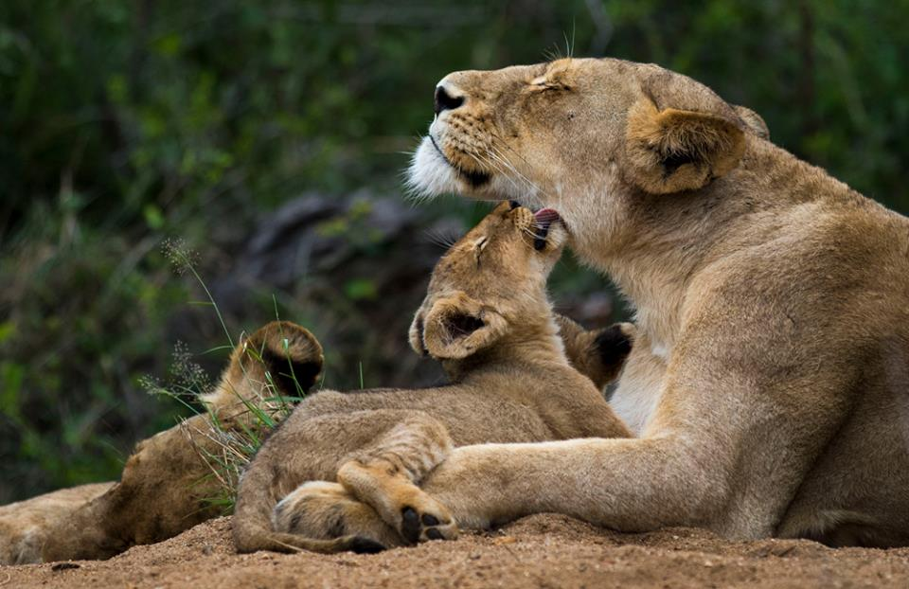
'A mother's love' in Manyeleti Game Reserve, South Africa © Armand Grobler

Slide 29
A portrait of a group of women from the Borana tribe in southern Ethiopia © Greg Metro

Slide 30
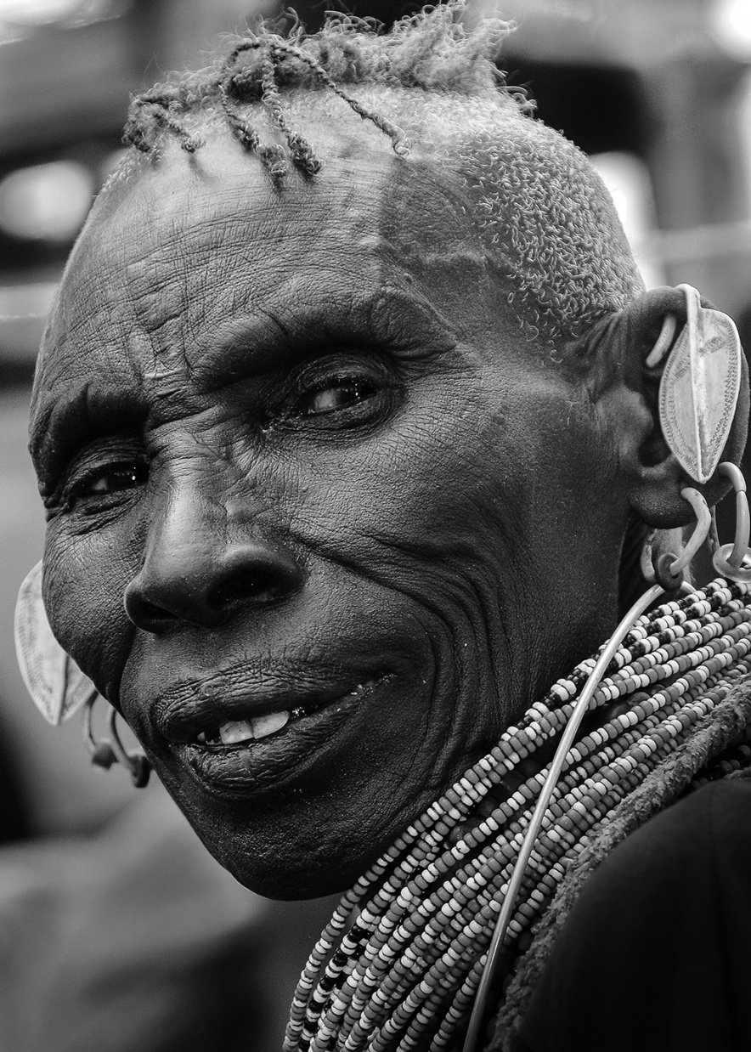
An old Turkana lady at Lake Turkana, Kenya © Andrei Daniel Mihalca

Slide 31
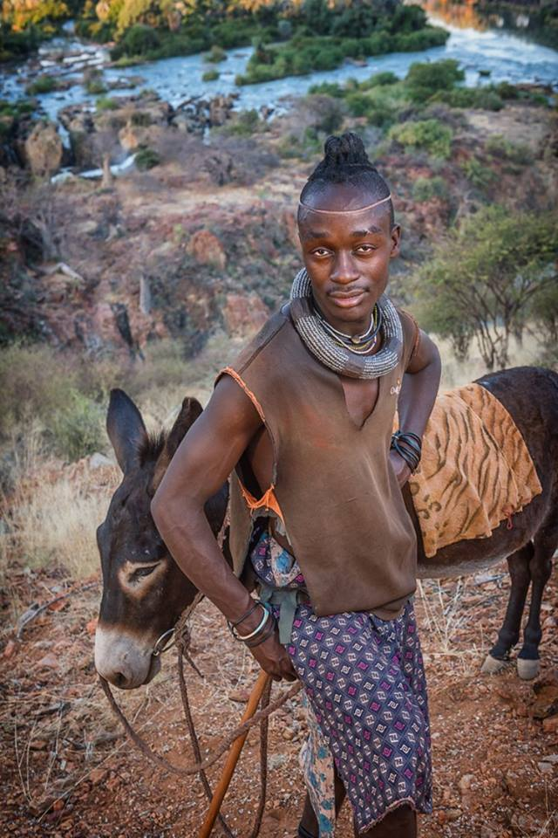
Himba warrior leading his donkey above Epupa Falls, Namibia © Cohan Zarnoch

Slide 32
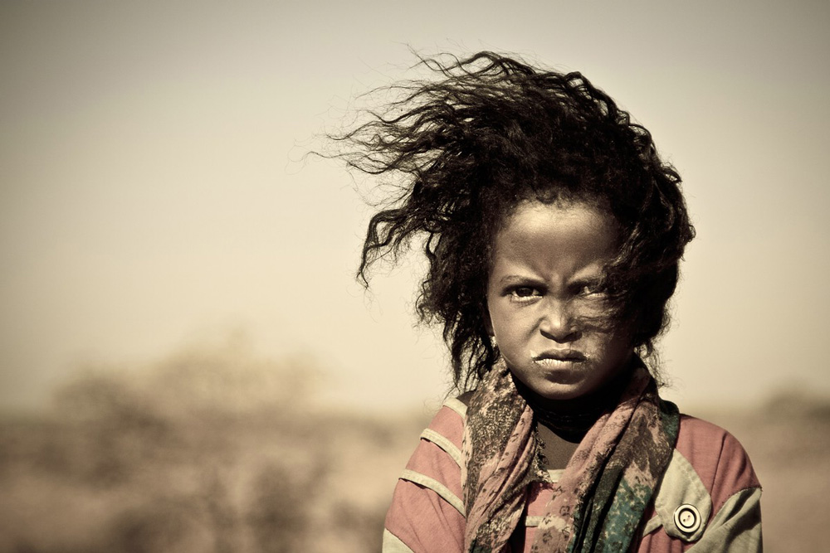
'Grumpy face' – a girl at a water well in Naga, Sudan © Rene Bauer

Slide 33
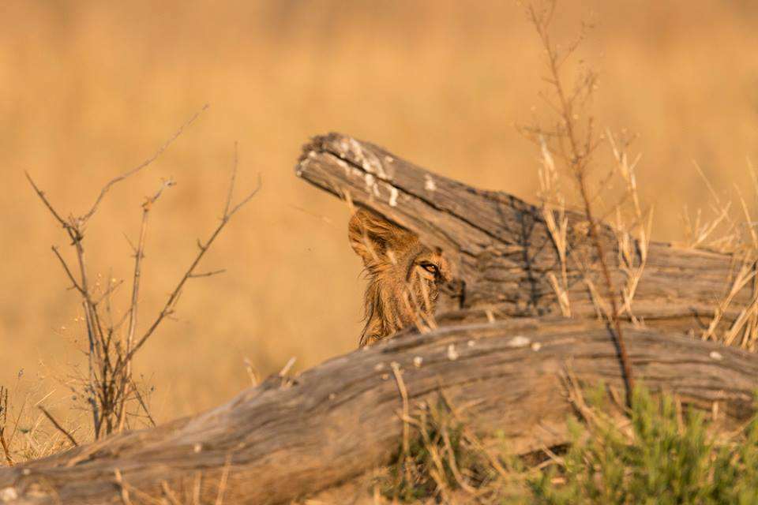
'Lion's eye' in Chobe National Park, Botswana © Vikram Ghanekar

Slide 34
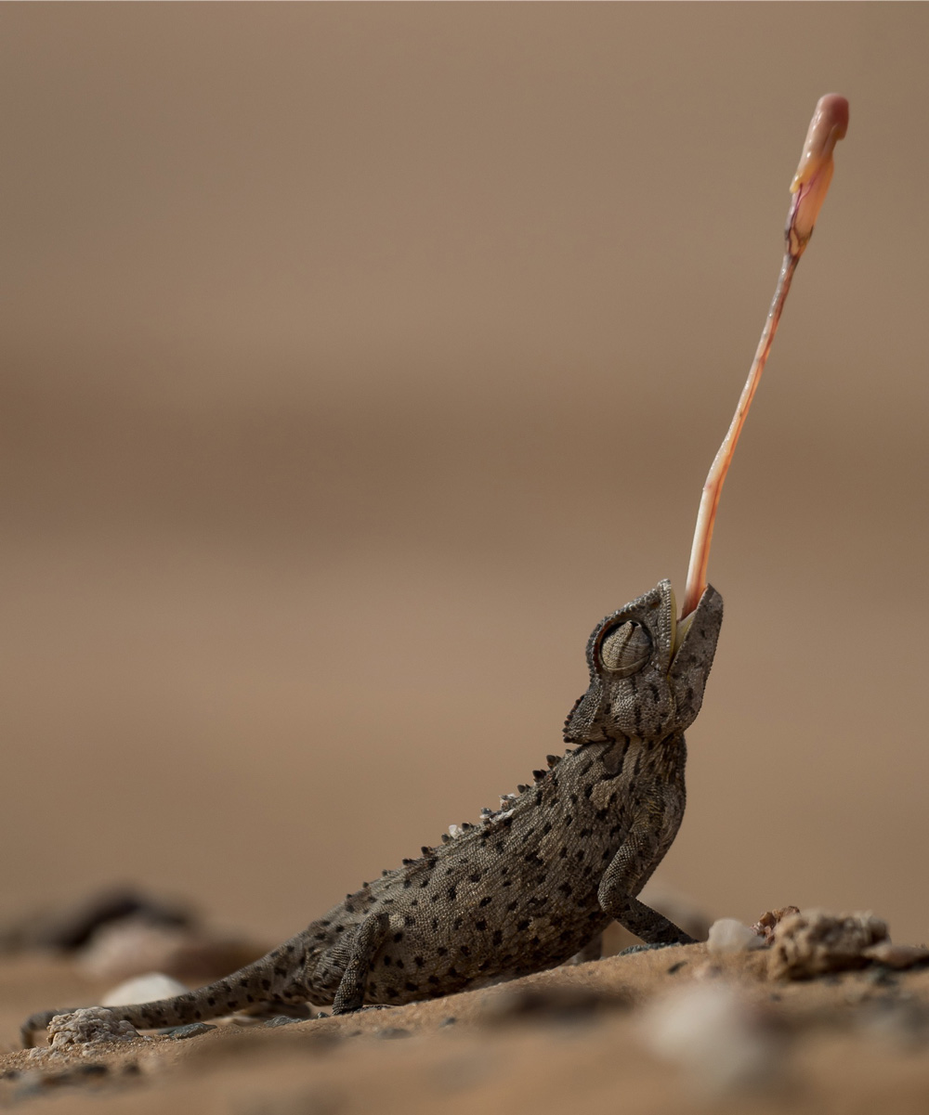
'Strike' – a chameleon tries to catch his lunch in Windhoek, Namibia © Andy Edge

Slide 35
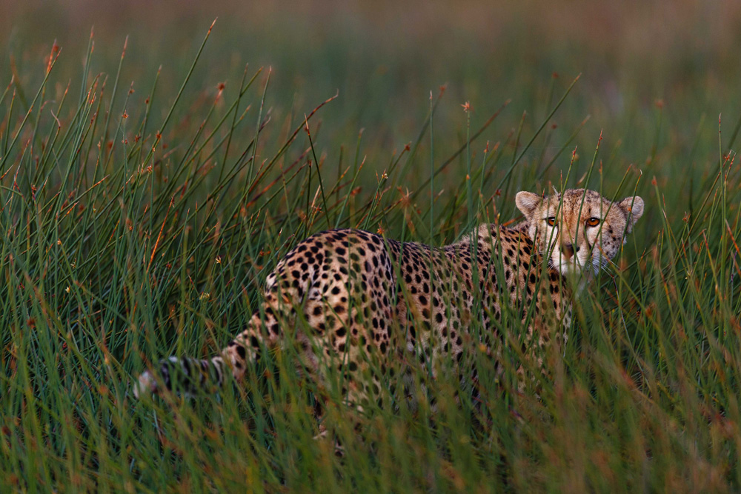
A cheetah hiding in the marsh in Ndutu, Tanzania © Thorsten Henewald

Slide 36
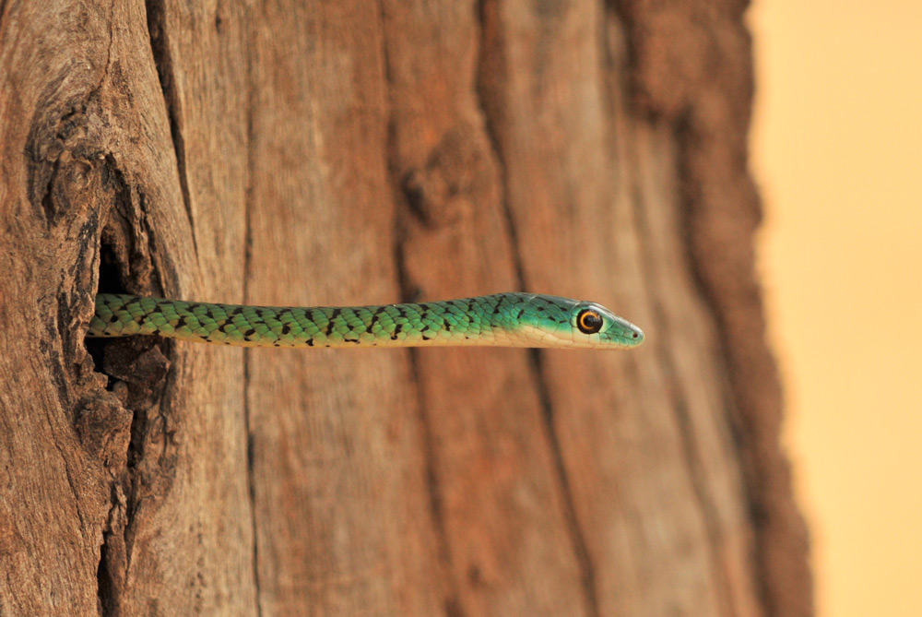
A spotted bush snake, South Luangwa, Zambia © Karin Tieche

Slide 37
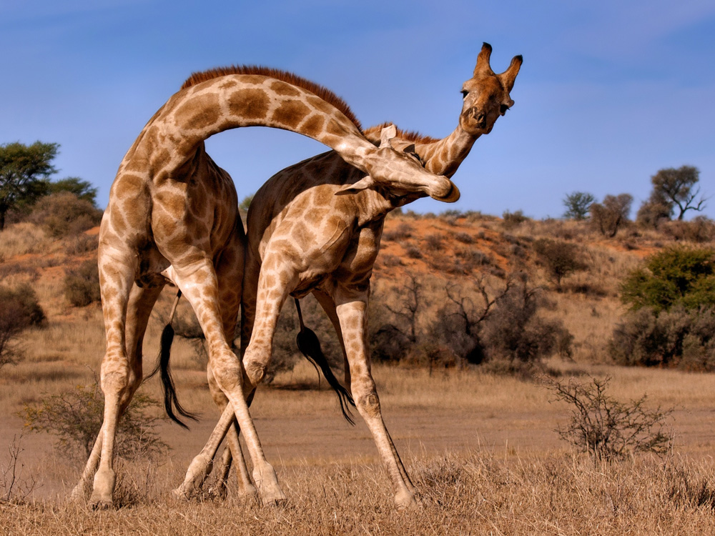
Two giraffes fighting each other in Mata Mata, Kgalagadi, South Africa © Annette Heymans

Slide 38
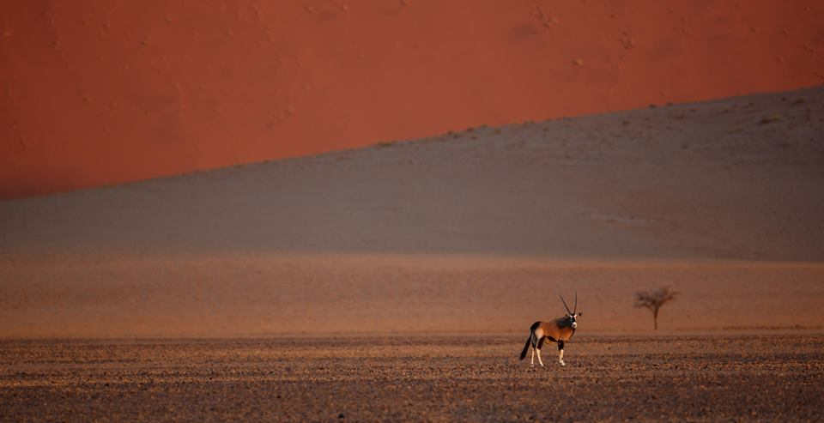
'Solitary gemsbok' in Sossusvlei, Namibia © Monique Adams

