Slide 1


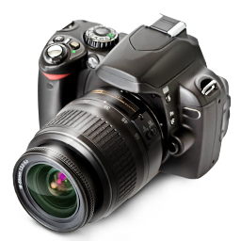


♫ Turn on Speakers
PowerPoint Show by Andrew

Slide 2
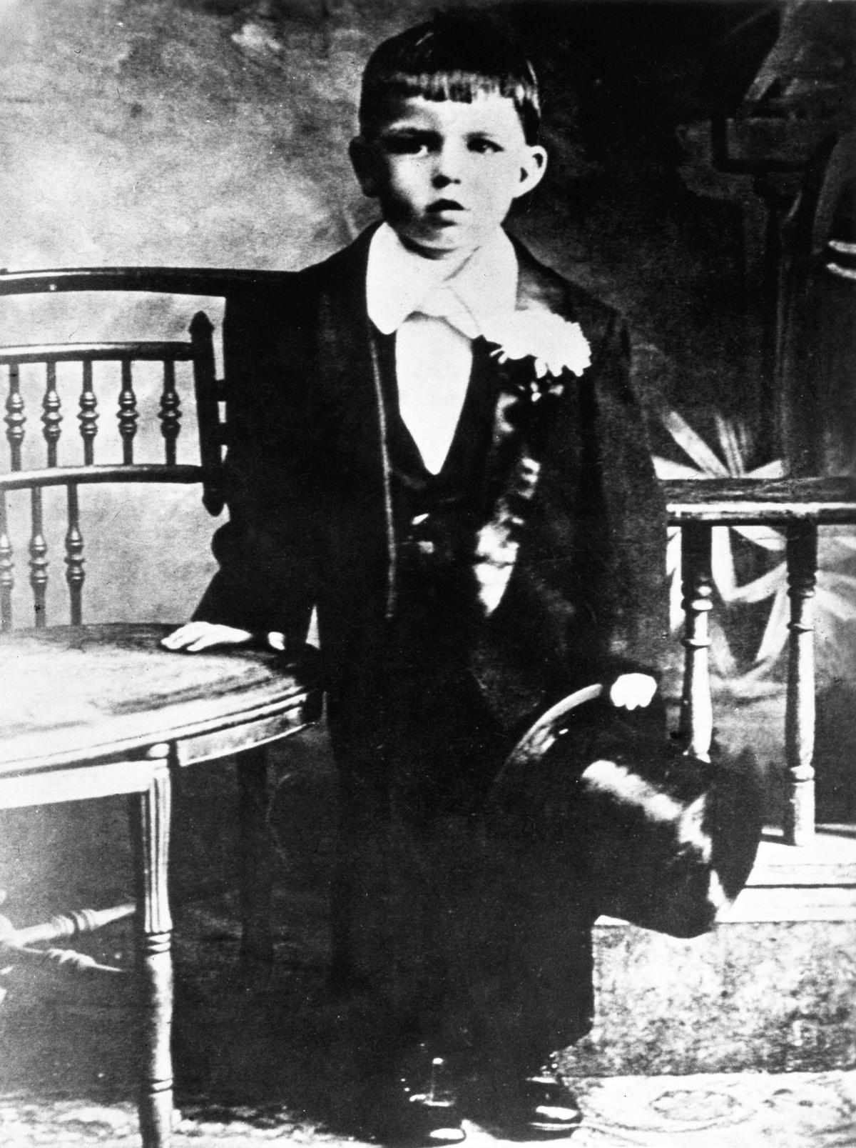
A formal portrait of Sinatra around age six - 1921

Slide 3
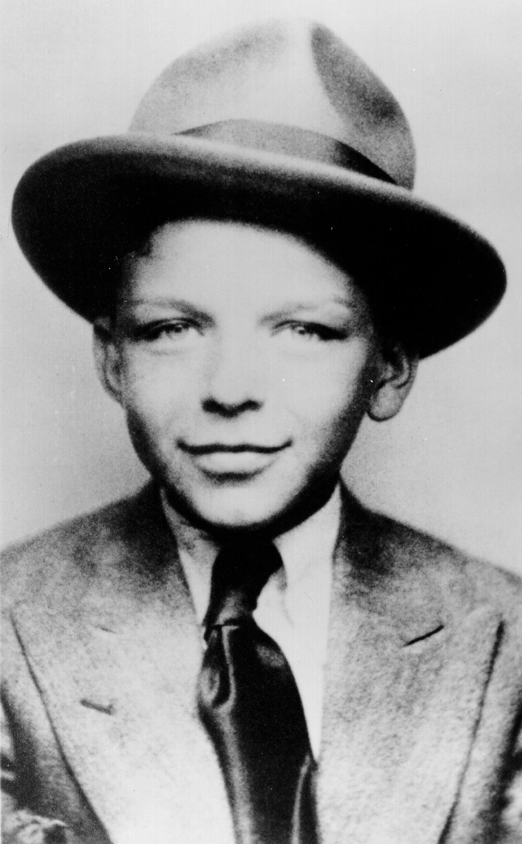
Sinatra at seven
years old - 1922

Slide 4
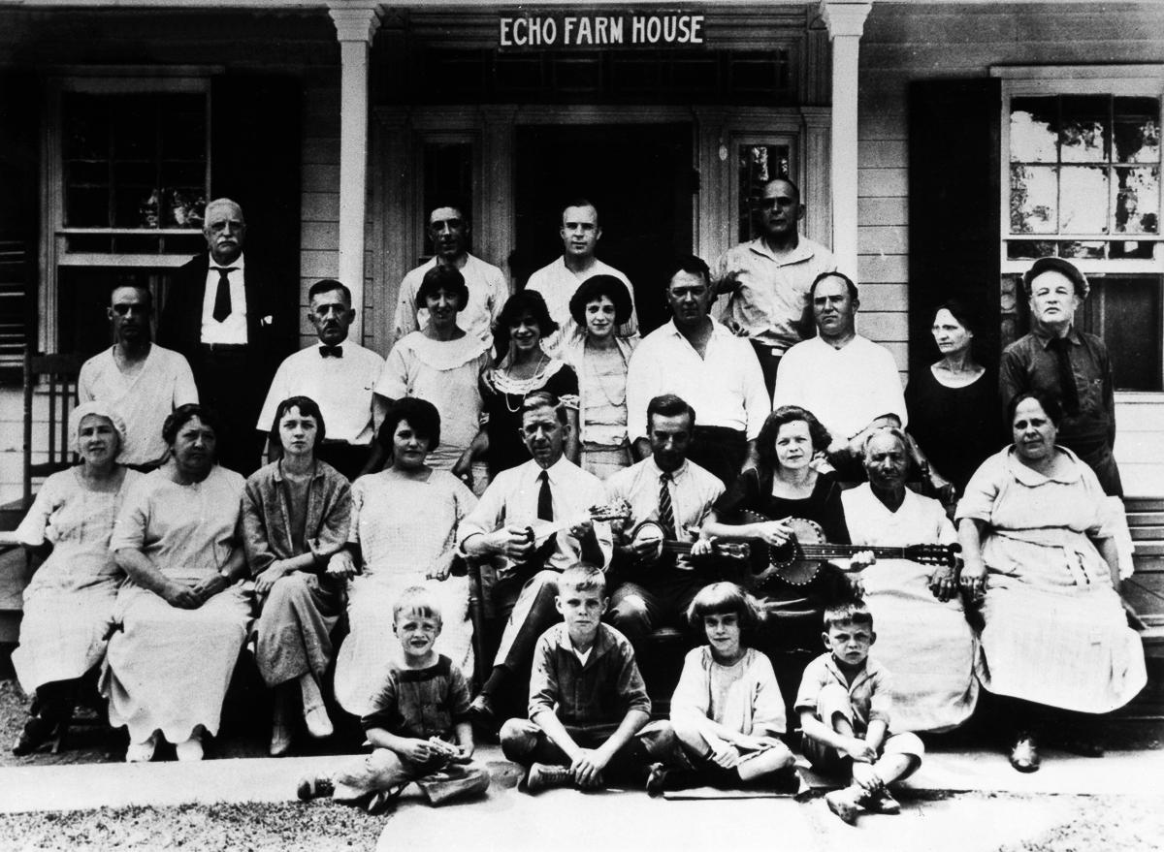
Sinatra (first row, right) sits for a portrait with family members
and other guests at the Echo Farm House summer retreat
in the Catskill Mountains, New York - 1923

Slide 5
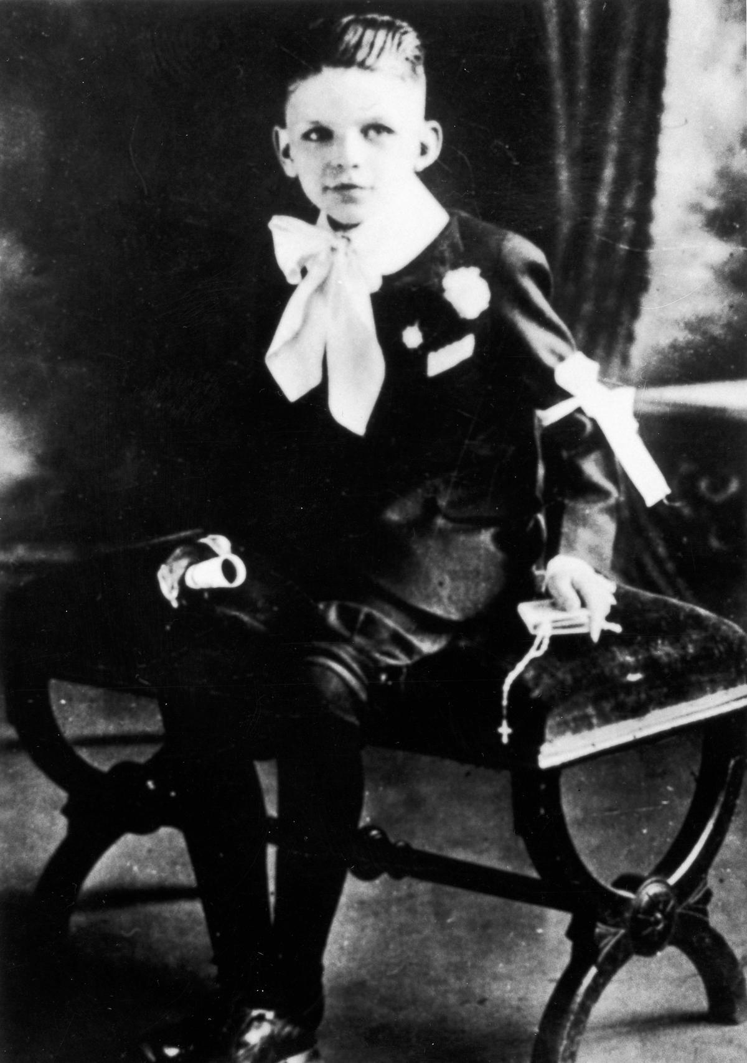
Sinatra on his first Holy Communion - 1924

Slide 6
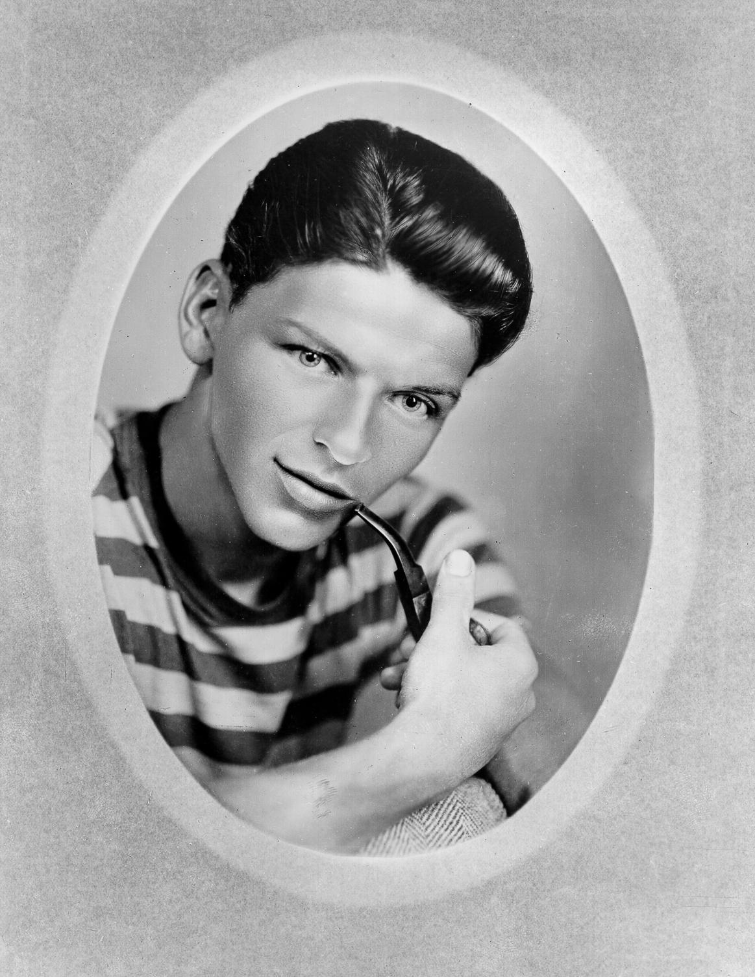
A teenage Sinatra poses for a portrait - 1933

Slide 7
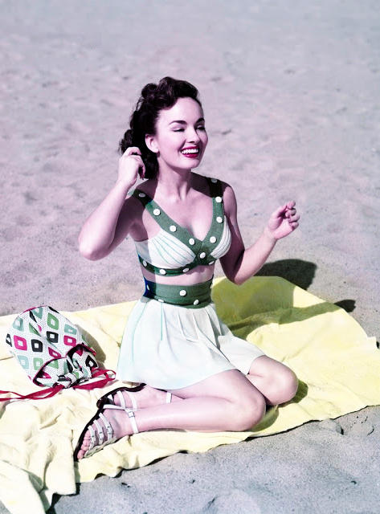
Ann Blyth - 1950

Slide 8
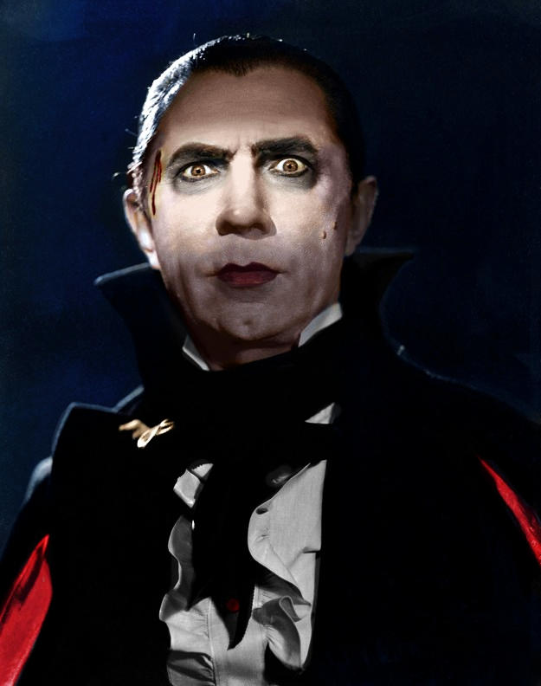
Bela Lugosi as
Dracula - 1931

Slide 9
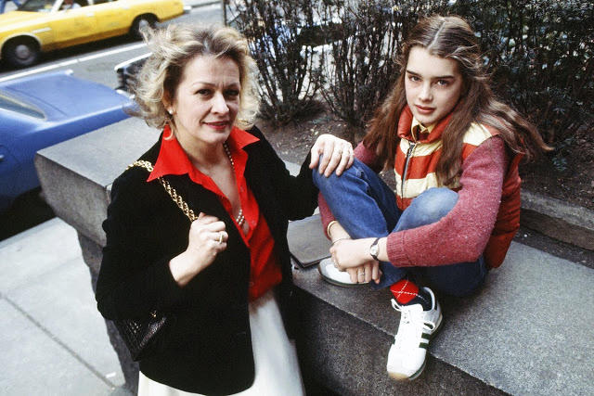
Brooke Shields and her mother Teri - 1978

Slide 10
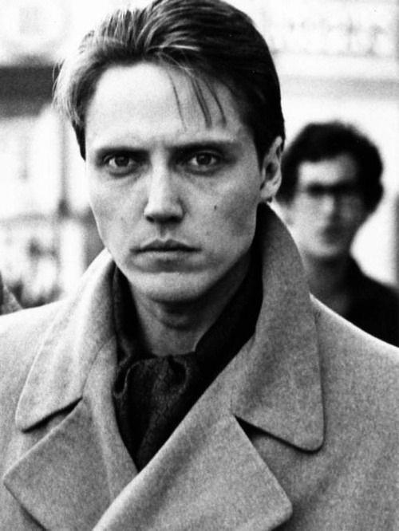
Christopher Walken - 1971

Slide 11
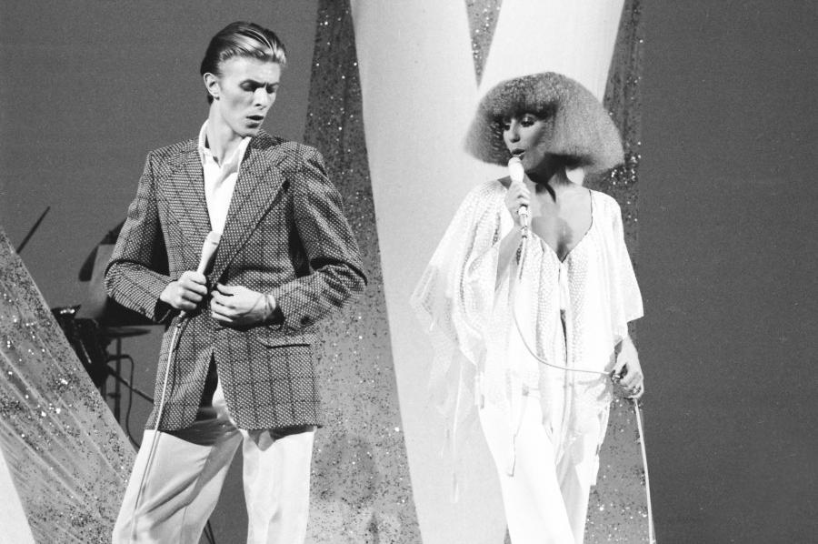
David Bowie and Cher perform a duet on the
music variety television show, 1975.

Slide 12
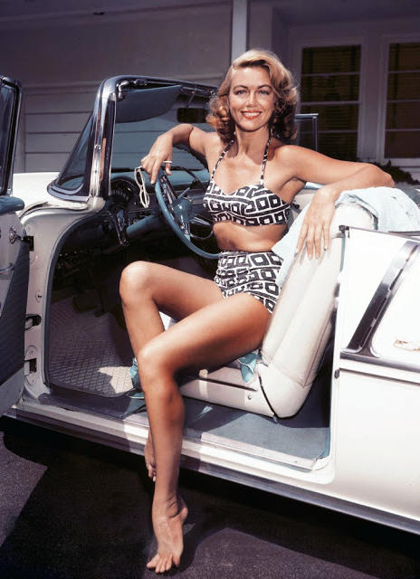
Dorothy Malone - 1955

Slide 13
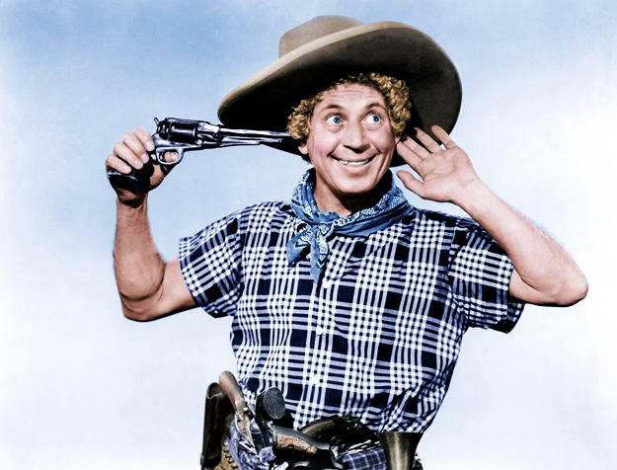
Harpo Marx -1946

Slide 14
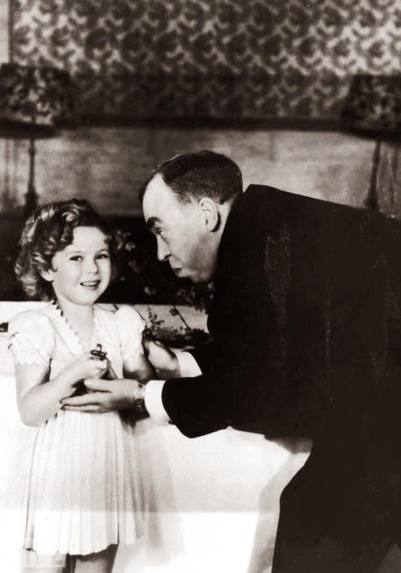
Screenwriter Irvin S Cobb, host of the 7th Academy Awards in 1935, gives a special, tiny Oscar to Shirley Temple for her ‘outstanding contribution’ to the industry in 1934, a year when the 6-year-old star made 12 movies.

Slide 15
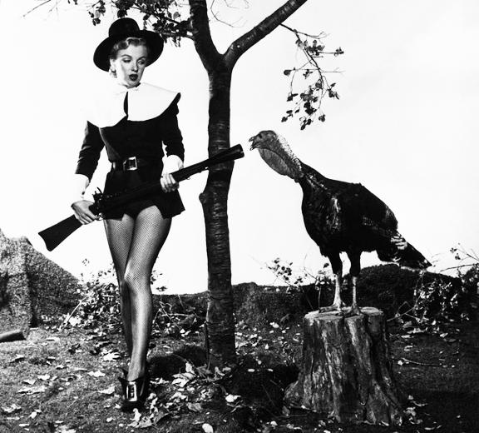
Marilyn Monroe's Thanksgiving Photo in 1950

Slide 16
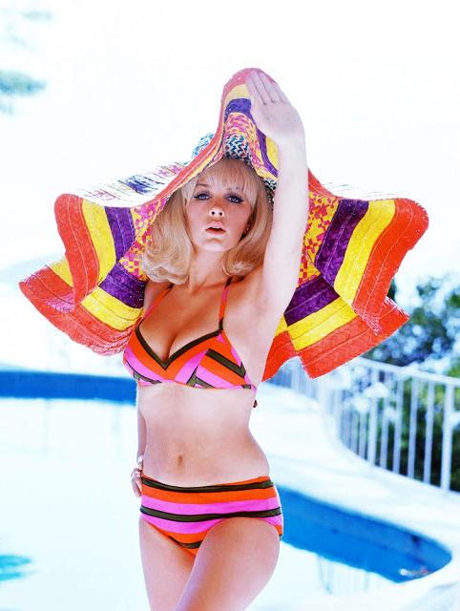
Stella Stevens - 1960

Slide 17
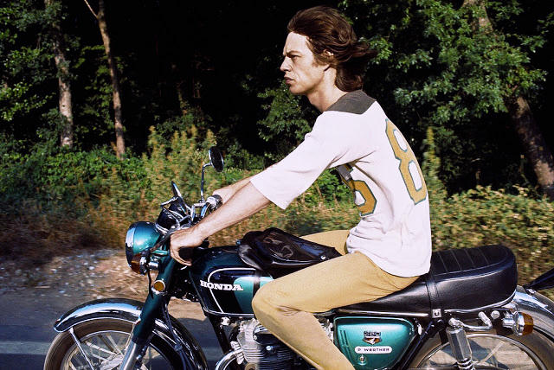
Mick Jagger on a motorcycle - 1977

Slide 18
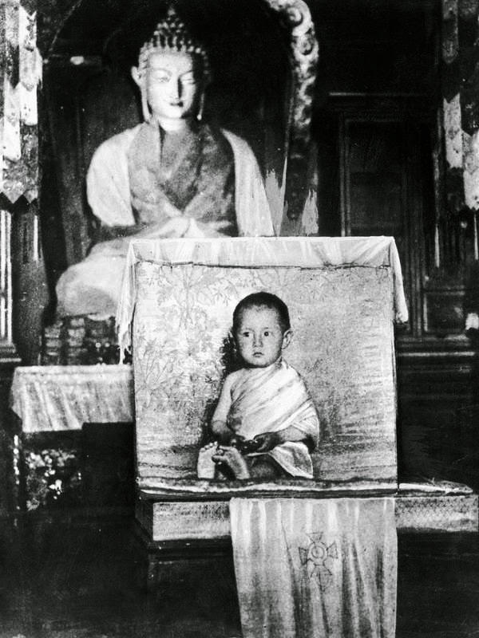
The Dalai Lama at
age two - 1937

Slide 19
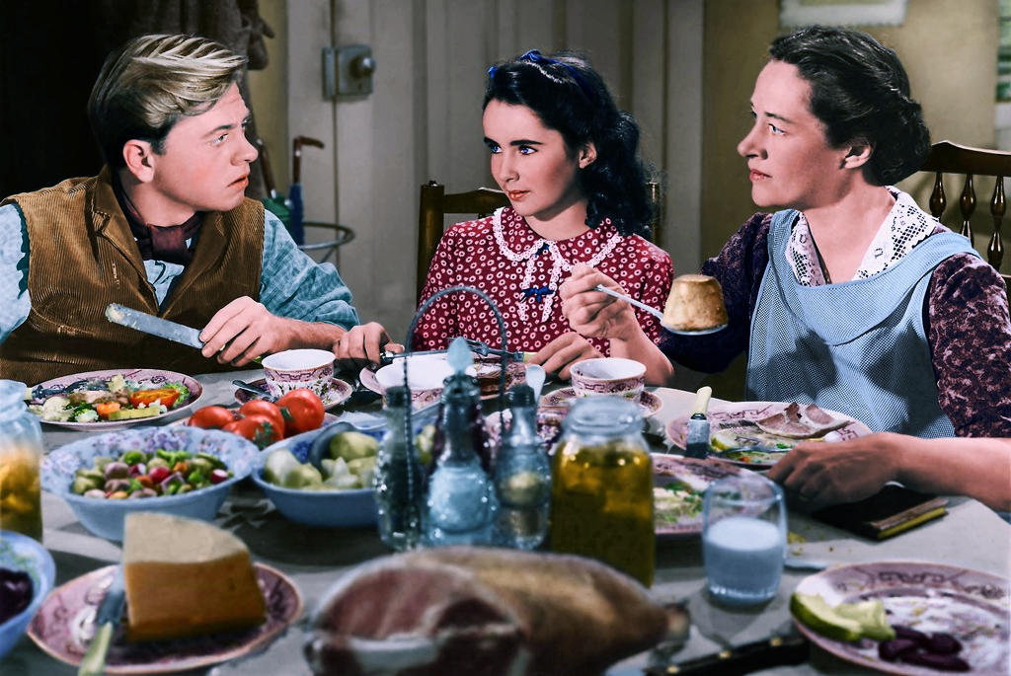
Mickey Rooney and Liz Taylor in National Velvet - 1944

Slide 20
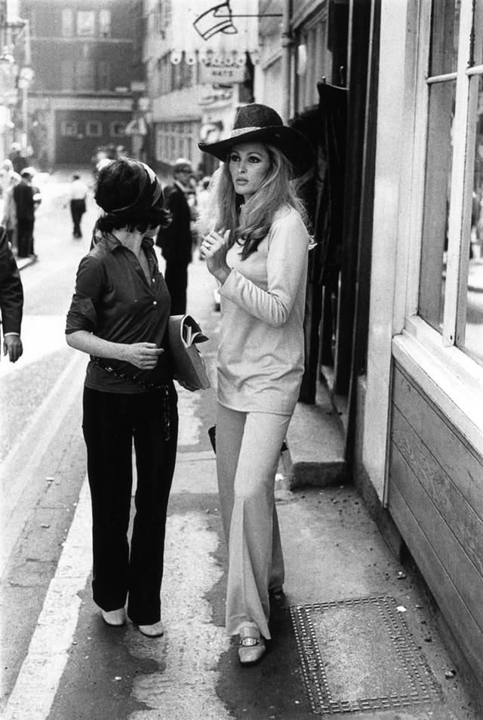
Ursula Andress - 1968

Slide 21
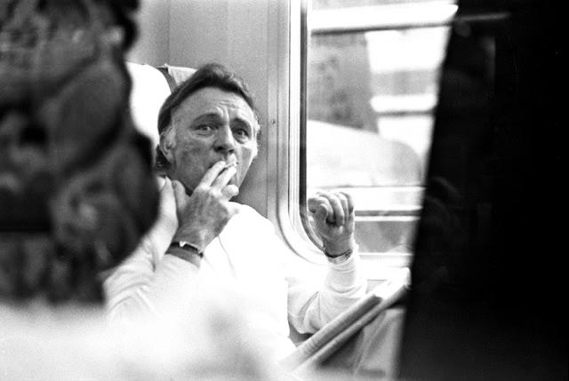
Richard Burton smoking in a train - 1978

Slide 22
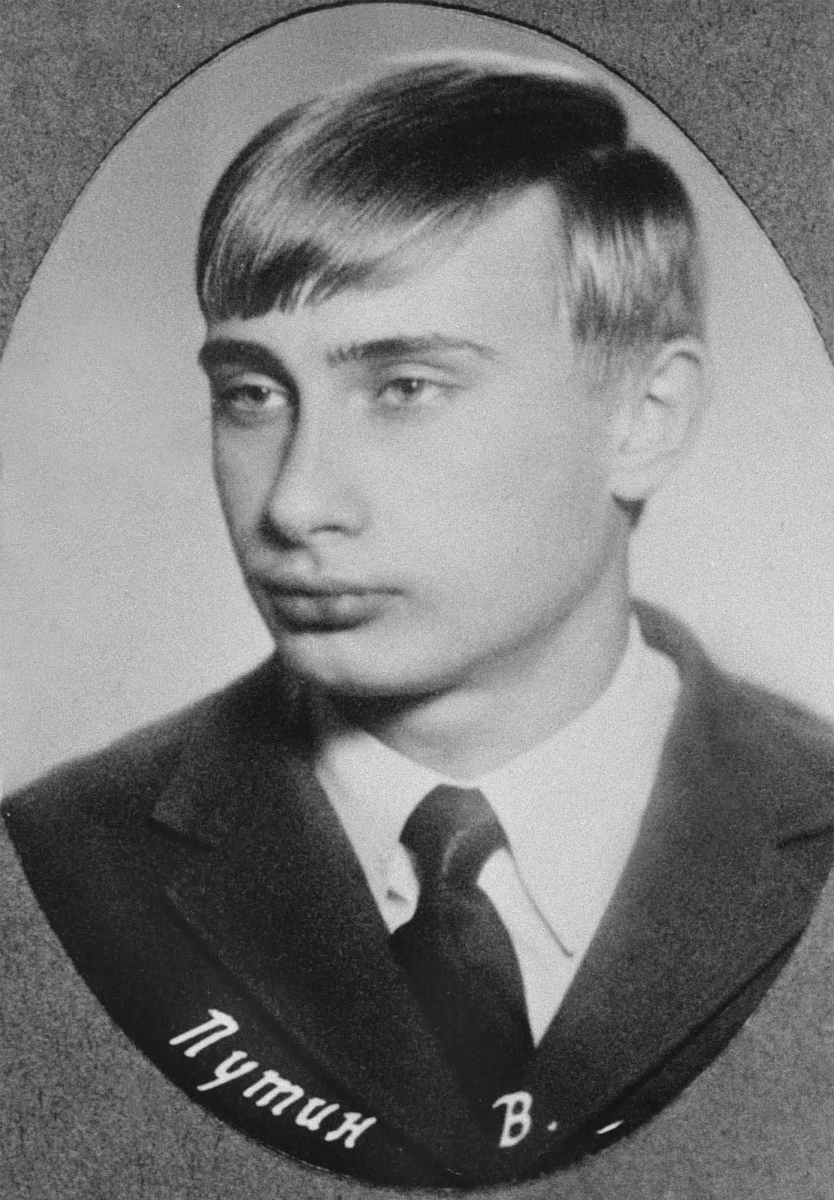
Vladimir Putin - 1970

Slide 23
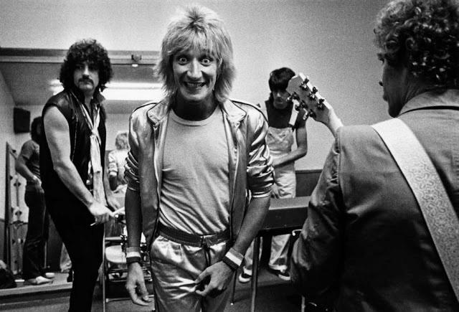
Rod Stewart - 1976

Slide 24
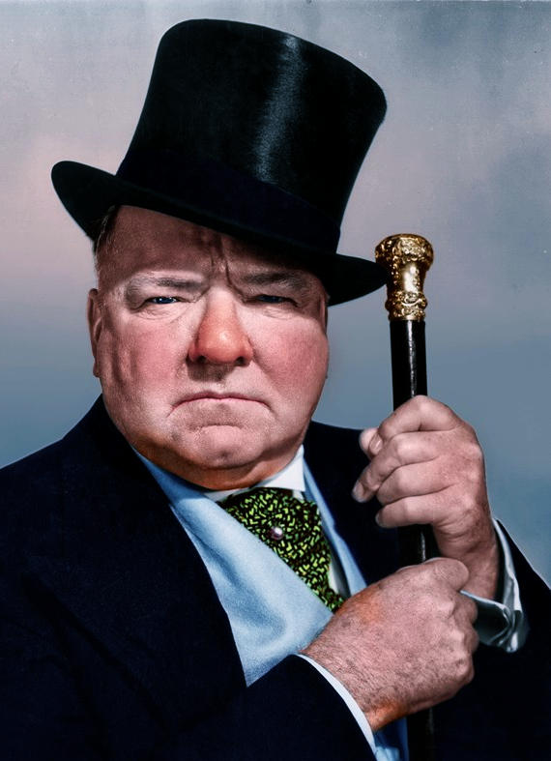
W.C. Fields - 1937

Slide 25
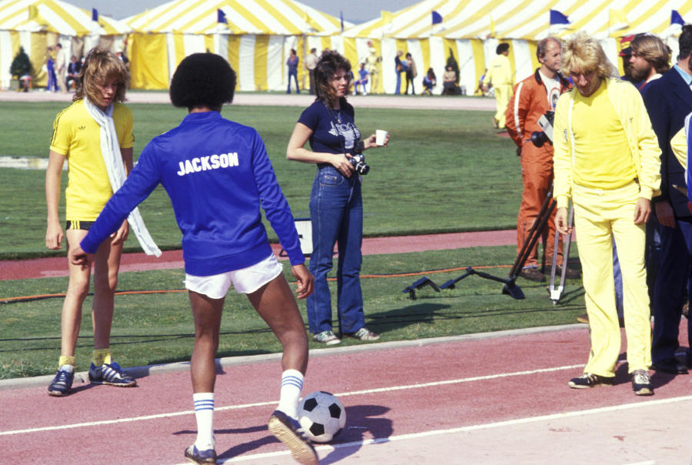
Rod Stewart (right) and Michael Jackson in blue attend
First Annual Rock N Roll Sports Classic, 1978.

Slide 26
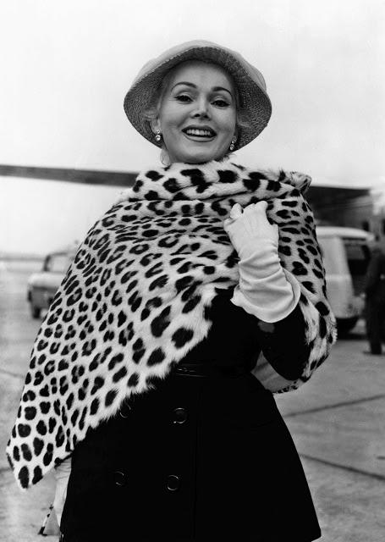
Zsa Zsa Gabor arrives at Heathrow airport in London - 1956

Slide 27
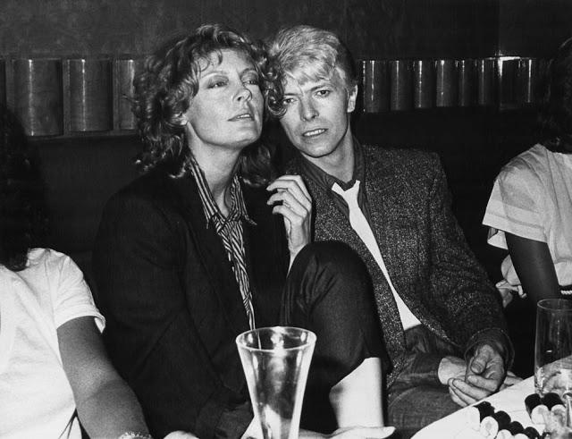
Susan Sarandon and David Bowie, 1983.

Slide 28
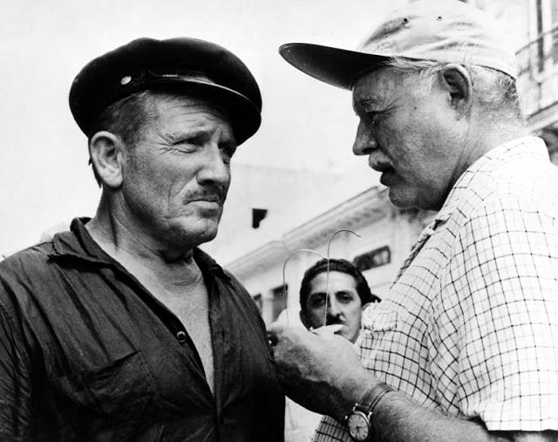
Spencer Tracy and Ernest Hemingway spend time together
during filming of The Old Man and the Sea, 1958.

Slide 29


Seen on Bigfun.be
Author: Andrew

