Slide 1


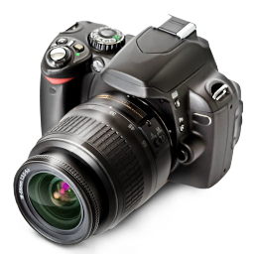


♫ Turn on Speakers
PowerPoint Show by Andrew

Slide 2
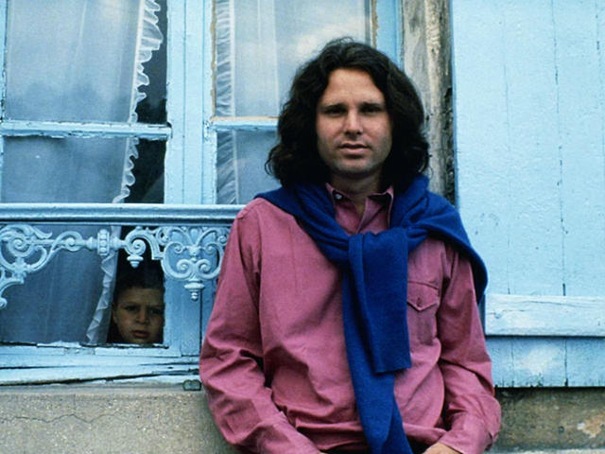
Last known photograph of Jim Morrison (The Doors)
in Saint-Leu-d’Esserent, France - June 1971

Slide 3
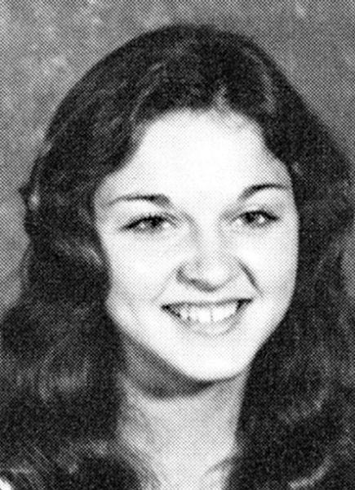
Madonna - 1974

Slide 4
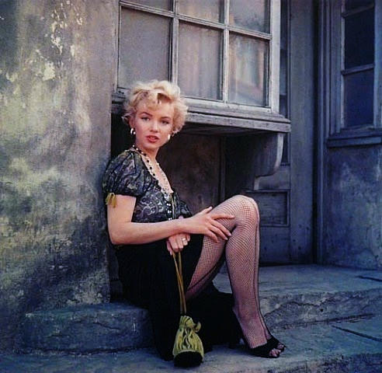
Marilyn Monroe - 1953

Slide 5
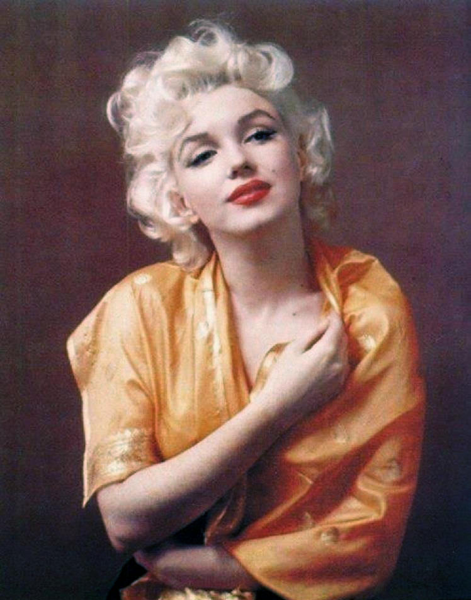
Marilyn Monroe - 1953

Slide 6
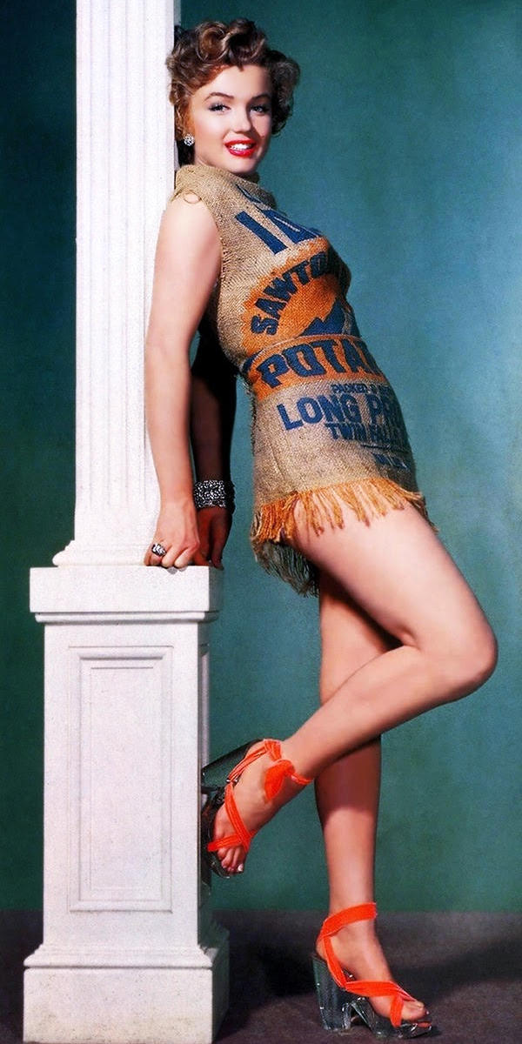
Marilyn Monroe and the Potato Sack Dress, 1951

Slide 7
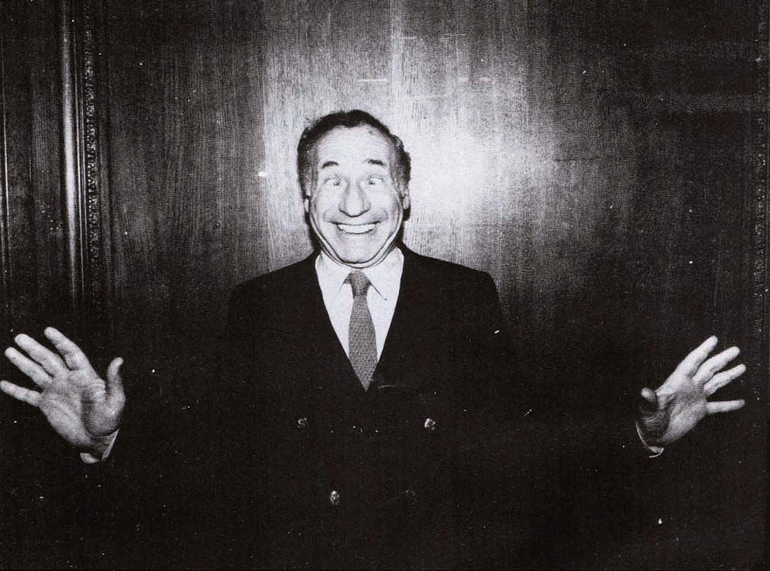
Mel Brooks

Slide 8
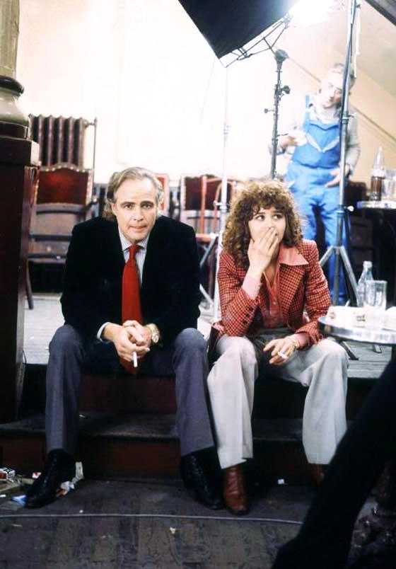
Marlon Brando and Maria Schneider having a smoke break on the set of Last
Tango In Paris - 1972.

Slide 9
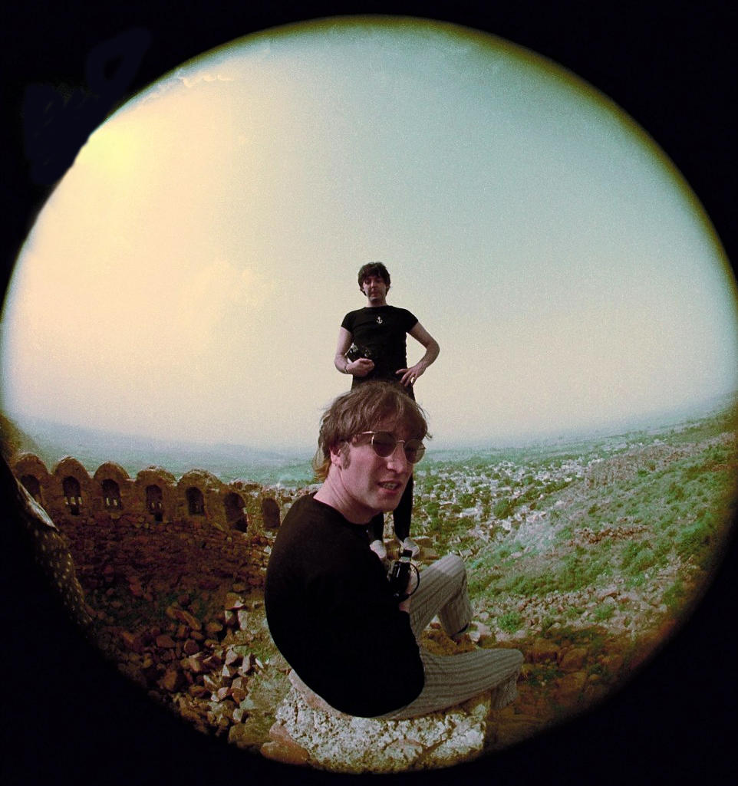
McCartney and Lennon photographed relaxing near
Delhi on a tour of India in July 1966

Slide 10
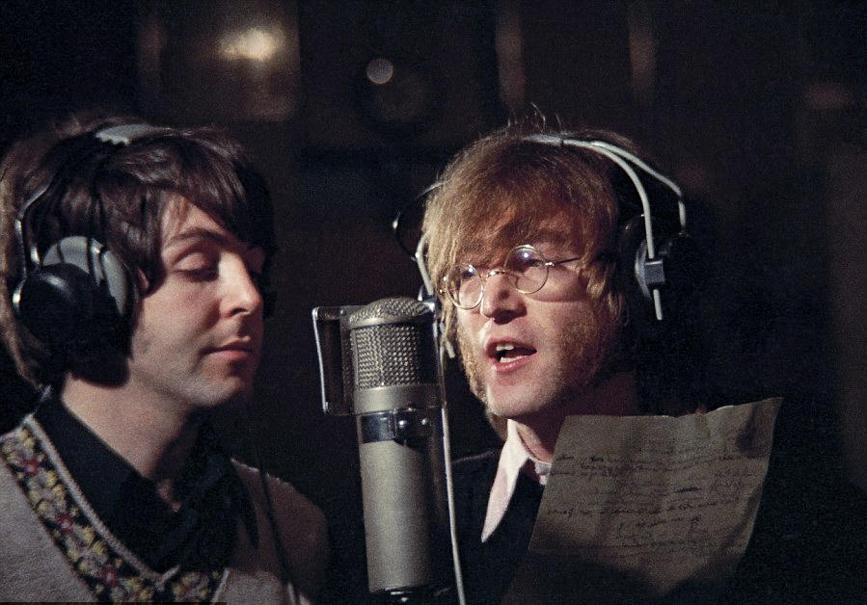
McCartney and Lennon pictured recording Hey Bulldog in Studio
three at Abbey Road Studios on the February, 11th - 1968

Slide 11
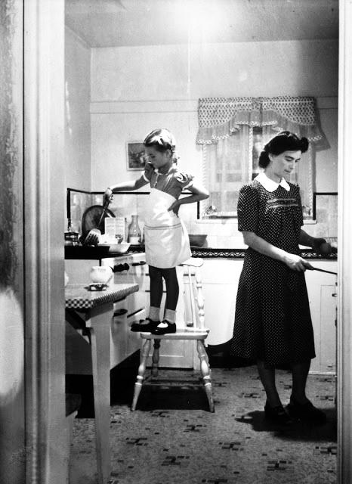
Natalie Wood in the kitchen with her mother, 1945.

Slide 12
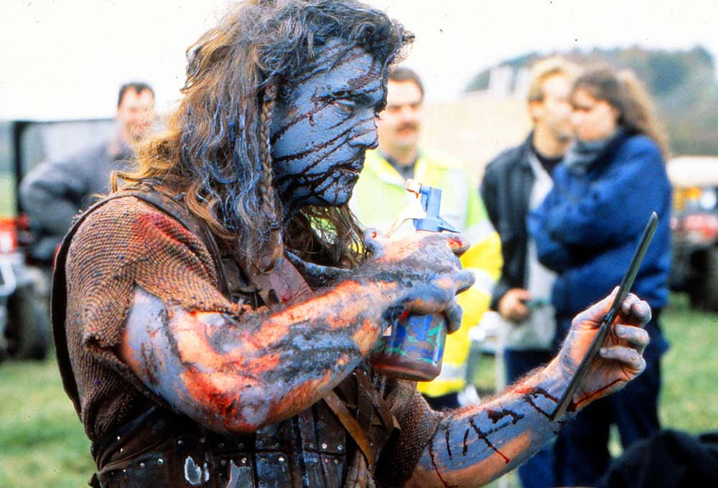
Mel Gibson checking his makeup on the set of Braveheart.

Slide 13
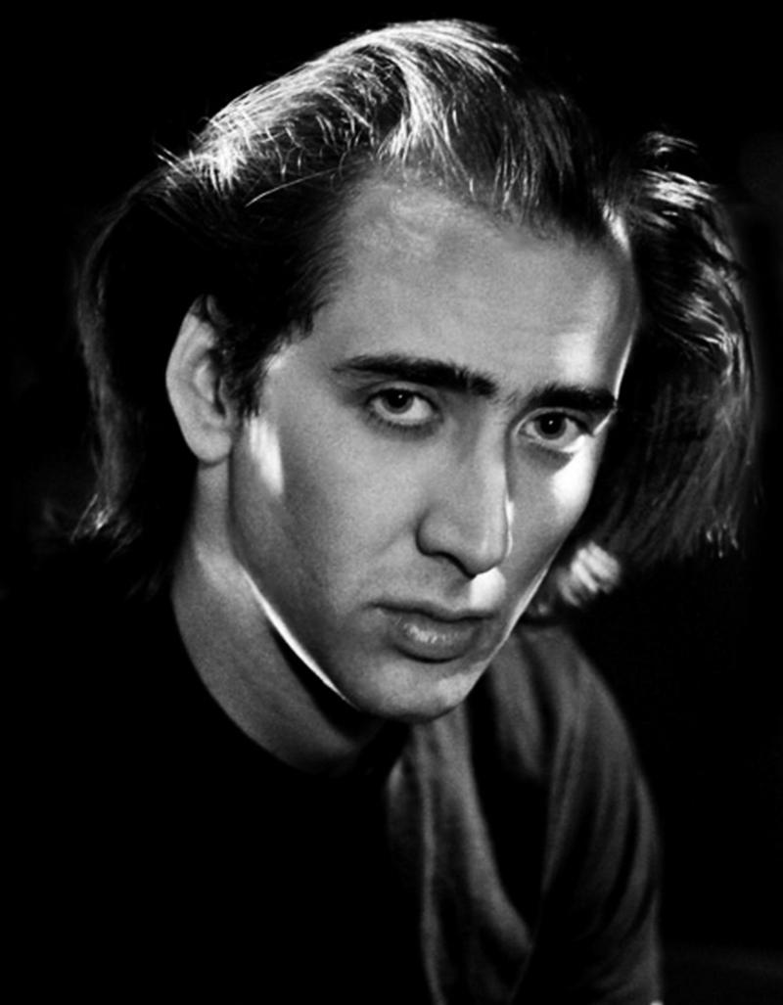
Nicolas Cage

Slide 14
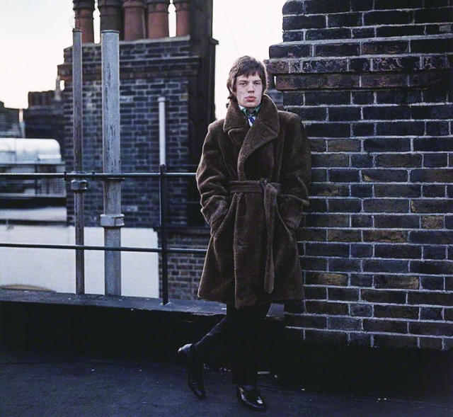
Mick Jagger - 1966

Slide 15
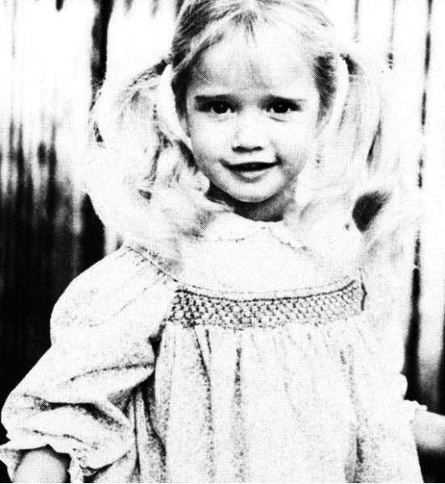
Paris Hilton - 1987

Slide 16
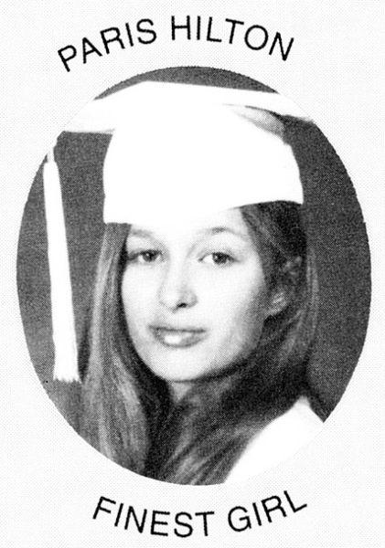
Paris Hilton - 1995

Slide 17
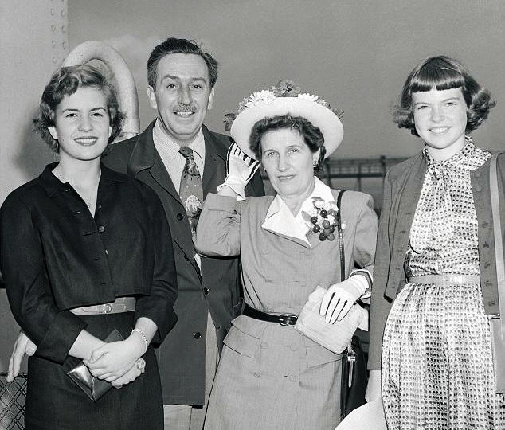
On their way to Europe on the Queen Mary, Sharon Disney
at 13 (right), Walt, Lillian (center), Diane at 16 (left), 1956

Slide 18
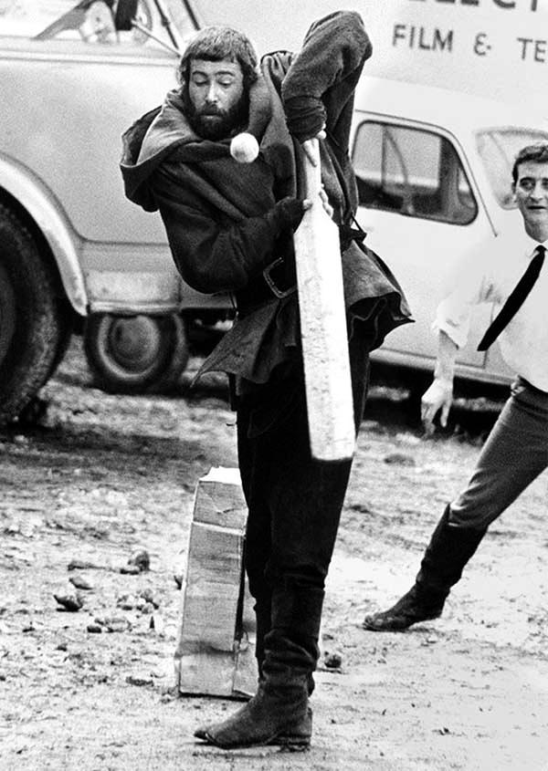
Peter O’Toole playing cricket, dressed as King Henry II, on the set of The Lion in Winter - 1968

Slide 19
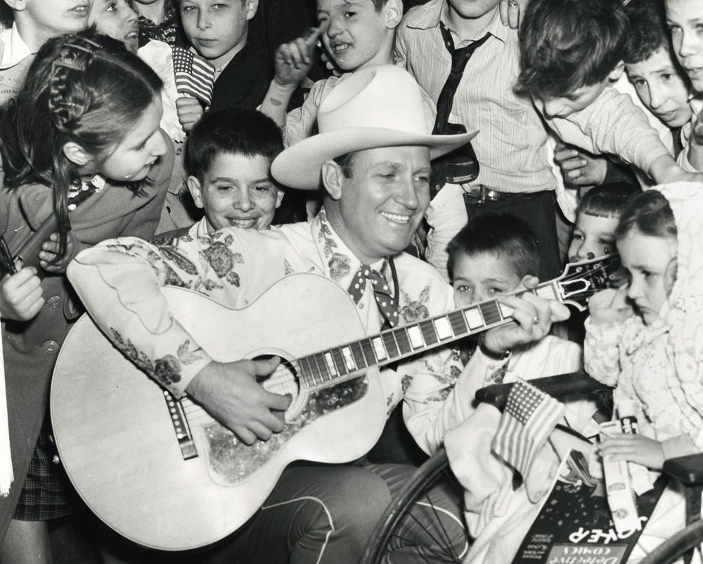
Singing cowboy Gene Autry visiting children
patients at Bellevue Hospital, NYC, 1946

Slide 20
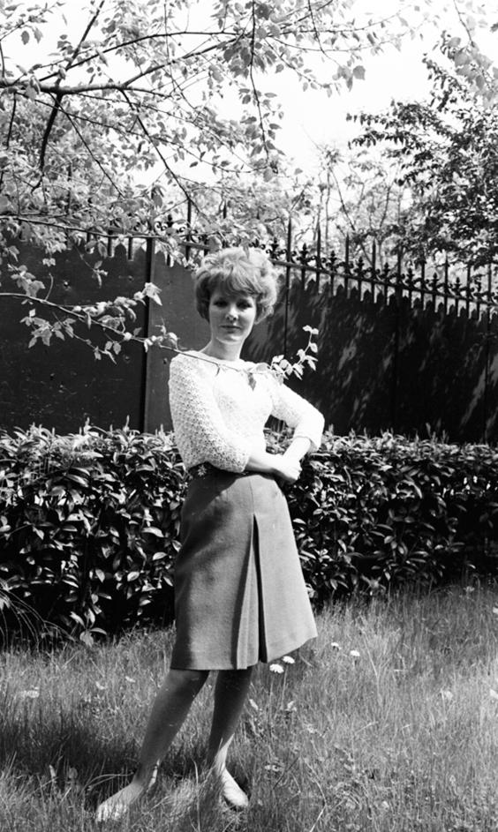
Petula Clark - 1967

Slide 21
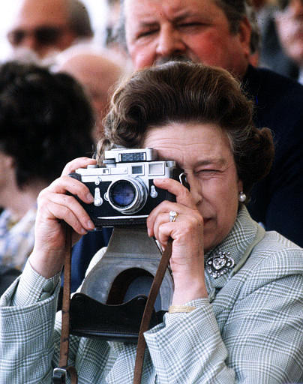
Queen Elizabeth
with a camera.

Slide 22
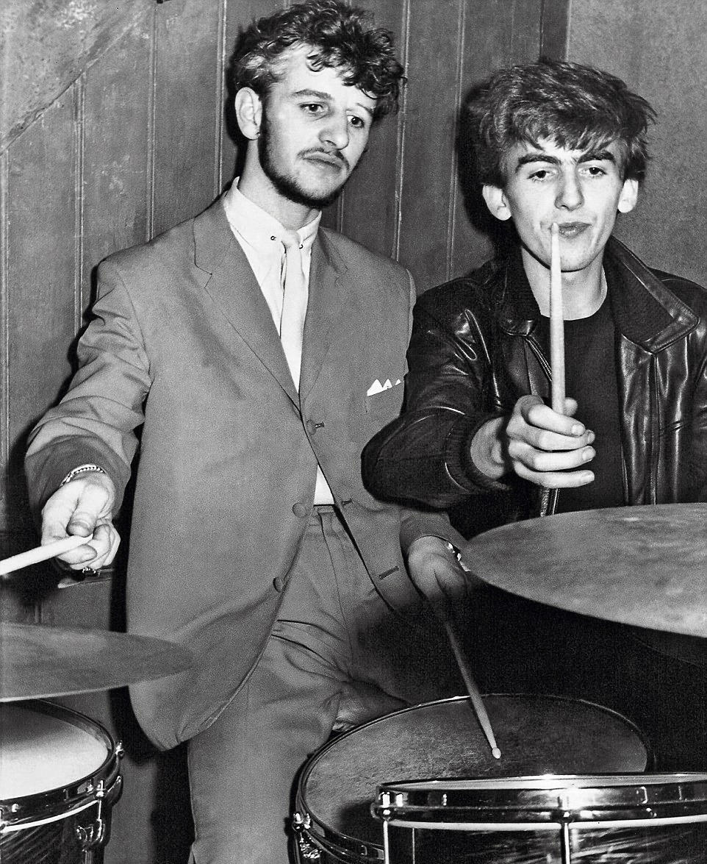
Ringo Starr and George Harrison photographed backstage at the Big Beat, held at the Tower Ballroom in Brighton, in 1961

Slide 23
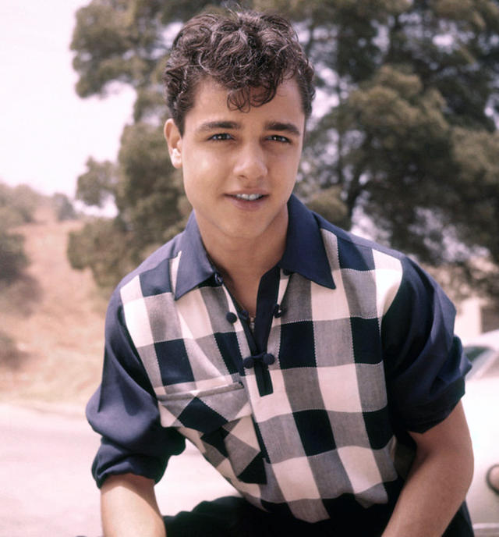
Sal Mineo - 1954

Slide 24
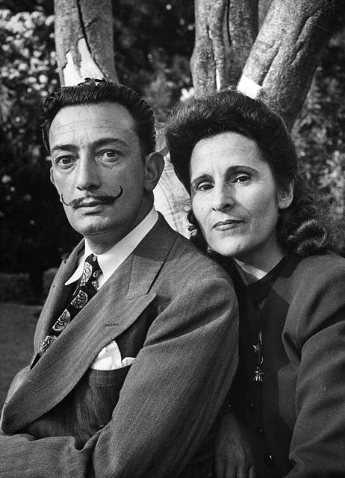
Salvador Dali with his wife Gala, 1945.

Slide 25
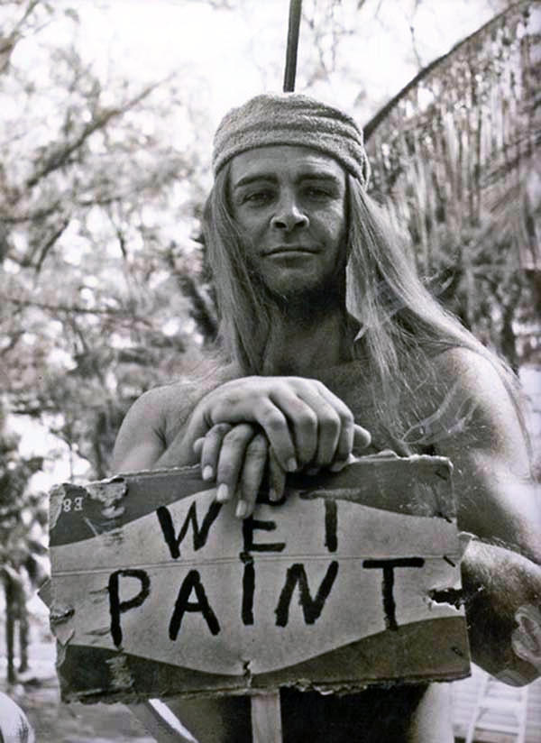
A young Sean Connery

Slide 26
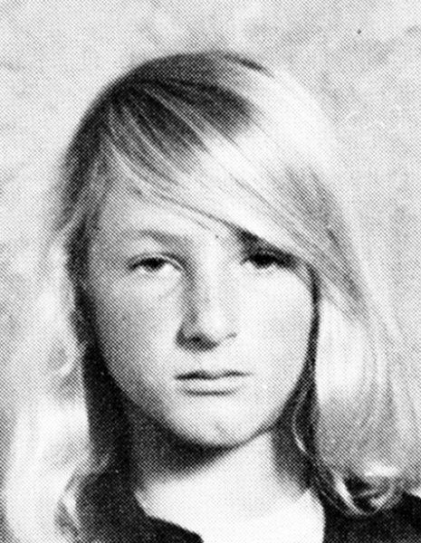
Sean Penn, 1982

Slide 27
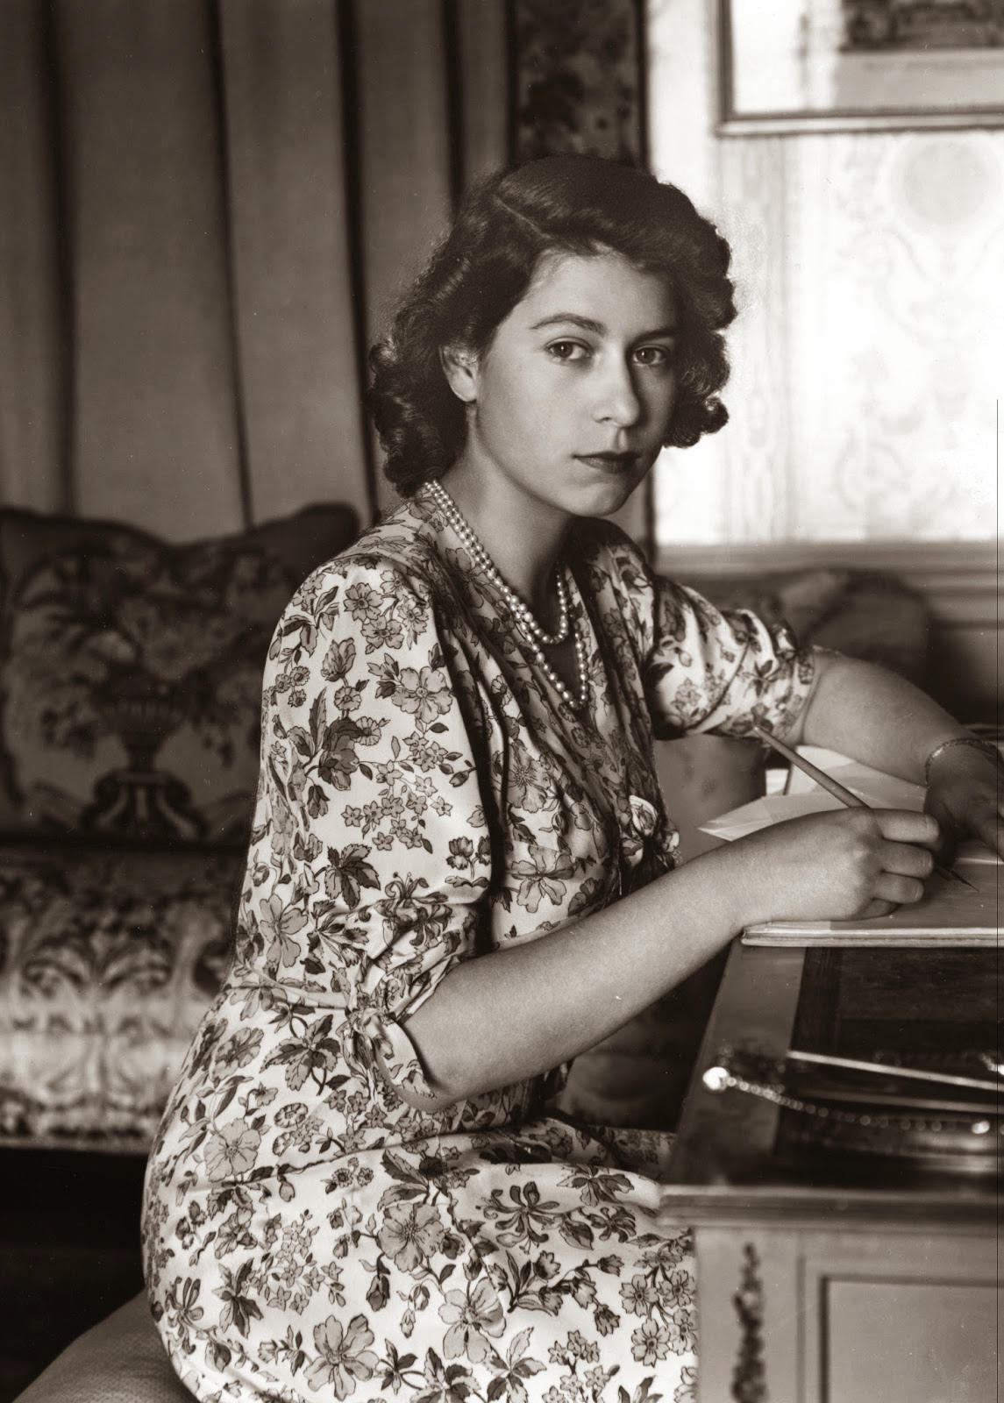
Queen Elizabeth - 1944

Slide 28
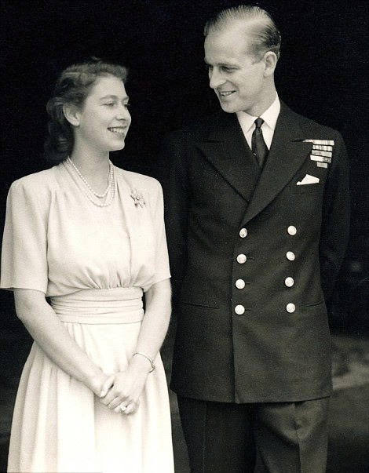
The Queen after announcing her engagement to Prince Philip in 1947.

Slide 29
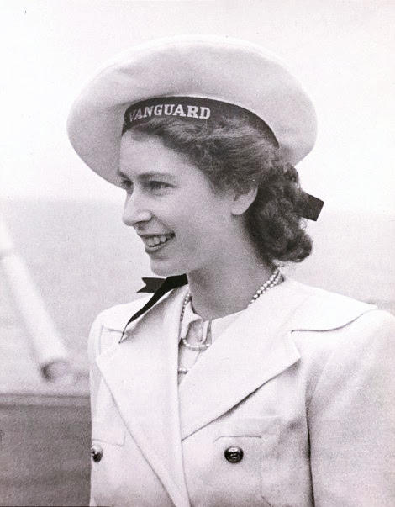
The Queen in
South Africa in 1947.

Slide 30
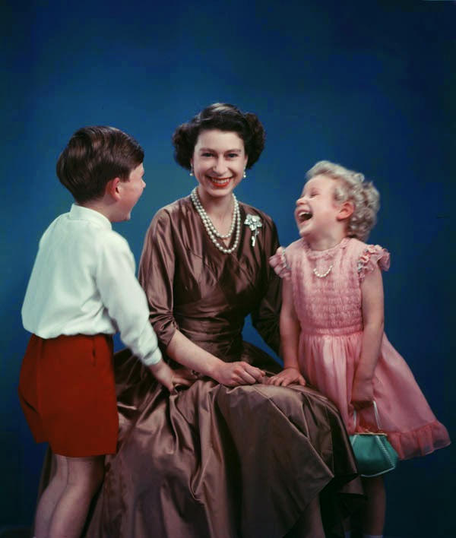
The Queen with Prince Charles and Princess Anne, 1954

Slide 31
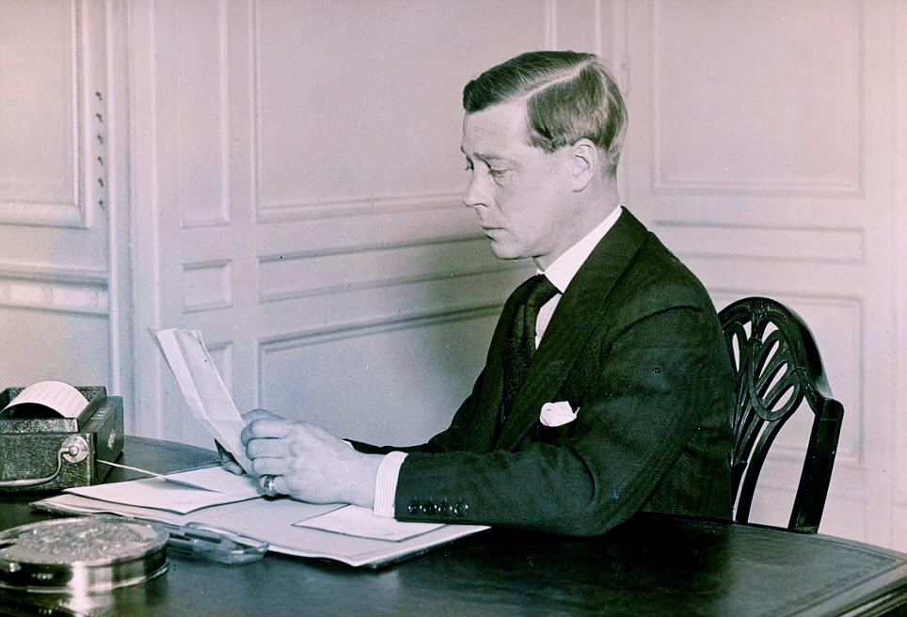
The Queen's uncle, Edward VIII prepares to
make his abdication speech in 1936.

Slide 32
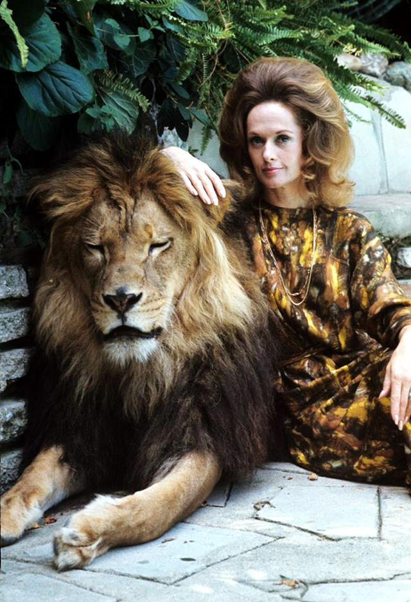
Tippi Hedren with
her pet lion Neil.

Slide 33
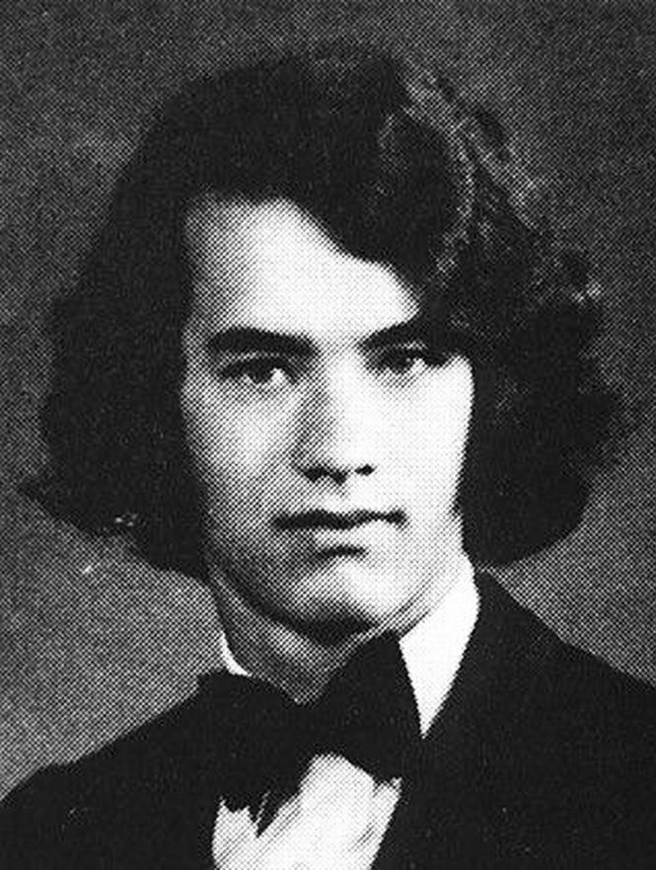
Tom Hanks in
high school.

Slide 34
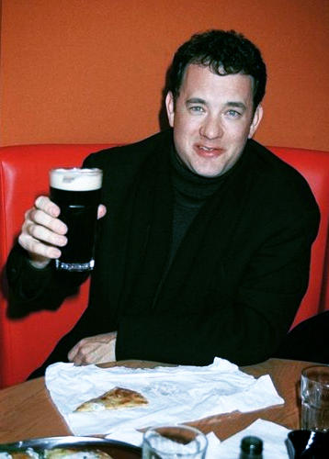
Tom Hanks having
a Guiness.

Slide 35
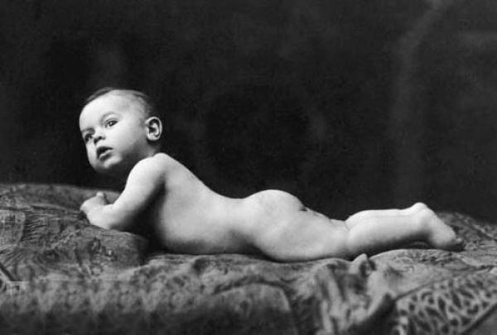
Tony Curtis baby picture - 1926

Slide 36
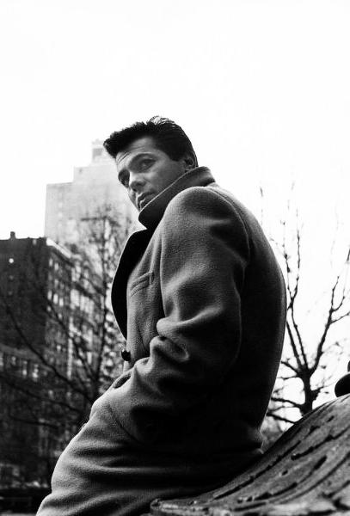
Tony Curtis - 1961

Slide 37
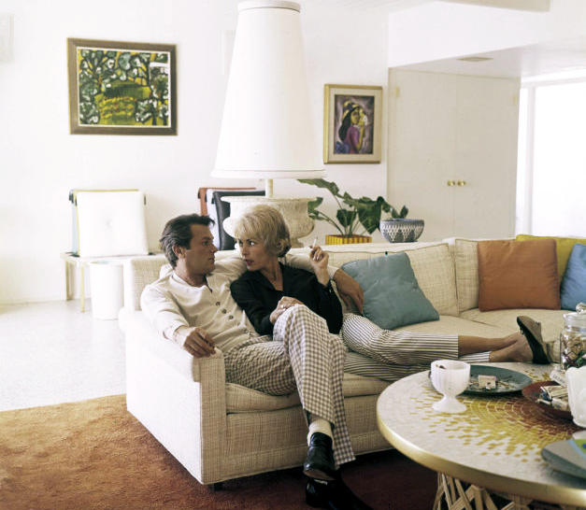
Tony Curtis and his wife Janet Leigh - 1959

Slide 38
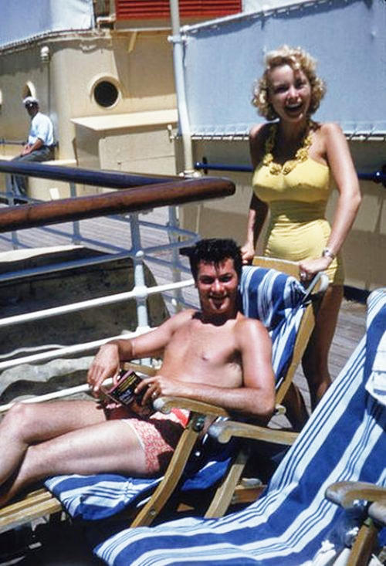
Tony Curtis and
Janet Leigh

Slide 39
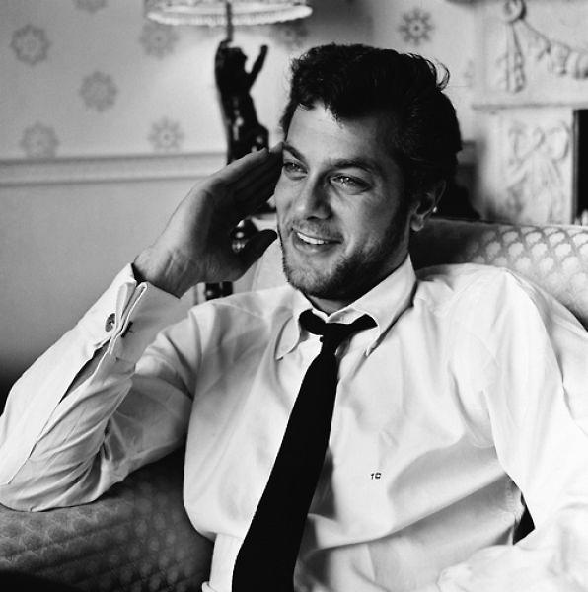
Tony Curtis - 1957

Slide 40
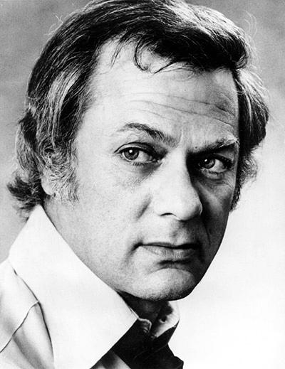
Tony Curtis - 1972

Slide 41
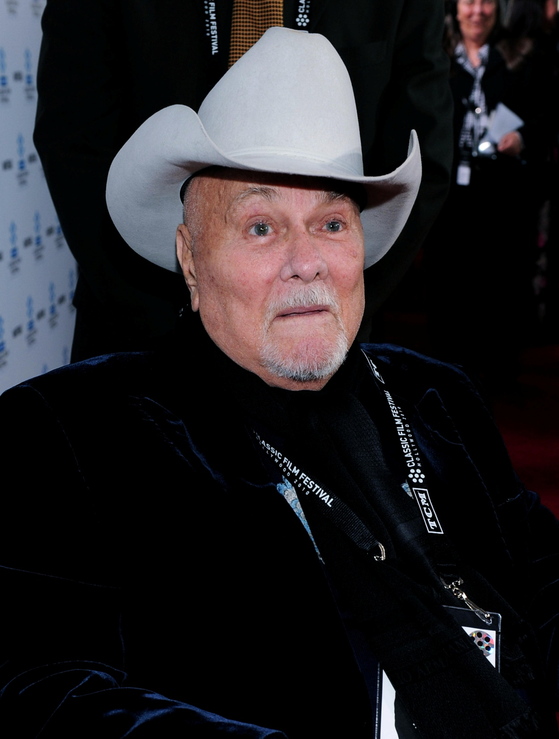
Tony Curtis - 2010

Slide 42


Seen on Bigfun.be
Author: Andrew

