Slide 1

Africa Geographic Photographer of The Year 2016
Winners & Finalists…

Slide 2
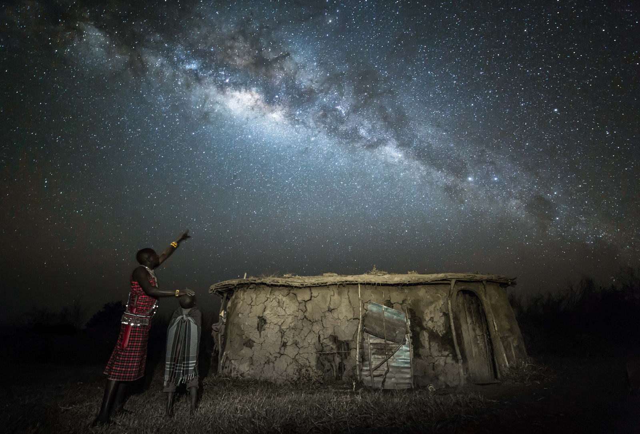
Overall winner-A Maasai warrior teaches his son about the stars ©Robin Stuart

Slide 3
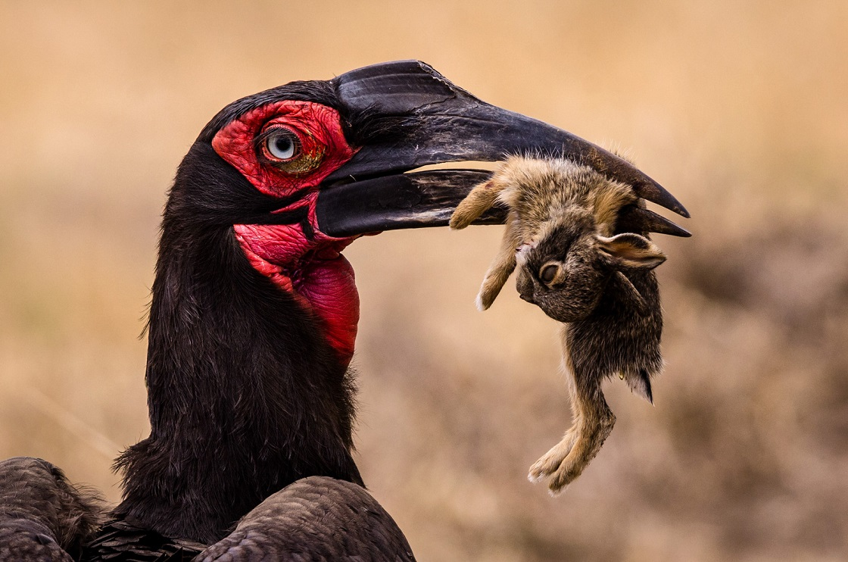
1. Wildlife-A hornbill and a hare in the Serengeti National Park, Tanzania ©William Walldén

Slide 4
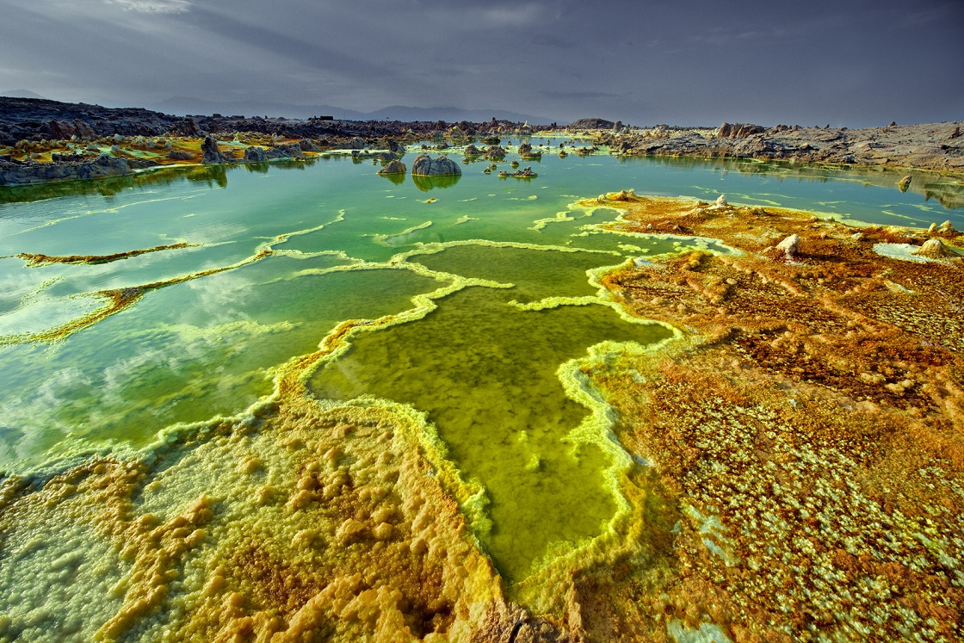
Travel-The surreal landscape of the sulphur pools at Dallol in the Danakil Depression, Ethiopia ©Trevor Cole

Slide 5
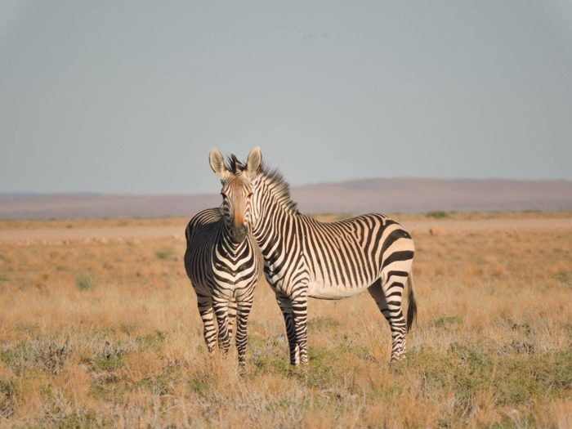
Audience favourite (winner of most votes) Illusions by nature in the Namib Desert, Namibia ©Gal Zanir

Slide 6
The finalists…

Slide 7
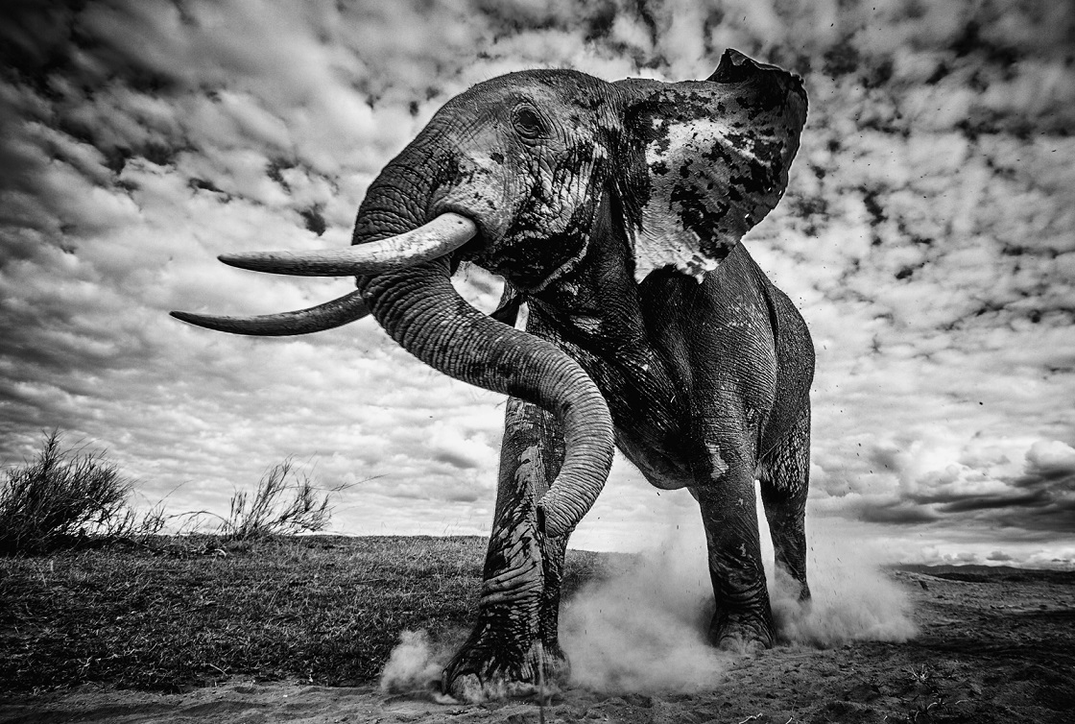
An elephant bull walks to the water in Amboseli National Park, Kenya ©Pieter Ras

Slide 8
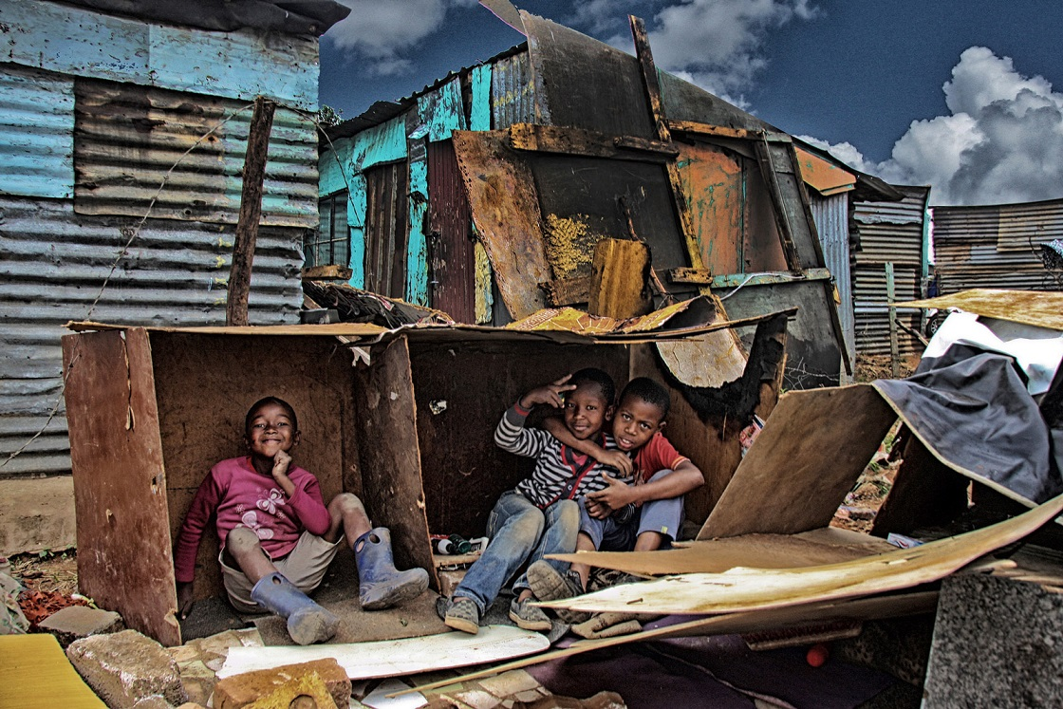
Children create a makeshift house in Motsoaledi informal settlement, South Africa ©Ilan Ossendryver

Slide 9
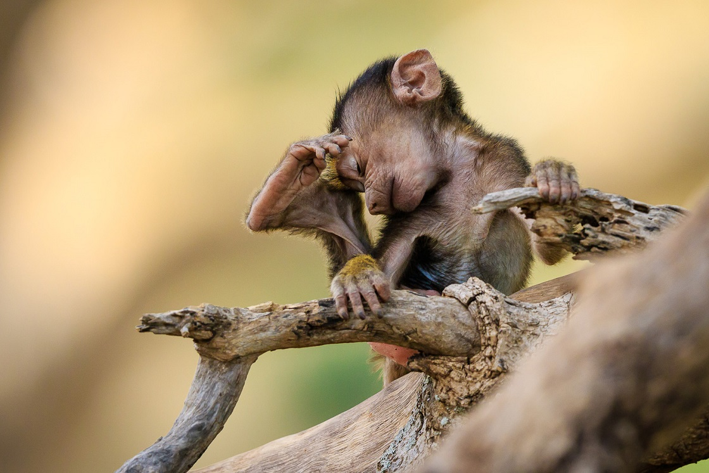
A young baboon strikes a pose in Tarangire National Park, Tanzania ©Jacques-Andre Dupont

Slide 10
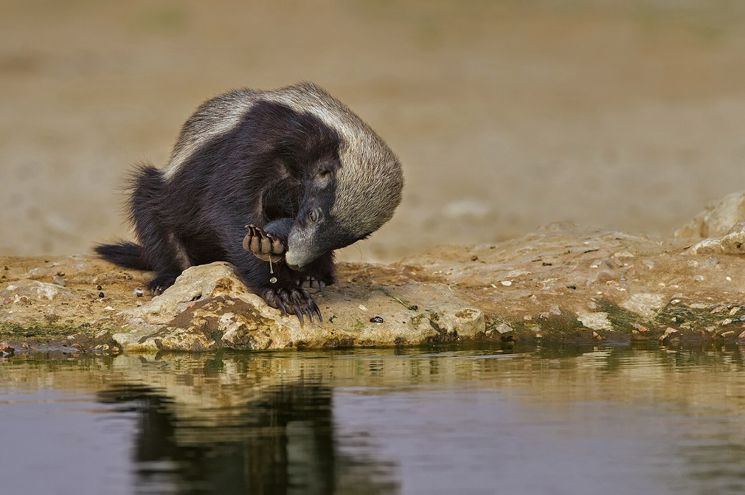
A honey badger at Cubitje Quap waterhole in the Kgalagadi Transfrontier Park ©Willem Kruger

Slide 11
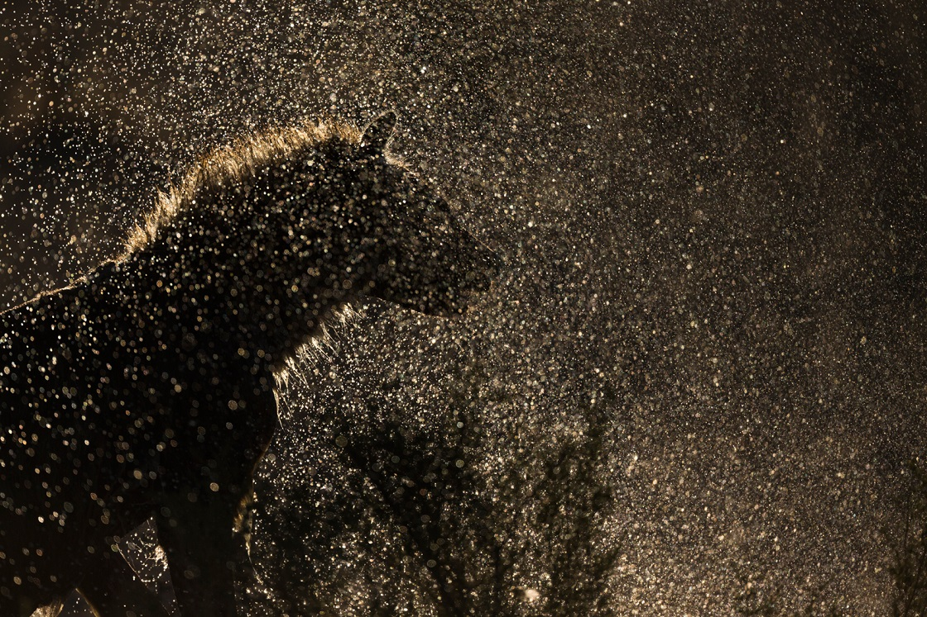
A hyena gets caught in the rain ©Nick Rabjohn

Slide 12
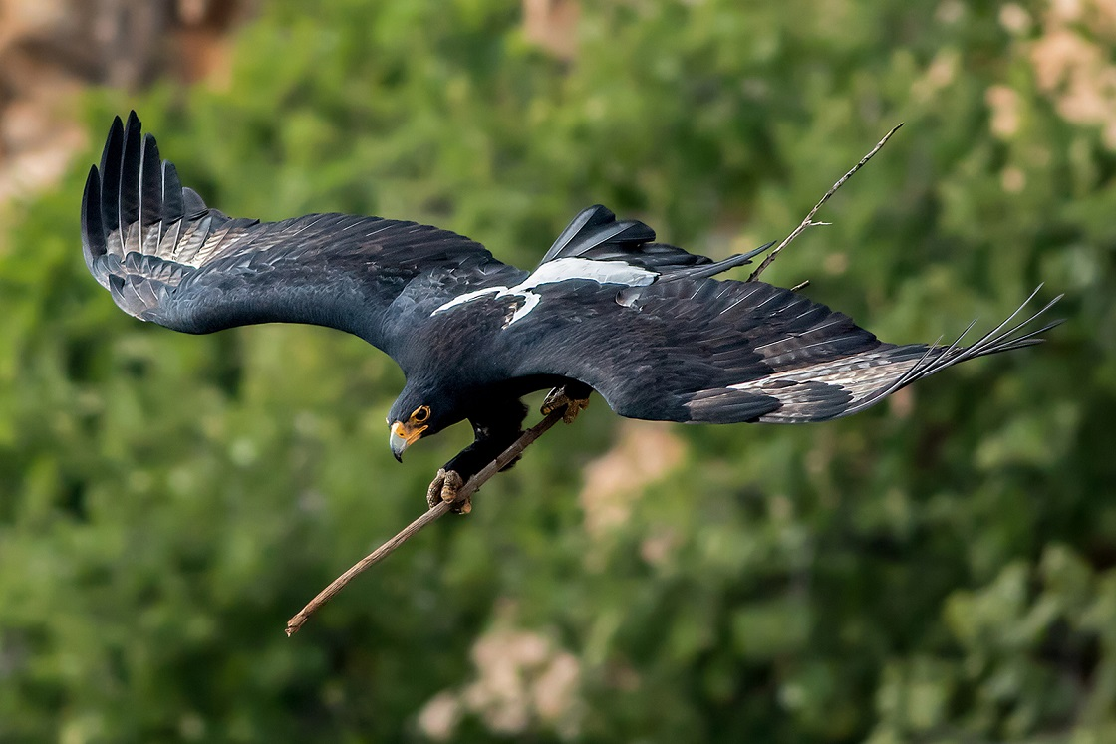
A black eagle takes a branch to its nest in Walter Sisulu National Botanical Gardens, South Africa ©Ernest Porter

Slide 13
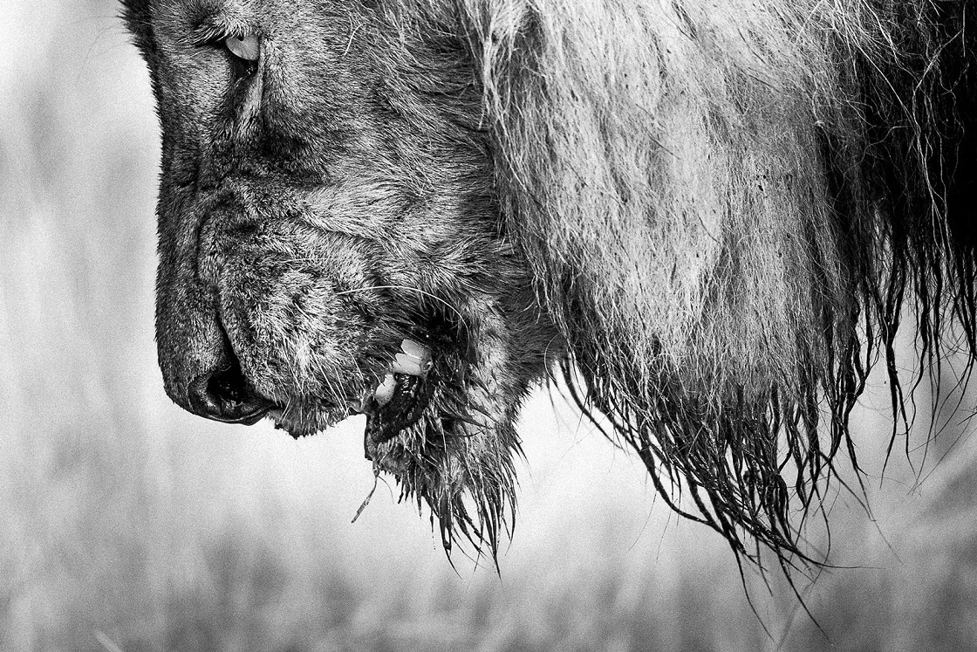
A male lion in the twilight of his reign in Kruger National Park, South Africa ©Craig Hayman

Slide 14
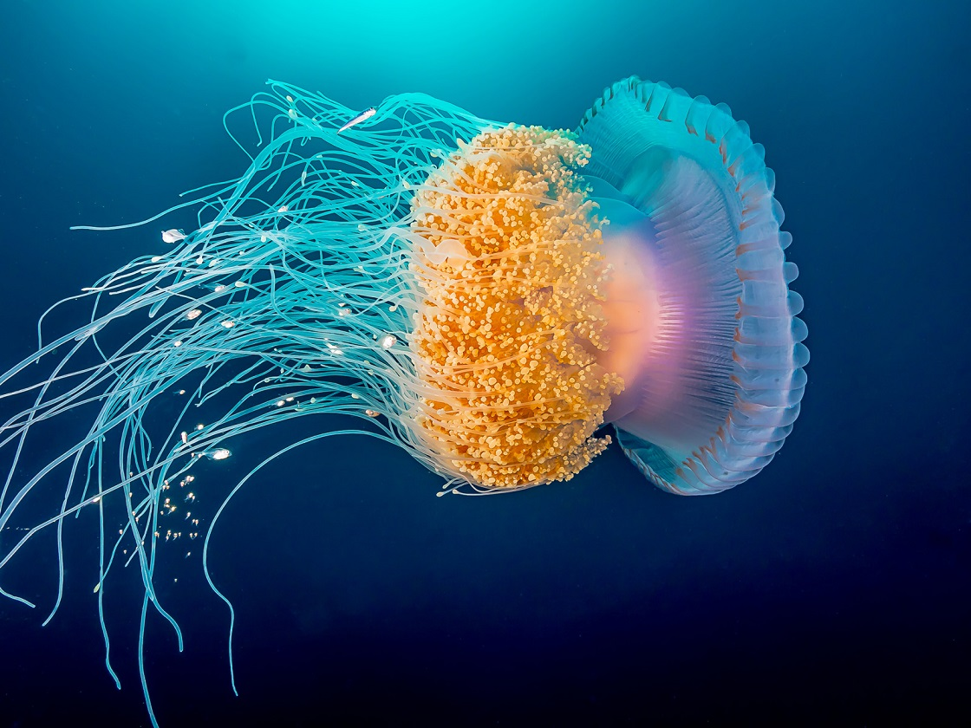
An underwater dancer in Protea Banks, a top dive site off the coast of KwaZulu-Natal, South Africa ©Pier Mane

Slide 15
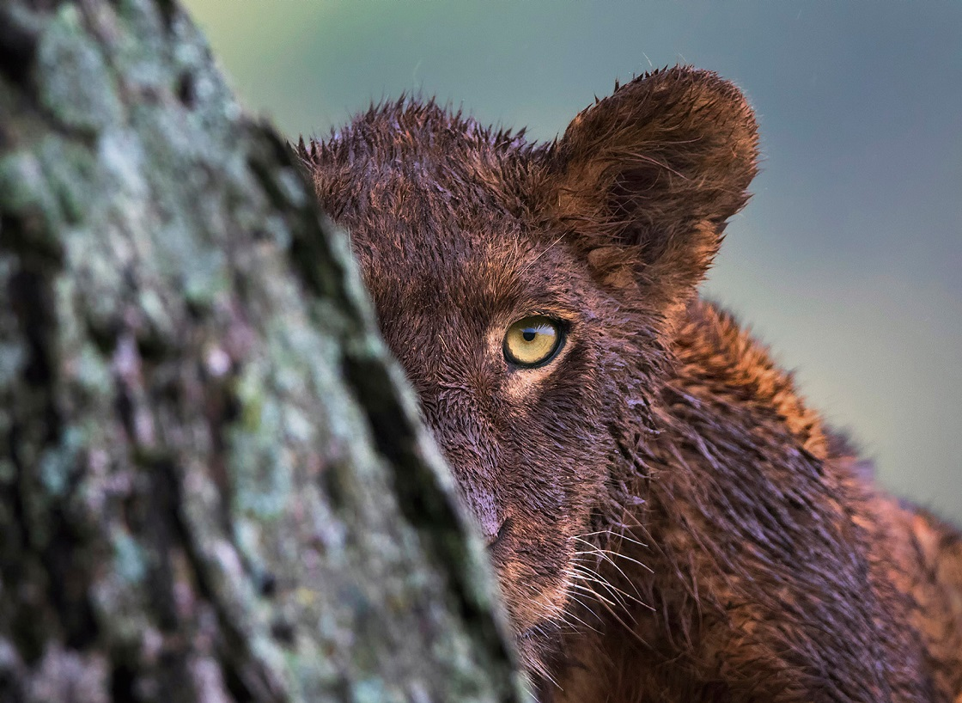
A rainy day for a lion in the Serengeti National Park, Tanzania ©Panos Laskarakis

Slide 16
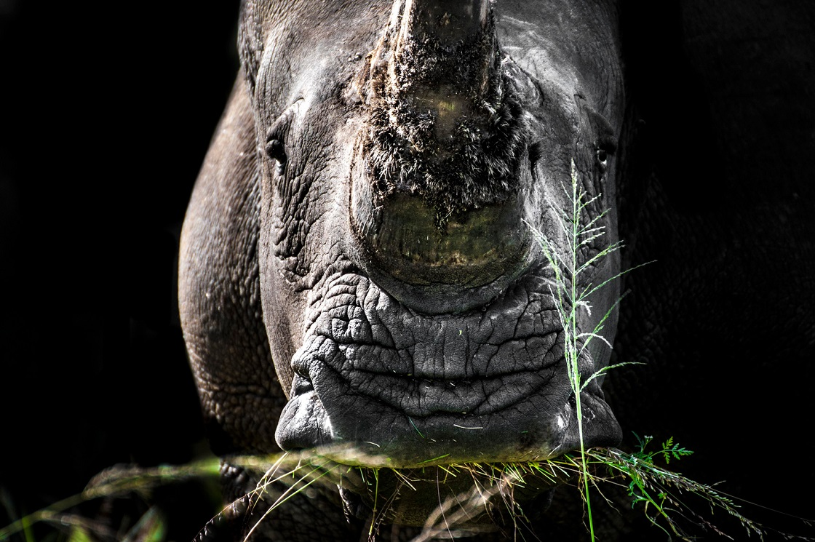
Greener pastures for a white rhino in a private game reserve in South Africa ©Mark Winckler

Slide 17
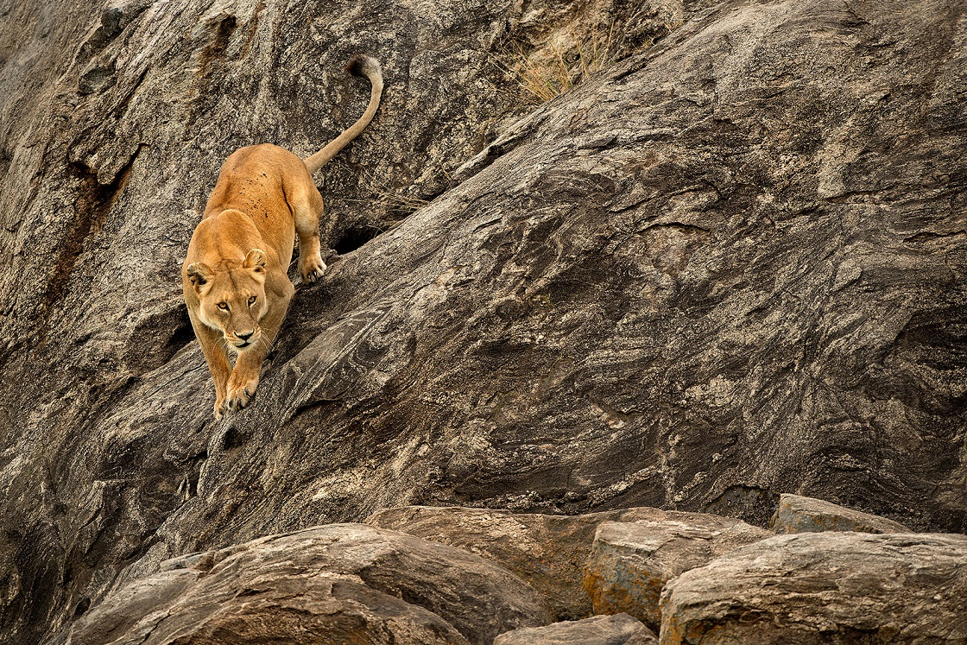
A lioness prepares to hunt in the Serengeti National Park, Tanzania ©Roie Galitz

Slide 18
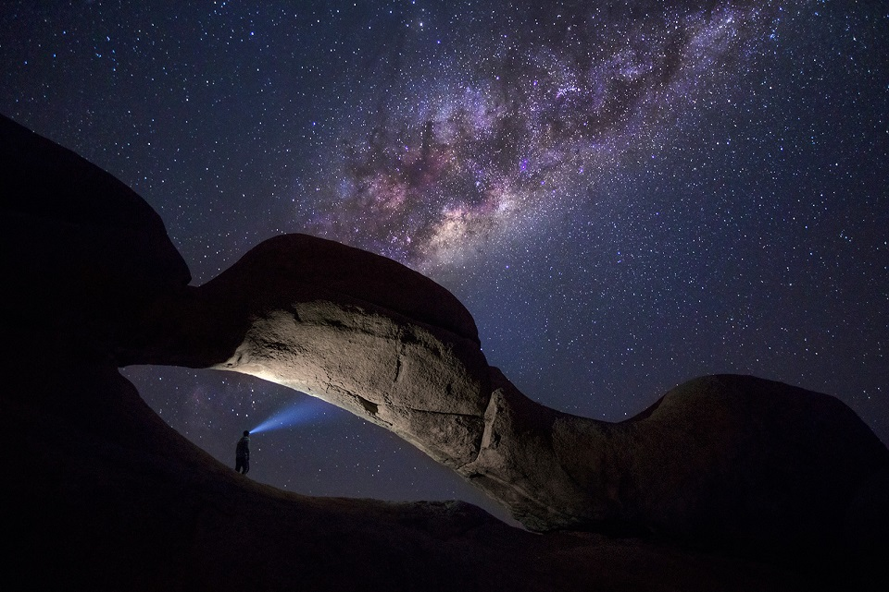
Shining a light on the Milky Way in Spitzkoppe, Namibia ©Ben McRae

Slide 19
Competition Round-up

Slide 20
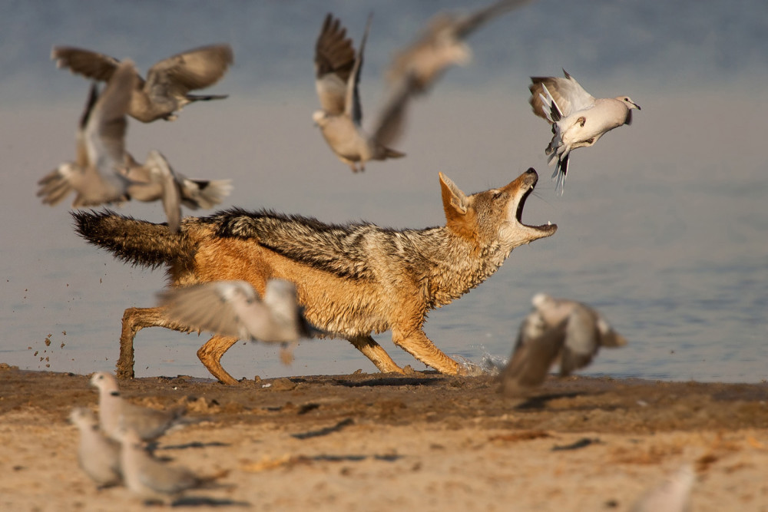
A jackal tries to catch doves in Etosha ©Johan J. Botha

Slide 21
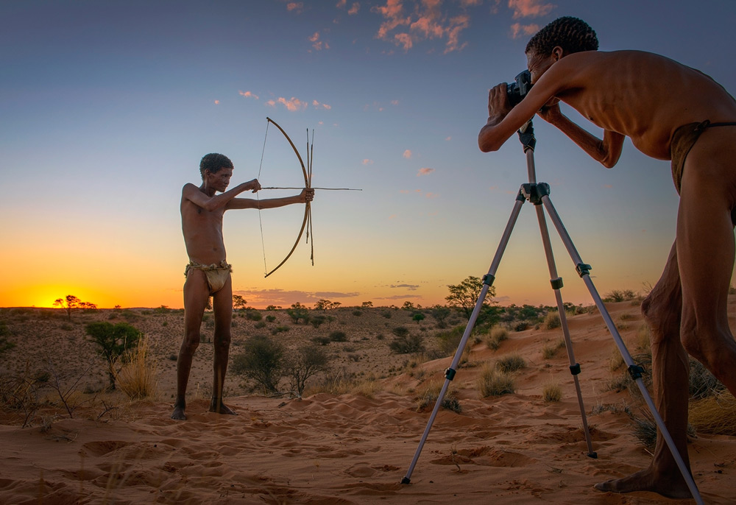
A double take on shooting in the Kalahari Desert ©Ferdinand Veer

Slide 22
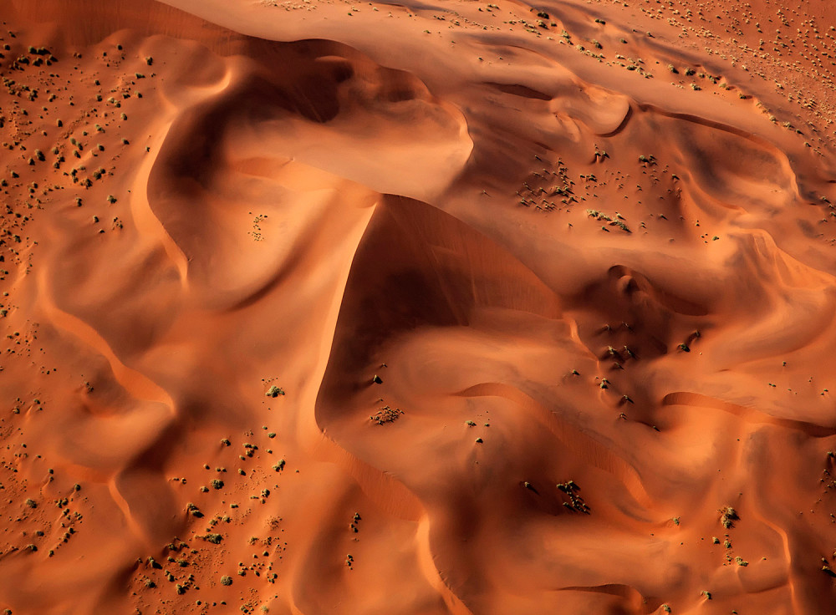
An aerial view of the rolling dunes of Sossusvlei in Namibia ©Panos Laskarakis

Slide 23
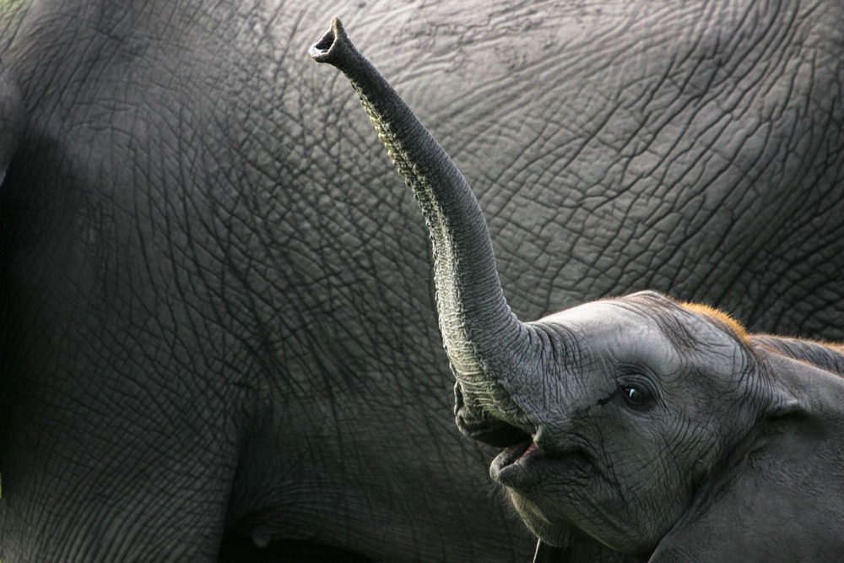
A baby ellie waves at the camera in Savuti, Botswana ©Jack Hochfeld

Slide 24
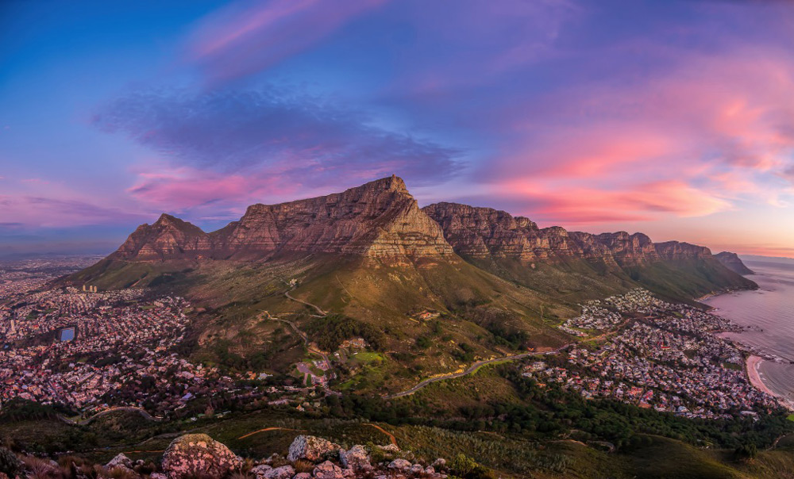
It’s hard for other cities to compete with the view of Cape Town, South Africa ©Dercio Jose Pinto Chim Jin

Slide 25
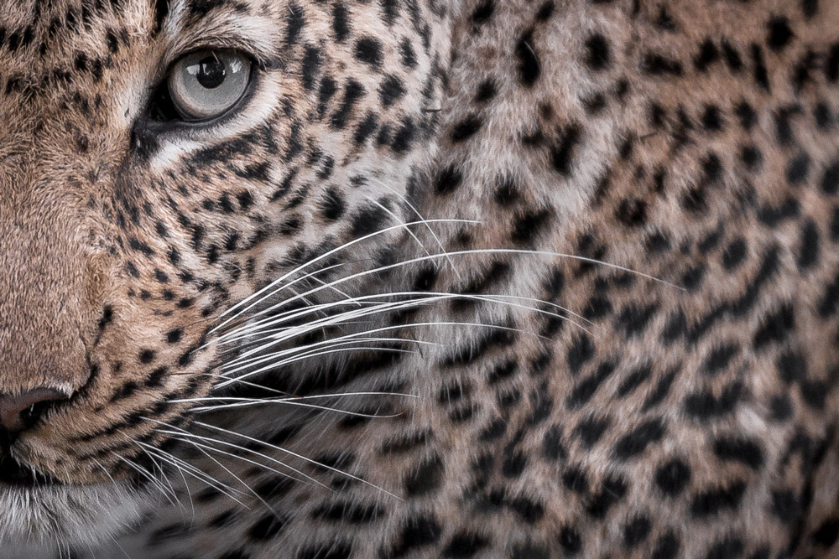
It’s the eye of the… leopard in Sabi Sand Game Reserve, South Africa ©Sean Cresswell

Slide 26
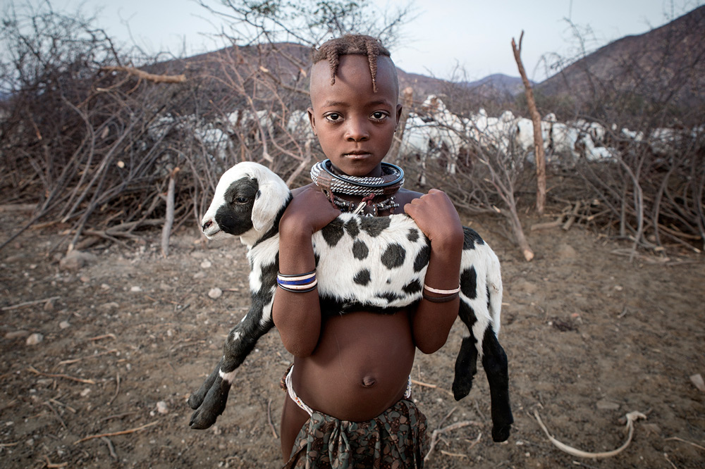
A child and a baby goat in the Epupa region of Namibia ©Ben Mcrae

Slide 27
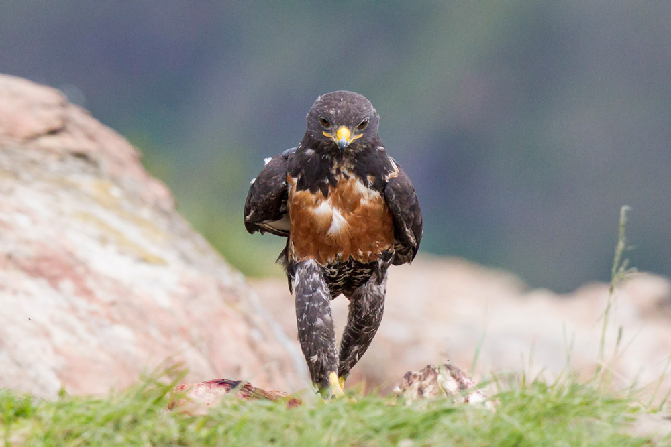
A jackal-buzzard takes a walk to clear his mind in Giants Castle, South Africa ©Clint Ralph

Slide 28
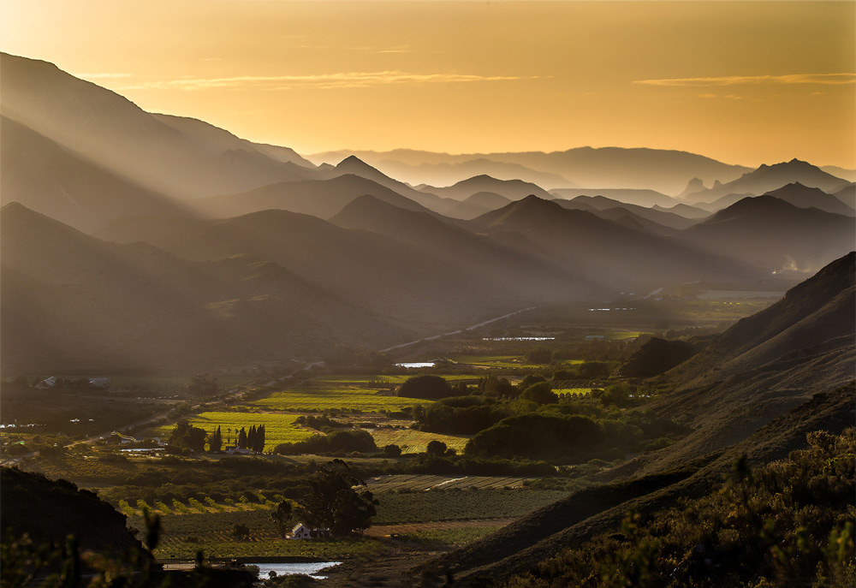
Magnificent rays of light shine down on Prince Albert, South Africa ©John Vosloo

Slide 29
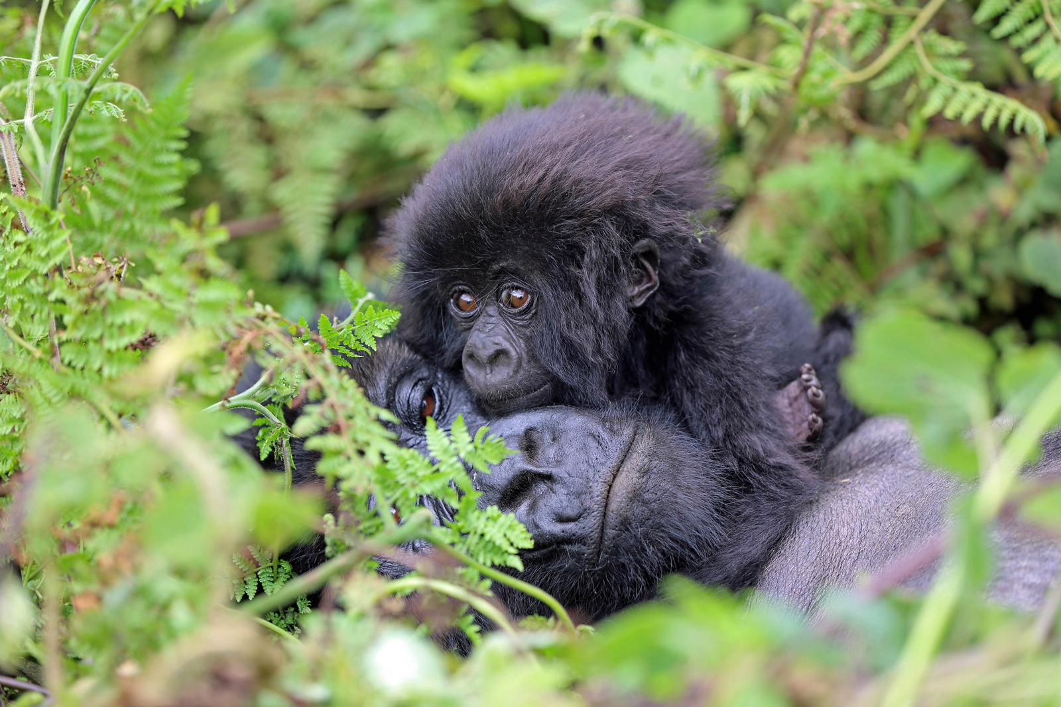
Baby gorilla loving in Volcanoes National Park, Rwanda ©Matthias Alter

Slide 30
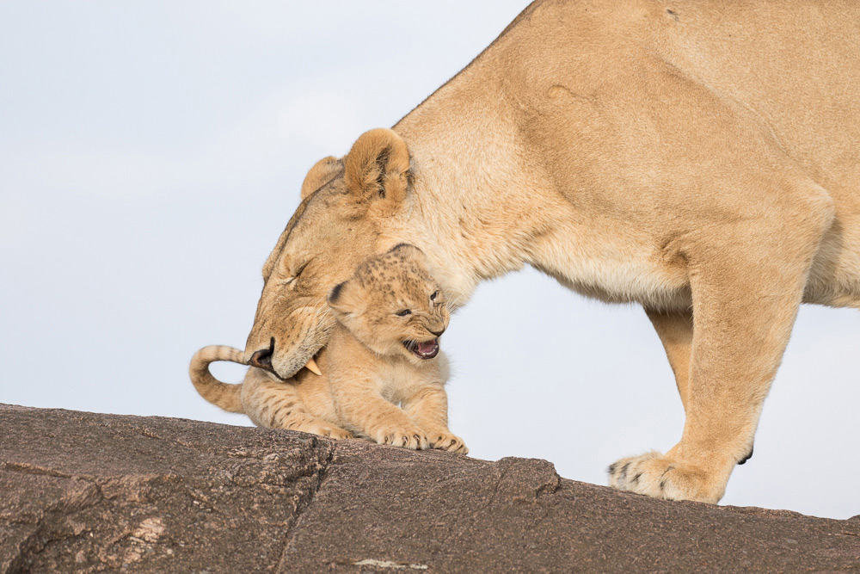
Look at the face of this little cub in the Maasai Mara National Reserve, Kenya ©Robyn E Preston

Slide 31
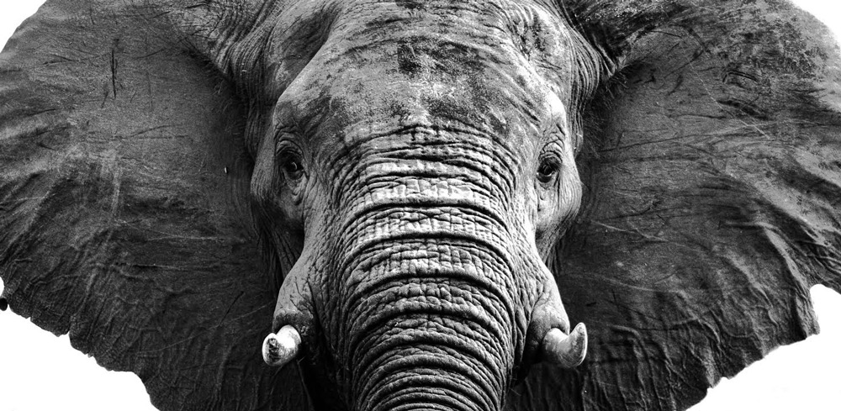
An elephant stand-off in Zambezi National Park ©Simon Webber

Slide 32
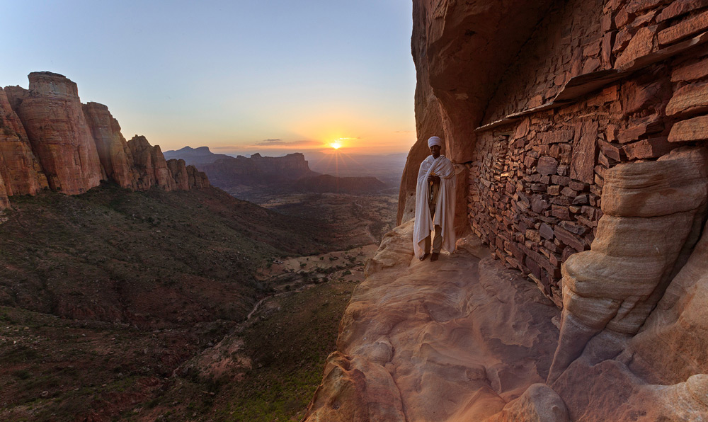
The sun sets behind an orthodox priest in Tigray, Ethiopia ©Greg Metro

Slide 33
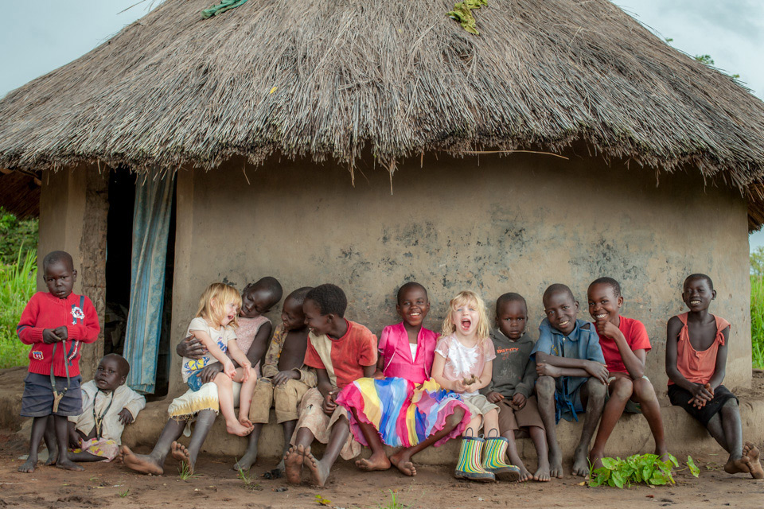
Children make friends in a former Lord’s Resistance Army village ©Brina Bunt

Slide 34
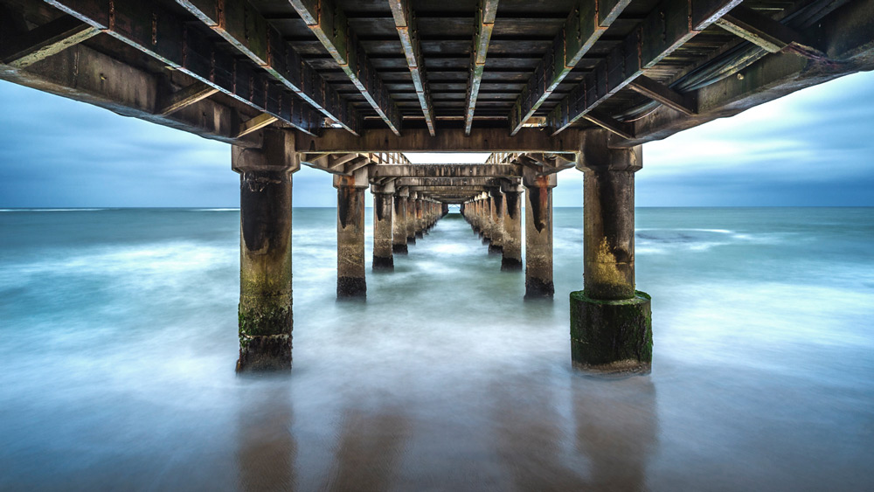
The iconic jetty in Swakopmund, Namibia ©Anna Mart-Kruger

Slide 35
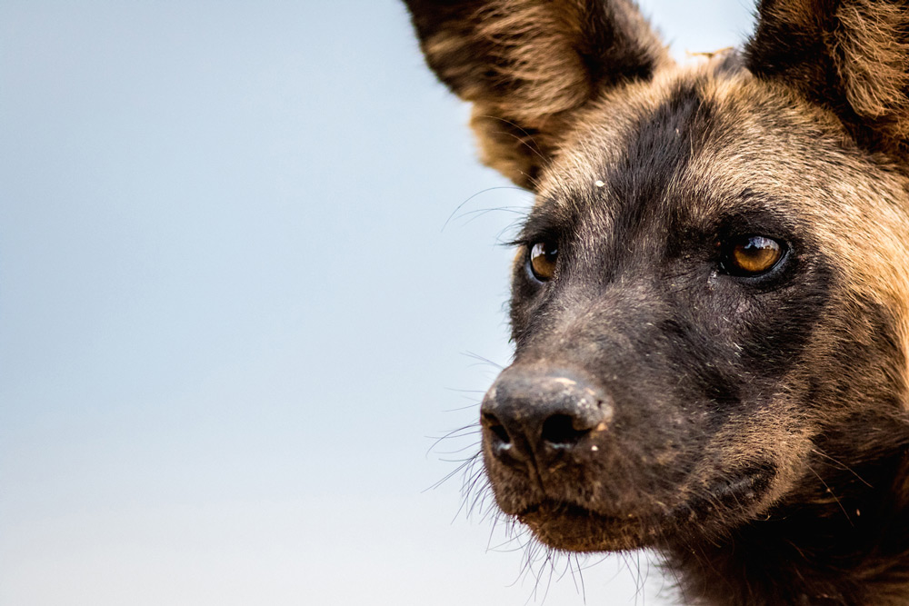
A wild dog shows off its best side in Selous Game Reserve ©Jeff Trollip

Slide 36
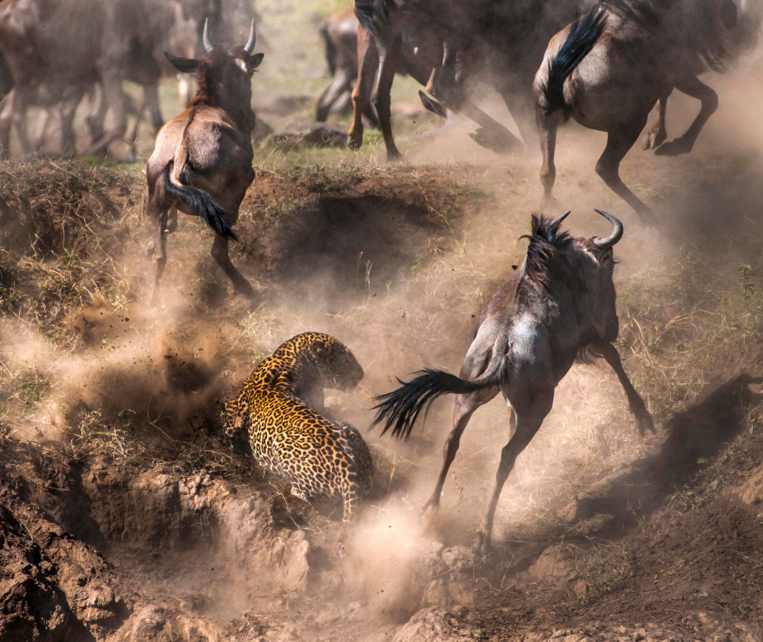
Chaos ensues in the Maasai Mara National Reserve, Kenya ©Paolo Torchio

Slide 37
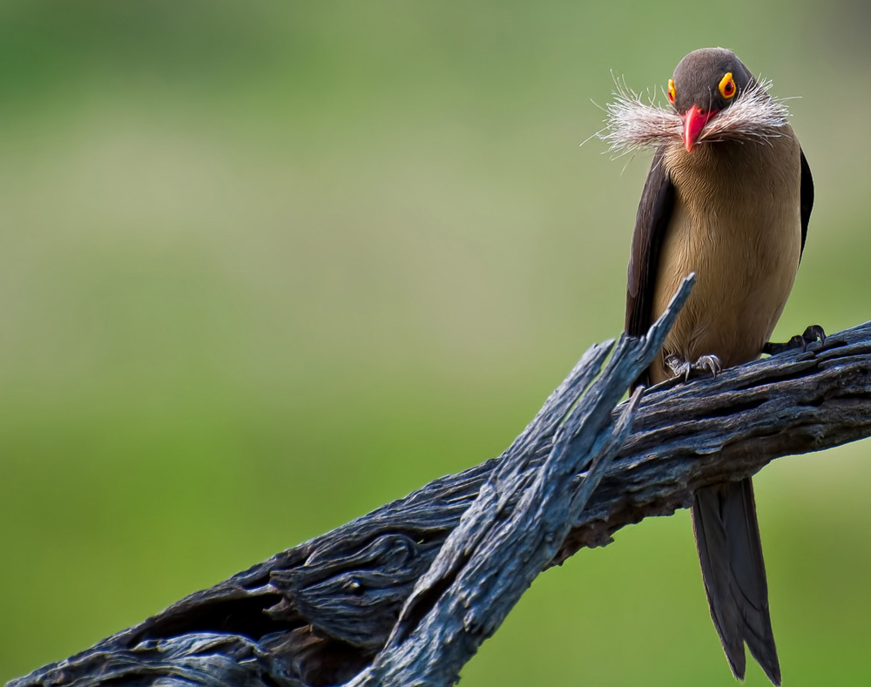
A red-billed oxpecker gets ready for Movember ©Tinus Beyers

Slide 38
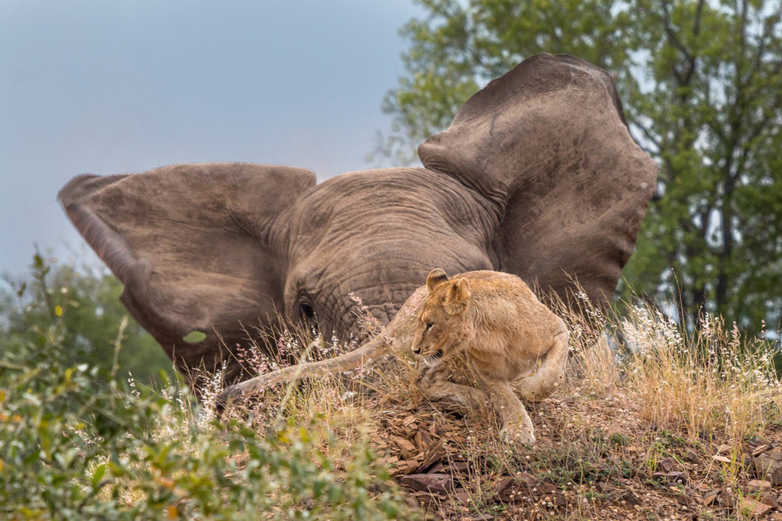
“He’s behind you!” Screamed the pantomime audience in Hluhluwe-Imfolozi Park, South Africa ©Jonathan Webster

Slide 39
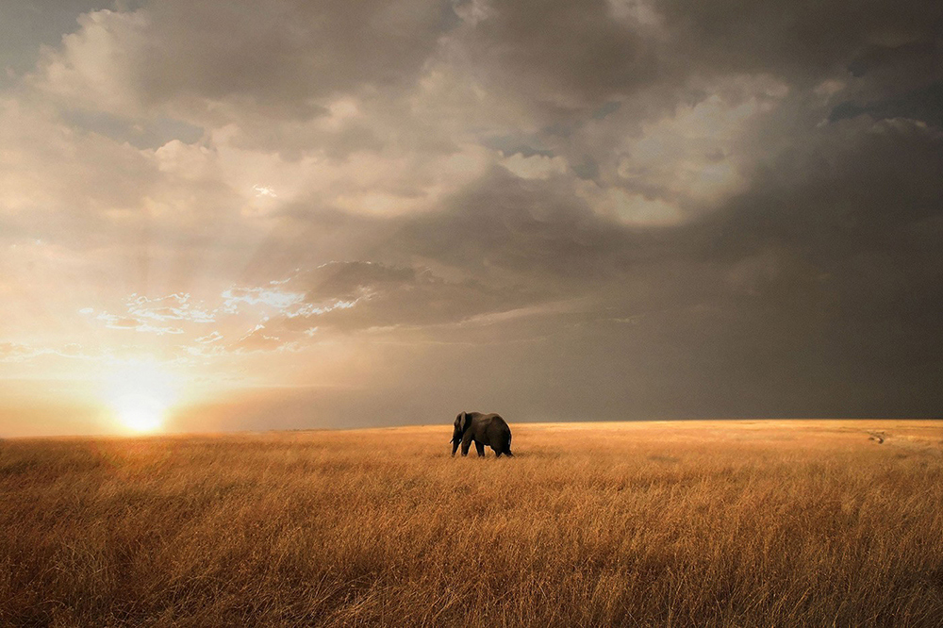
The golden light of the Maasai Mara National Reserve, Kenya ©Bjorn Persson

Slide 40

END SHOW
Seen on Bigfun.be
Author: Magdalena

