Slide 1
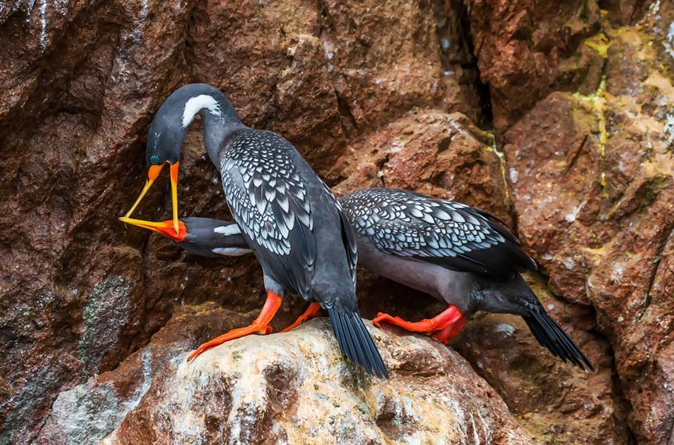
The 2016 Audubon Photography Awards: Top 100
Chaque année, nous présentons des milliers de candidatures pour les Audubon Photography Awards, et chaque année, nous devons faire le choix époustouflant de choisir une poignée de gagnants. Heureusement pour nous, nos lecteurs ont toujours faim de photos d'oiseaux plus étonnantes. Nous aimerions donc partager une centaine de nos favoris (sans ordre particulier
Lucienne ppsx

Slide 2
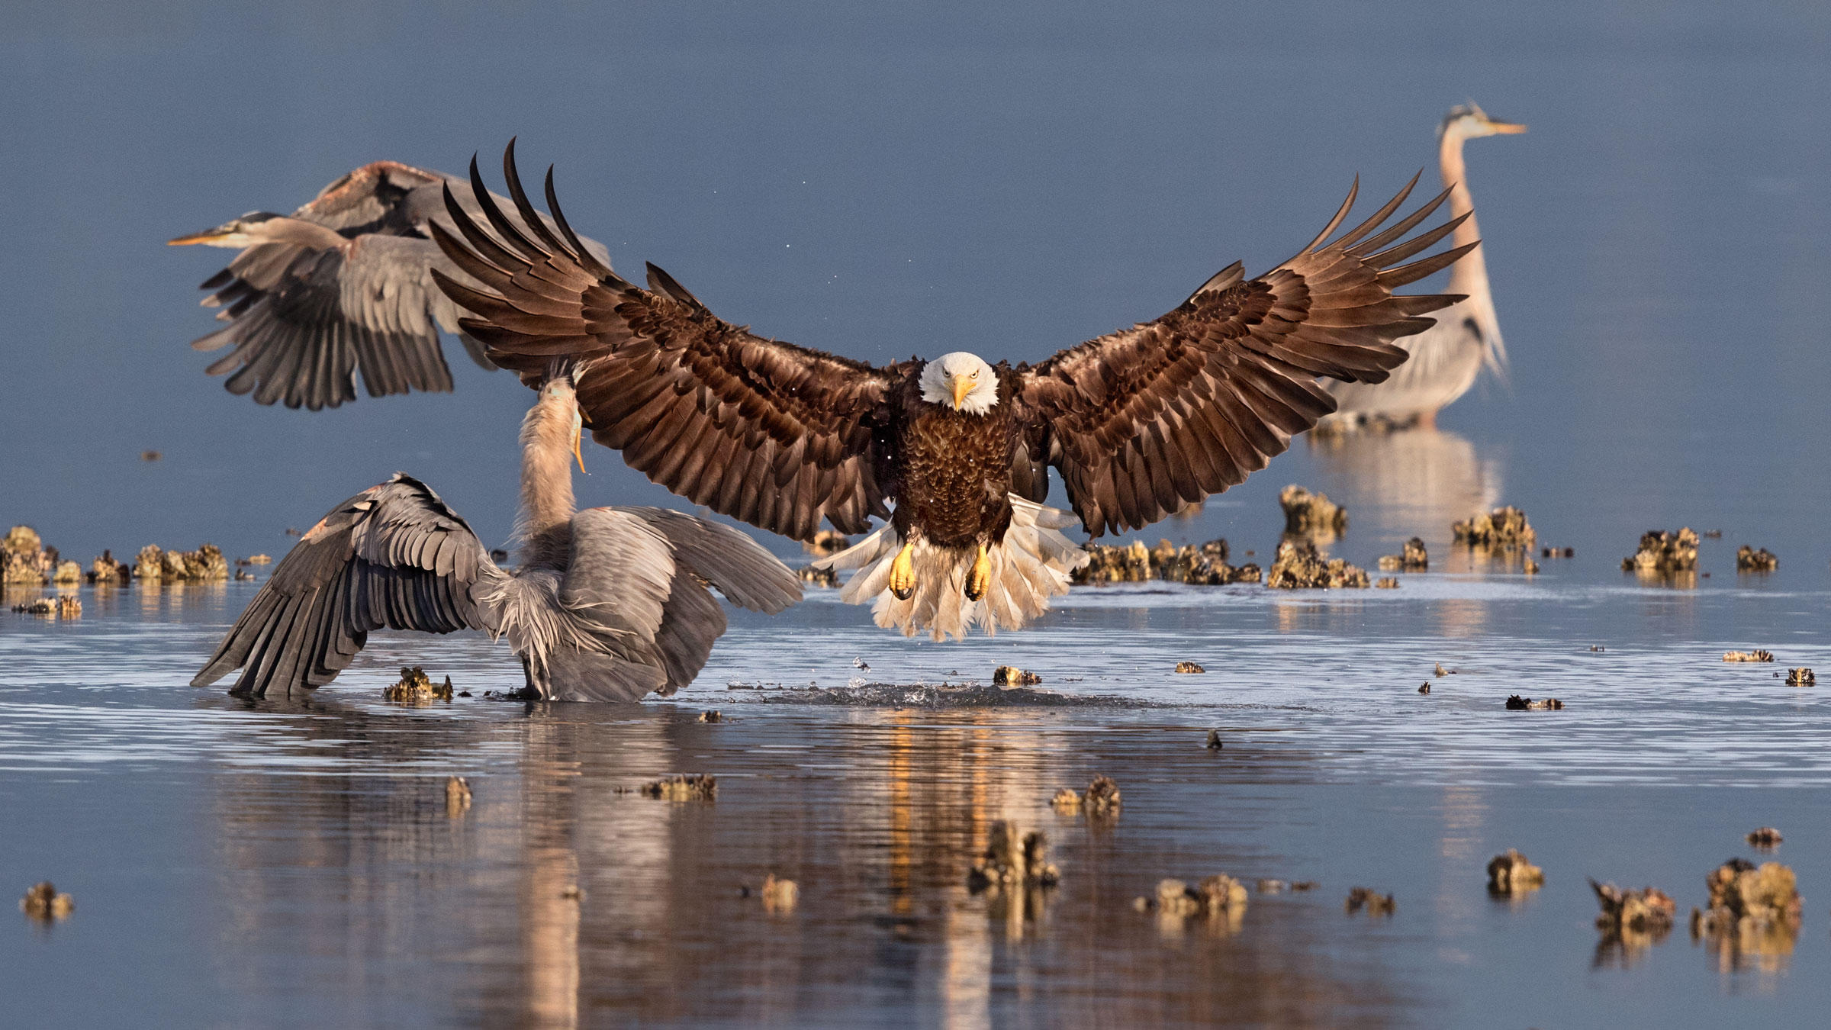
Grand Prize Winner Bonnie Block

Slide 3
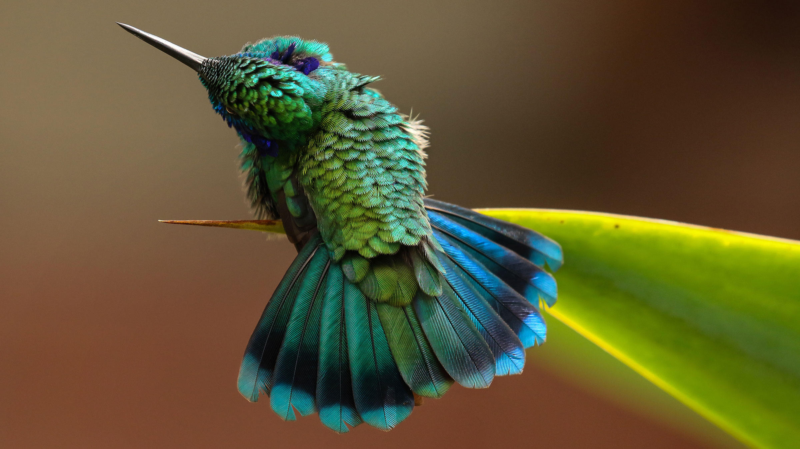
Green Violetear. Photo: Barbara Driscoll/Audubon Photography Awards

Slide 4
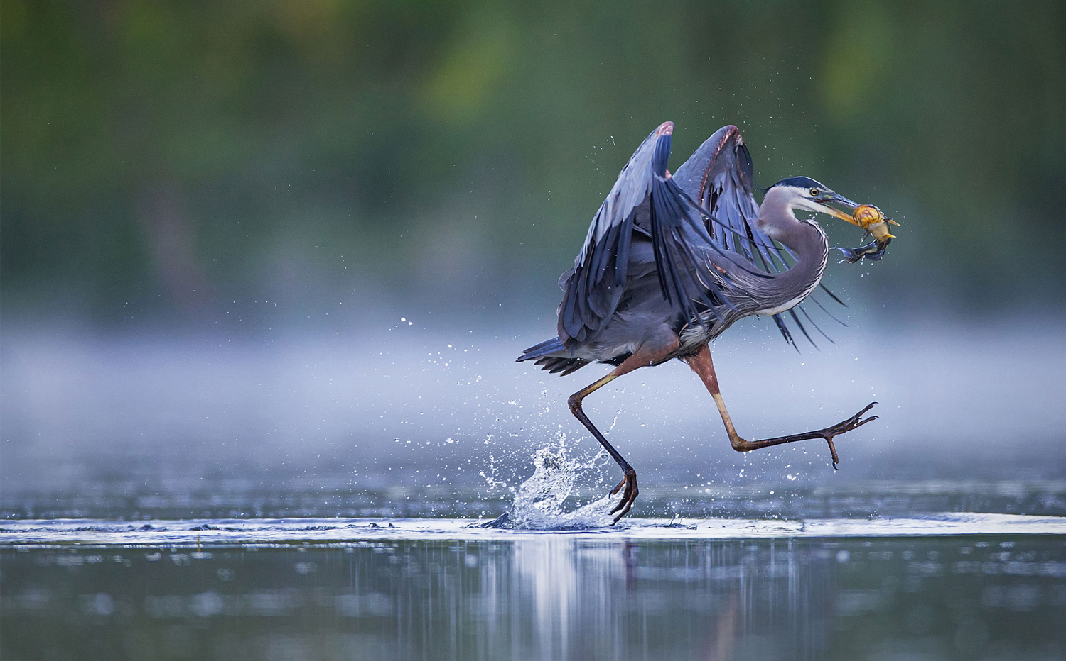
Great Blue Heron / Top 100, Amateur Category. Christopher Schlaf / Audubon Photography Awards #

Slide 5
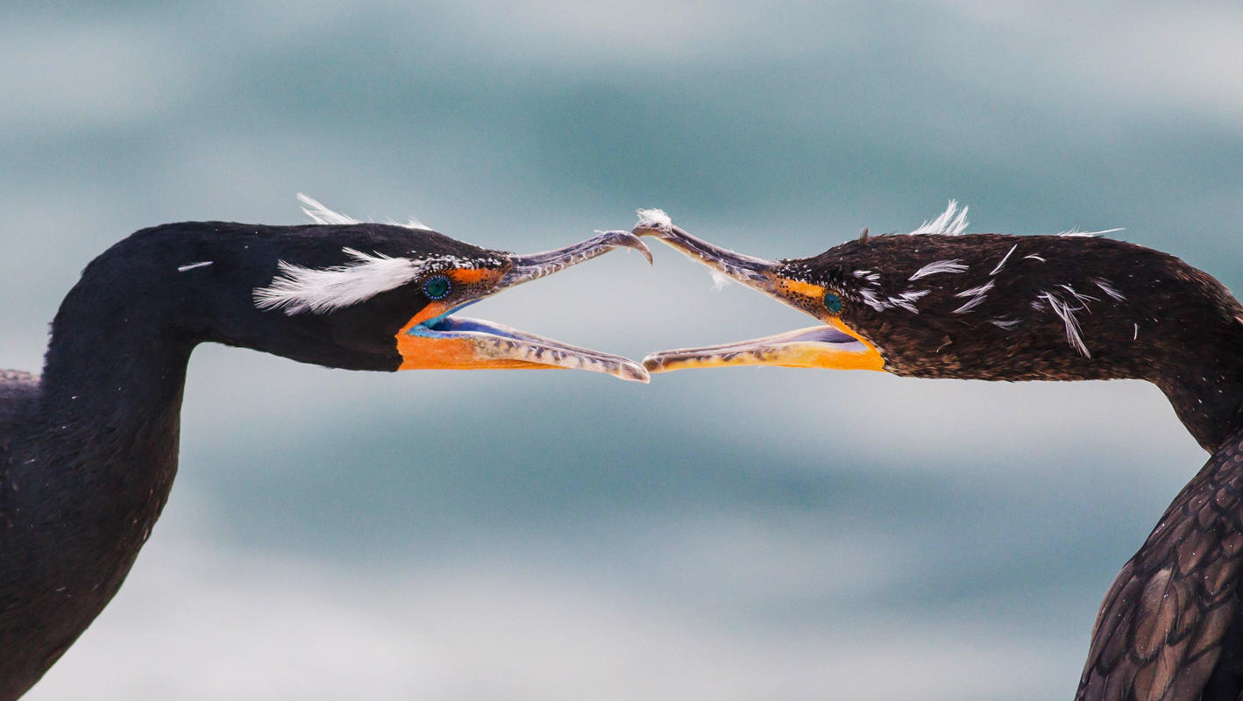

Slide 6
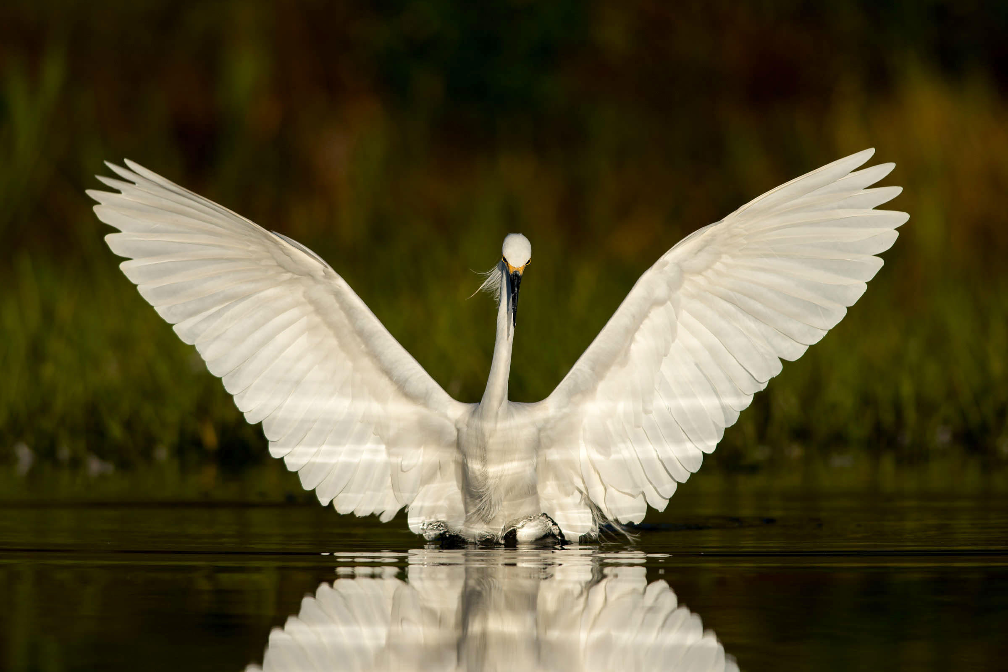

Slide 7
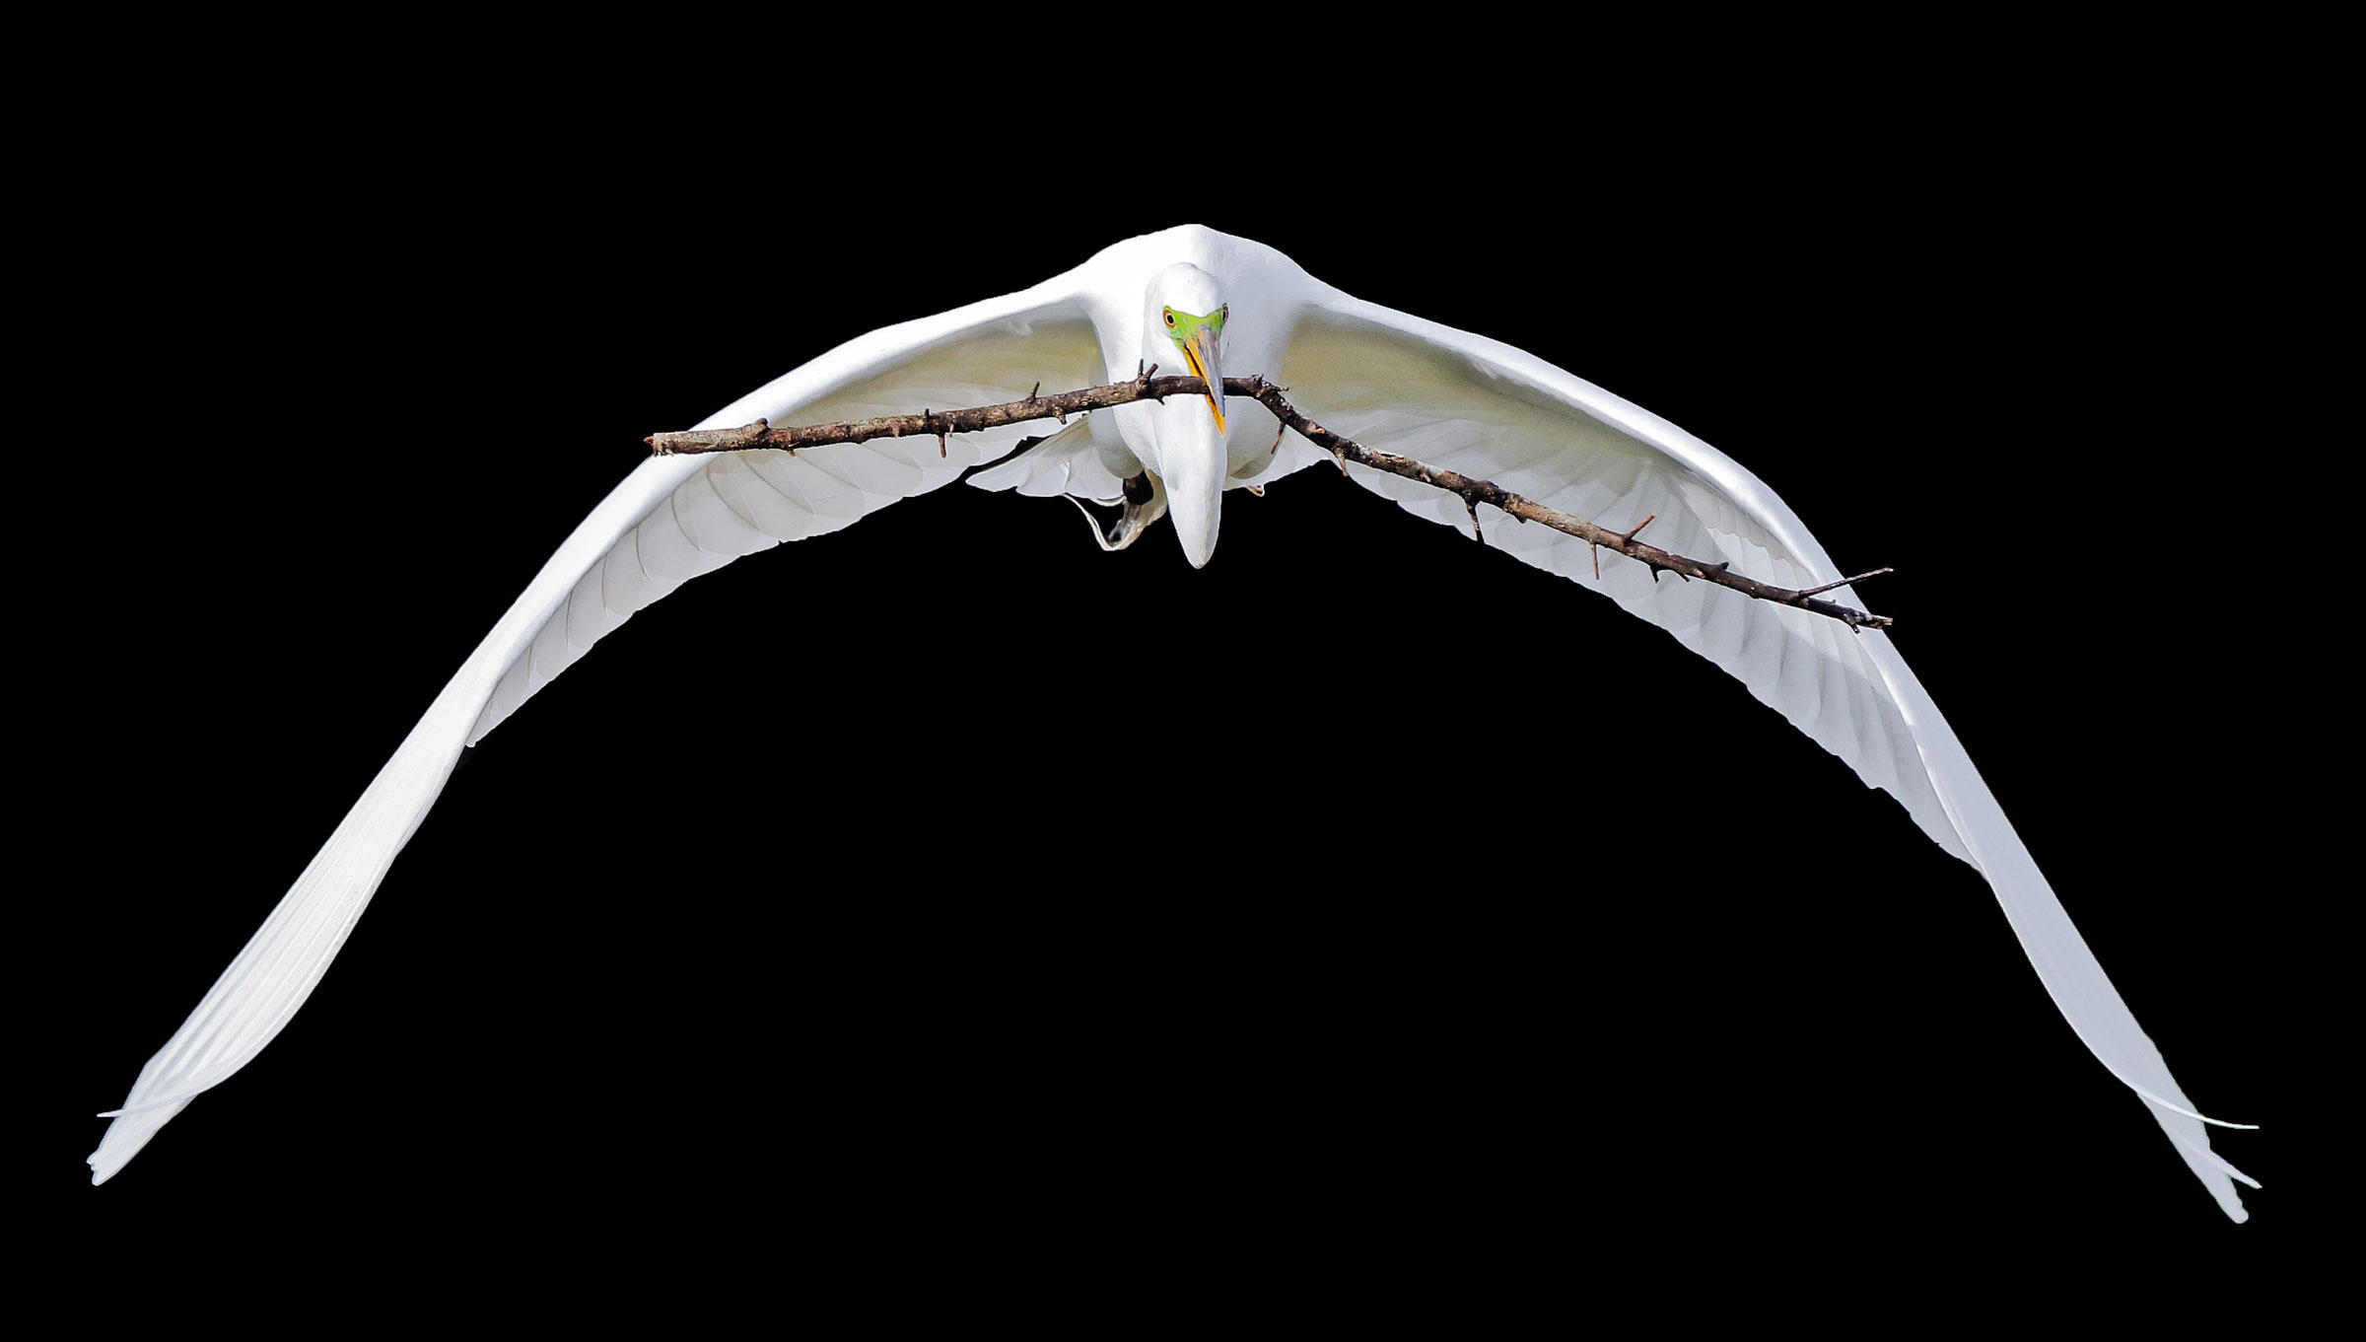

Slide 8
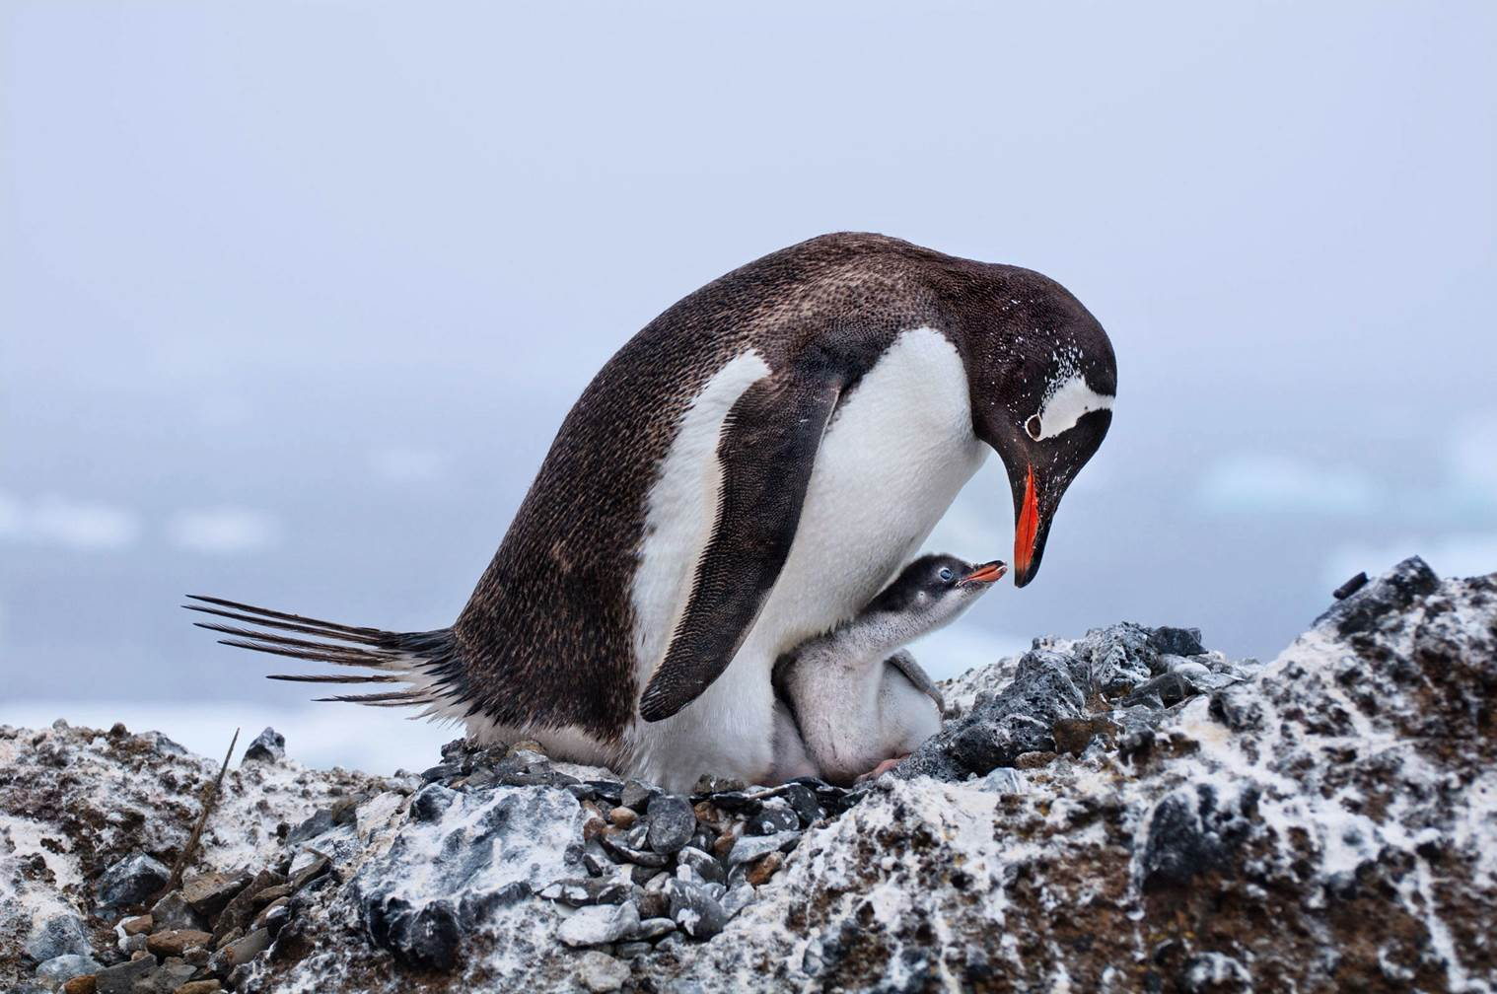

Slide 9
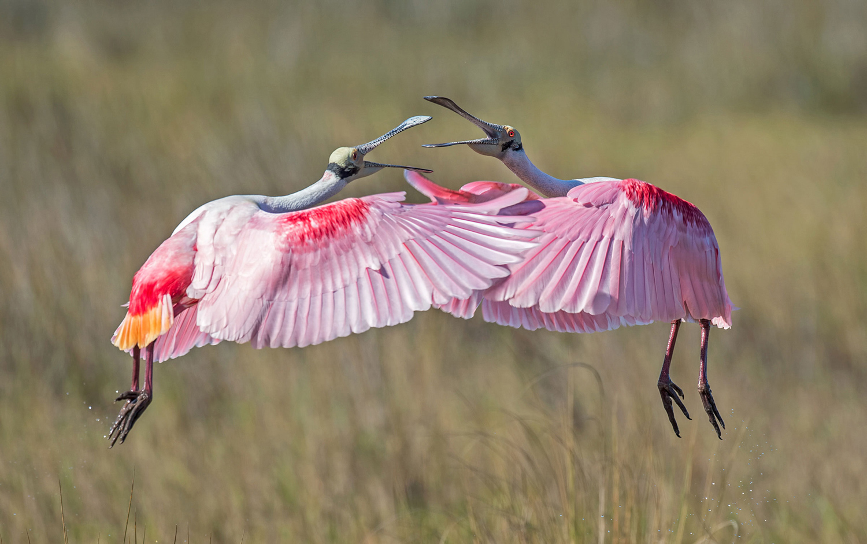
Roseate Spoonbills / Top 100, Amateur Category. Judylynn Malloch / Audubon Photography Awards #

Slide 10
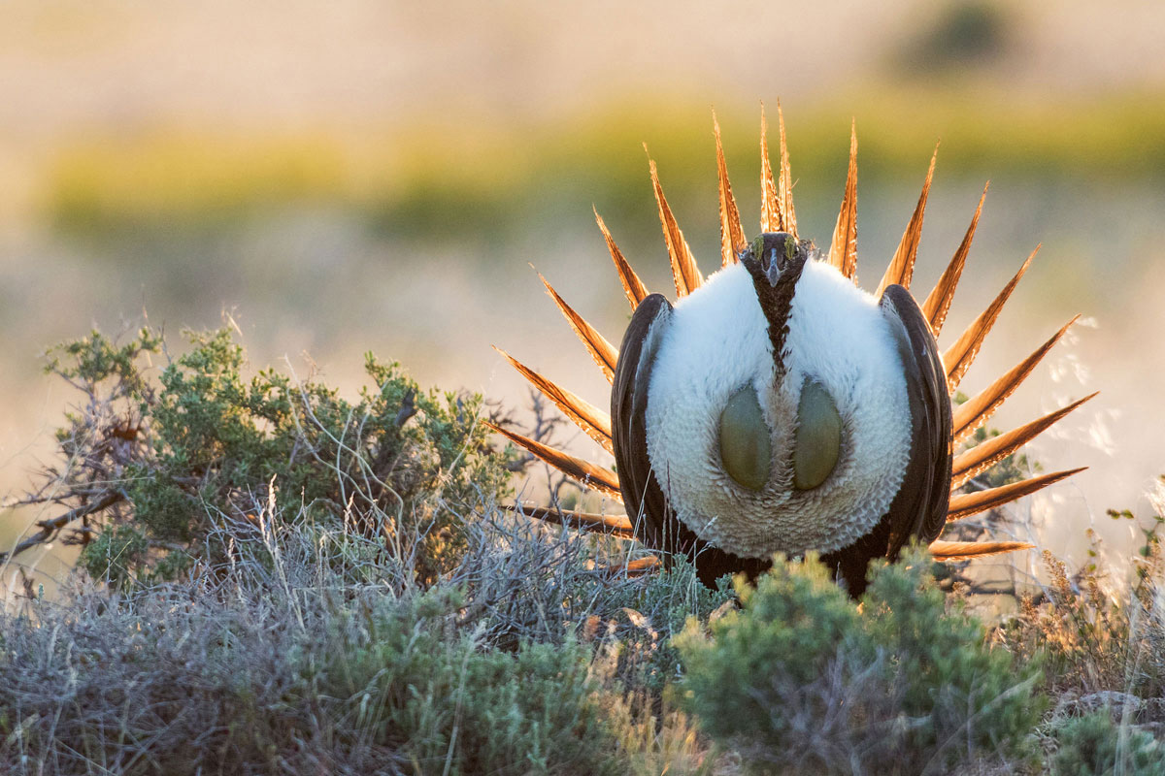
Greater Sage-Grouse / Top 100, Professional Category. Ken Archer / Audubon Photography Awards #

Slide 11
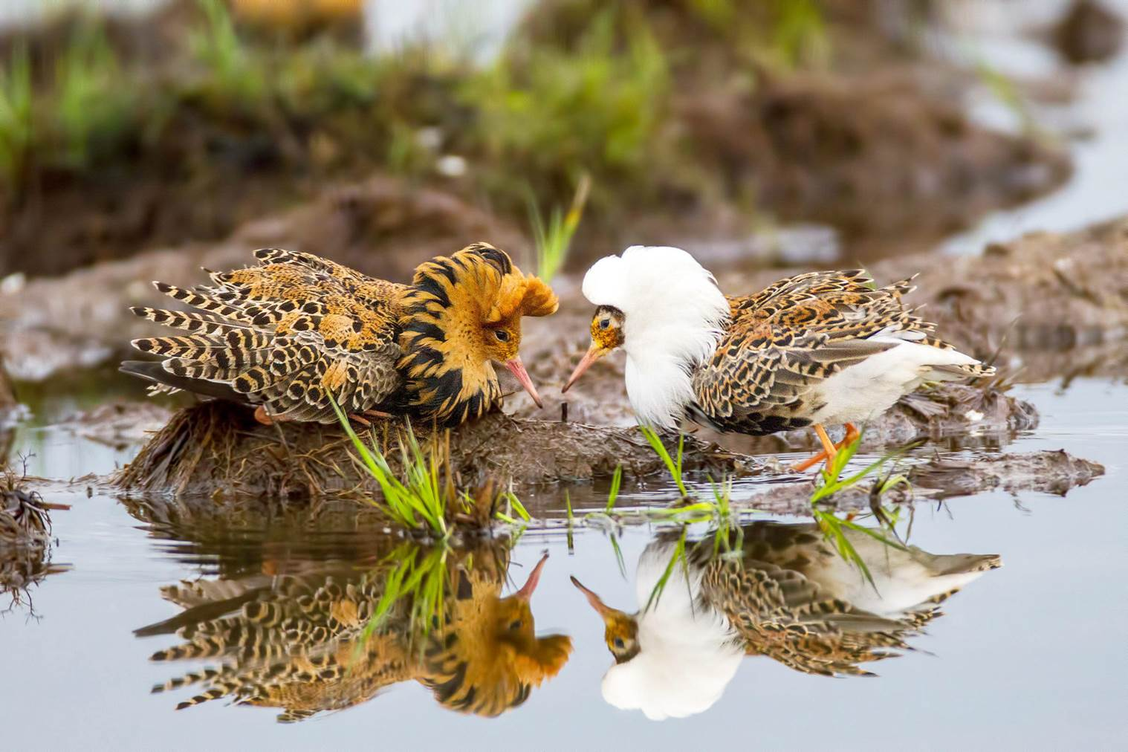

Slide 12
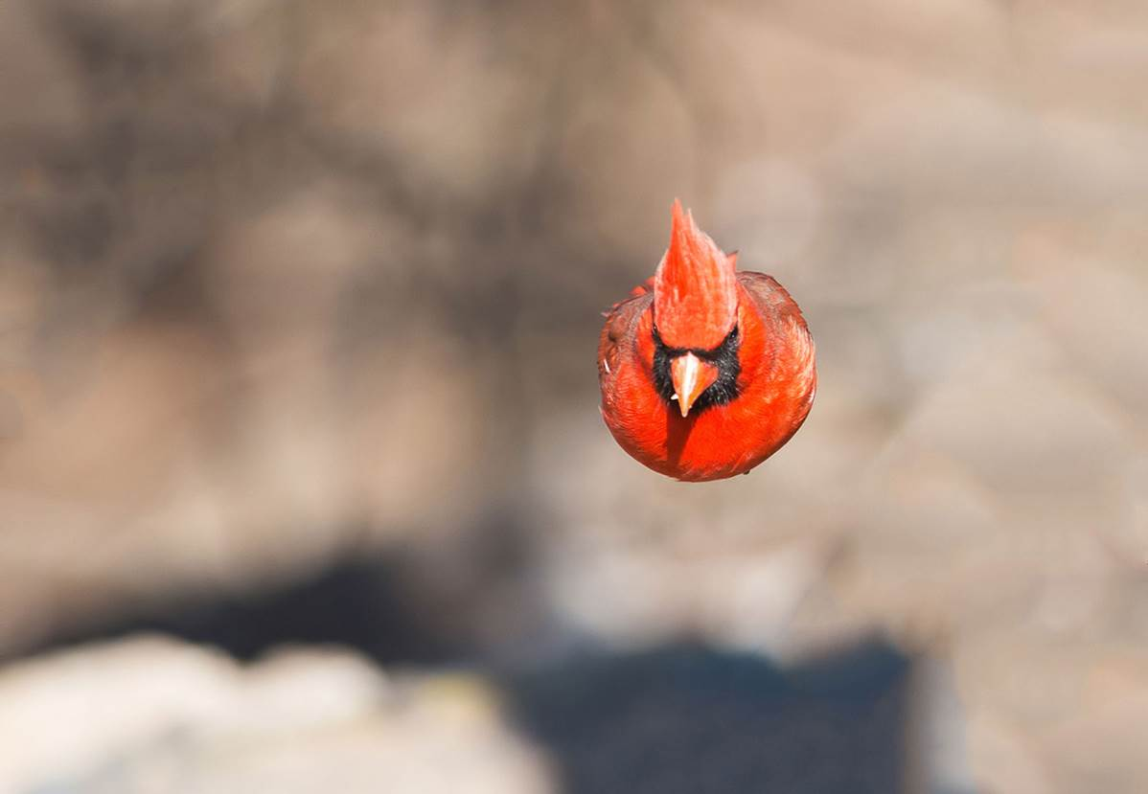
Northern Cardinal / Top 100, Amateur Category. Brian Kushner / Audubon Photography Awards #

Slide 13
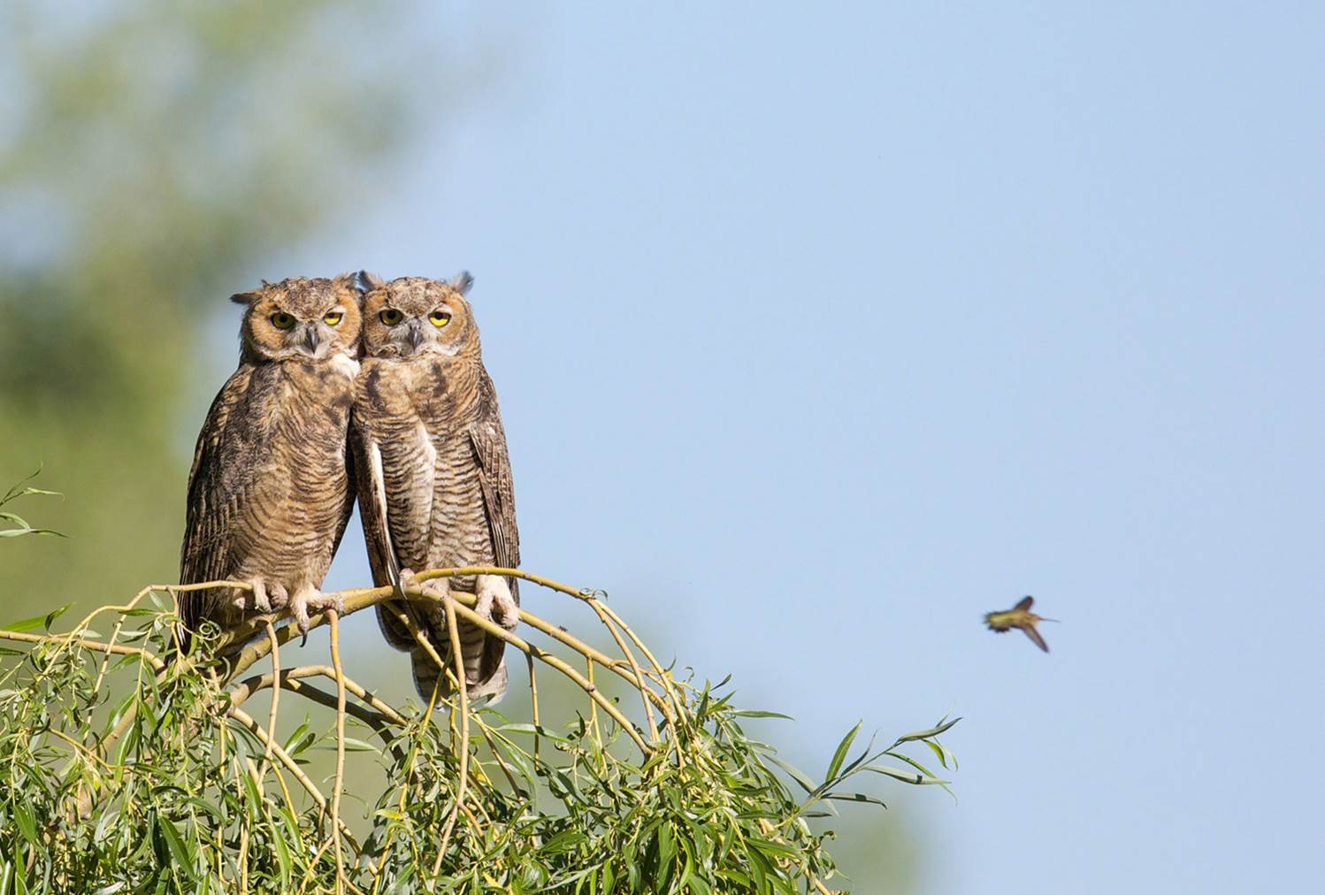
Great Horned Owls and Black-chinned Hummingbird / Top 100, Professional Category. Ed Mackerrow / Audubon Photography Awards #

Slide 14
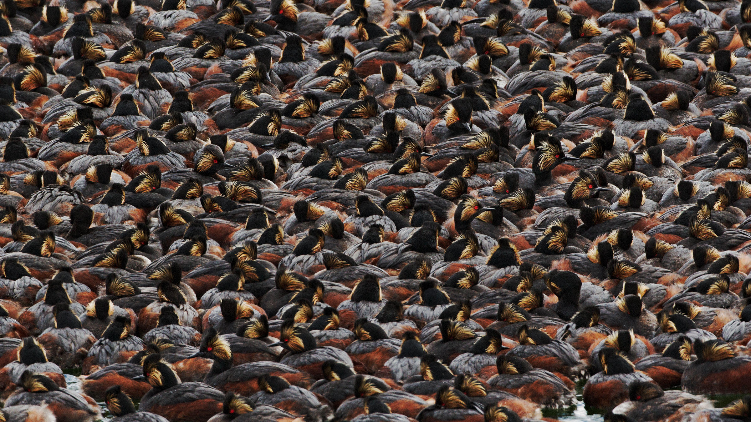
Amateur Winner Steve Torna
Amateur Winner Eared Grebe, Yellowstone Lake, Wyoming. Stephen P Torna / Audubon Photography Awards #

Slide 15
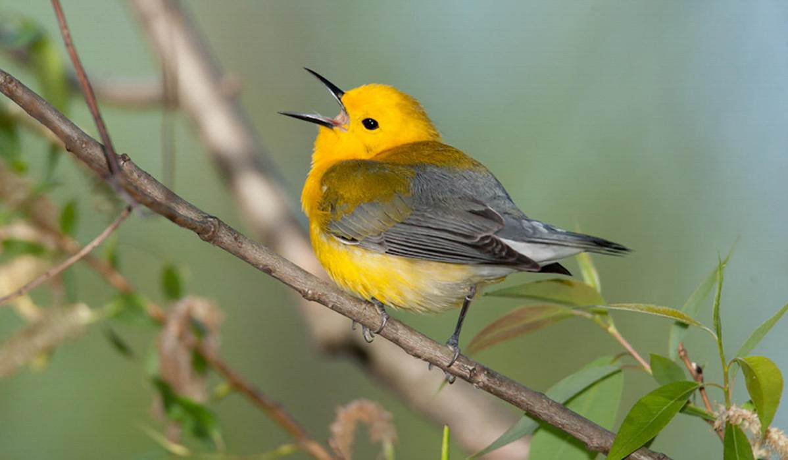

Slide 16
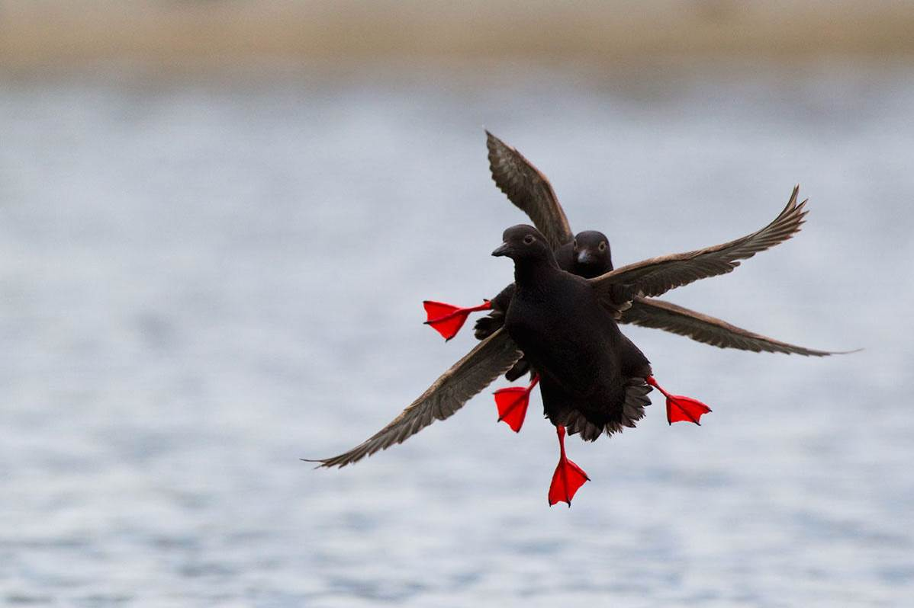

Slide 17
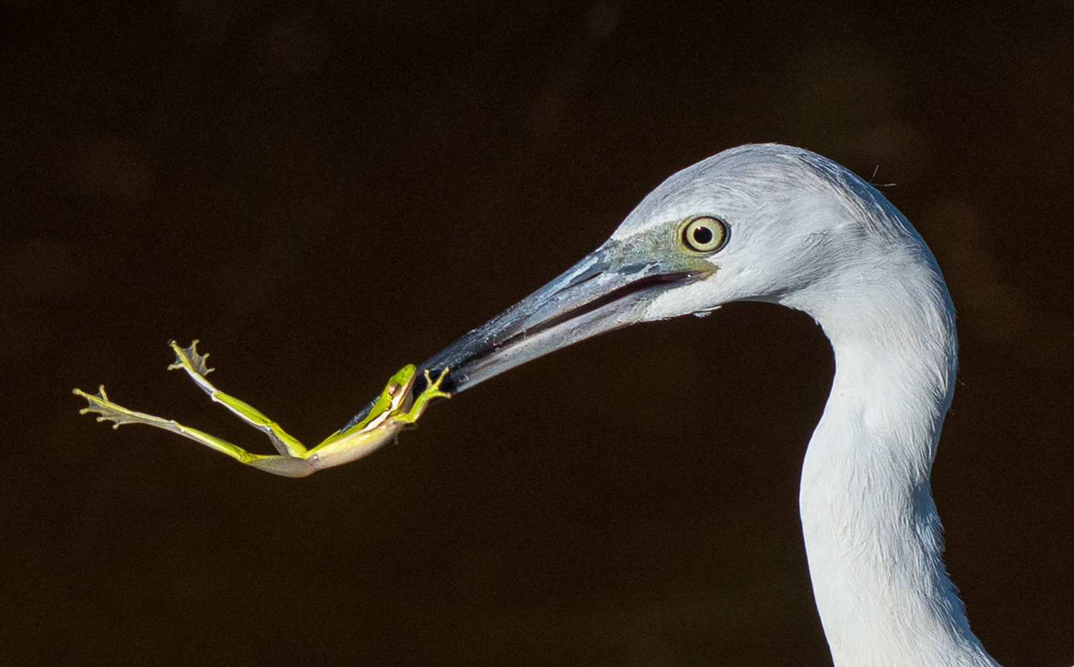
Little Blue Heron / Top 100, Amateur Category. Lynn Miller / Audubon Photography Awards #

Slide 18
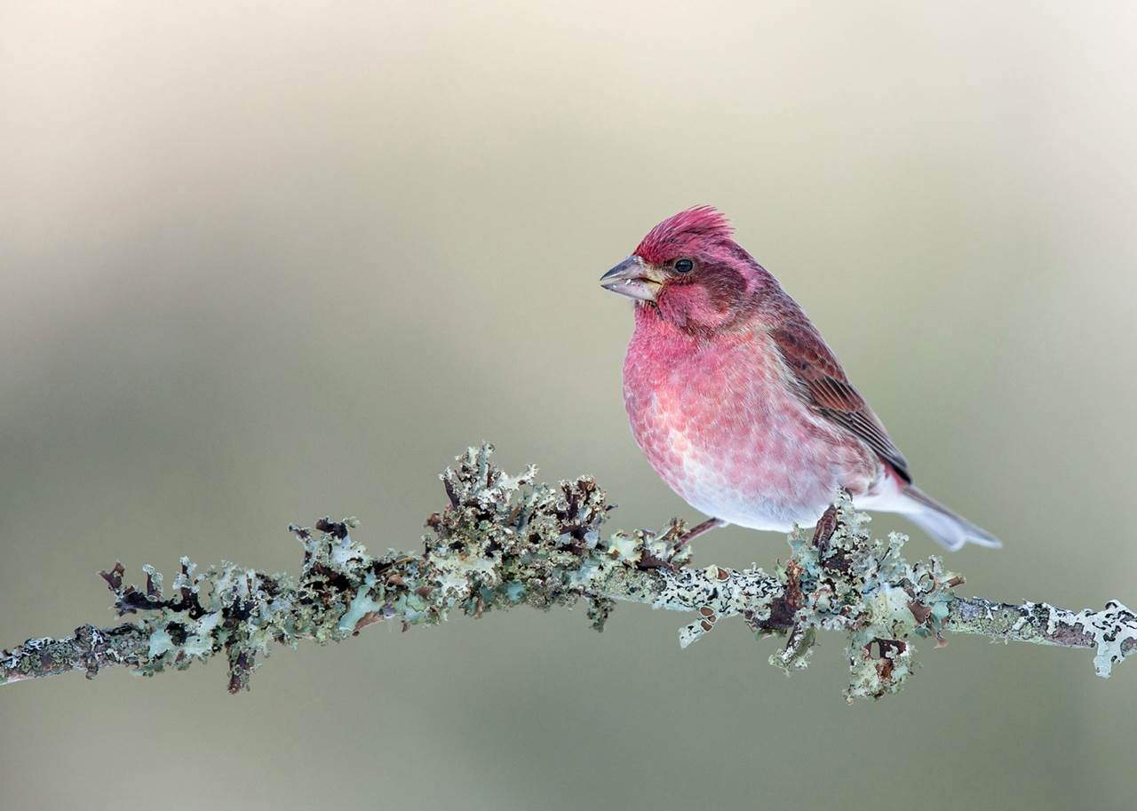
Purple Finch / Top 100, Amateur Category. Gail Bisson / Audubon Photography Awards #

Slide 19
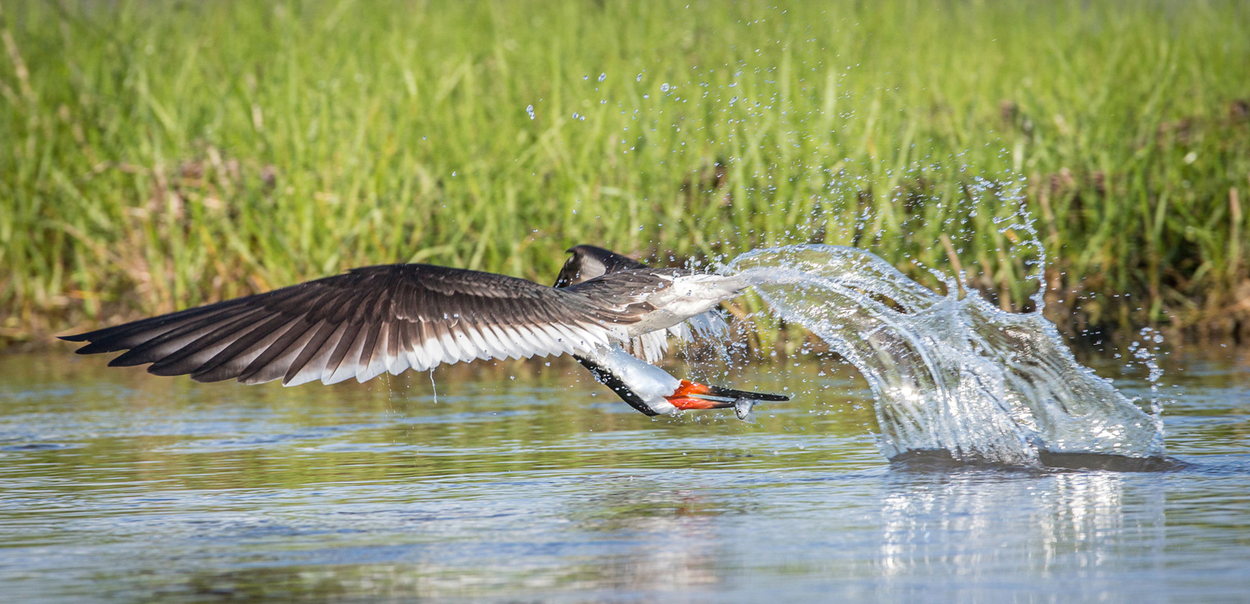
Black Skimmer / Top 100, Professional Category. Mark Buckler / Audubon Photography Awards #

Slide 20
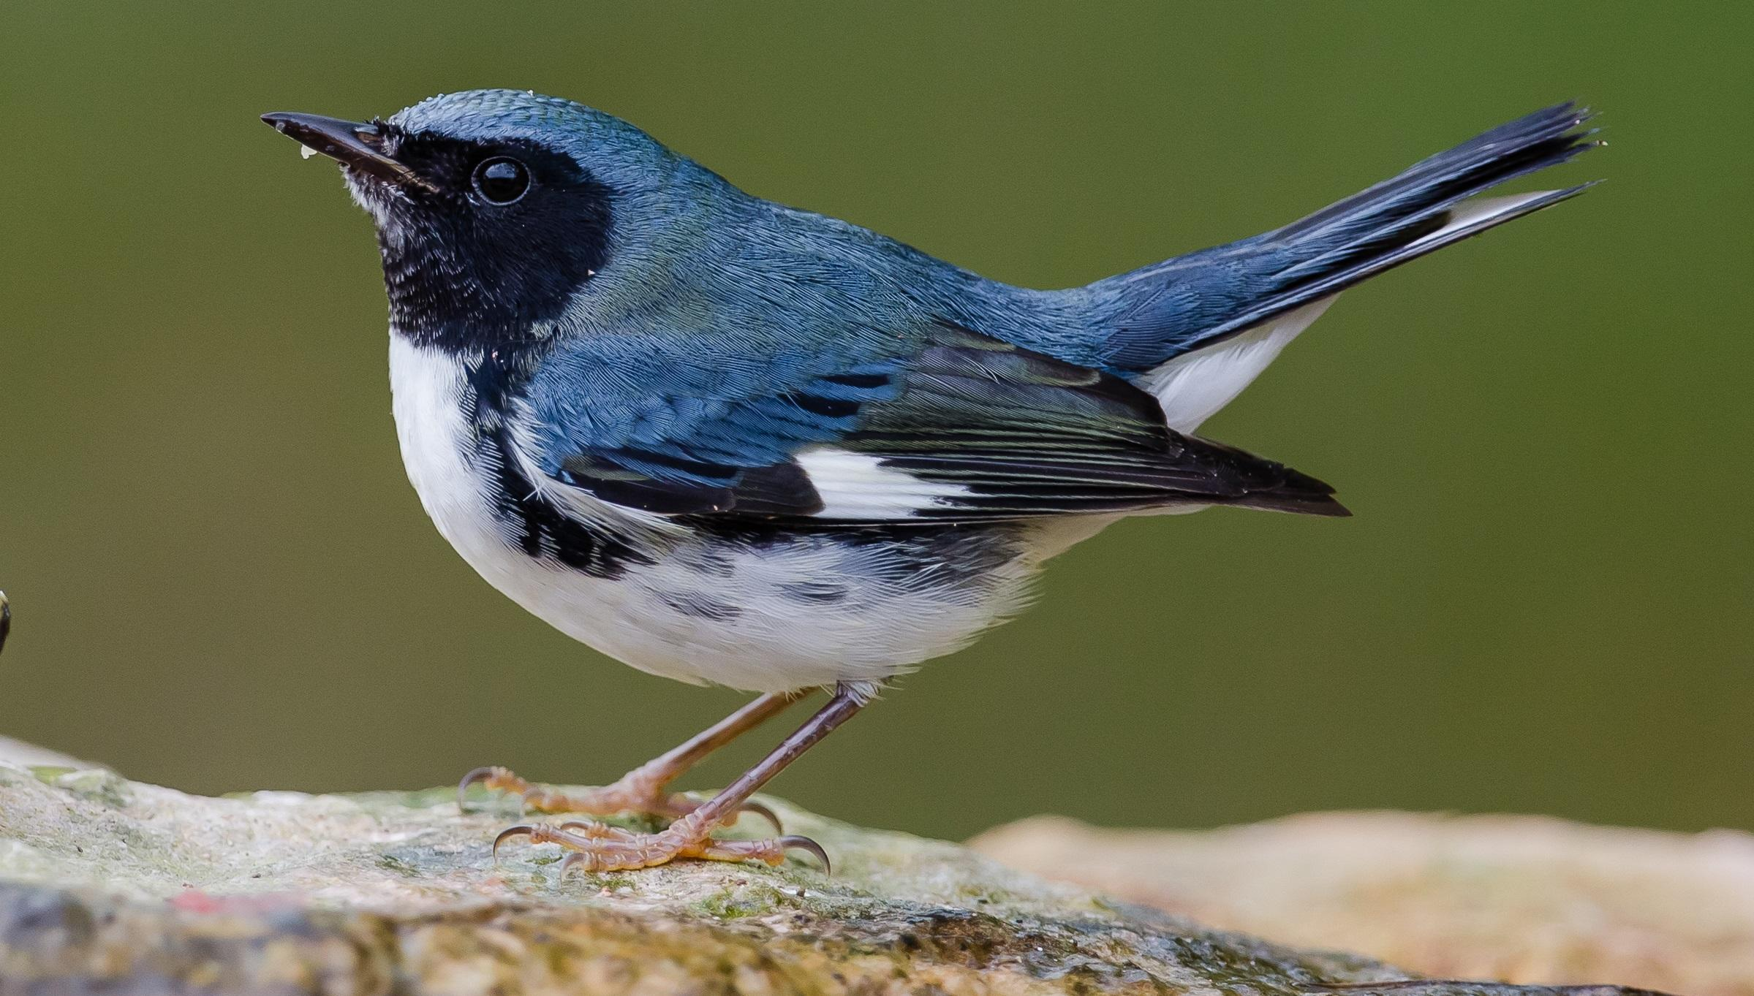

Slide 21
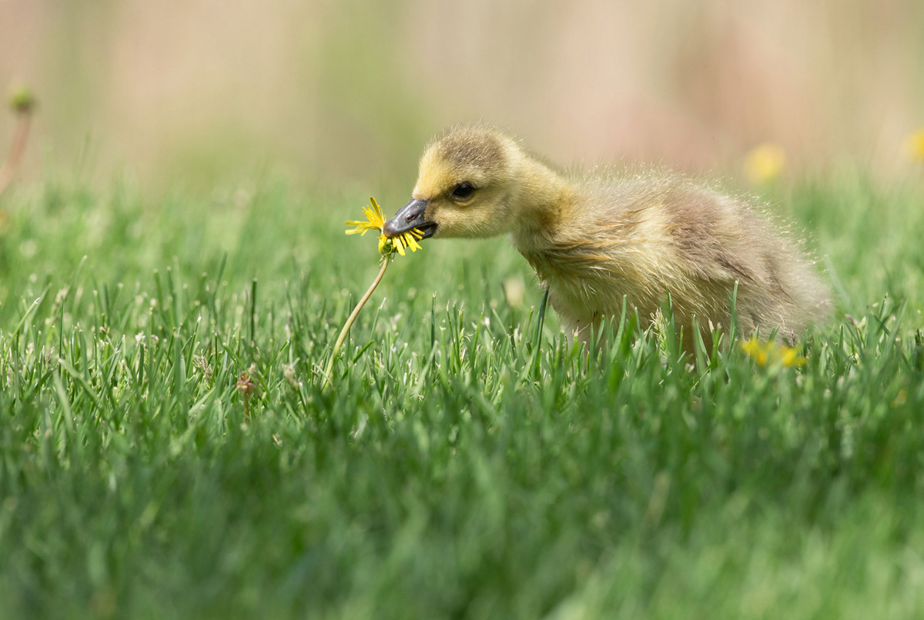
Canada Goose / Top 100, Amateur Category. Barb D'Arpino / Audubon Photography Awards #

Slide 22
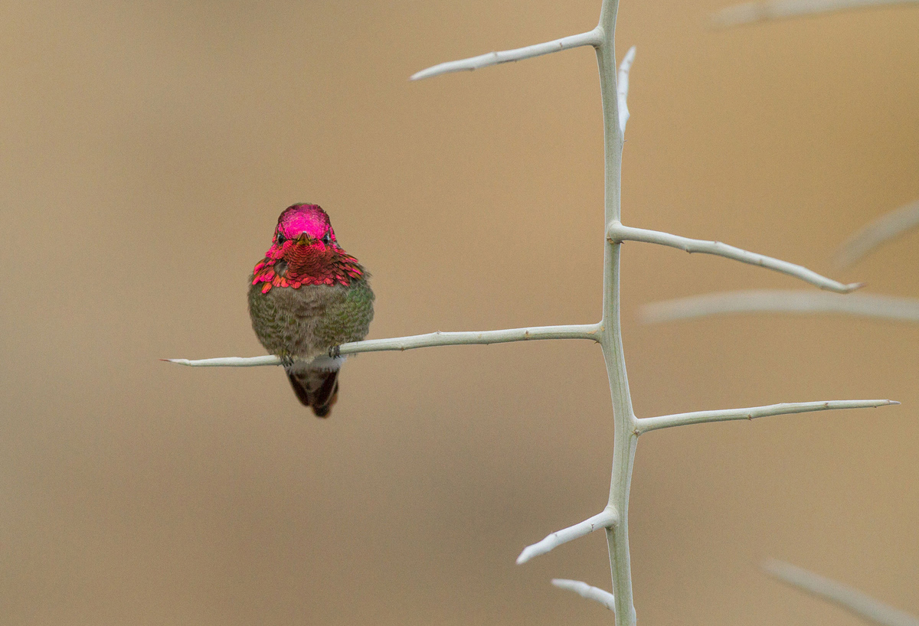
Great Blue Heron / Top 100, Amateur Category. Christopher Schlaf / Audubon Photography Awards #

Slide 23
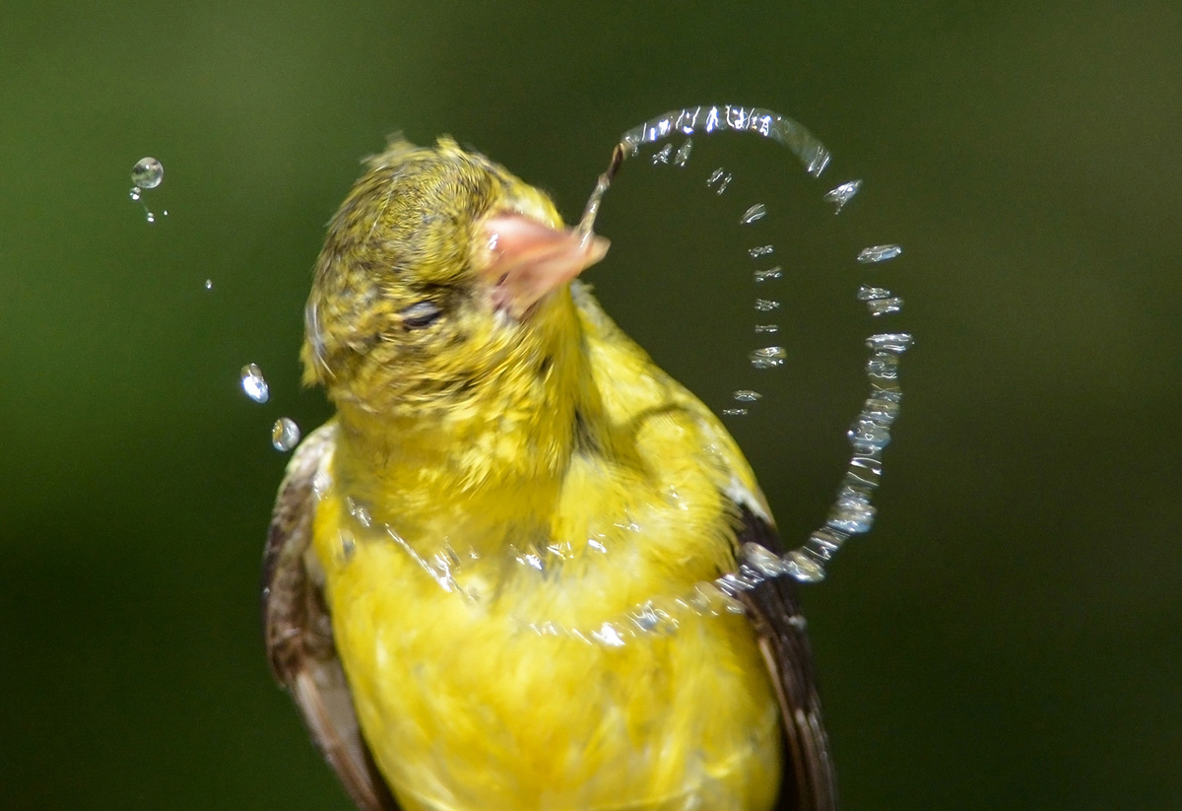
American Goldfinch / Top 100, Amateur Category. Deborah O'Sullivan / Audubon Photography Awards #

Slide 24
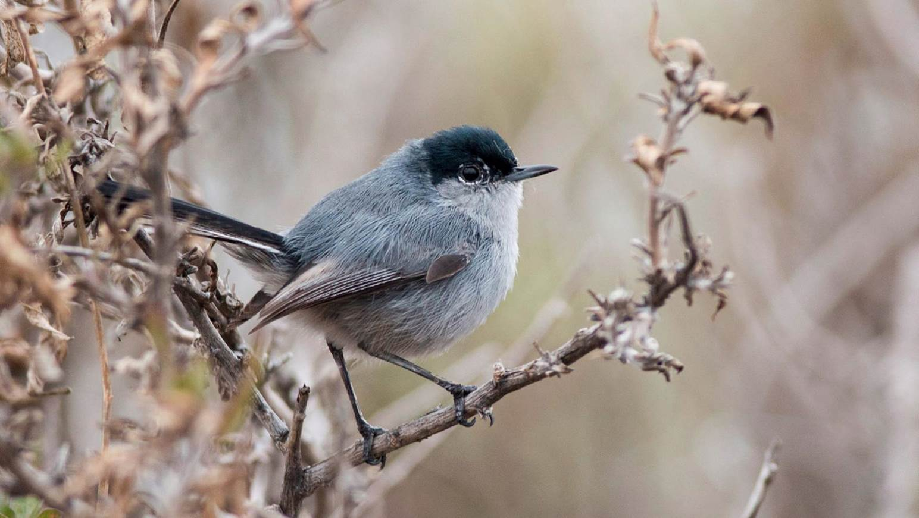

Slide 25
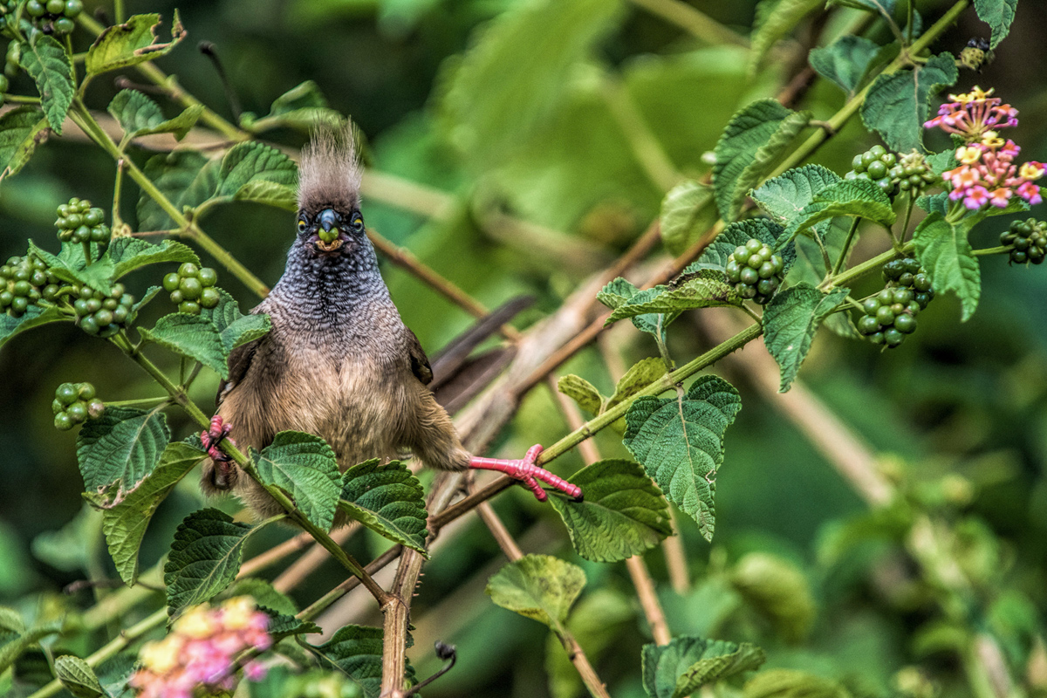
Speckled Mousebird / Top 100, Amateur Category. Nancy Gaudino / Audubon Photography Awards #

Slide 26
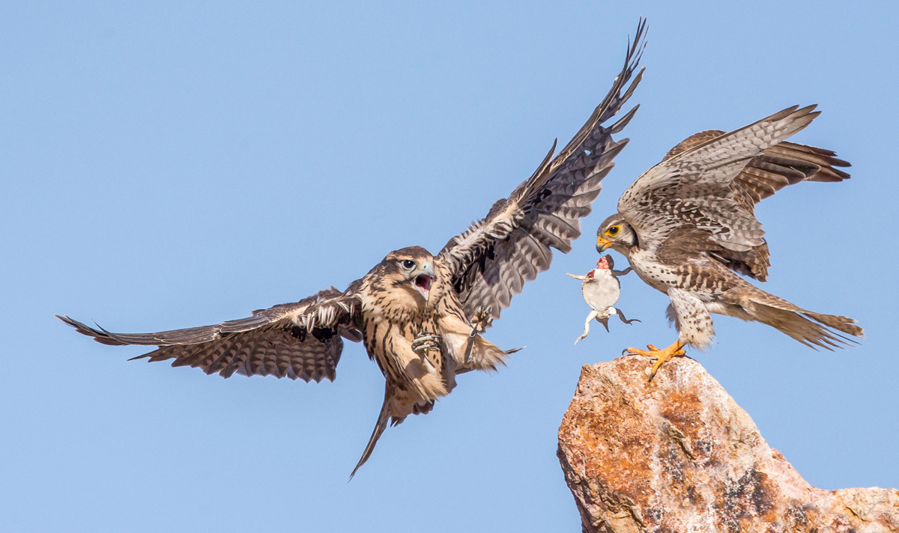
Prairie Falcons / Top 100, Professional Category. David Salem / Audubon Photography Awards #

Slide 27
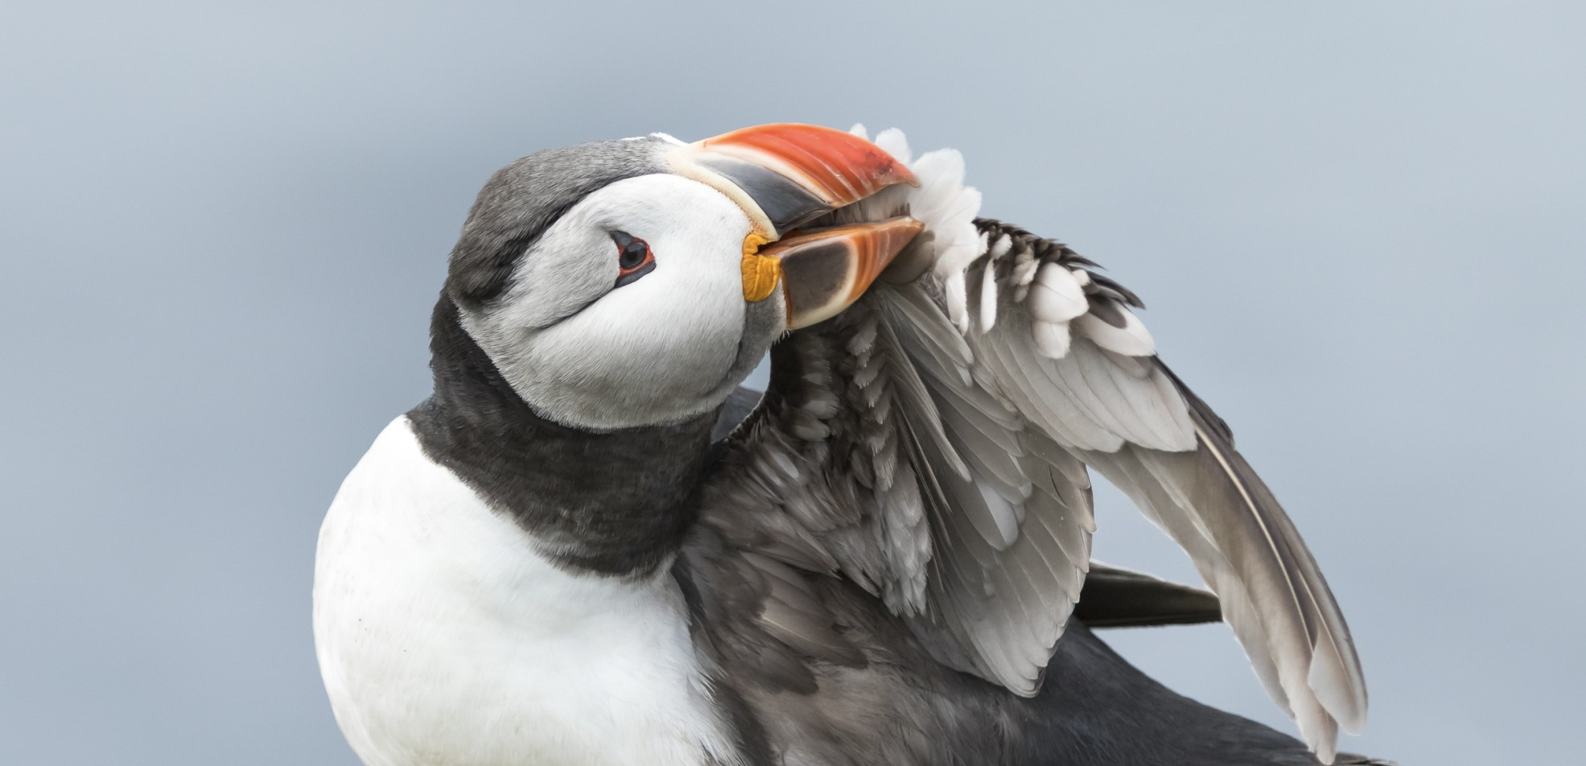

Slide 28
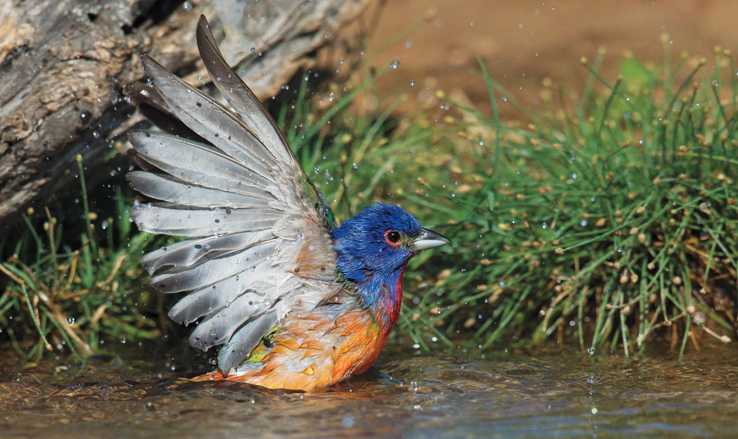

Slide 29
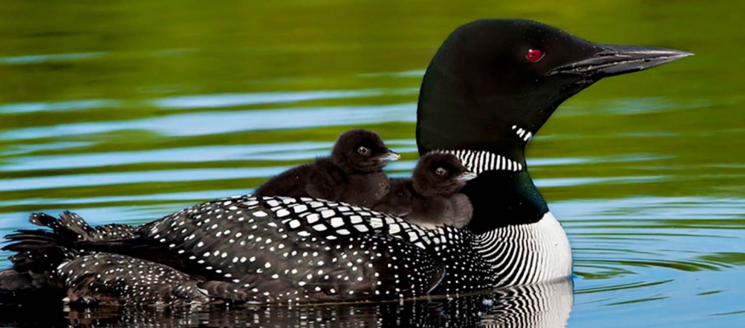

Slide 30
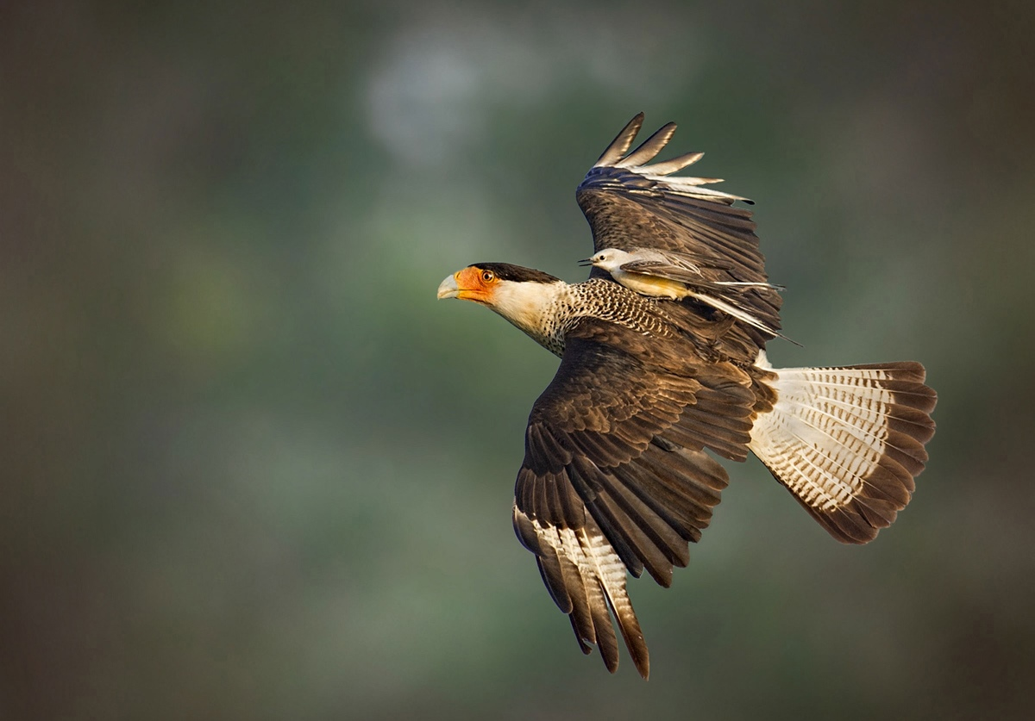

Slide 31
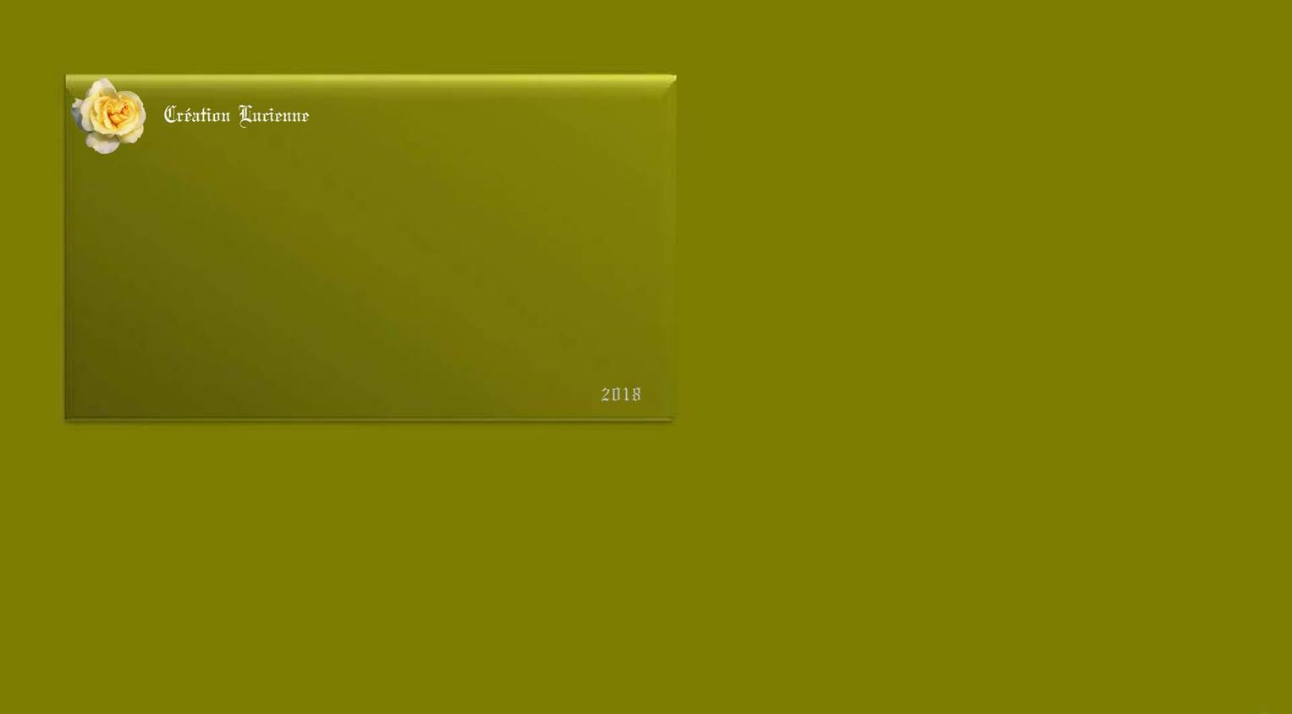
Accueil - Akia
http://akia.eklablog.fr/
Akia
http://www.ppsmania.fr/author/akia

