Slide 1
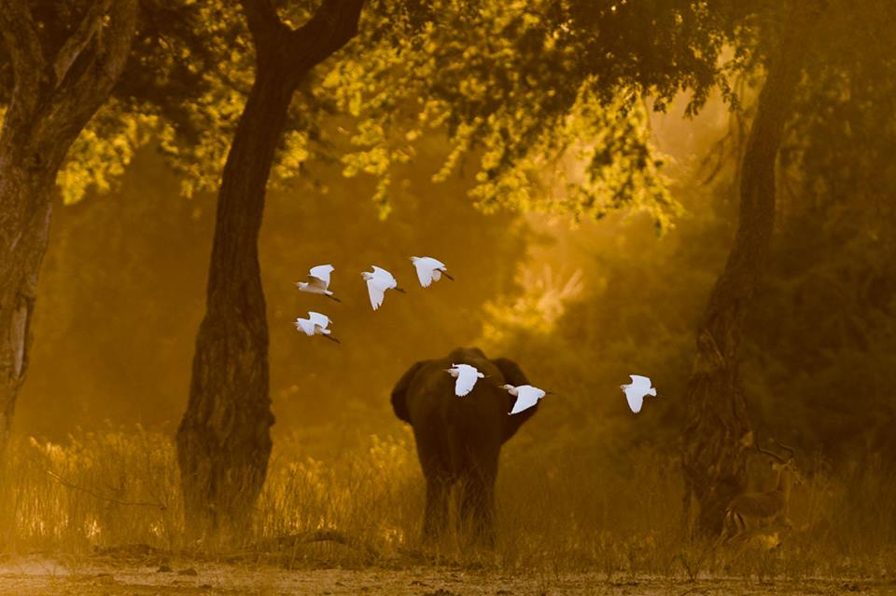

Flight of gold in Mana Pools National Park, Zimbabwe by ©Vikram Ghanekar

Slide 2
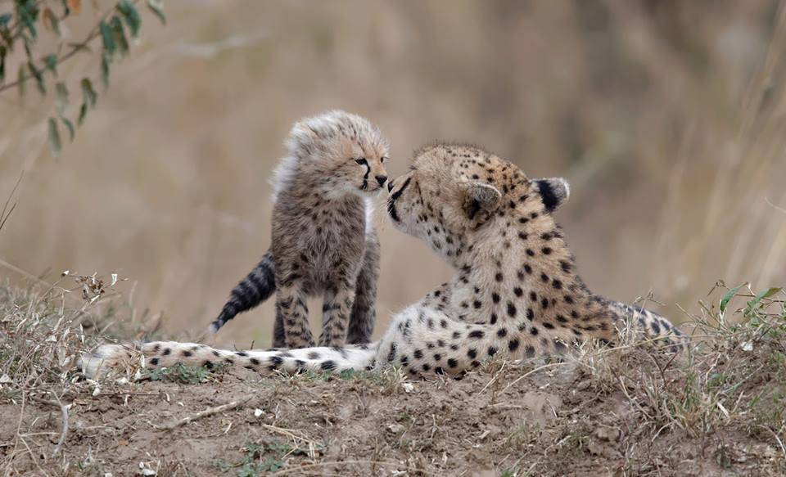
The kiss in Maasai Mara, Kenya ©Olivier Delaere

Slide 3
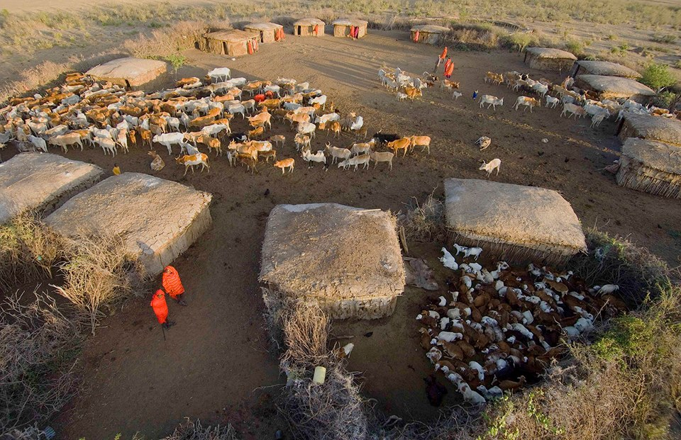
Larry Broutman - A Masai family village in Kenya. Preparing for the daily chores

Slide 4
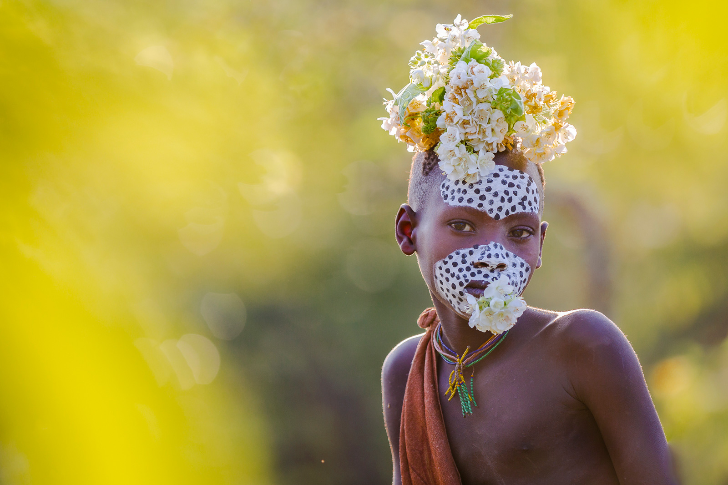
Josef Buergi Surma boy

Slide 5
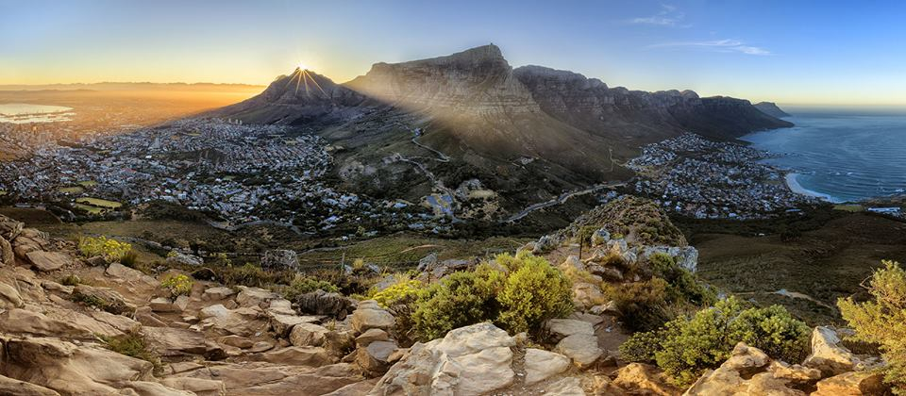
Cape Town panorama, South Africa ©Greg Metro

Slide 6
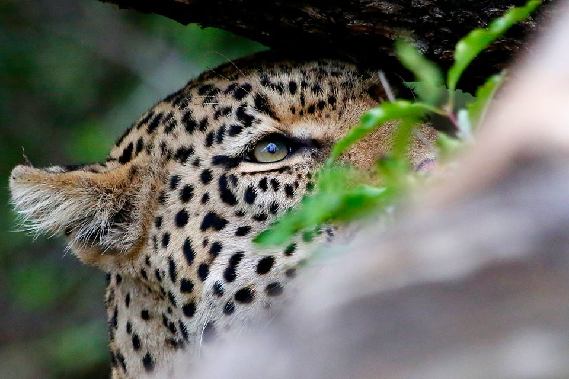
John-Ray Brentnall - madikwe game reserve

Slide 7
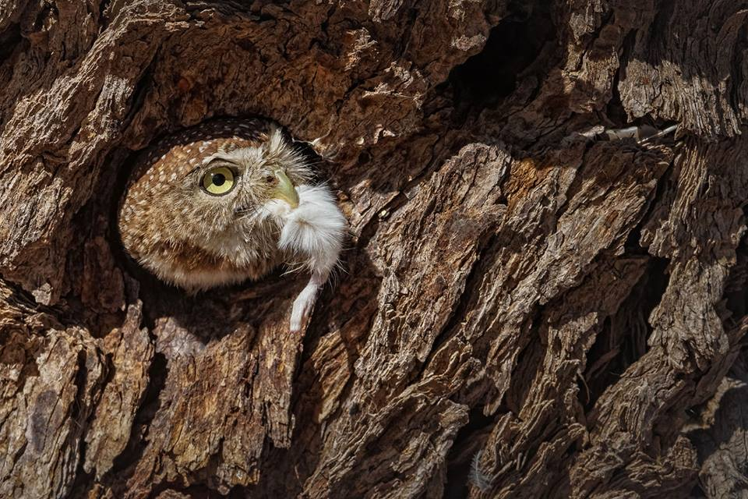
Owlett housekeeping ©Willem Kruger

Slide 8
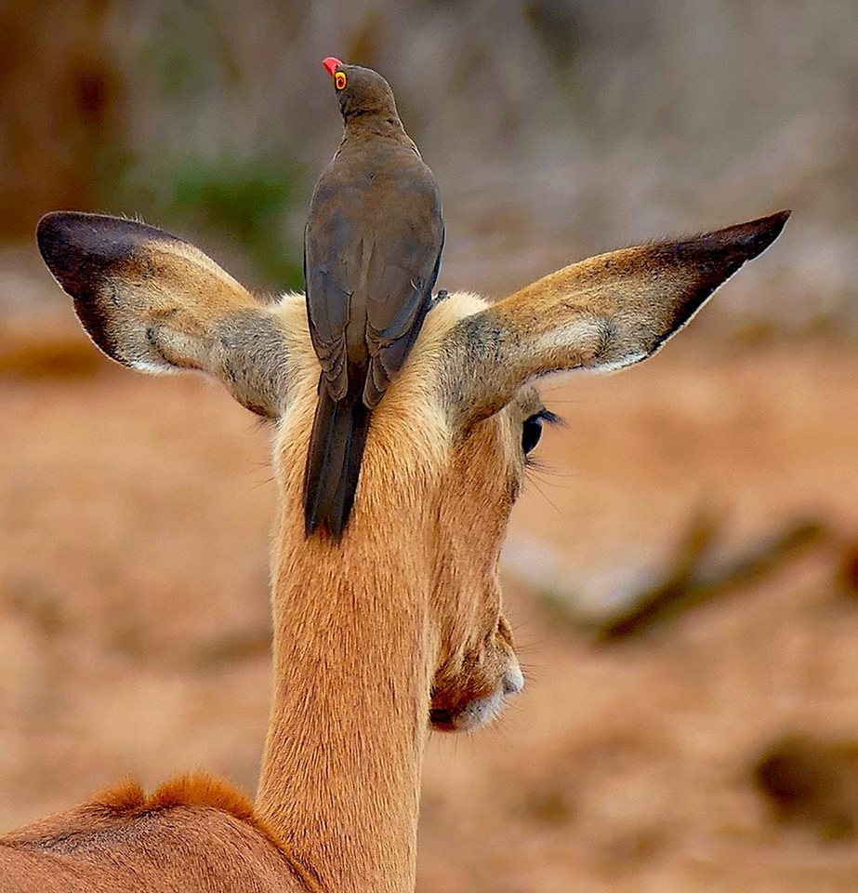
Anthony Starling - The Red billed Oxpecker - Kruger National Park

Slide 9
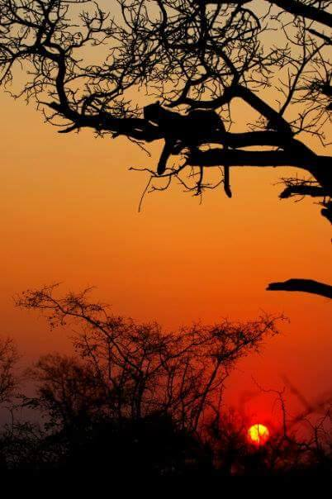
John-Ray Brentnall - a leopard at sunset

Slide 10
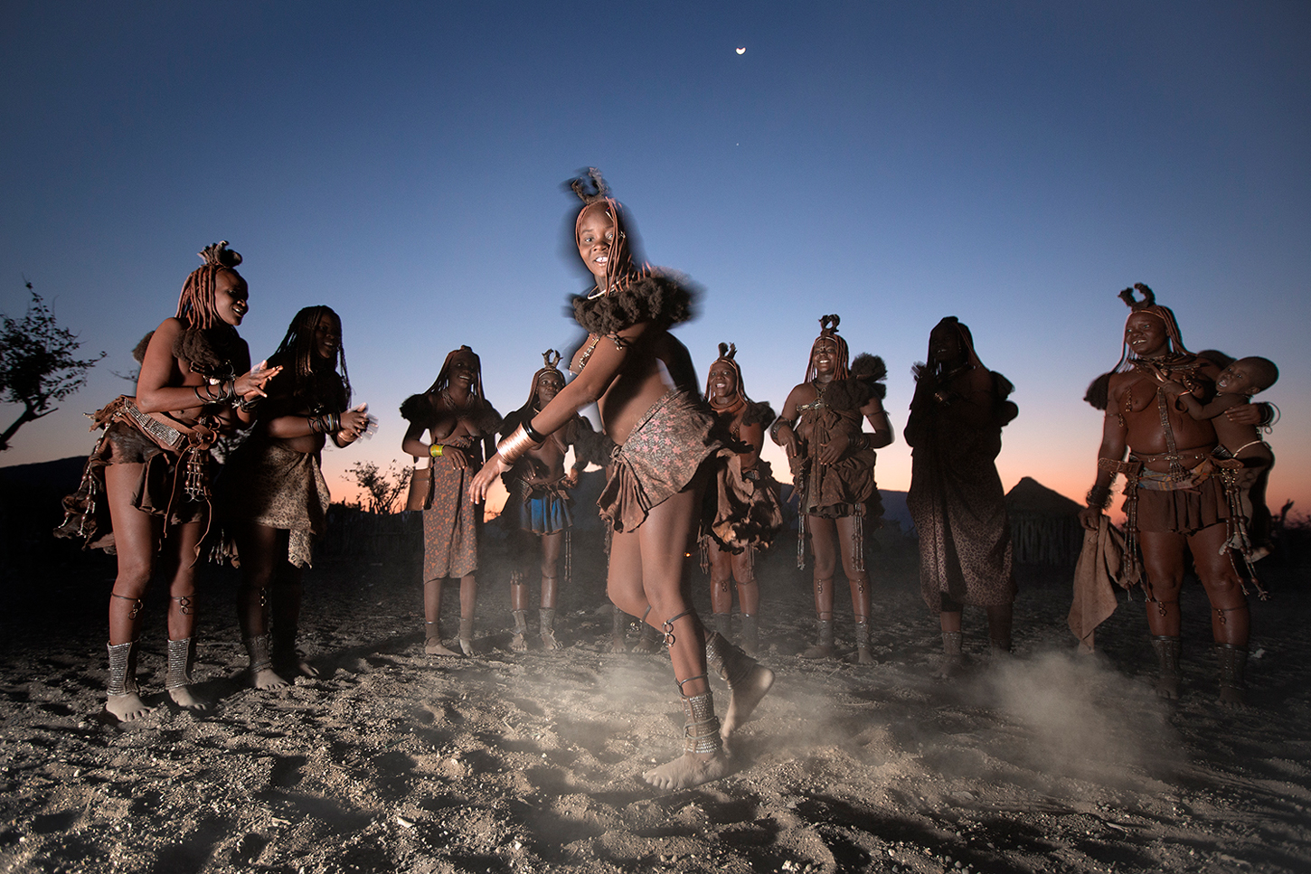
Ben McRae - Himba Tribe - Epupa in Namibia

Slide 11
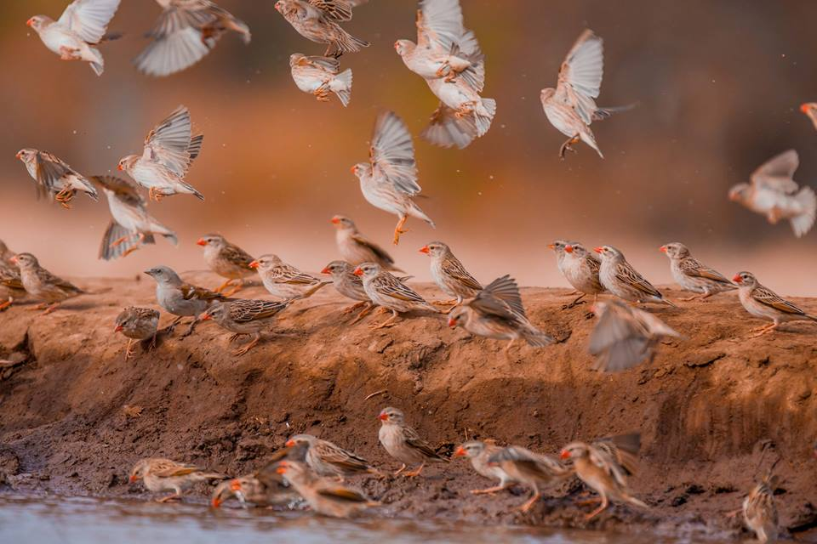

Slide 12
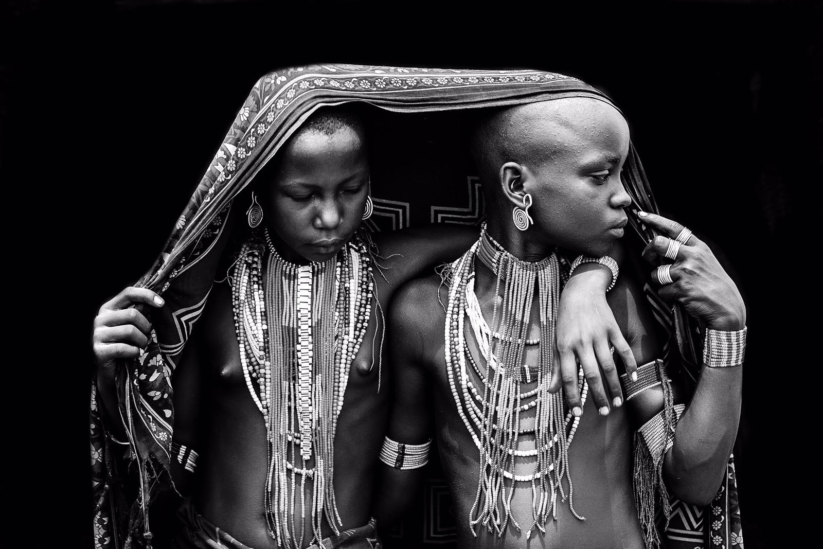
Arbore tribe members in Omo Valley, Ethiopia ©Robin Young

Slide 13
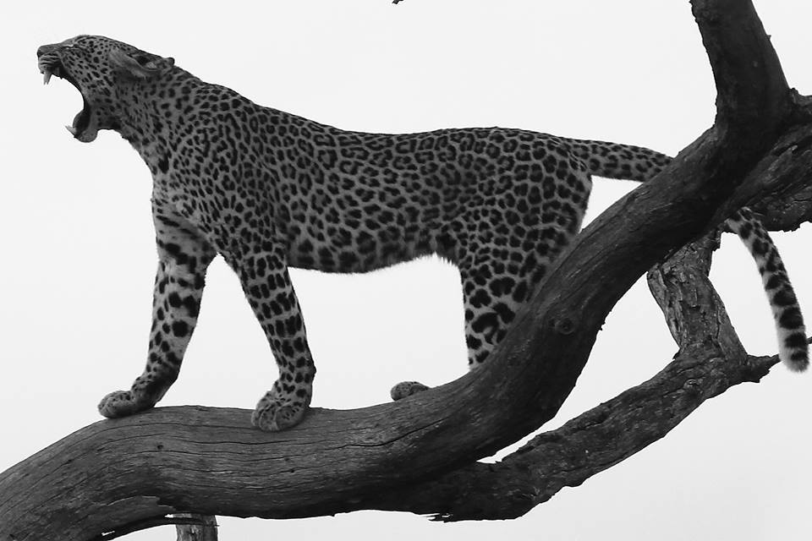
Adam Barnard - Leopard - Kruger Park

Slide 14
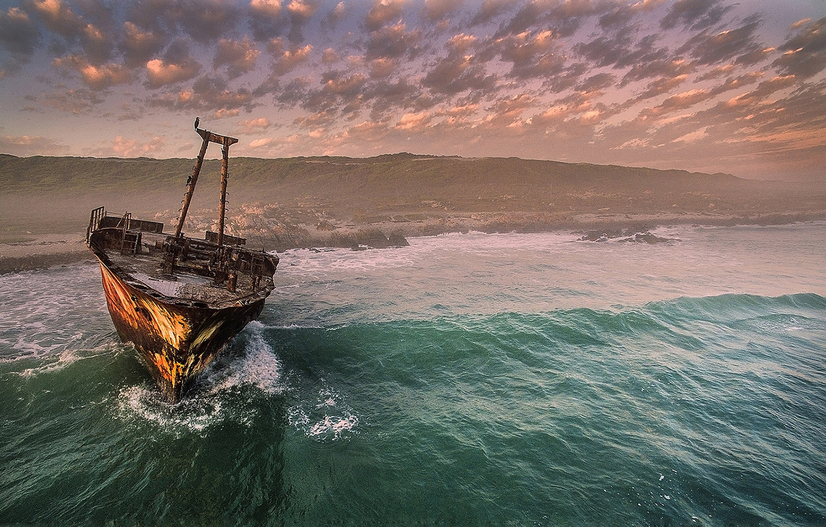
Ship wreck in Cape Agulhas, Western Cape, South Africa ©Dirkie Heydenrych

Slide 15
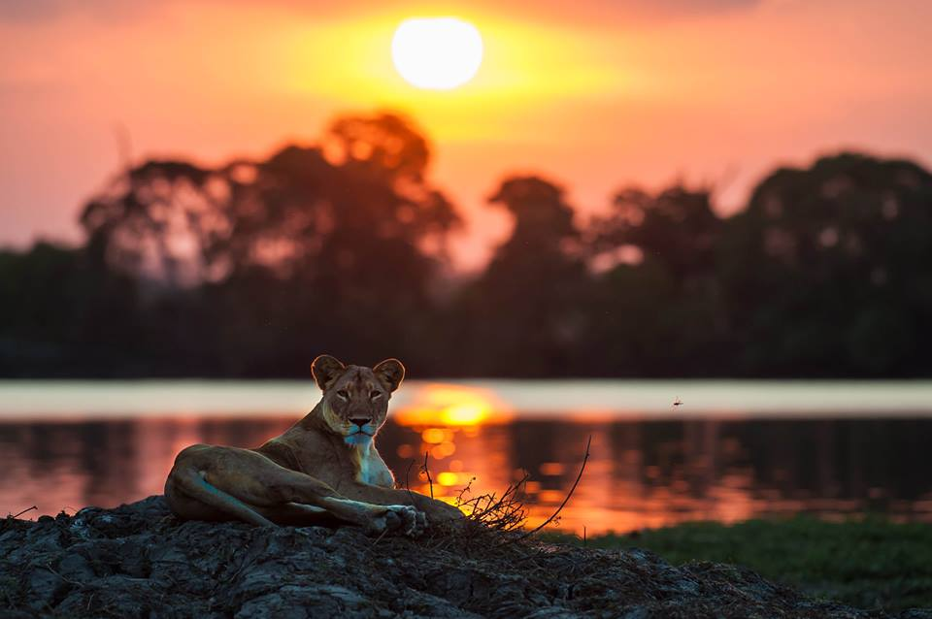
Phil Jeffery - watchful eye - Kafue River

Slide 16
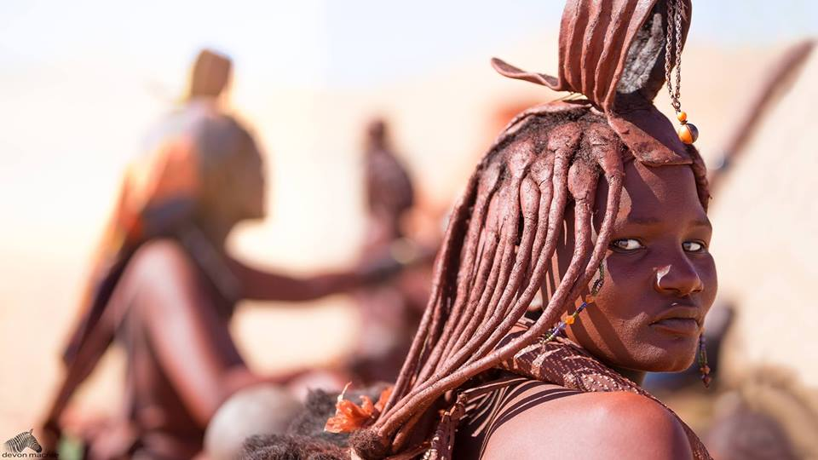
Image by Devon Macrae

Slide 17
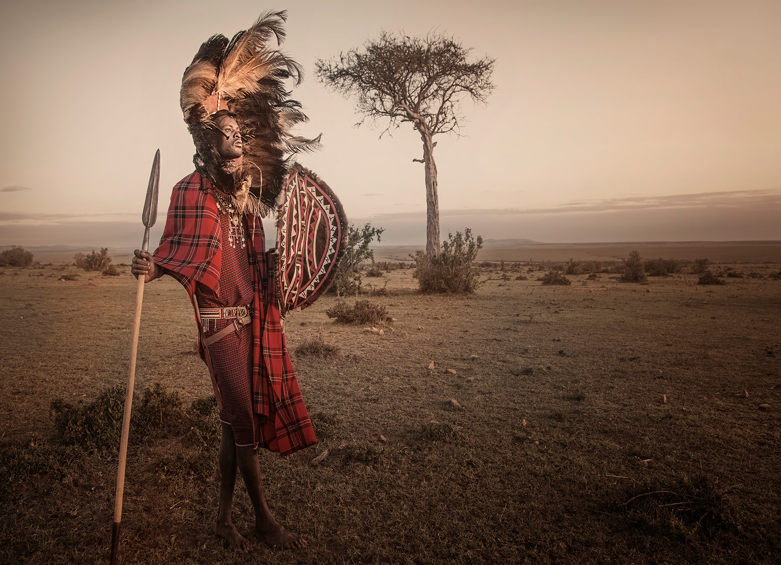
Panos Laskarakis-maasai-mara

Slide 18
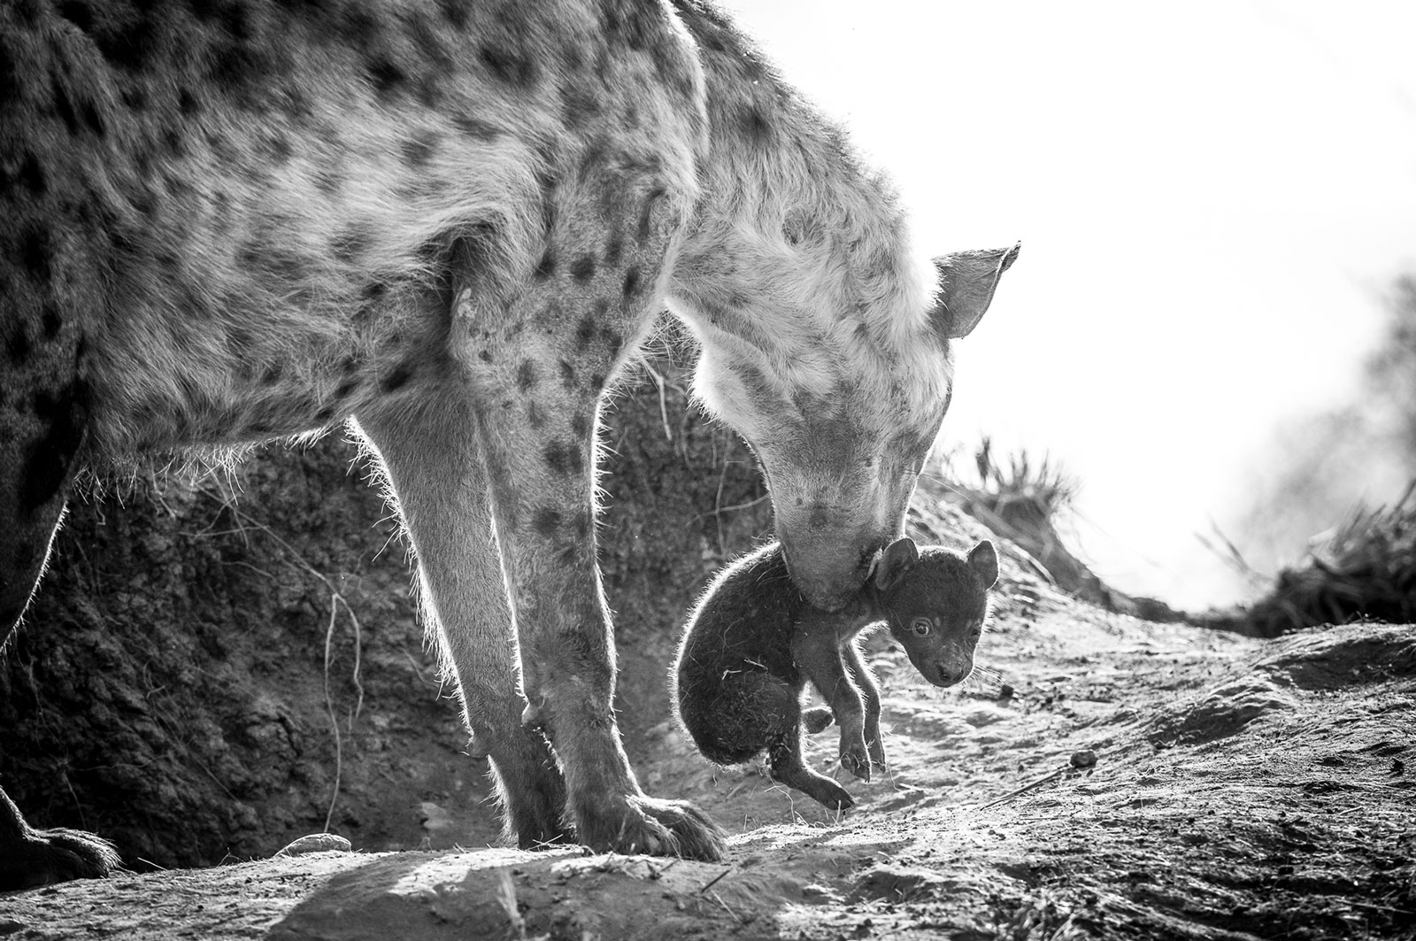
"Awwww Mom do I have to?" in Timbavati Game Reserve, South Africa ©Andrew Schoeman

Slide 19
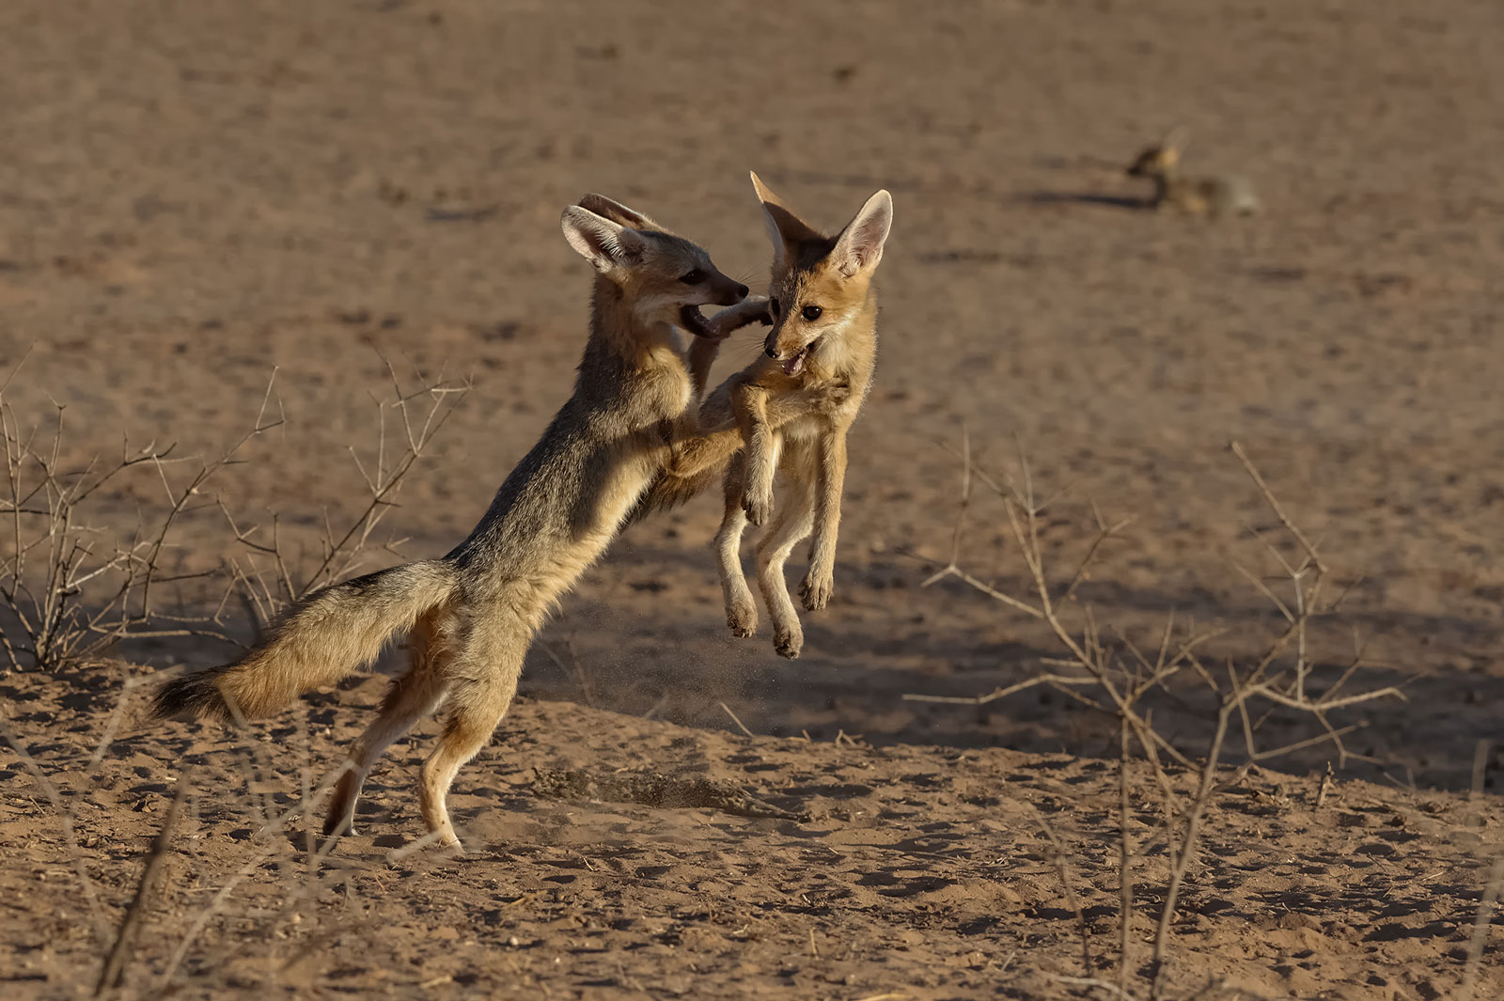
Fox jump in Kgalagadi Transfrontier Park, South Africa ©Willem Kruger

Slide 20
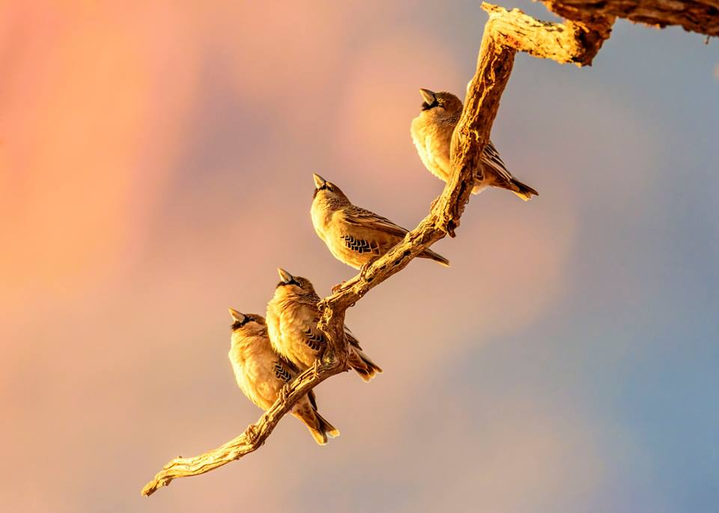
Memory Coetzee - taking-in-the-sunset - Namibia

Slide 21
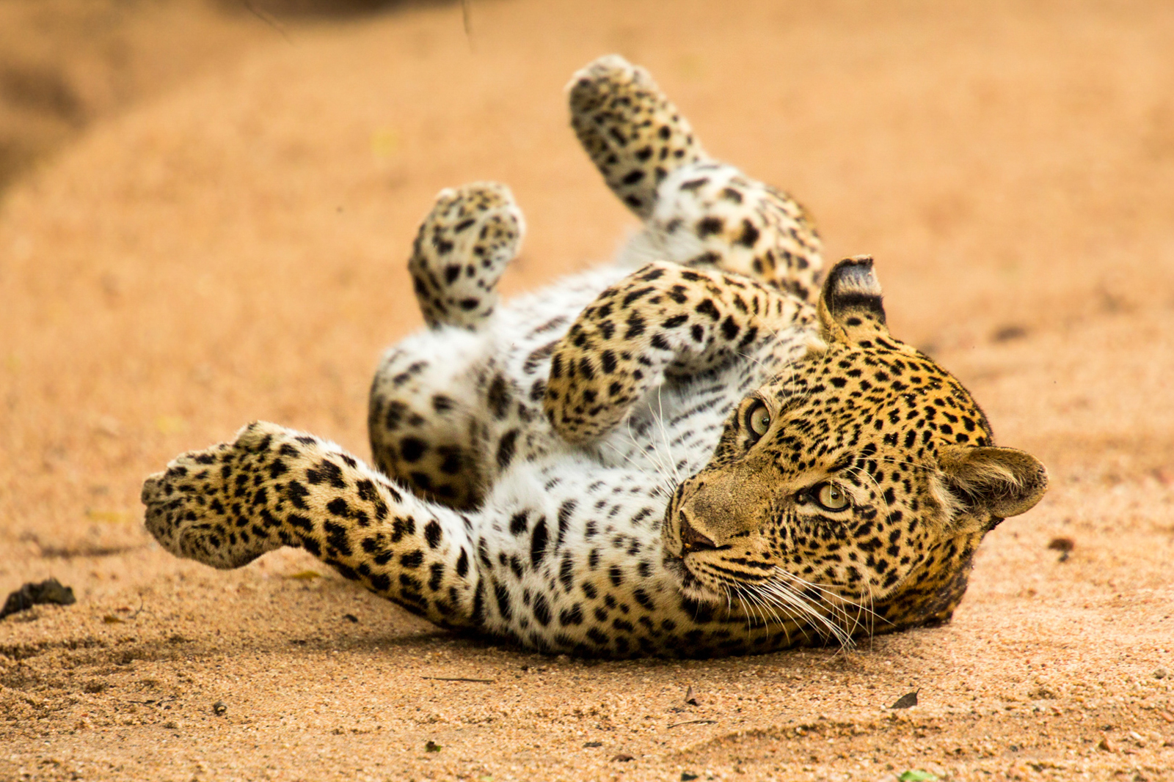
Caleb Shephard-leopard

Slide 22
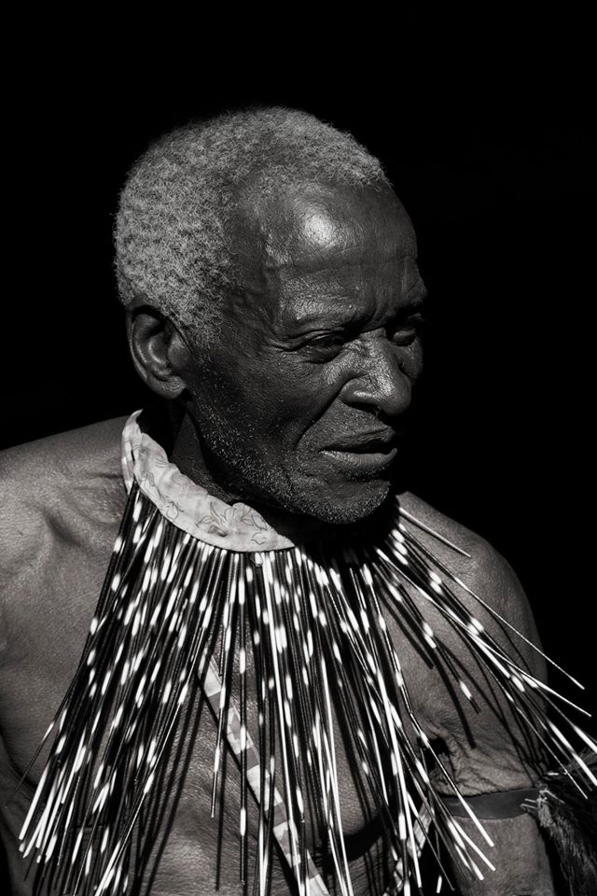
Tracy May - Chief Pondo, taken in Matobo National Park, Bulawayo, Zimbabwe

Slide 23
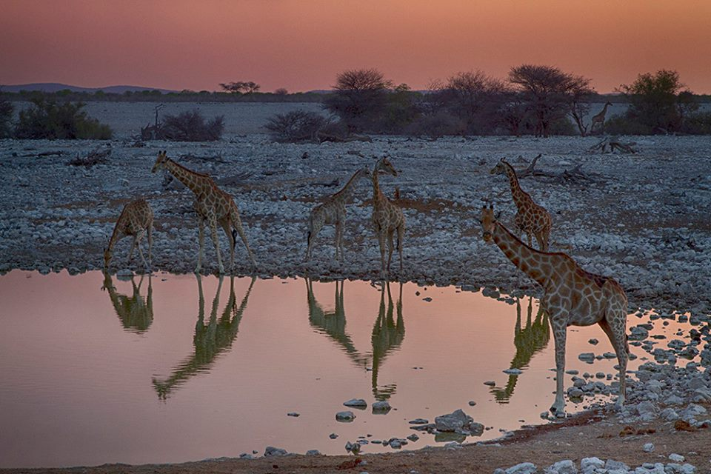
Ronit Rashook - Reflections - Etosha park - Namibia

Slide 24
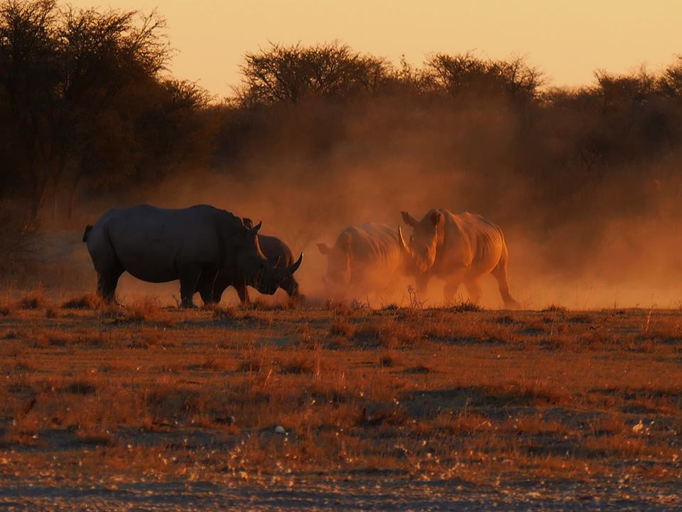
Anthony Starling -Sunset at a pan in Botswana

Slide 25
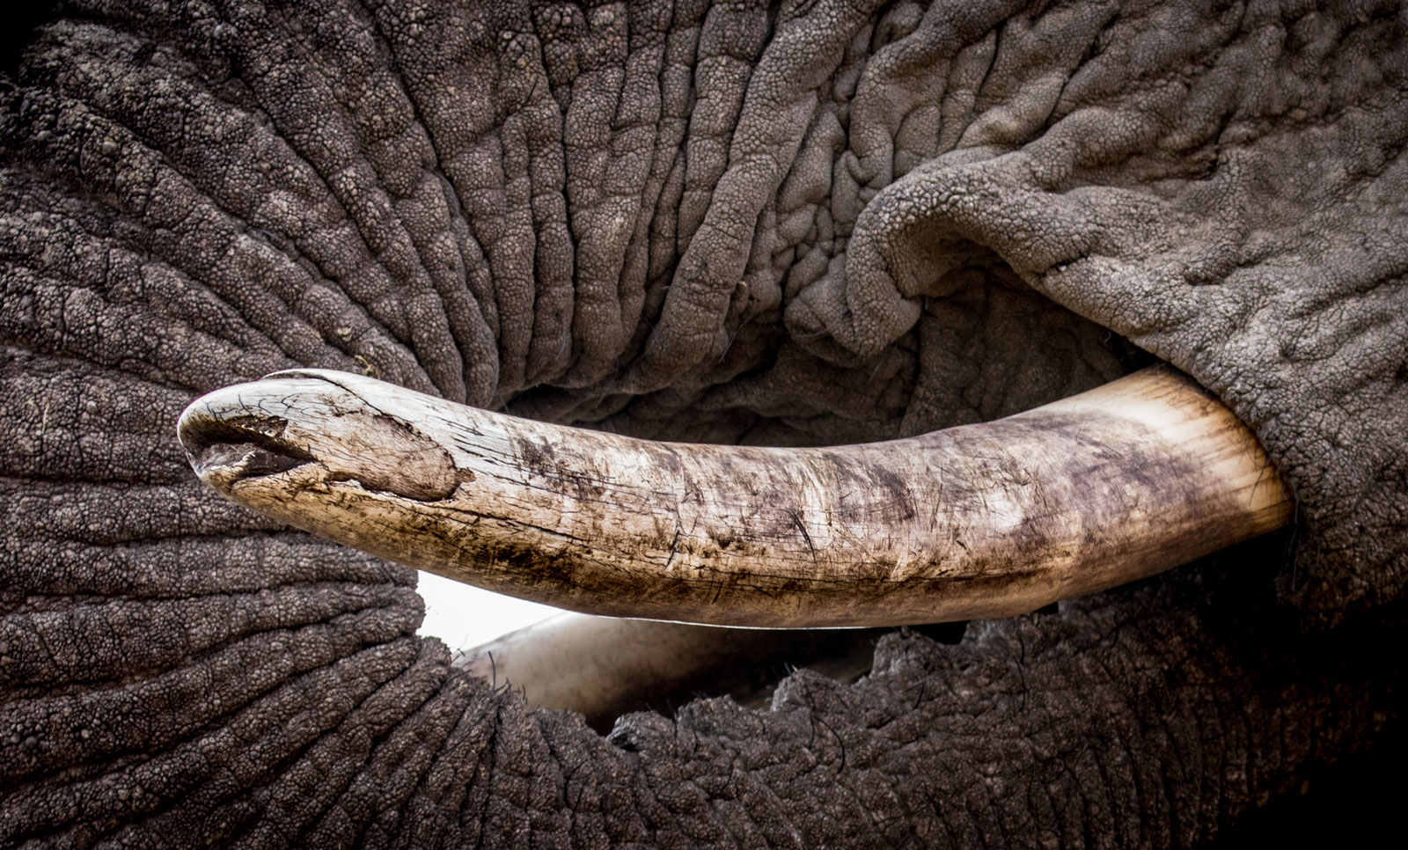
"Tusked" in Madikwe Game Reserve, South Africa ©Janine Malan

Slide 26
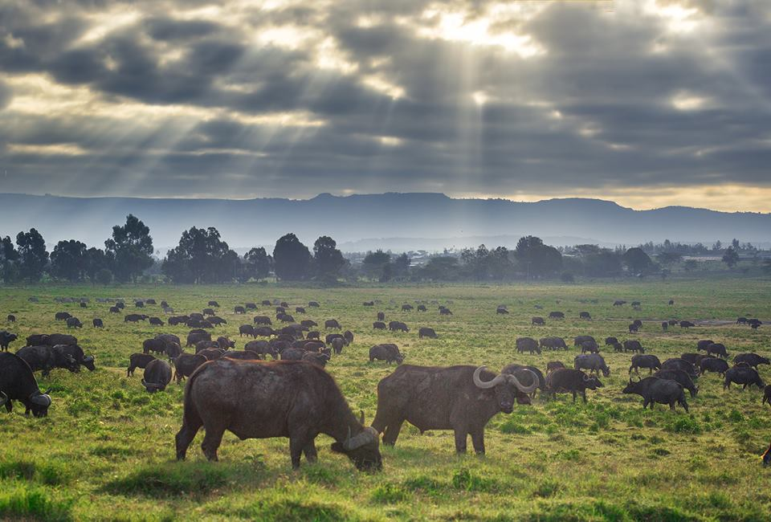
Greg Metro - wildebeast illuminated by beautiful crepscular rays in Nakuru National Park in Kenya

Slide 27
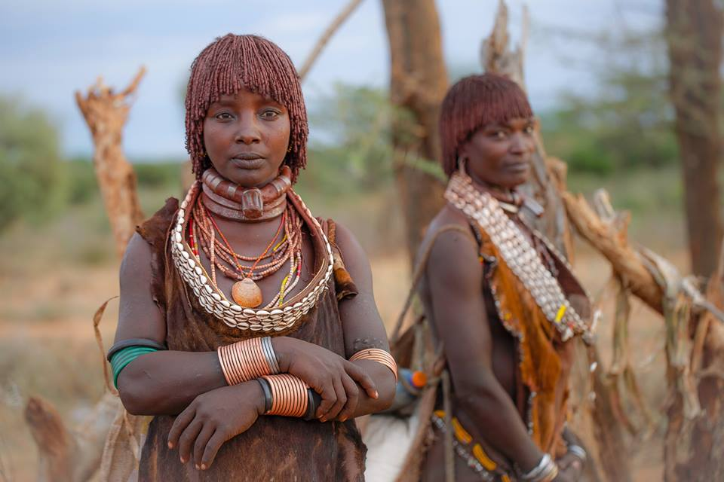
Robin Yong - Ladies of the Hamar tribe - Omo Valley, Ethiopia

Slide 28
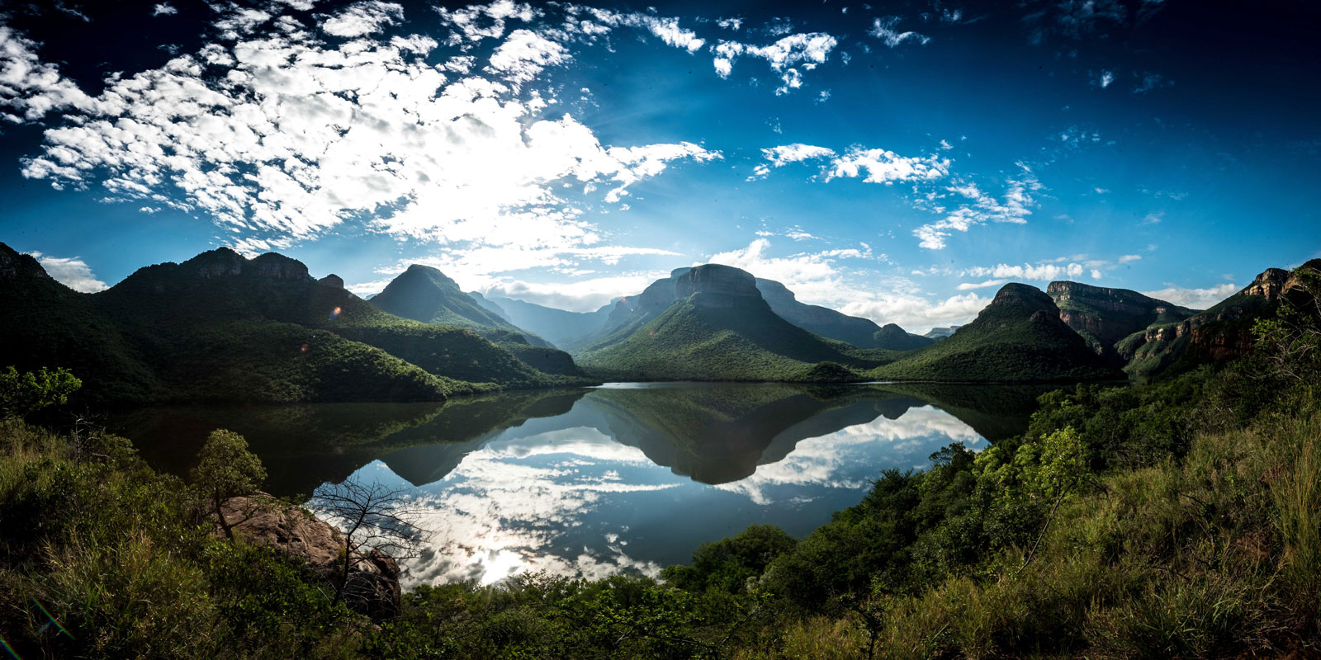
Blyde River Canyon in South Africa ©Tim Feherty

Slide 29
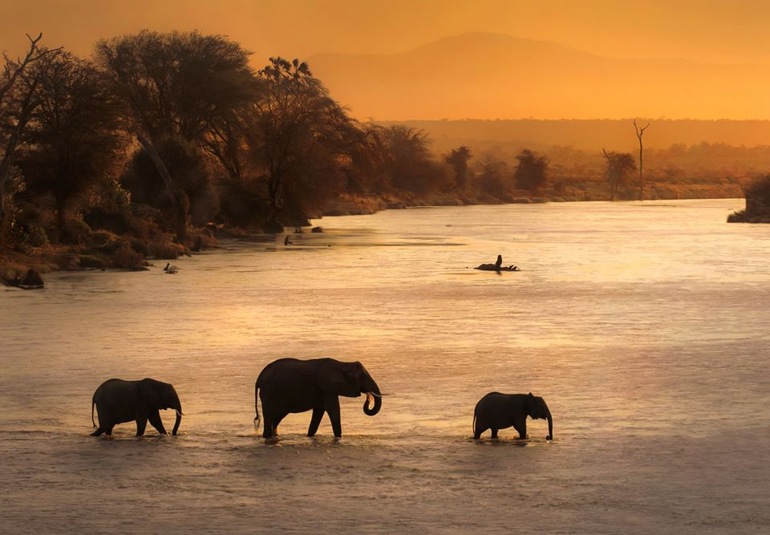
Theodore Mattas - River shadows - Kenya

Slide 30
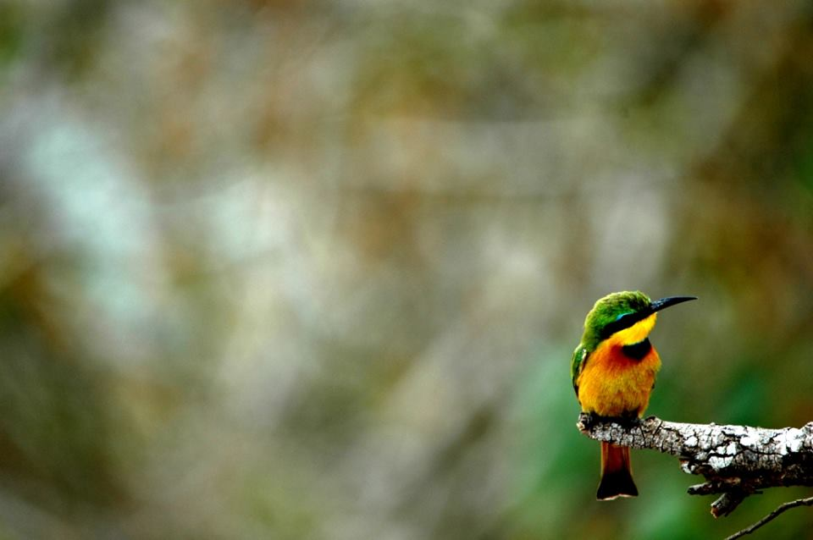
Karl Svendsen - Little Guy, Selous Game Reserve, Tanzania

Slide 31
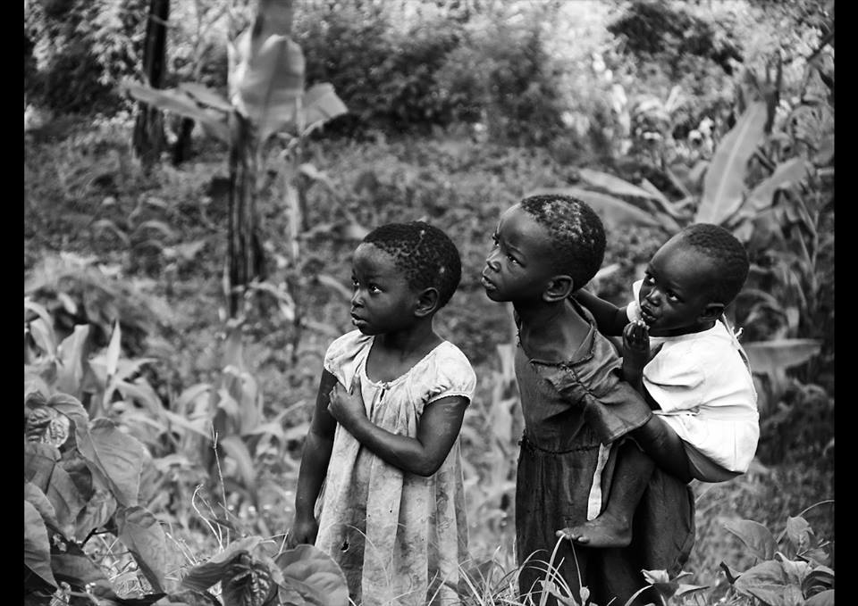
Alexander Bobeczko - Children - Elgon Mountains in Bupoto, Uganda

Slide 32
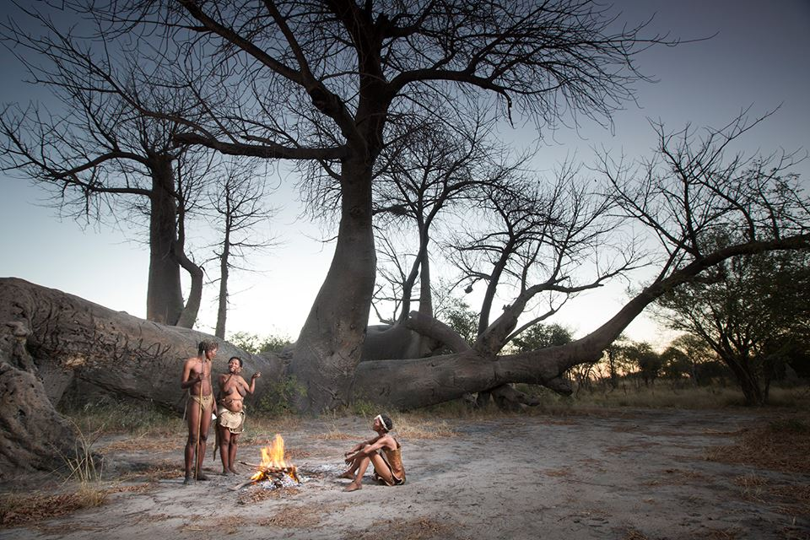
Ben McRae - San people - Khaudom National Park in Namibia

Slide 33
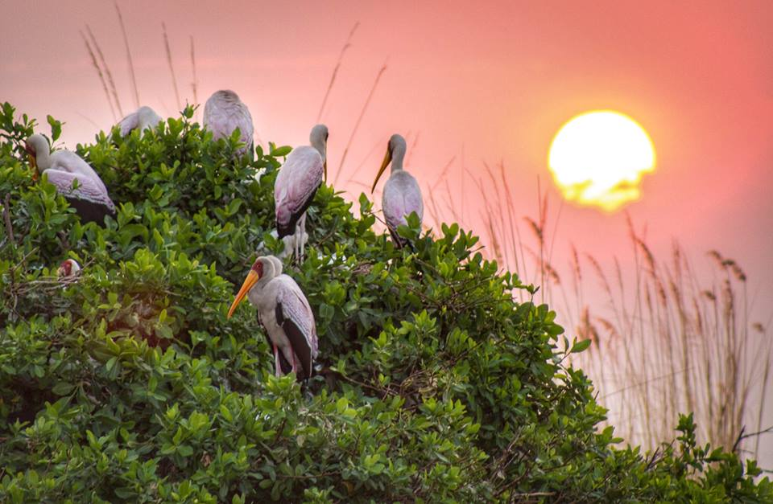

Slide 34
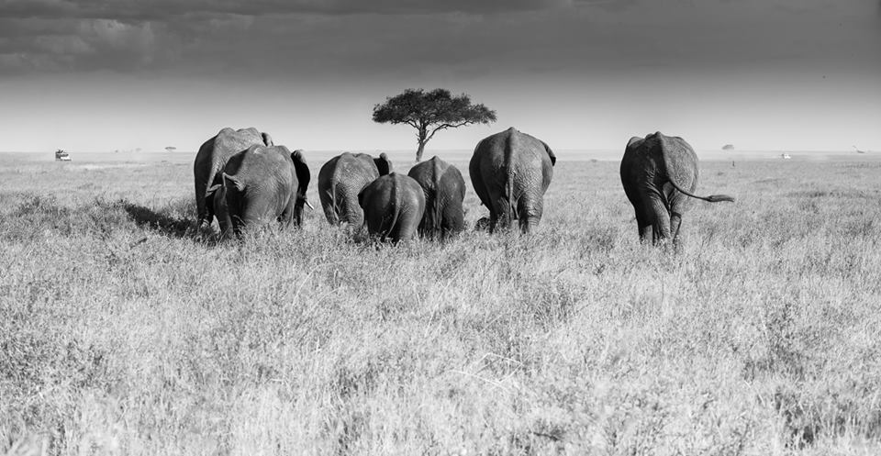
Dalida Innes-Escape from the midday

Slide 35
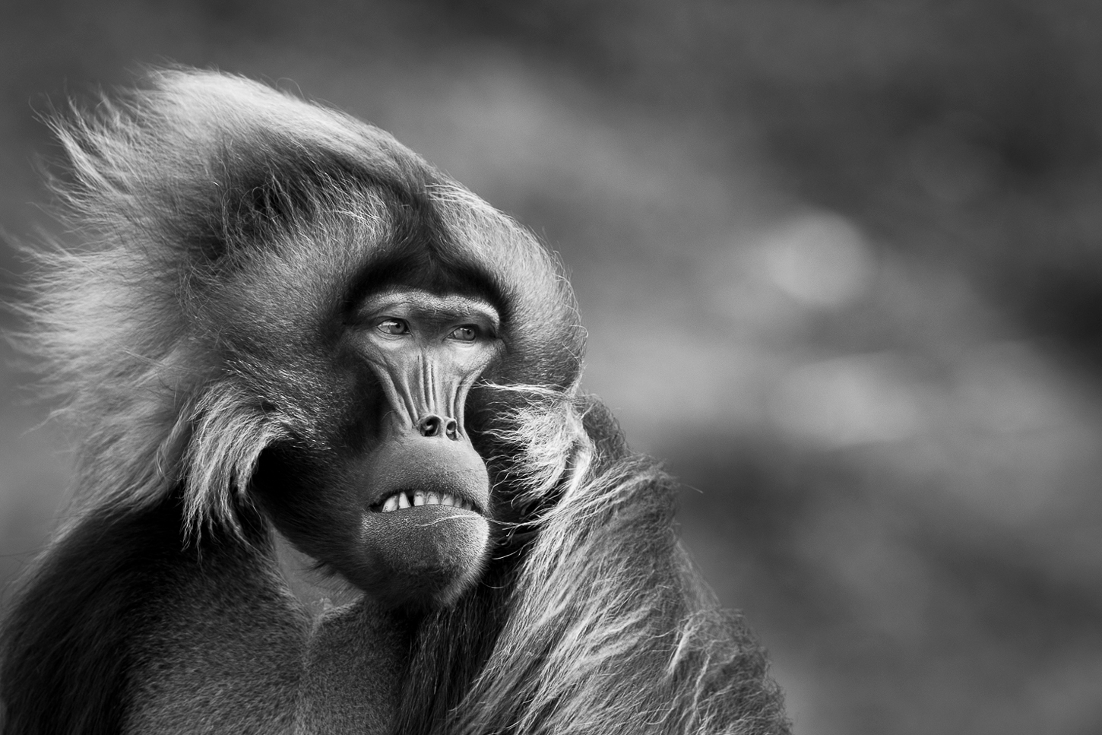
Patrice Quillard – blasted wind- Ethiopia

Slide 36
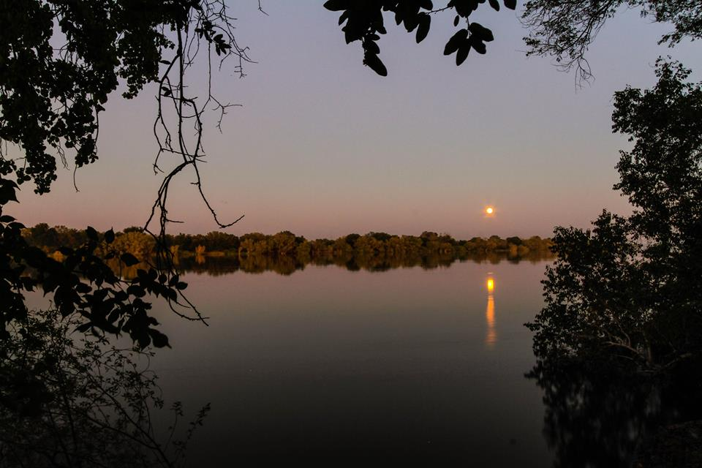

Slide 37
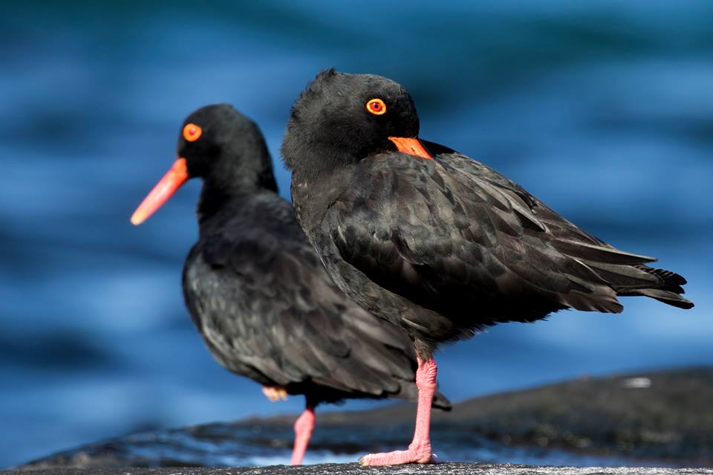
Joseph Ott - Long Day! Taken at Luderitz in Namibia late afternoon

Slide 38
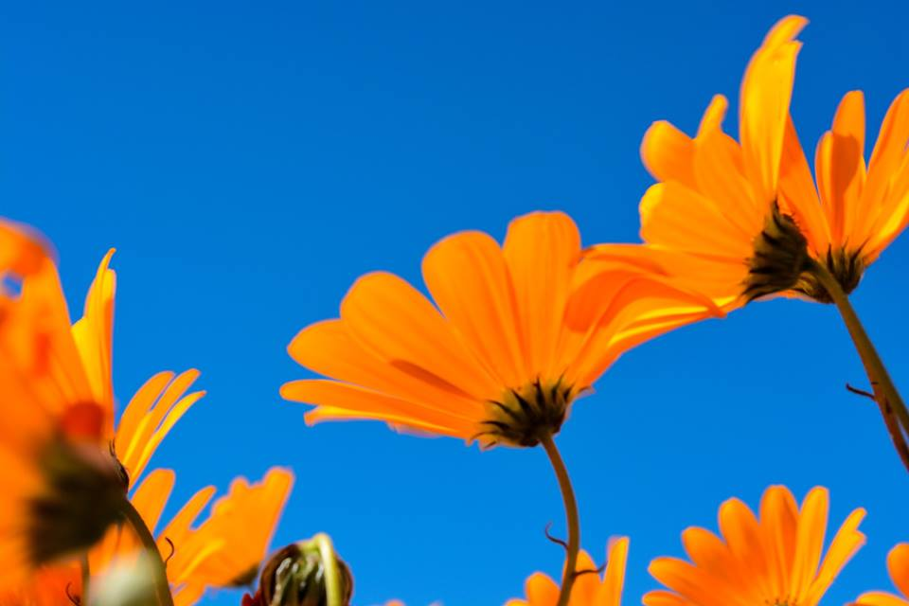

Slide 39
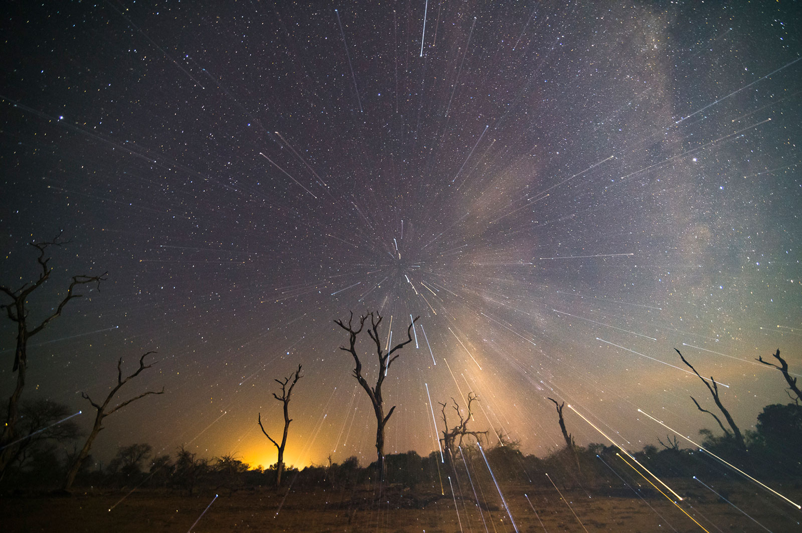
Andrew-Schoeman-stars

Slide 40
26-FEBRERO-2017
END

