Slide 1

Happy Advent Season…

Slide 2


Slide 3


Slide 4
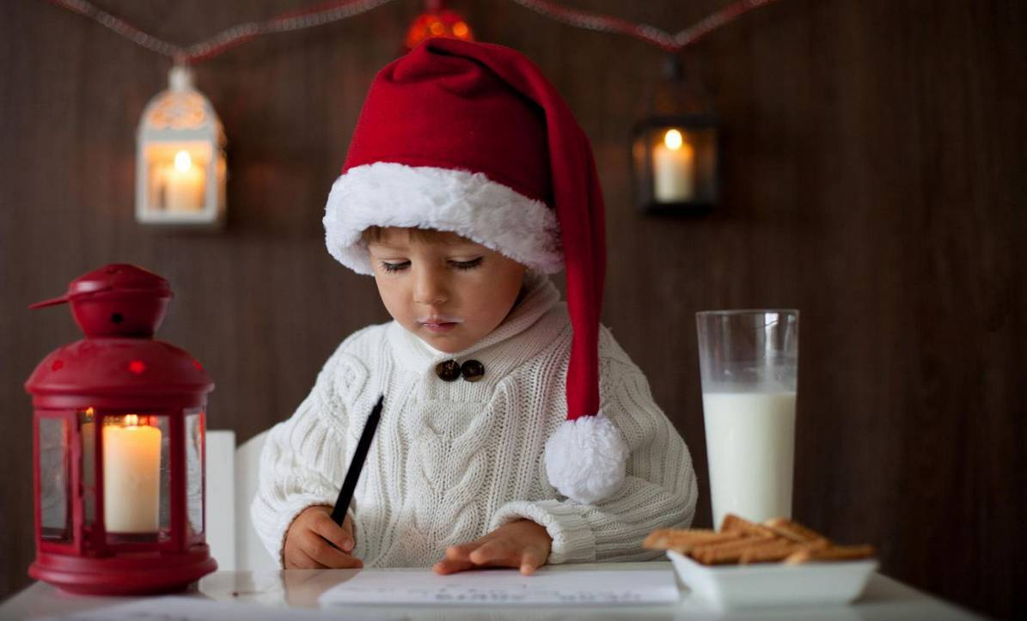

Slide 5
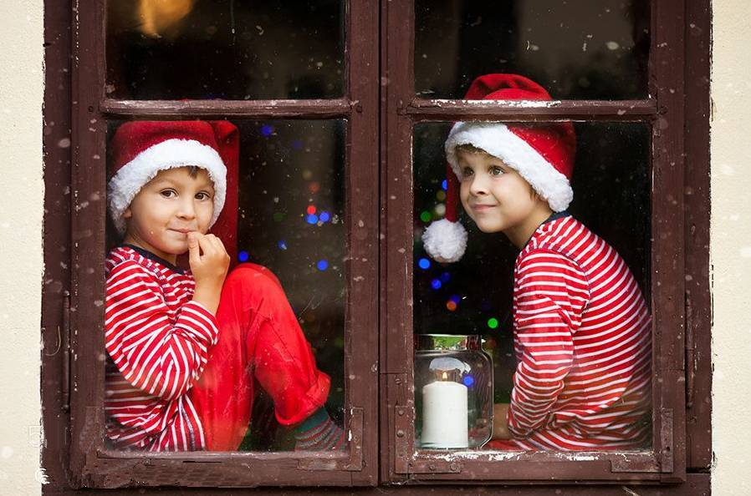

Slide 6
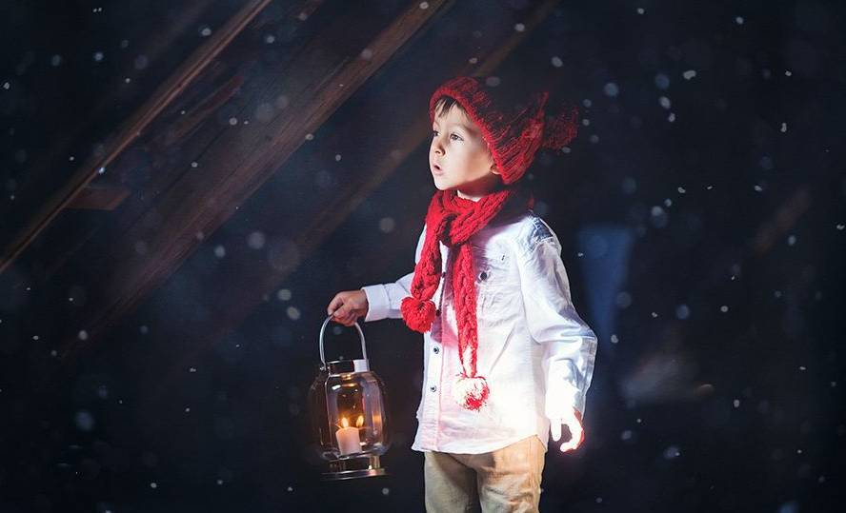

Slide 7


Slide 8



Slide 9
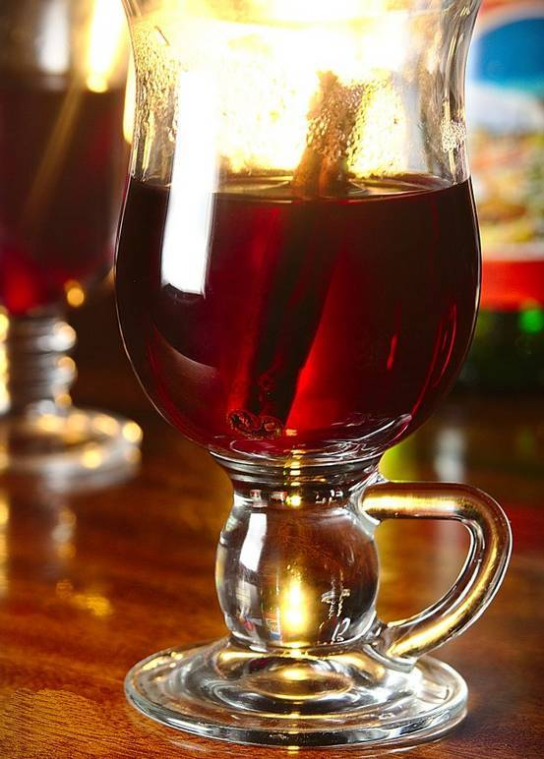
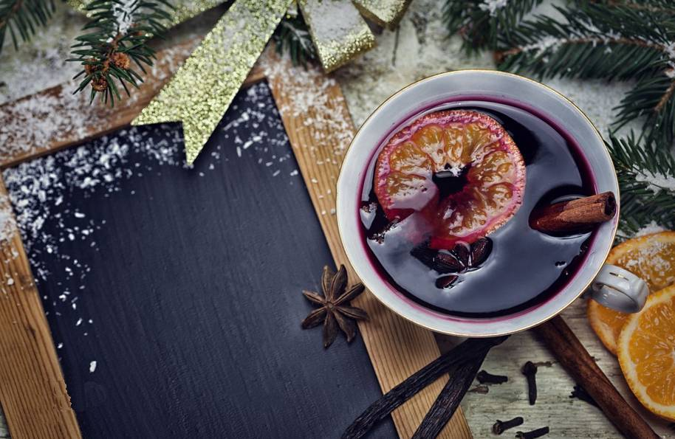


Slide 10
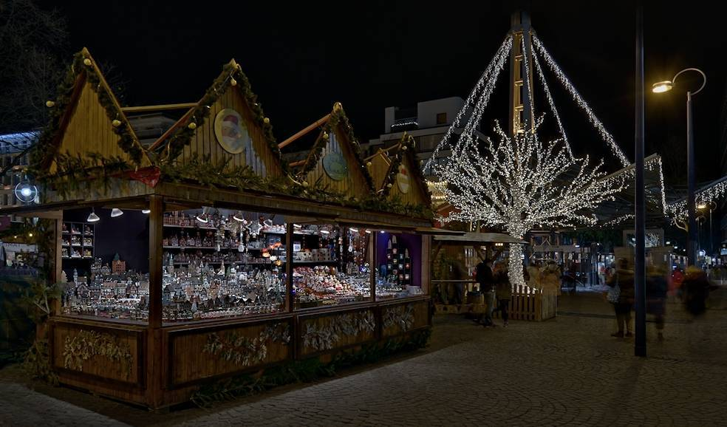

Slide 11
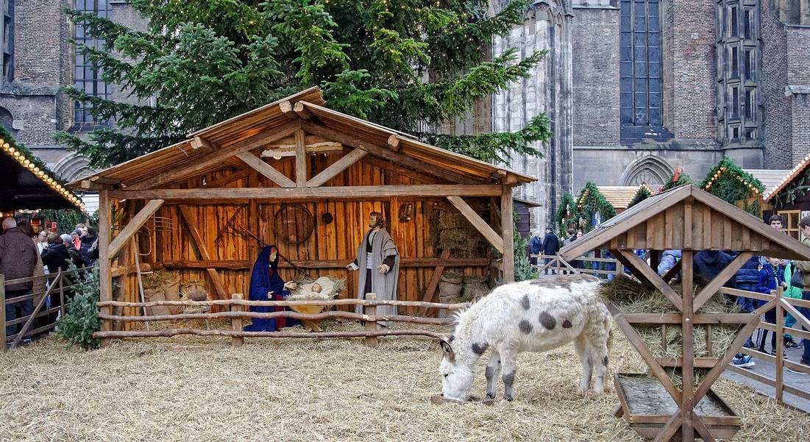

Slide 12
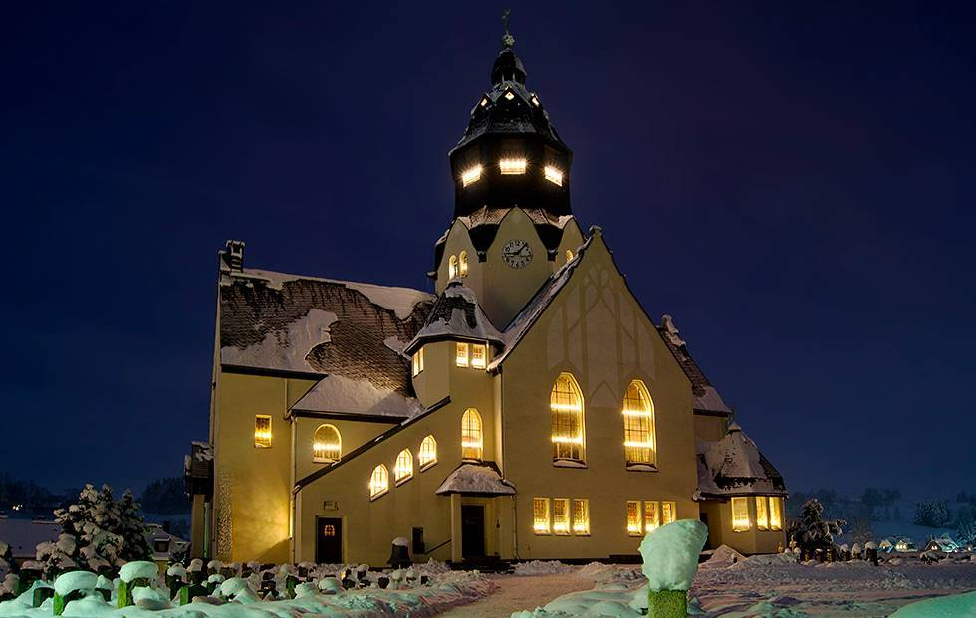

Slide 13
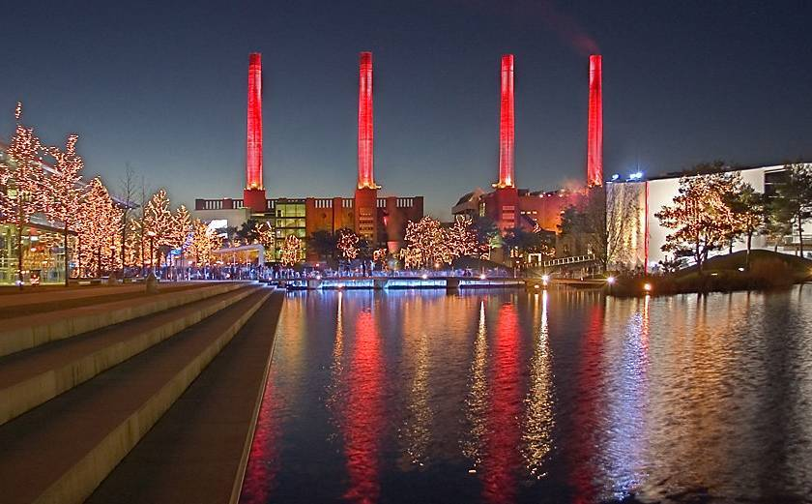
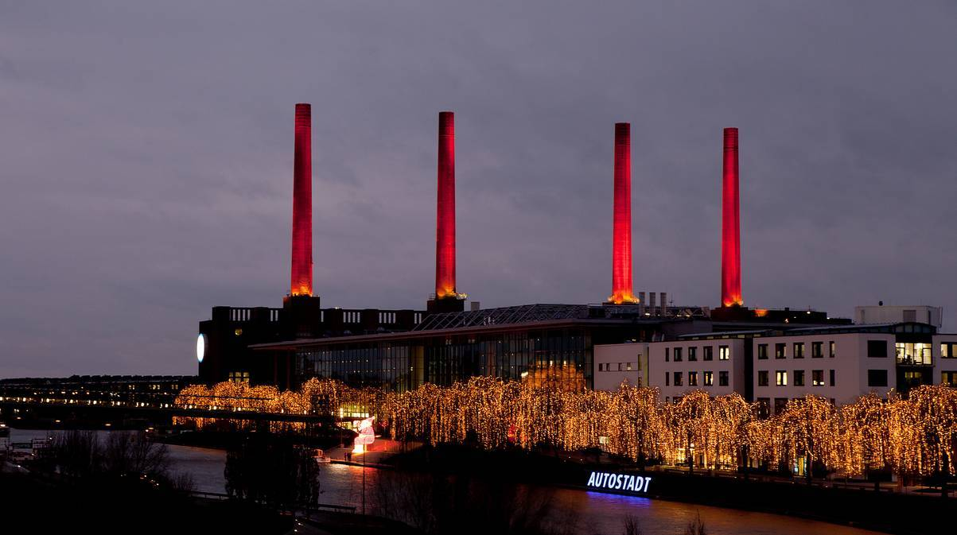

Slide 14
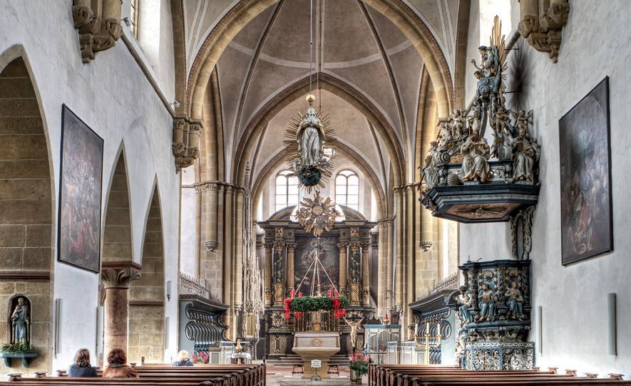

Slide 15
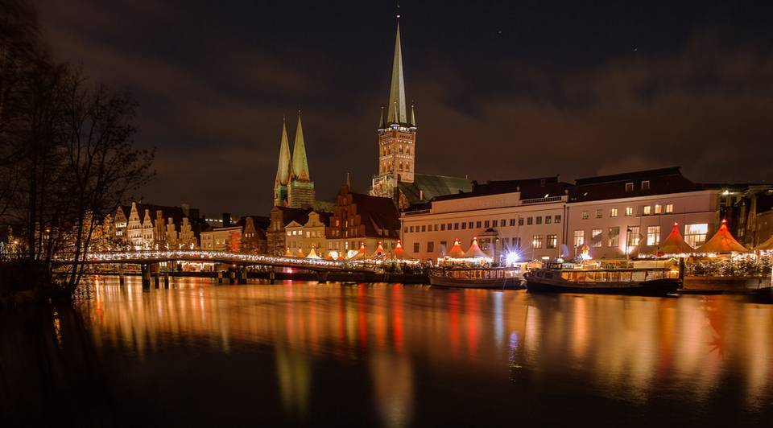

Slide 16
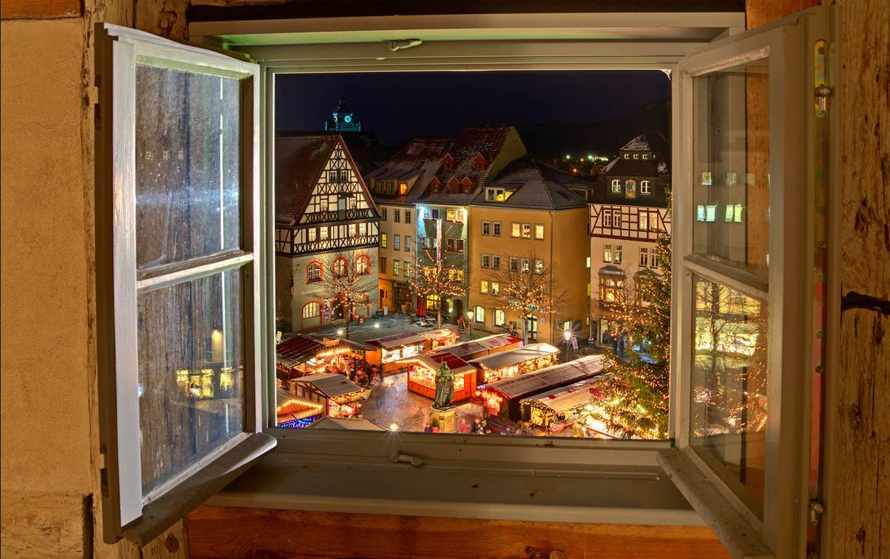

Slide 17
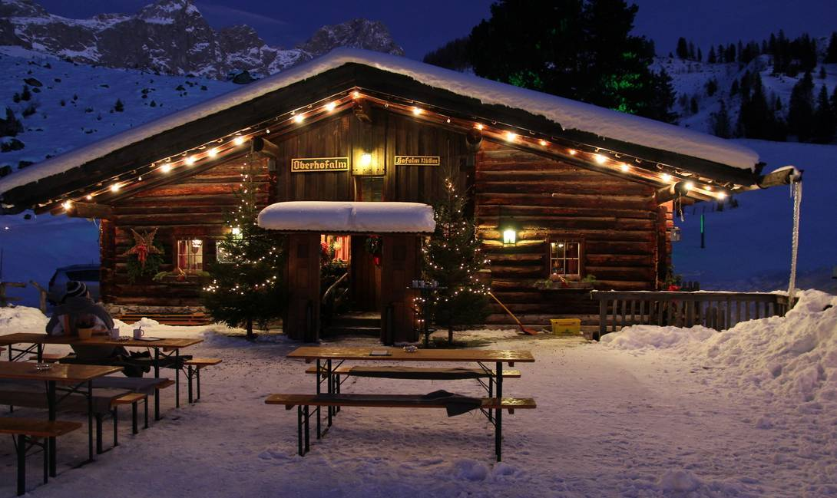

Slide 18
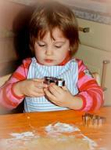
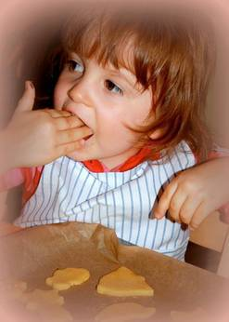
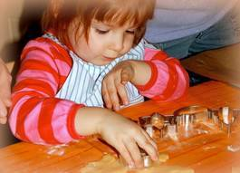
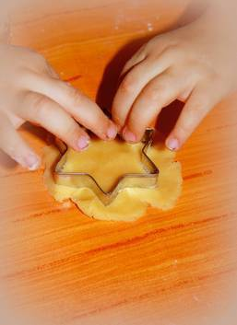


Slide 19
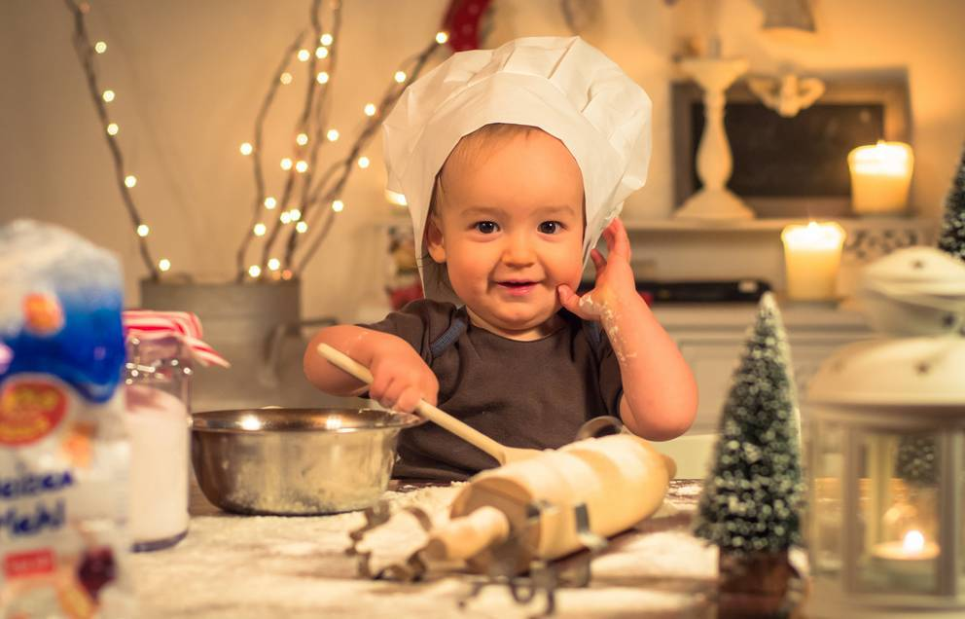

Slide 20
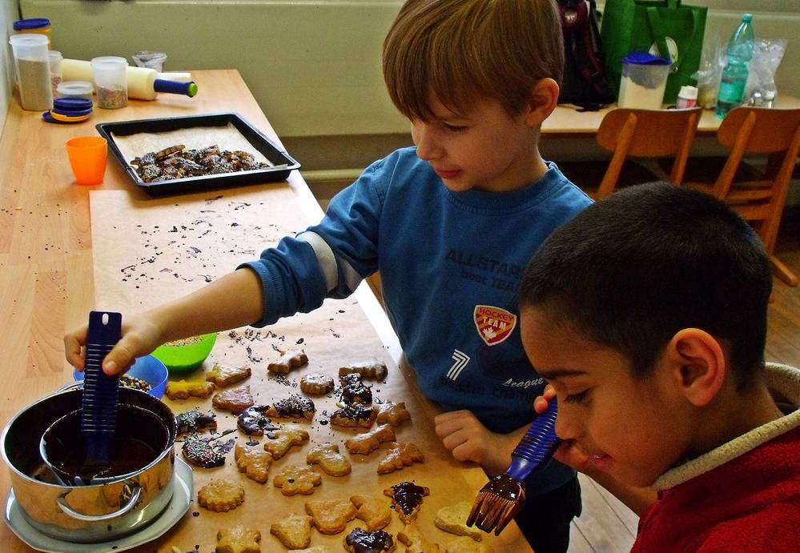

Slide 21
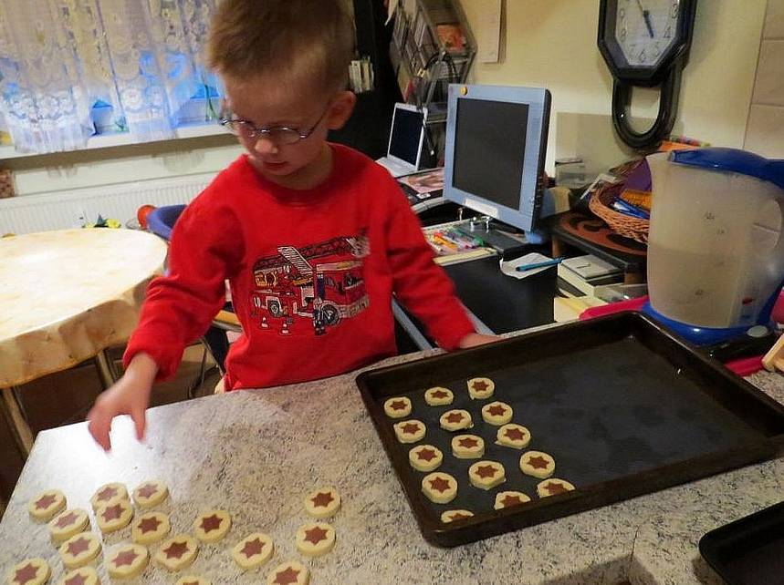

Slide 22
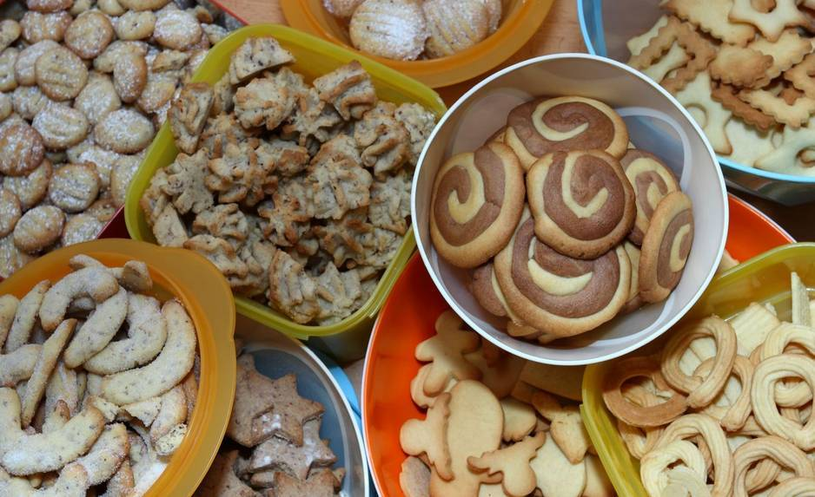

Slide 23
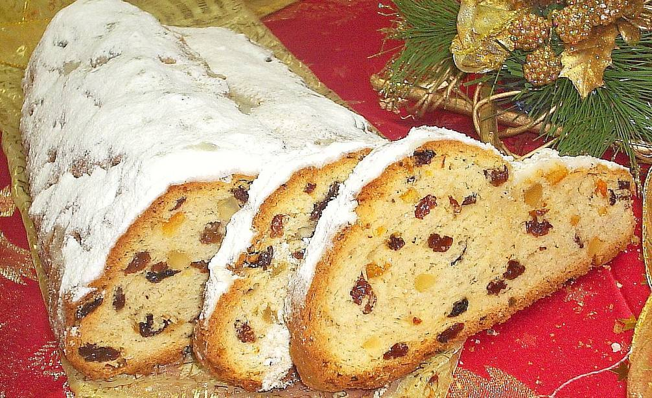

Slide 24
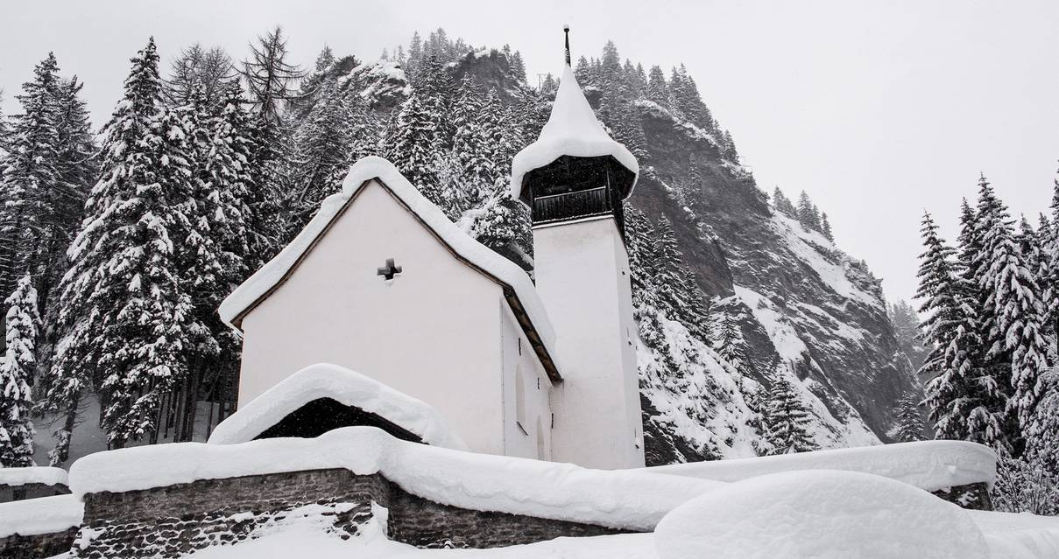

Slide 25
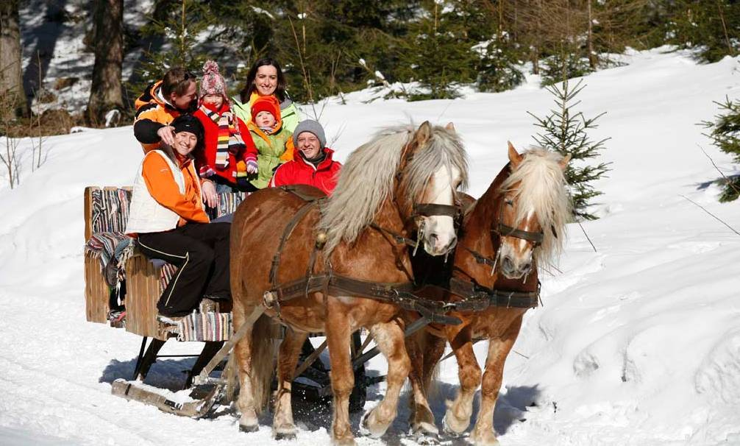

Slide 26


Slide 27
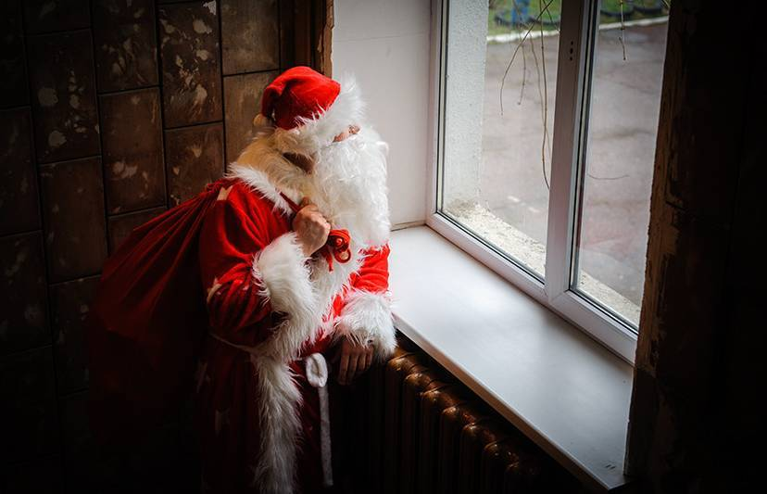

Slide 28


Slide 29
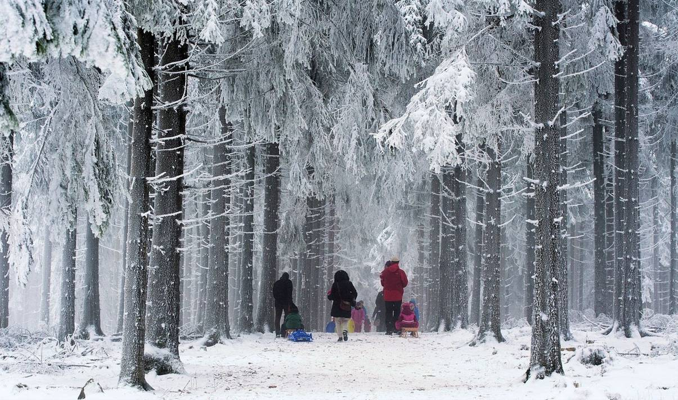

Slide 30


Slide 31
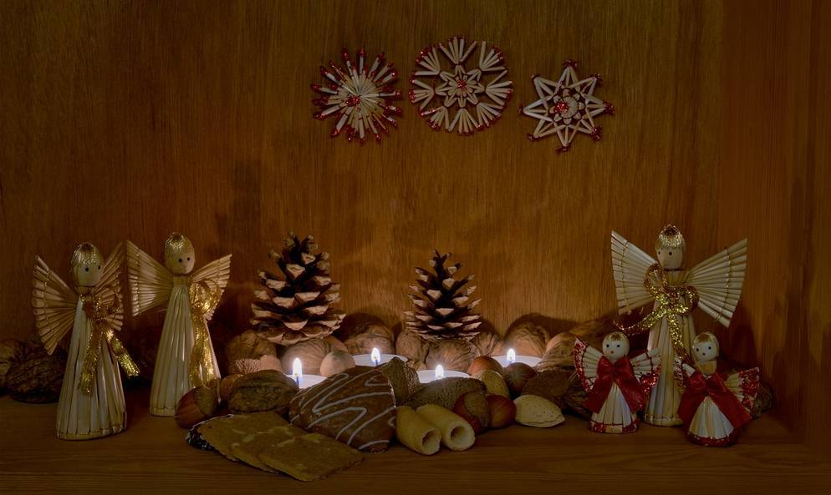

Slide 32
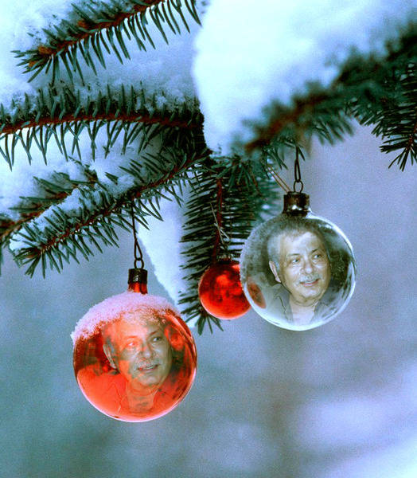
Photos: Tatyana Tomsickova
Gabriela Tulian
Frank King
Mykola Lunov
Lorenzo Ravasco
DJCarl
Sebastian Theilig
Bert Stamm
Martin Kober
Edmund Pichler
Martina I. Müller
Andrea Kusada
Zeljko Petrovic
aberabtula
Guido van Oepen
Pavel Zilke
Simone Torkington
Bernd Trennert
Dobrica Babic
Manuela Mager
Rolf Peine
End Show
Seen on Bigfun.be
Author: Bernd Trennert

