Slide 1
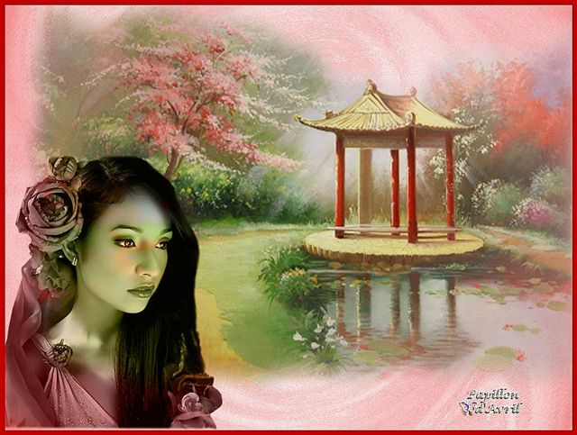

la CHINE

Slide 2
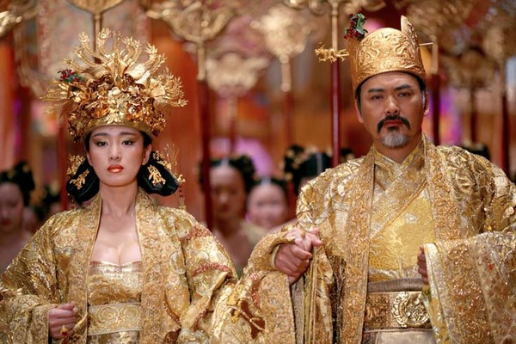
La cité interdite-la Chine ancienne

Slide 3
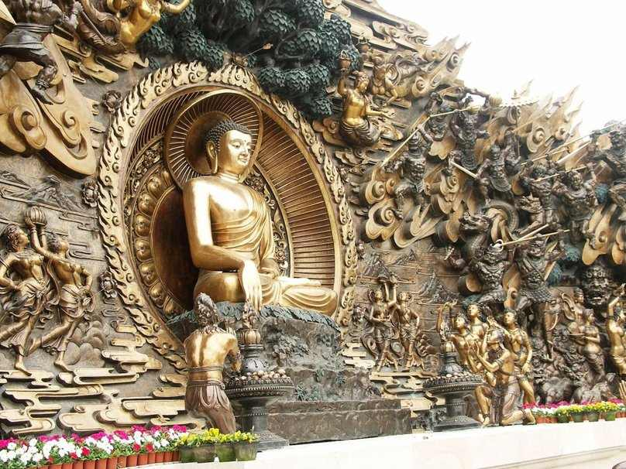
Xihui-park-Chine

Slide 4
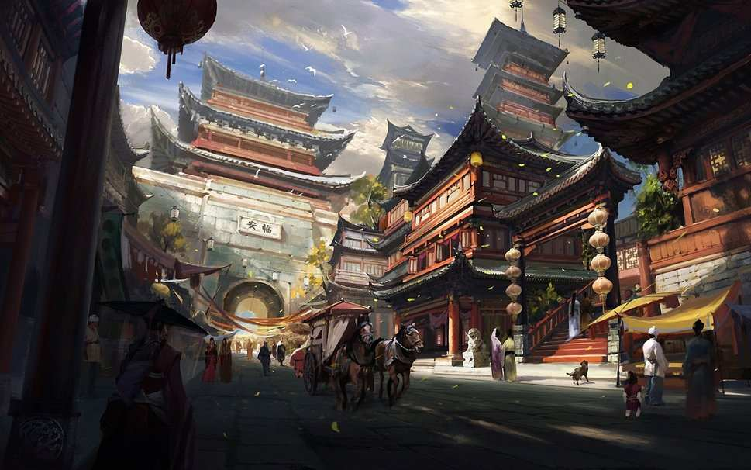
Chine

Slide 5
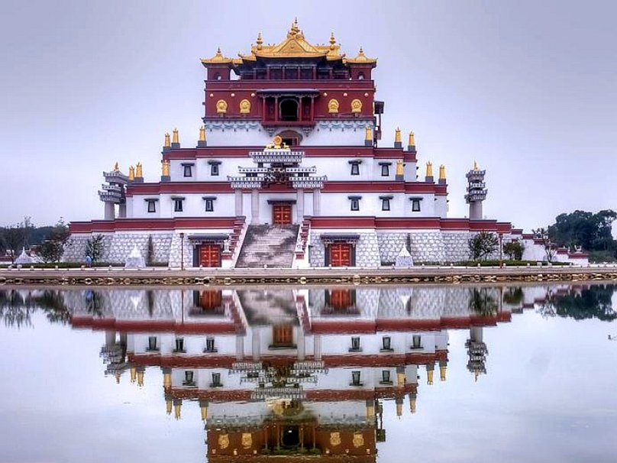
Chine

Slide 6
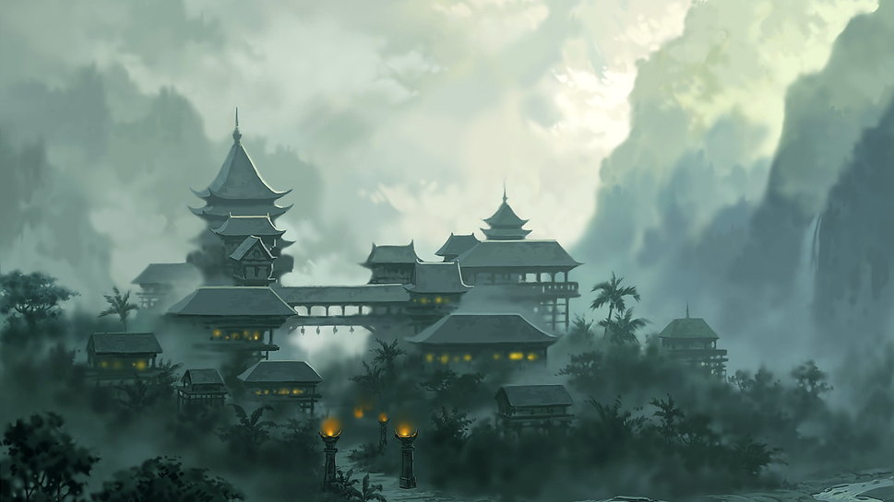
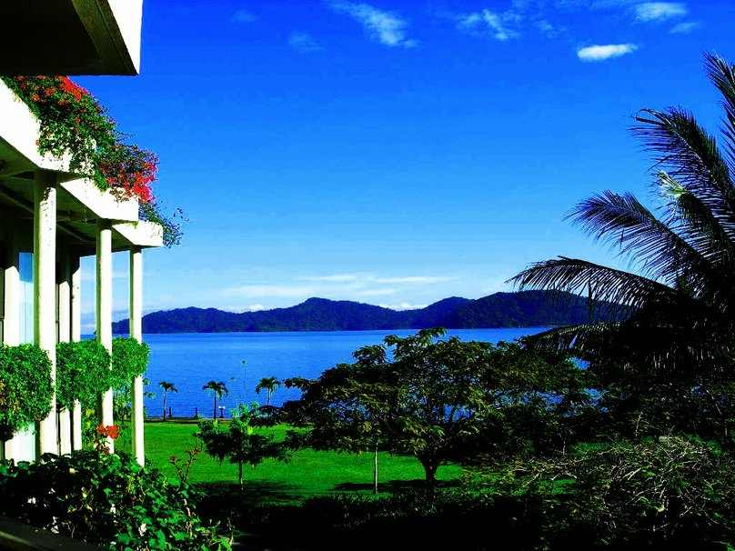
Chine-sea.

Slide 7
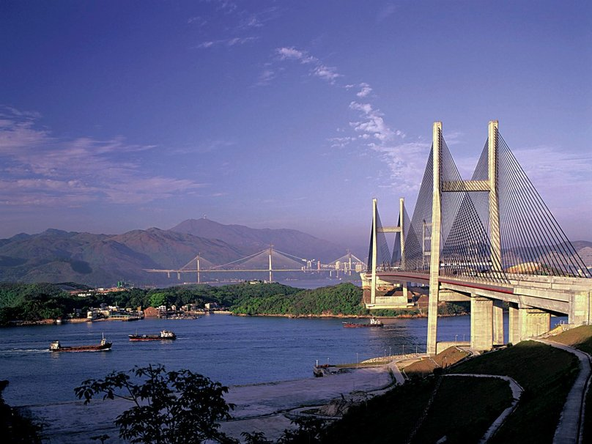
Chine hong-kong-bridges

Slide 8
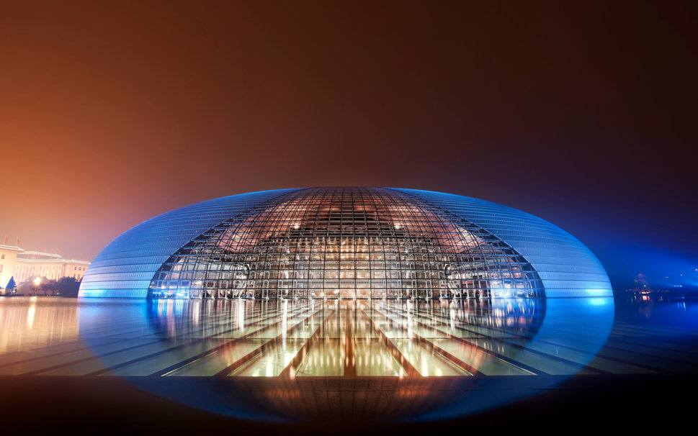
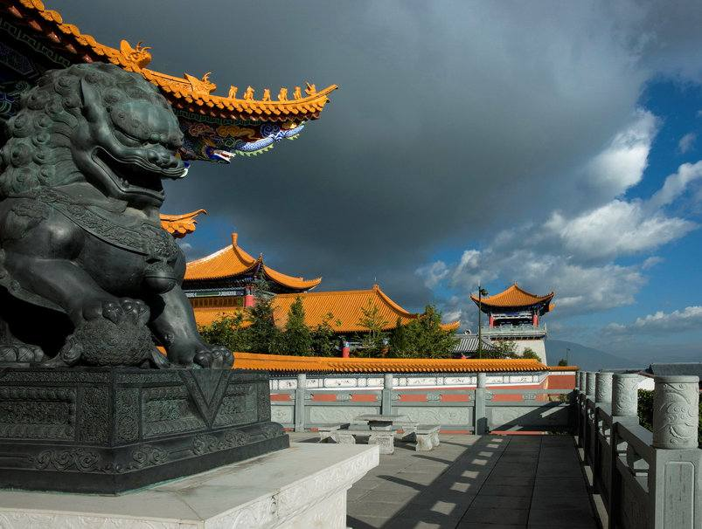
Nationa-grand-Théatre-Chine

Slide 9
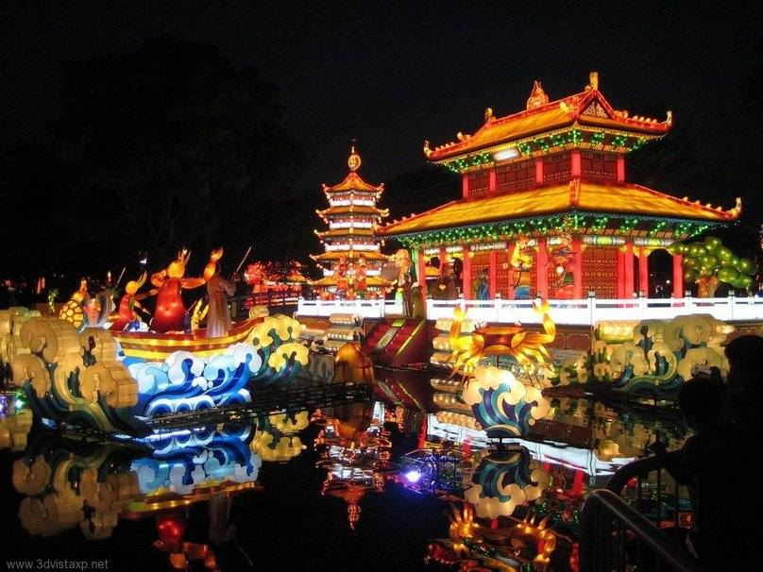
China-Town.

Slide 10
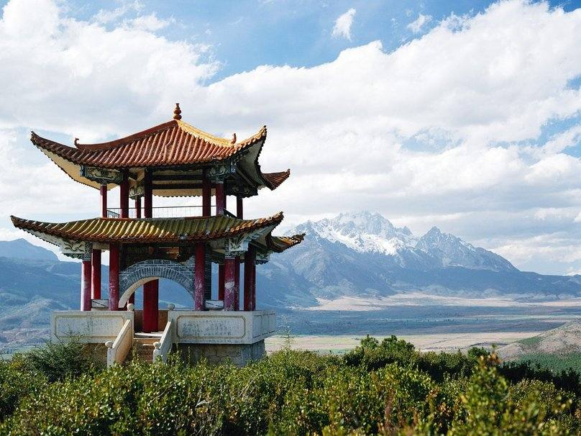
China-arbor-mountains

Slide 11
Sculpture dragon CHINE

Slide 12
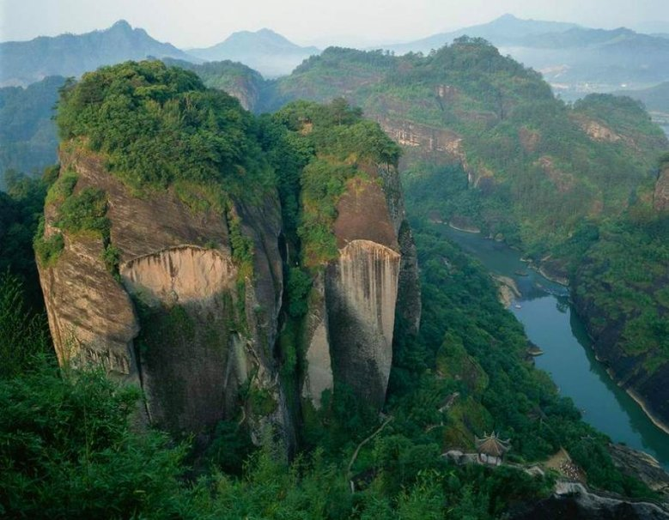
Cloud-nest-tianyou-Chine

Slide 13
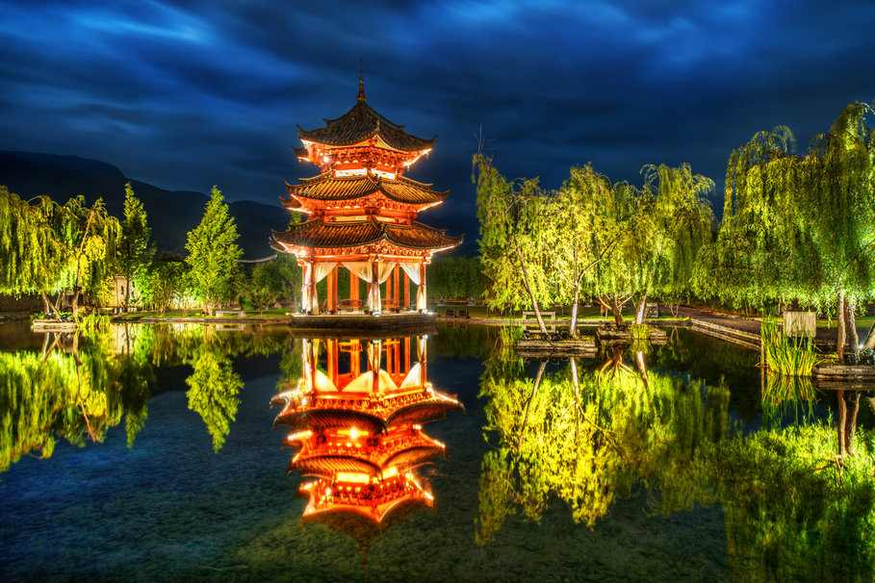
Lijiang-Chine

Slide 14
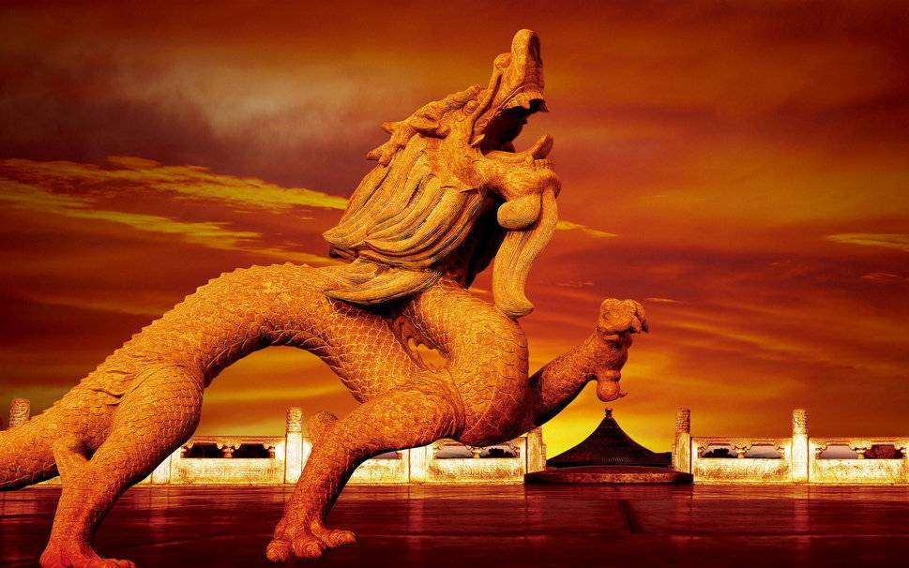
Dragon-Chine

Slide 15
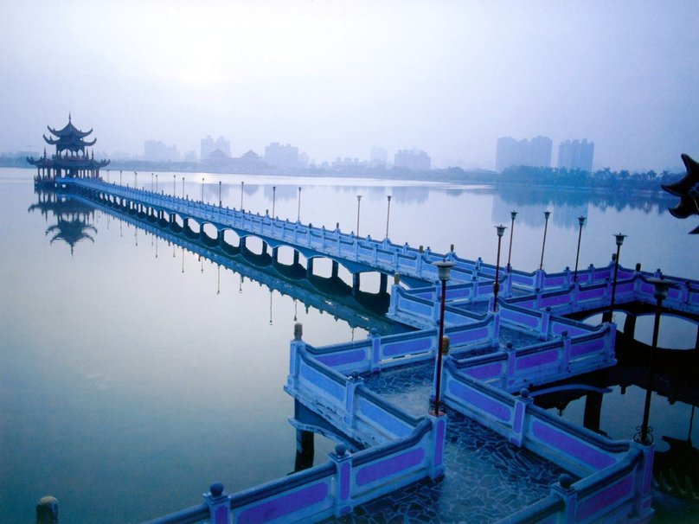
9-corner-bridge-Chine

Slide 16
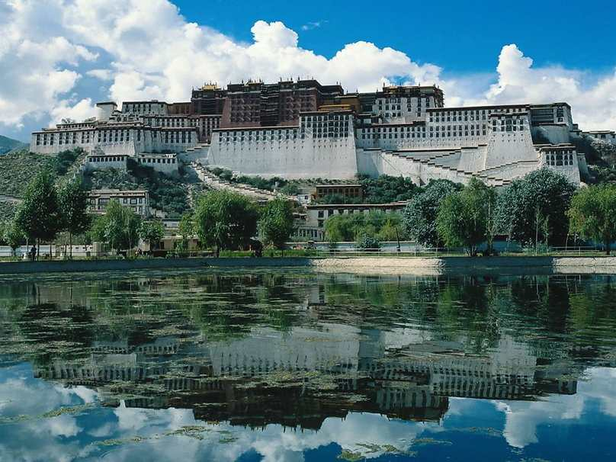
Maison du Potala-Chine-Tibet

Slide 17
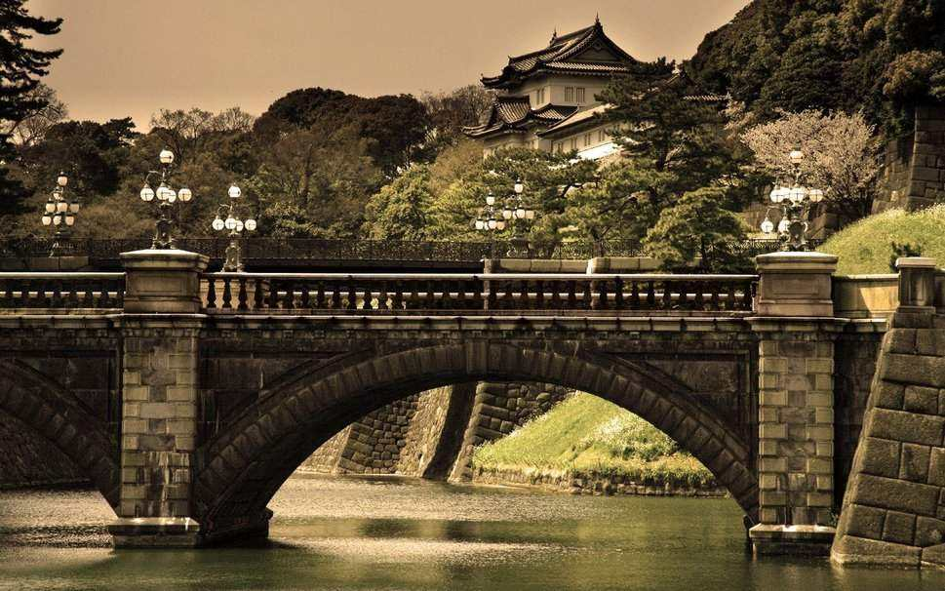
Résidence-house-Chine

Slide 18
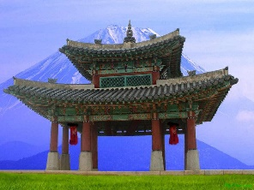
Chine-monument

Slide 19
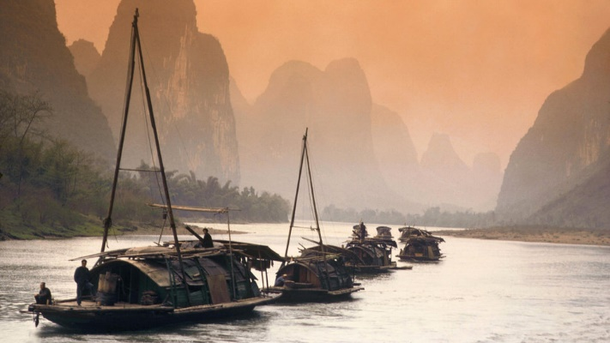
CHINE

Slide 20
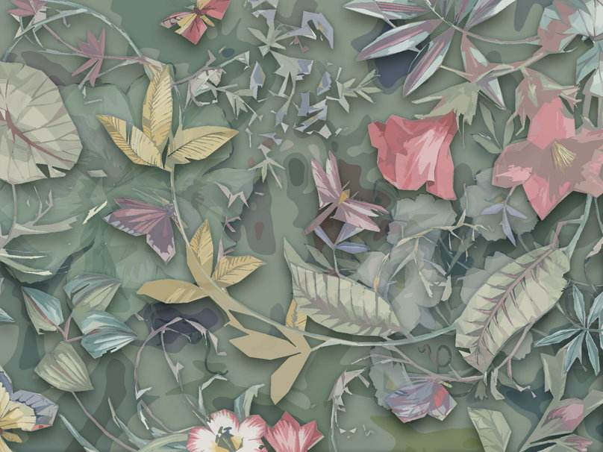
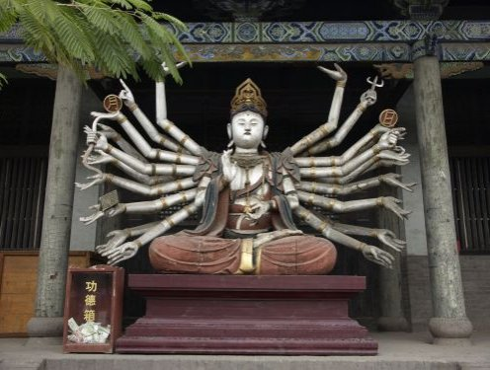
CHINE

Slide 21
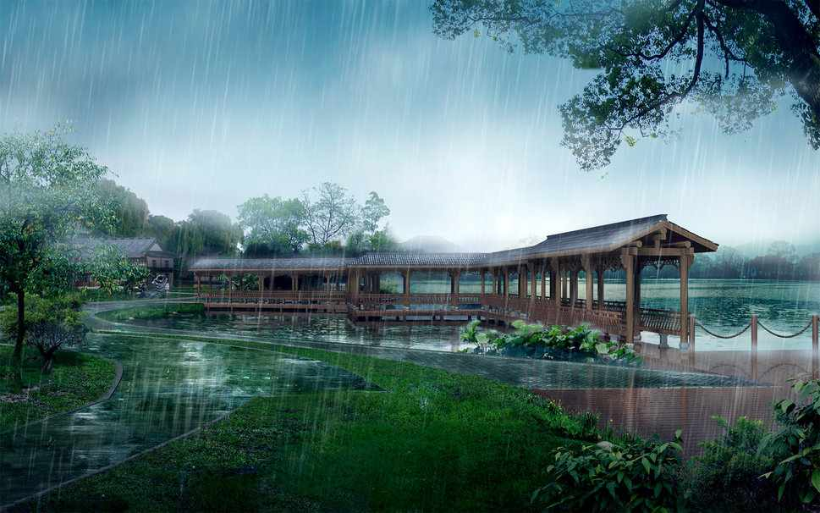
CHINE

Slide 22
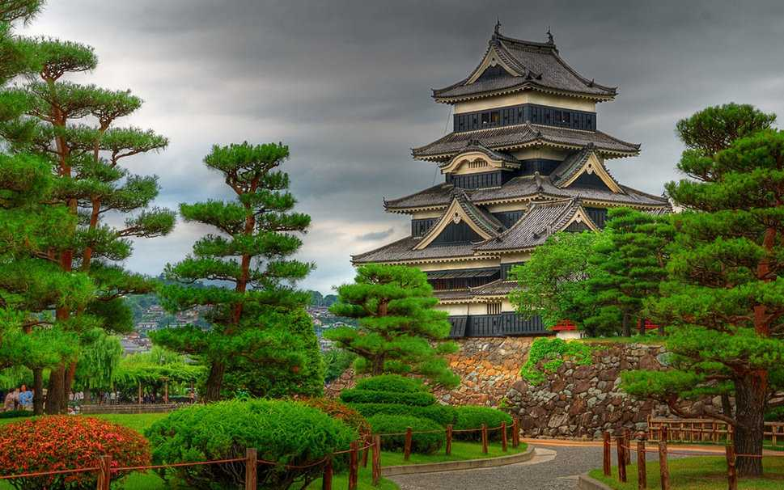
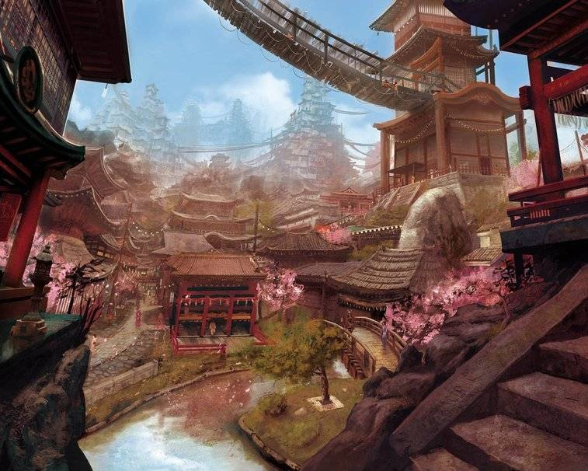
Old-School-CHINA-TOWN.

Slide 23
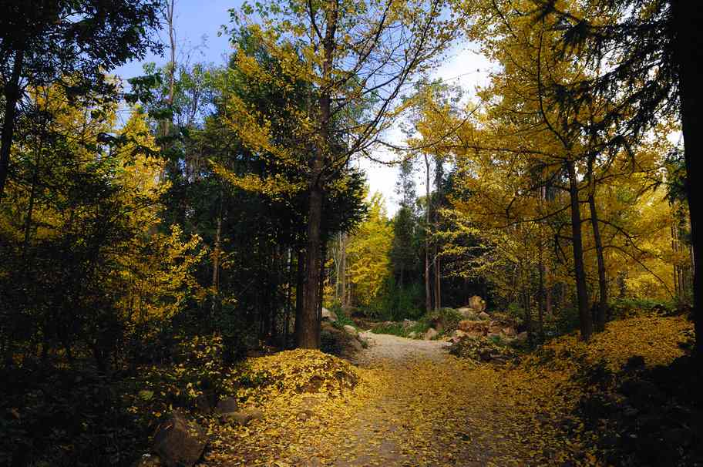
Ginkgo-village-Yunnan-CHINE

Slide 24
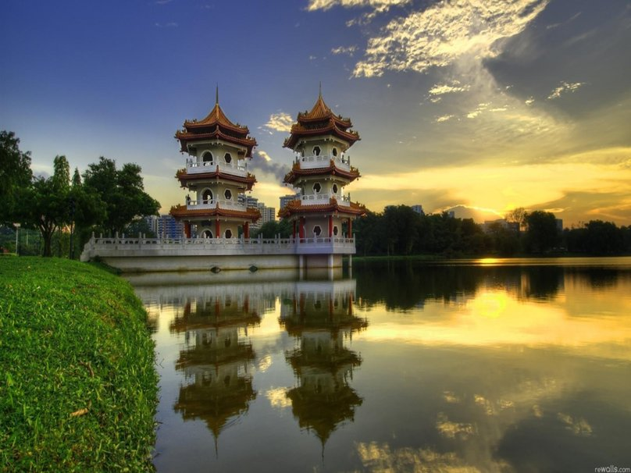
CHINE

Slide 25
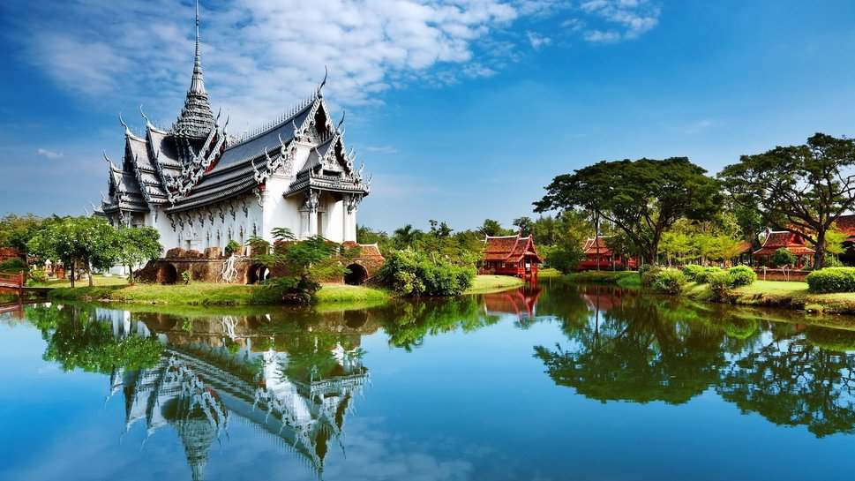
Beautiful-architecture-of-CHINA

Slide 26
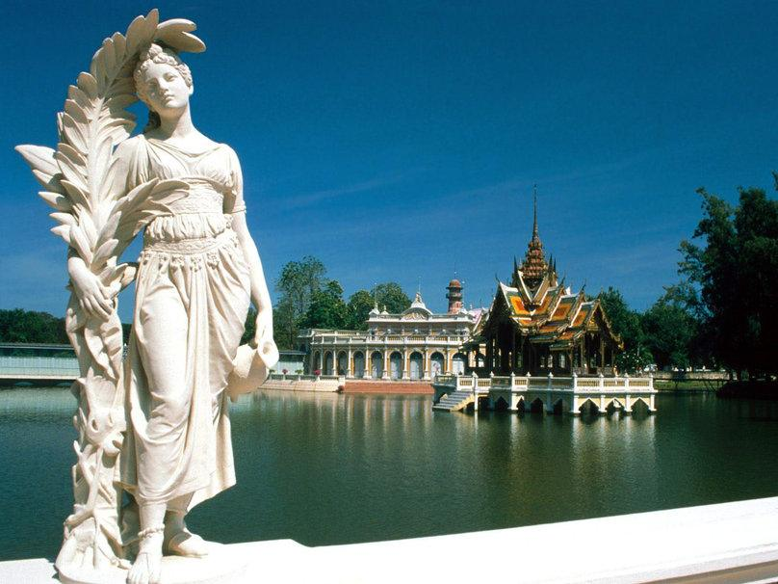
Statue-China-lake

Slide 27
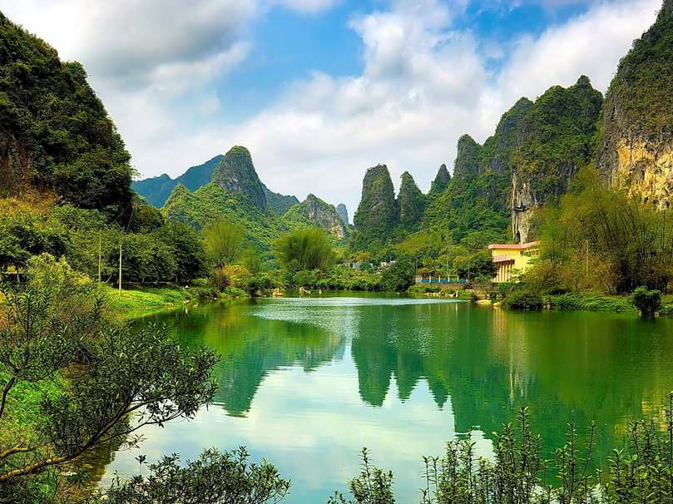
CHINE- montagne.

Slide 28
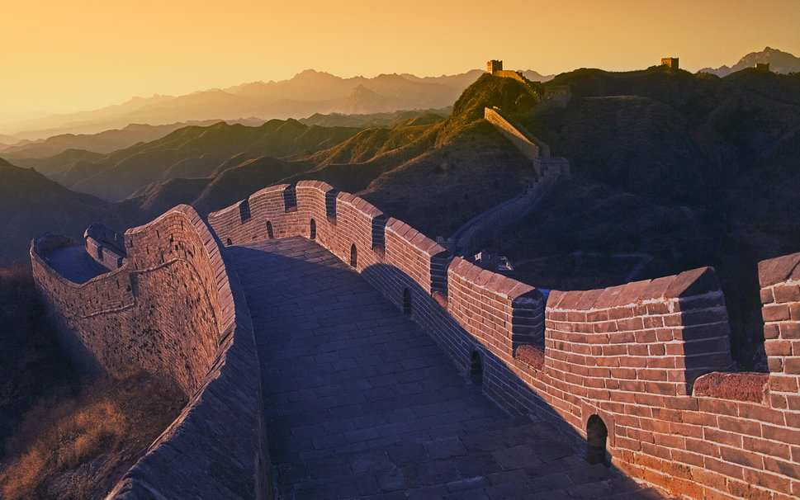
Le mur de CHINE
Le mur de CHINE

Slide 29
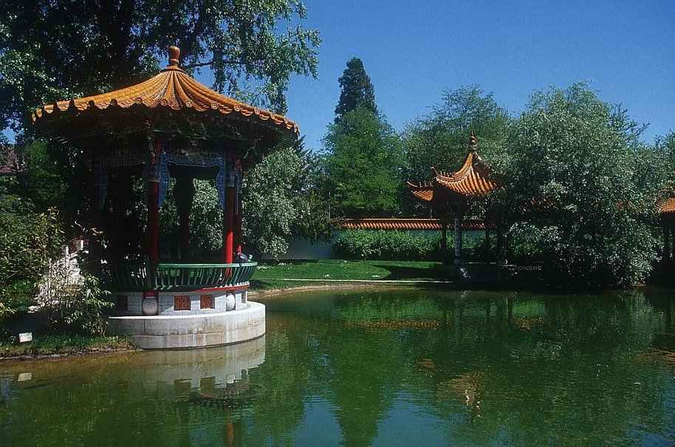
CHINE-Temple

Slide 30
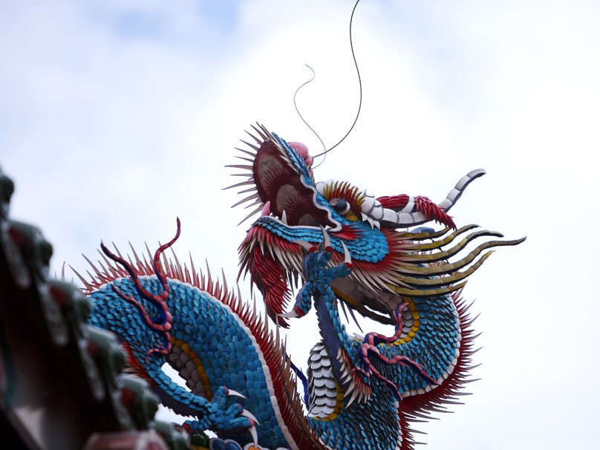
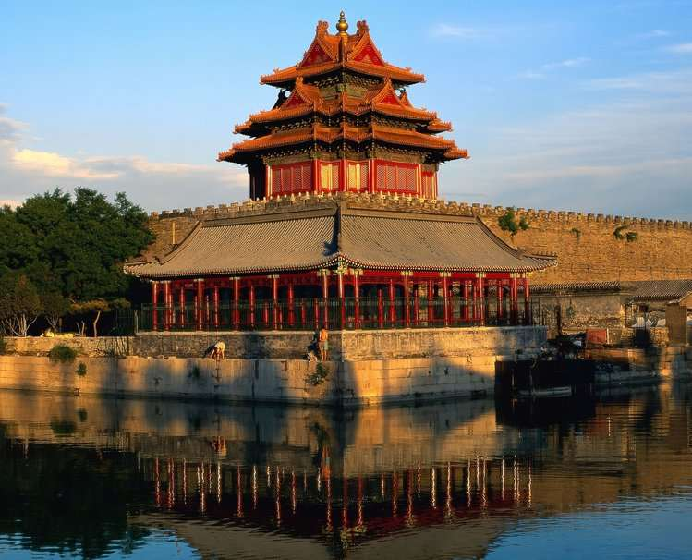
Temple-CHINE

Slide 31
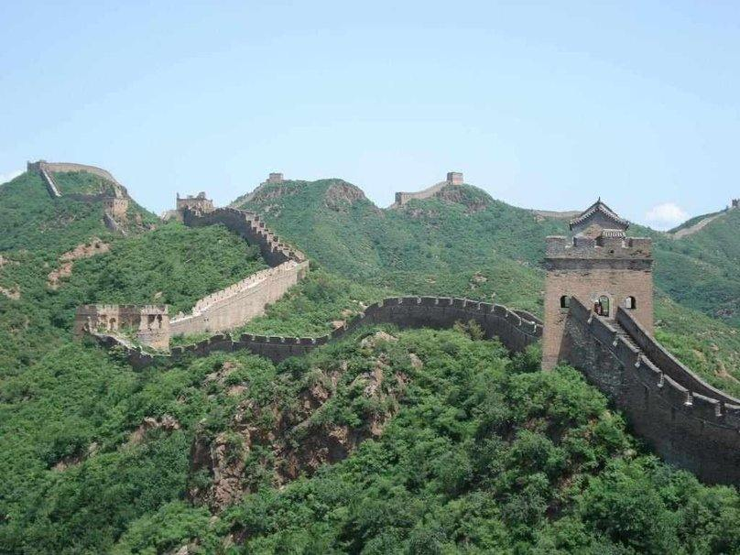
Le mur de CHINE

Slide 32
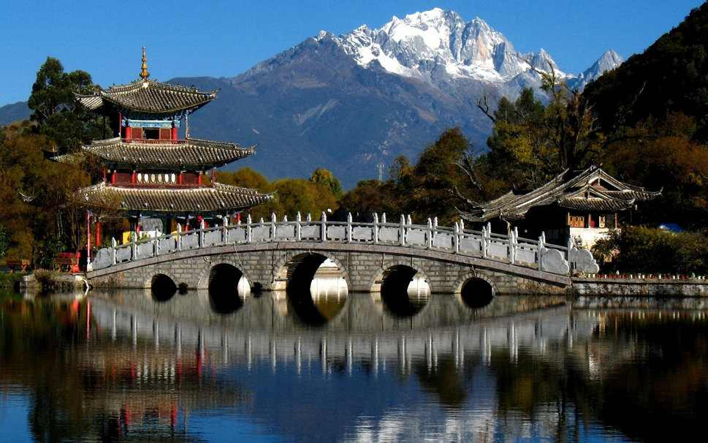
CHINE- montagne

Slide 33
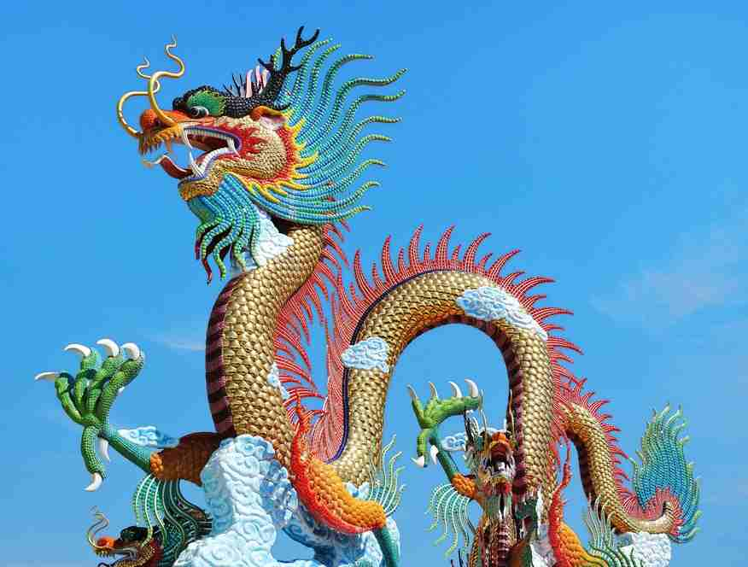

Musique:Sound China
montage
Images du web
http://wwwpapy16.net/

