Slide 1
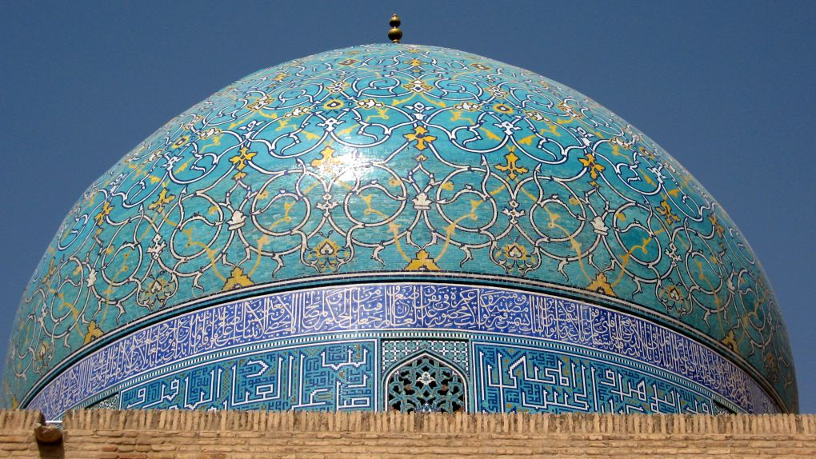
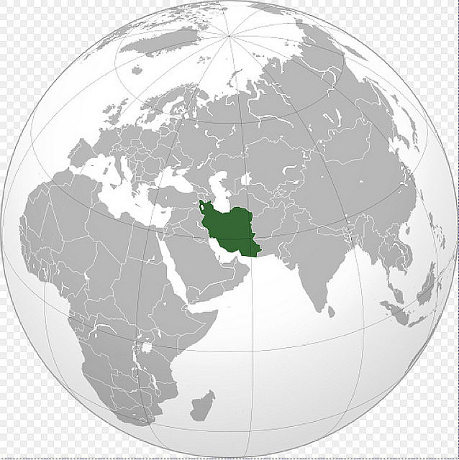


IRAN
13
Notes:
Imam Mosque is a mosque in Isfahan standing in south side of Naghsh-i Jahan Square.
The mosque is also known as Shah Mosque, Royal Mosque and Abbasi Jame Mosque.
Built during the Safavids period, it is an excellent example of Islamic architecture of Iran, and regarded as the masterpiece of Persian Architecture. The Imam Mosque of Esfahan is one of the everlasting masterpieces of architecture in Iran and all over the world. It is registered along with the Naghsh-i Jahan Square as a UNESCO World Heritage Site. Its construction began in 1611, and its splendor is mainly due to the beauty of its seven-color mosaic tiles and calligraphic inscriptions.
The portal of the mosque measures 27 meters high, crowned with two minarets 42 meters tall. The Mosque is surrounded with four iwans and arcades. All the walls are ornamented with seven-color mosaic tile. The most magnificent iwan of the mosque is the one facing the Qibla measuring 33 meters high. Behind this iwan is a space which is roofed with the largest dome in the city at 52 meters height. The dome is double layered.
The acoustic properties and reflections at the central point under the dome is an amusing interest for many visitors. There are two seminaries at the southwest and southeast sections of the mosque.

Slide 2
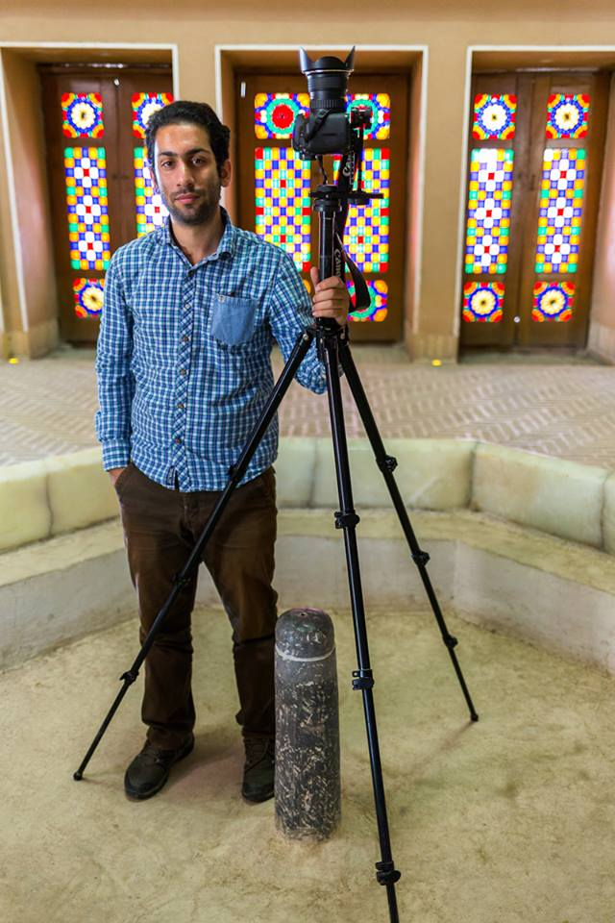
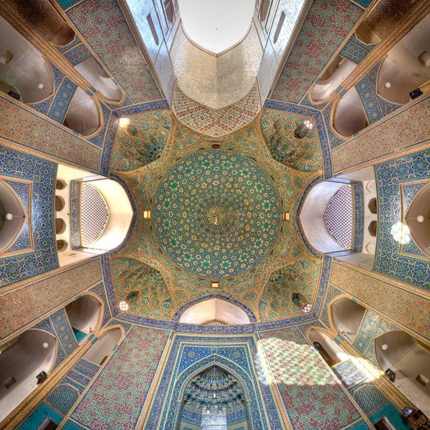
Mohammad Reza Domiri Ganji
The Jameh mosque of Yazd

Slide 3
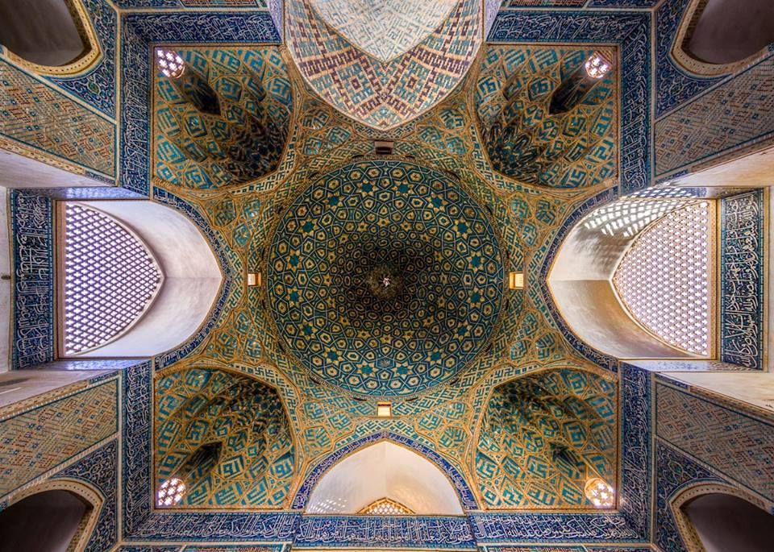
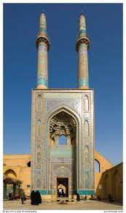
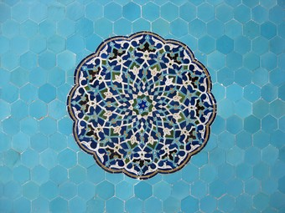
The Jameh mosque of Yazd

Slide 4
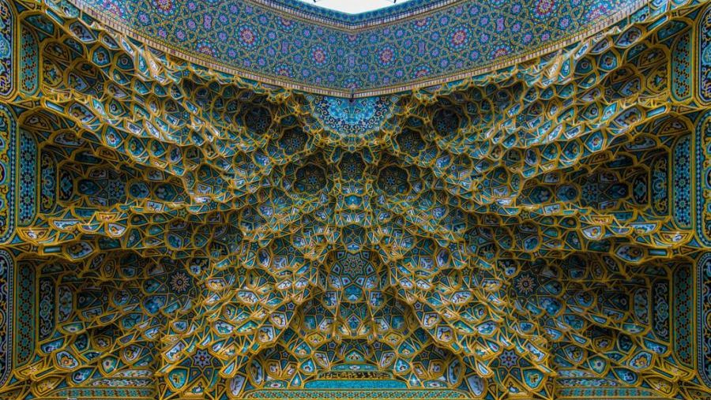
Fatima Masumeh Shrine of Sayeda Fatima Al-Masouma, in Qom

Slide 5
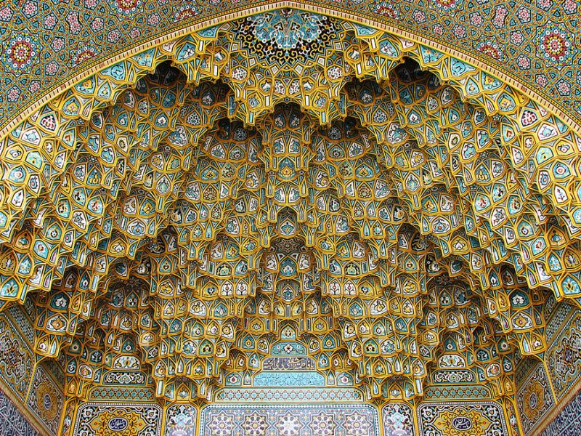
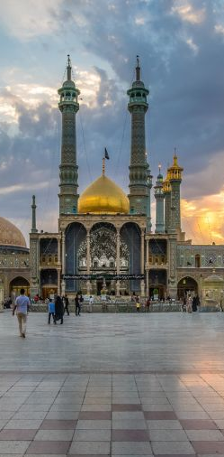
Fatima Masumeh Shrine of Sayeda Fatima Al-Masouma, in Qom

Slide 6
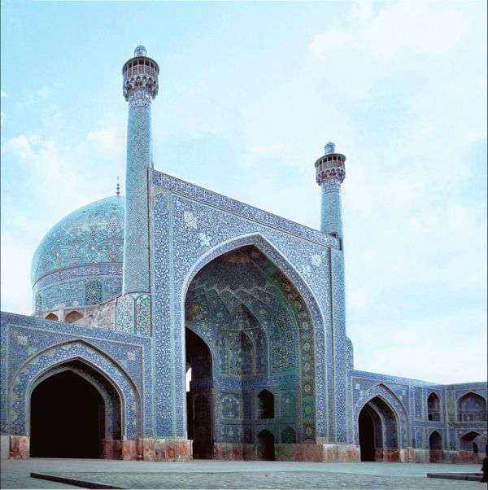
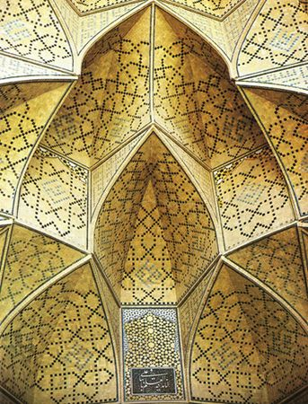
The Great Mosque (or Masjid-e Jameh) of Isfahan

Slide 7
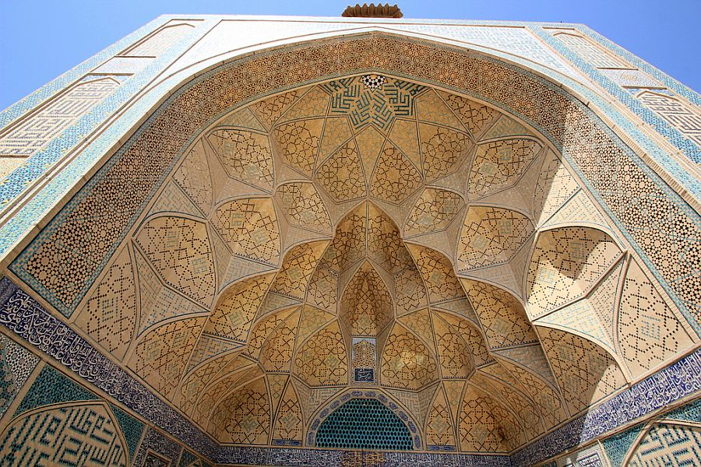
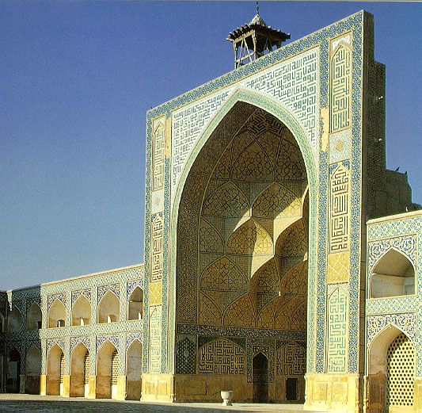
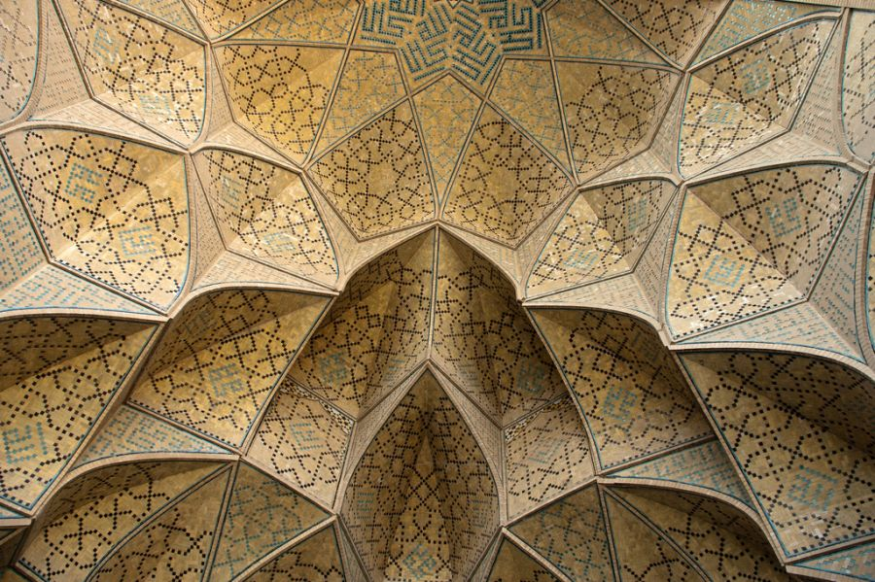
The Great Mosque (or Masjid-e Jameh) of Isfahan

Slide 8
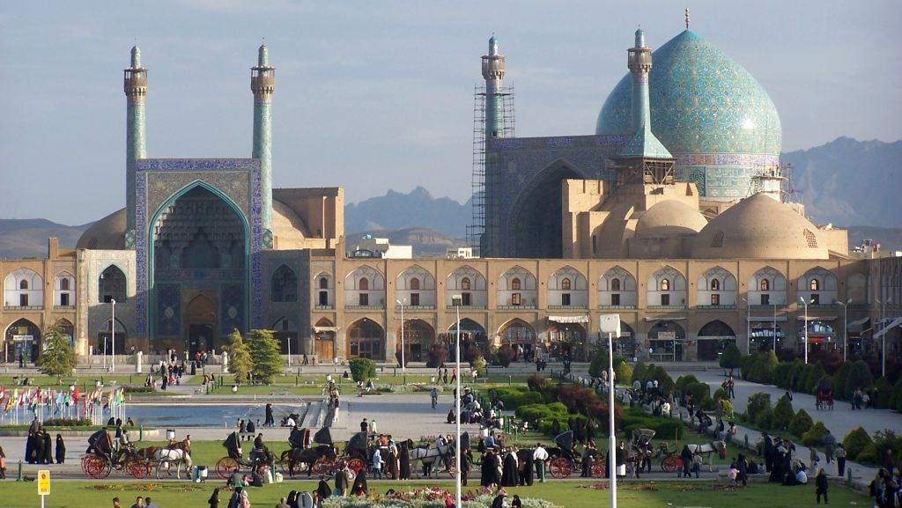
Naghsh-e-Jahan Square, Esfahan

Slide 9
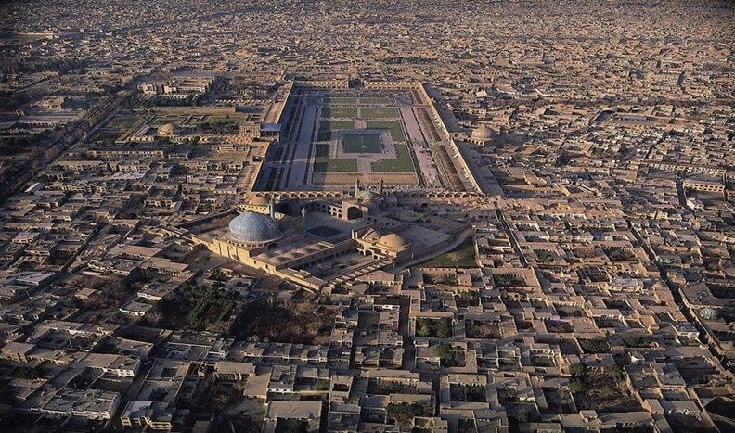
AliQapu Palace
Sheikh Lotfollah mosque
Shah (Emam) Mosque
Naghsh-e-Jahan Square, Esfahan

Slide 10
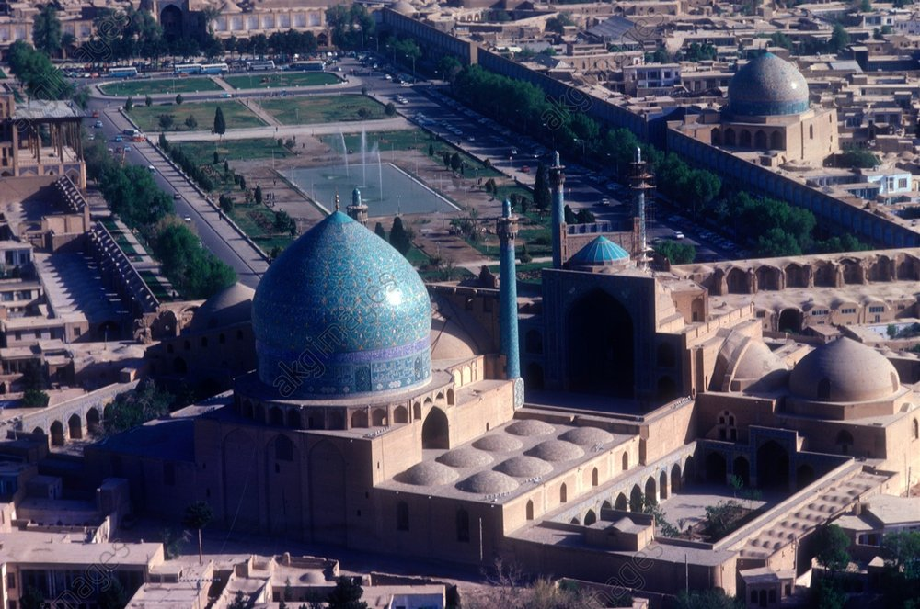
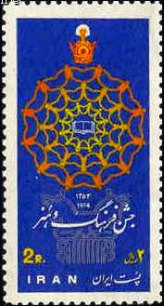
AliQapu Palace
Sheikh Lotfollah mosque
Esfahan Shah Mosque

Slide 11
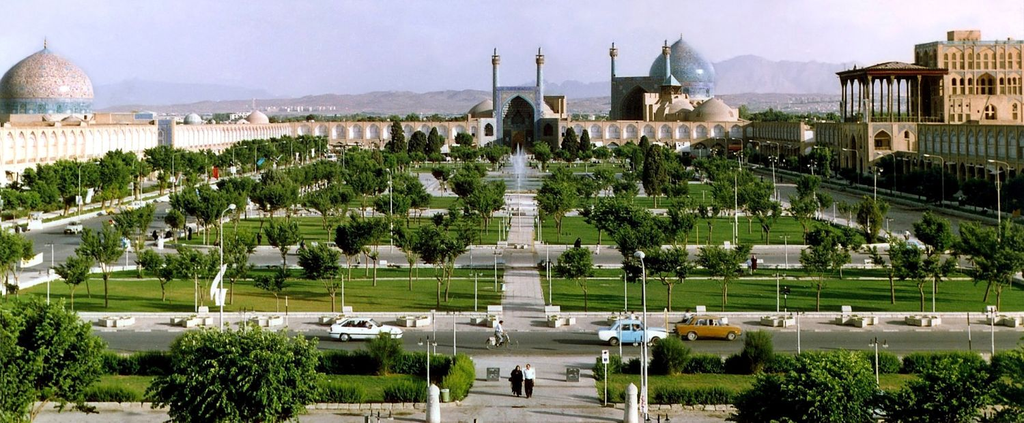

Slide 12
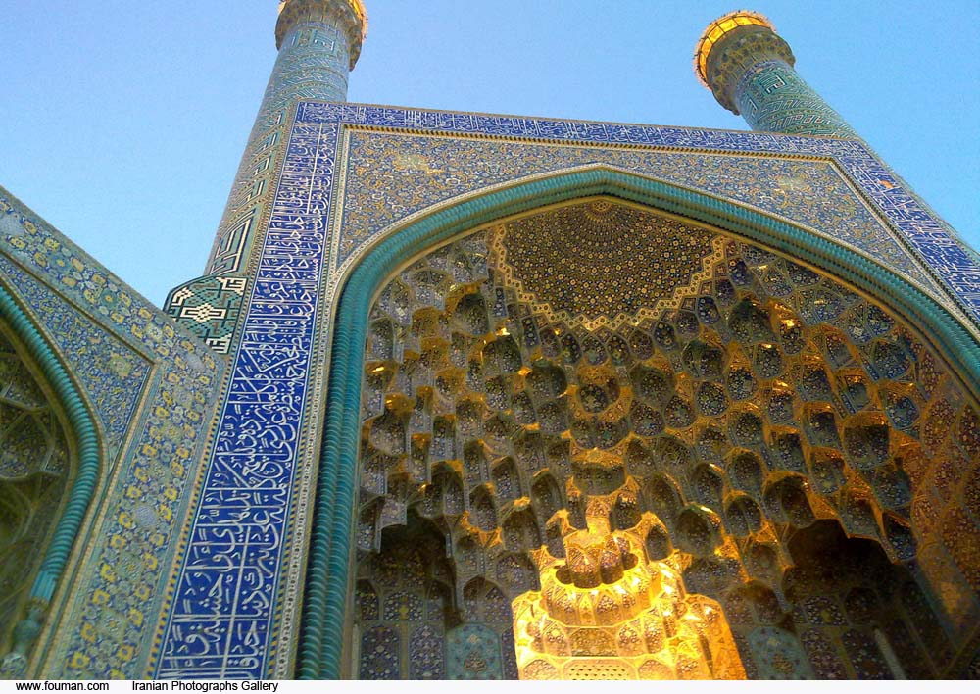
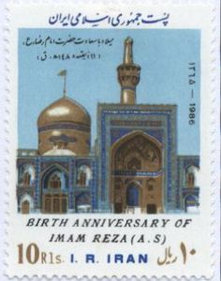
Imam Mosque is a mosque in Isfahan standing in south side of Naghsh-i Jahan Square.
The mosque is also known as Shah Mosque, Royal Mosque and Abbasi Jame Mosque.

Slide 13
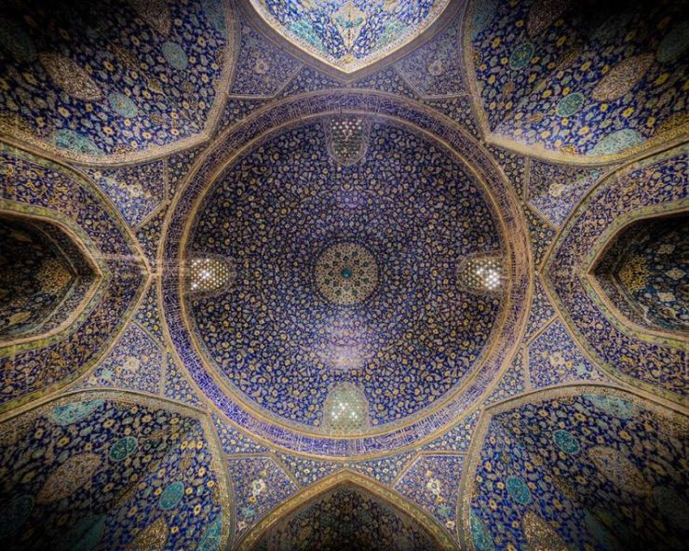
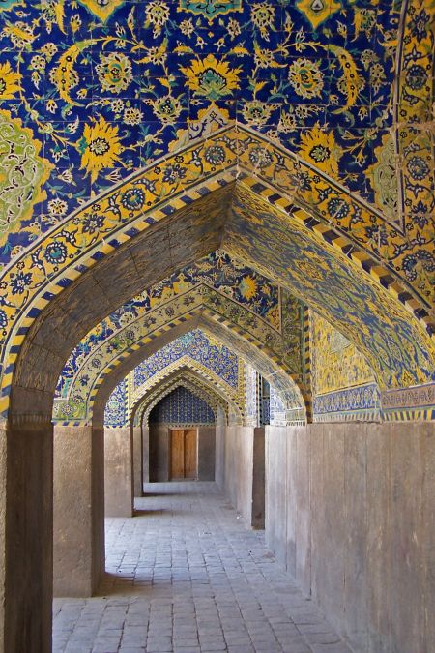
Built during the Safavids period, Esfahan Shah Mosque is an excellent example of Islamic architecture of Iran, and regarded as the masterpiece of Persian Architecture

Slide 14
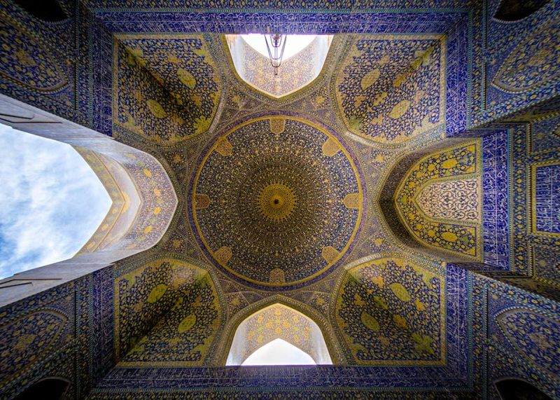
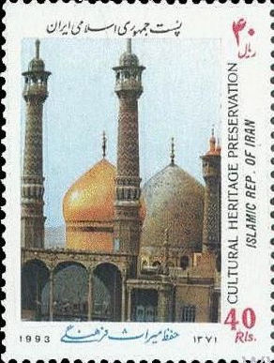
The Imam Mosque of Esfahan (Esfahan Shah Mosque) is one of the everlasting masterpieces of architecture in Iran and all over the world

Slide 15
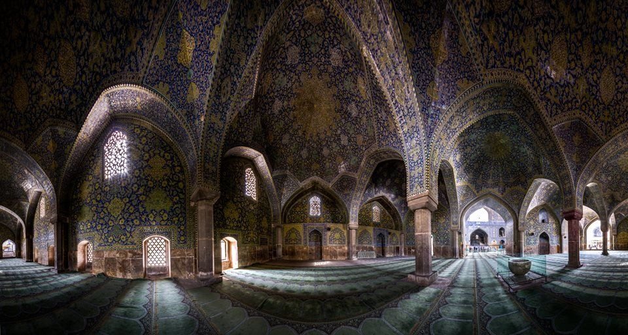
Esfahan Shah Mosque

Slide 16
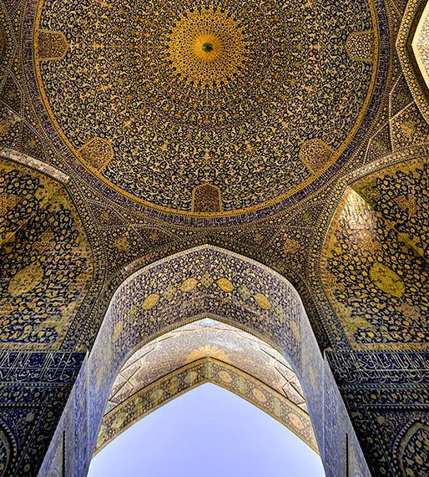
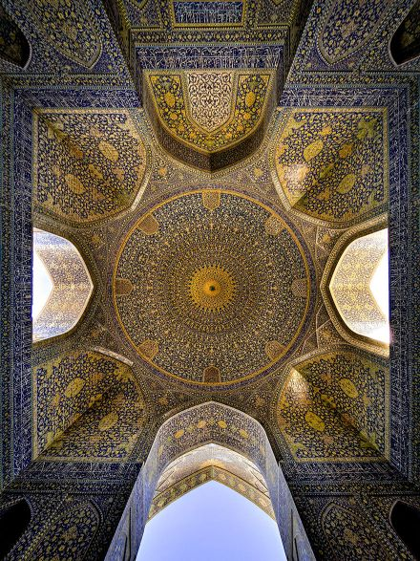
Esfahan Shah Mosque

Slide 17
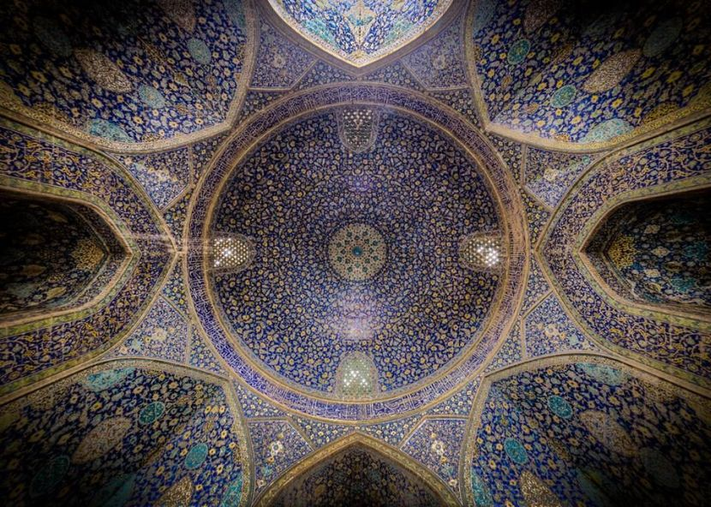
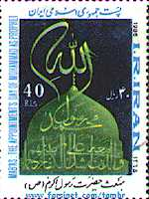
Esfahan Shah Mosque is registered along with the Naghsh-i Jahan Square as a UNESCO World Heritage Site

Slide 18
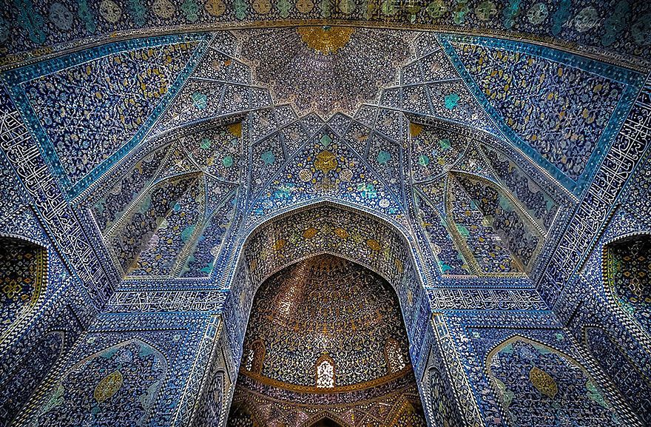
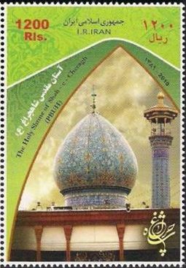
The construction of Esfahan Shah Mosque began in 1611, and its splendor is mainly due to the beauty of its seven-color mosaic tiles and calligraphic inscriptions

Slide 19
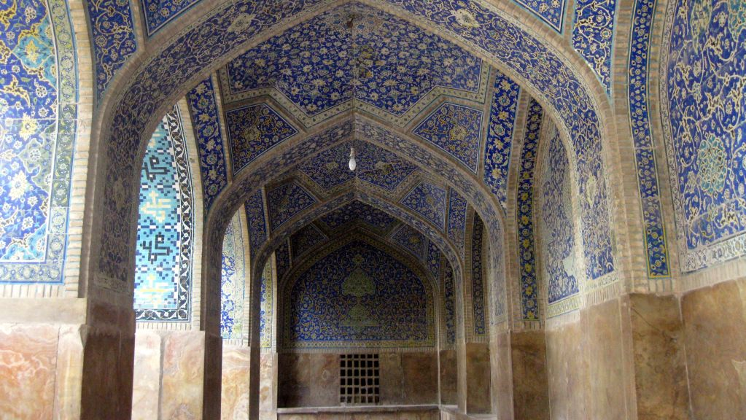
Esfahan Shah Mosque

Slide 20
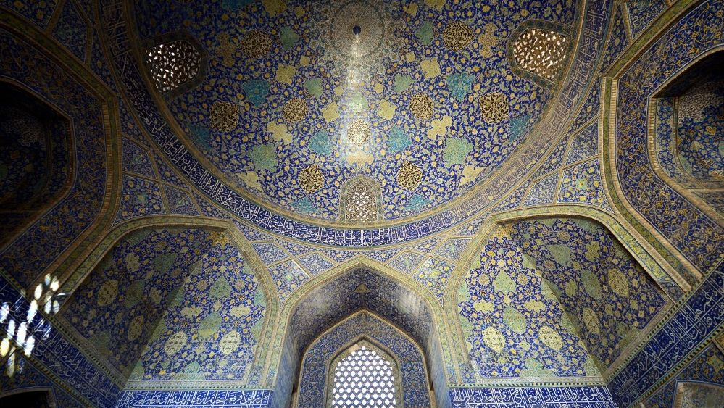
Esfahan Shah Mosque

Slide 21
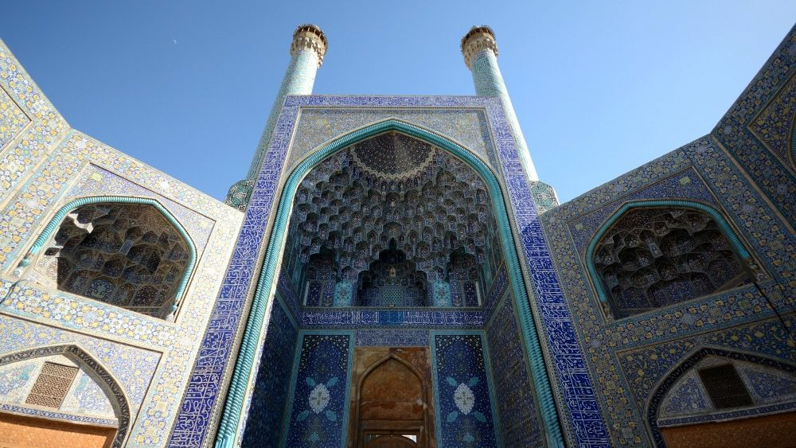
Esfahan Shah Mosque

Slide 22
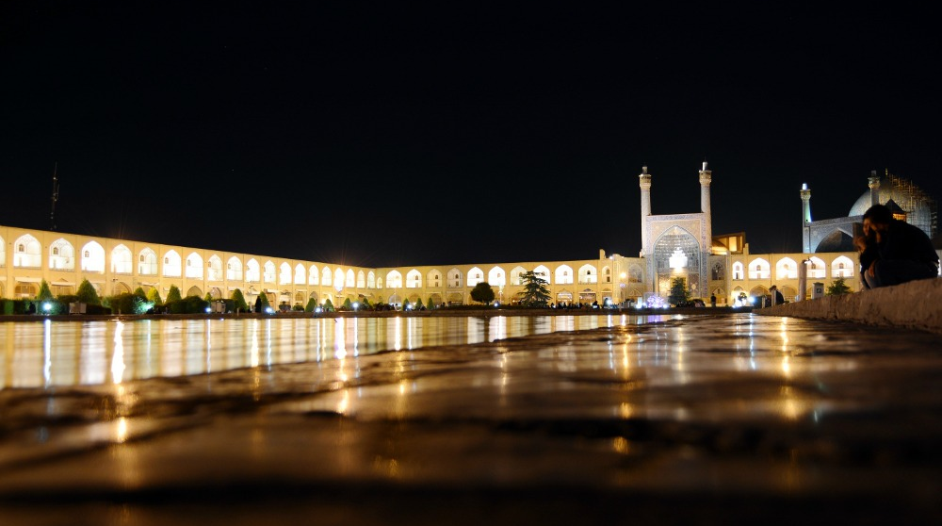
Naghsh-e-Jahan Square, Esfahan and Shah Mosque

Slide 23
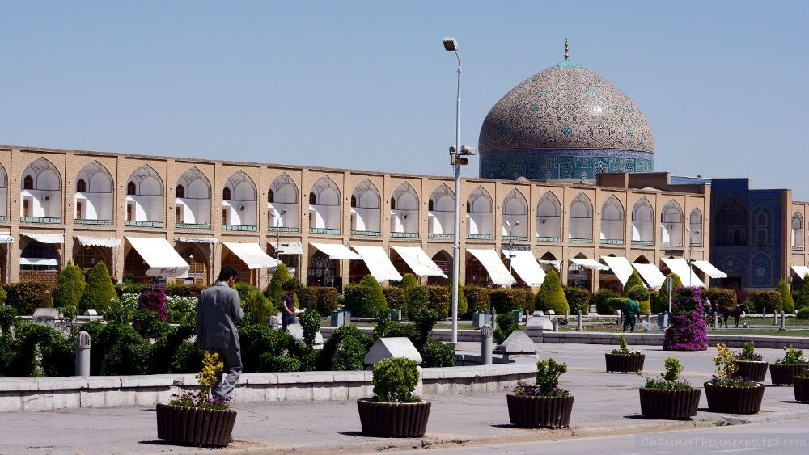
Sheikh Lotfollah mosque, Isfahan

Slide 24
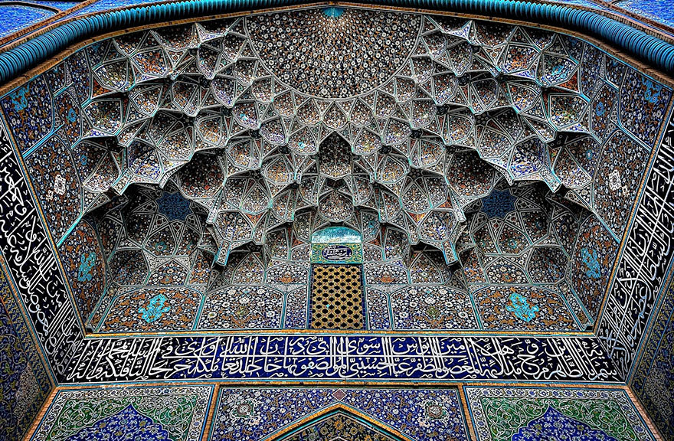
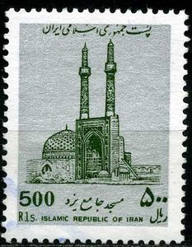
Sheikh Lotfollah mosque, Isfahan

Slide 25
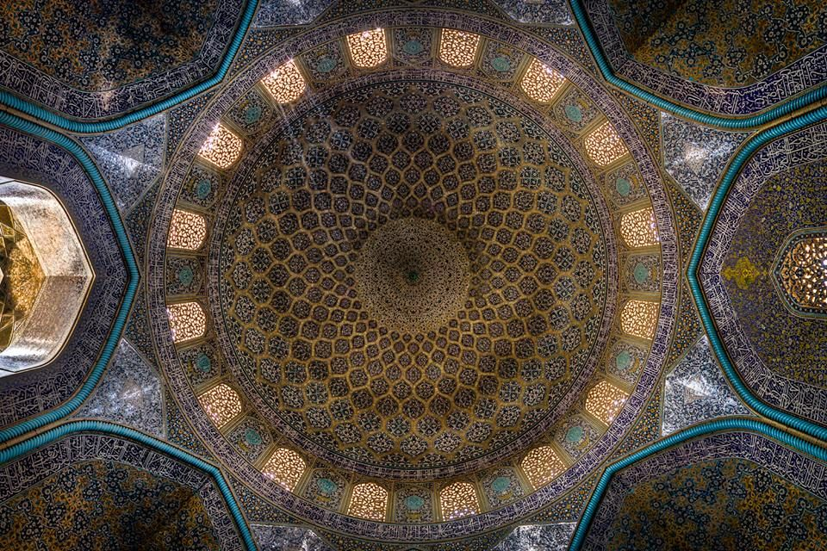
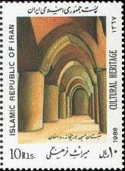
Sheikh Lotfollah mosque, Isfahan

Slide 26
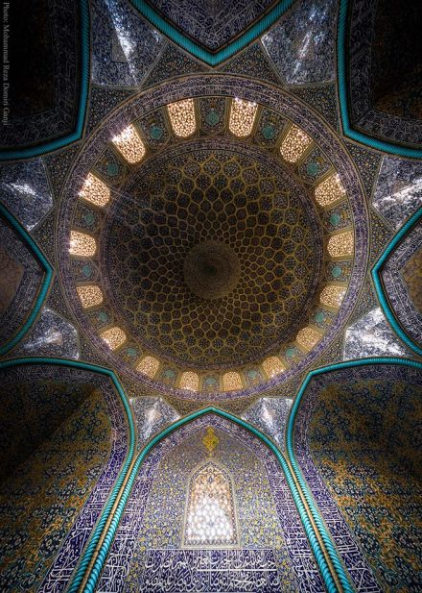
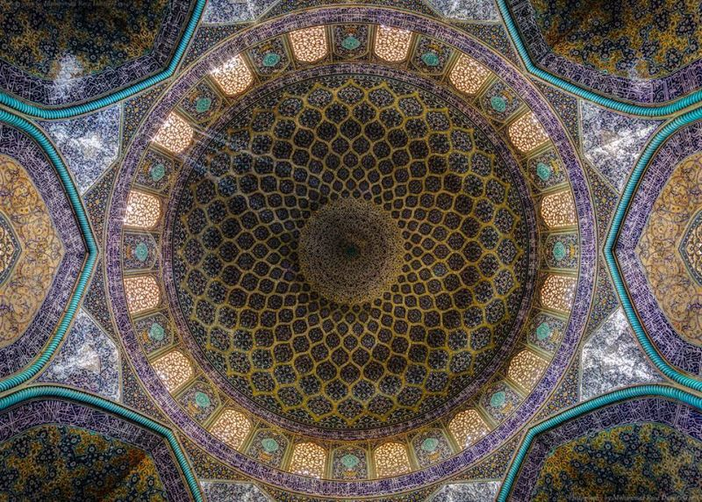
Sheikh Lotfollah mosque, Isfahan

Slide 27
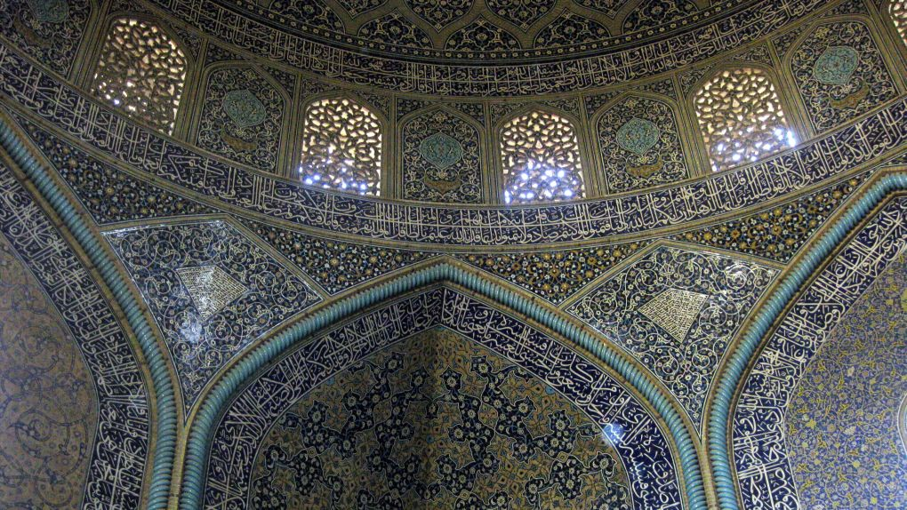
Sheikh Lotfollah Mosque

Slide 28
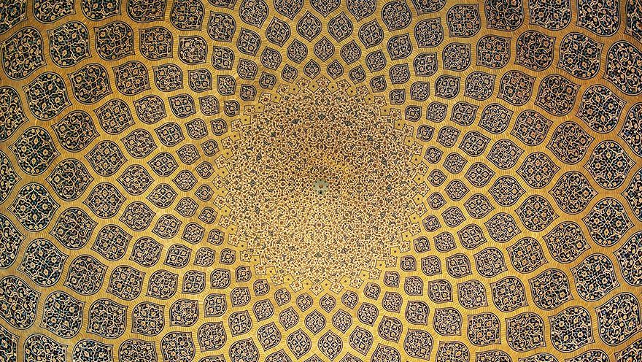
Sheikh Lotfollah mosque, Isfahan

Slide 29
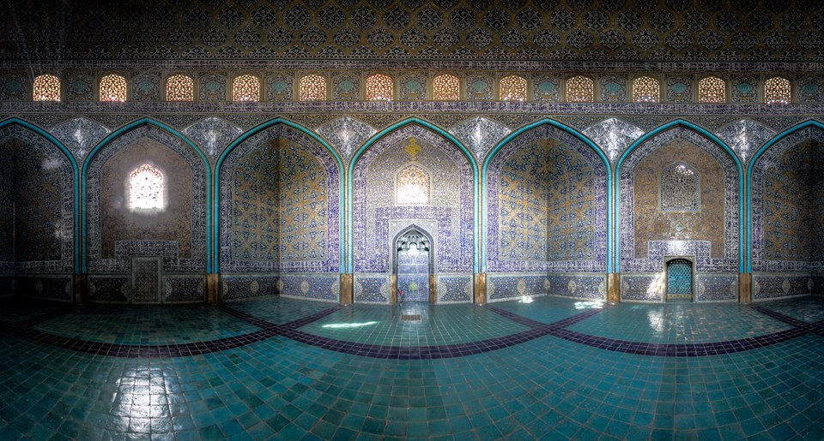
Sheikh Lotfollah mosque, Isfahan

Slide 30
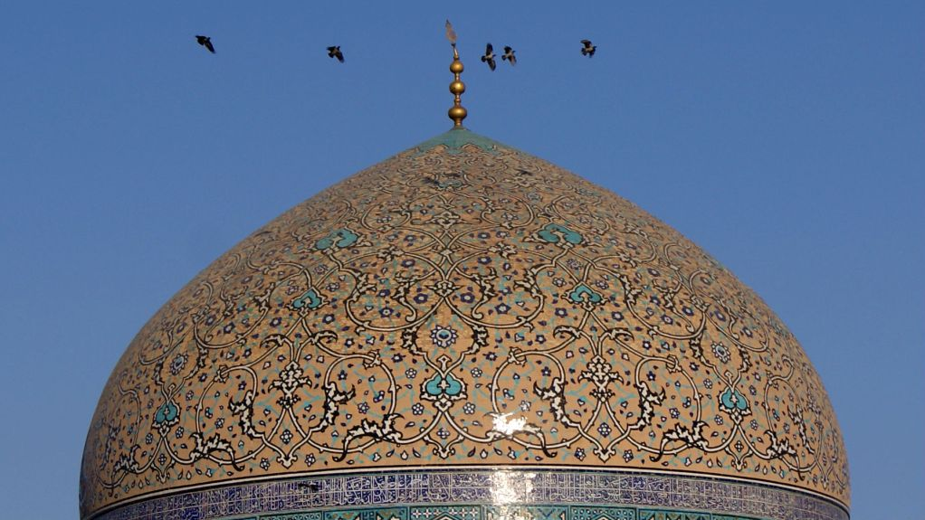
Sheikh Lotfollah mosque, Isfahan

Slide 31
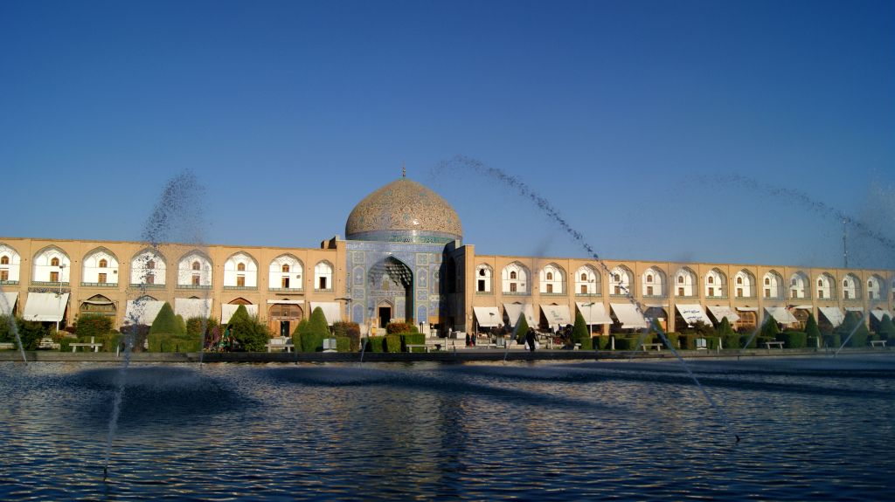
Sheikh Lotfollah mosque, Isfahan

Slide 32
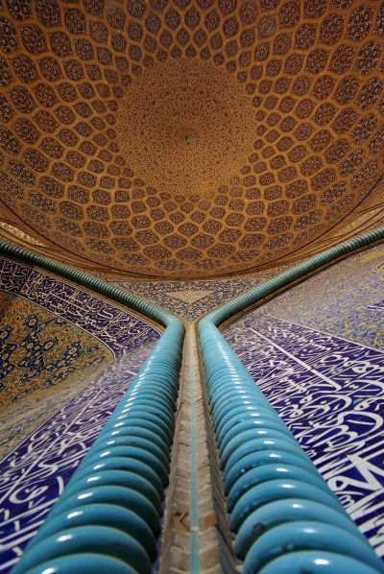

Sheikh Lotfollah mosque, Isfahan

Slide 33

Sheikh Lotfollah mosque, Isfahan

Slide 34


Sheikh Lotfollah mosque, Isfahan

Slide 35

Sheikh Lotfollah mosque, Isfahan

Slide 36

Sheikh Lotfollah mosque, Isfahan

Slide 37

Sheikh Lotfollah mosque, Isfahan

Slide 38

Sheikh Lotfollah mosque, Isfahan

Slide 39

Sheikh Lotfollah mosque, Isfahan

Slide 40

Naghsh-e-Jahan Square, Esfahan and Sheikh Lotfollah mosque

Slide 41



Pictures: Internet &
Mohammad Reza Domiri Ganji
All copyrights belong to their respective owners
Presentation: Sanda Foişoreanu
www.slideshare.net/michaelasanda
https://plus.google.com/+SandaMichaela
2015
Sound: Alireza Eftekhari - Avaze Afshari
Notes:
Azerbaijan Museum, Tabriz (Iran). Rock weight, Jiroft, 3rd mil. BC Azerbaijan Museum in Tabriz, Iran
Beautiful Iran13
http://www.authorstream.com/Presentation/michaelasanda-2534064-beautiful-iran13/
http://www.nicepps.ro/prezentare-powerpoint-beautiful-iran13-22196.html
http://www.slideshare.net/michaelasanda/beautiful-iran13
Beautiful Iran12
http://www.authorstream.com/Presentation/michaelasanda-2532830-beautiful-iran12/
http://www.nicepps.ro/prezentare-powerpoint-beautiful-iran12-22195.html
http://www.slideshare.net/michaelasanda/beautiful-iran12-49836898
Beautiful Iran11
http://www.authorstream.com/Presentation/michaelasanda-2531686-beautiful-iran11/
http://www.nicepps.ro/prezentare-powerpoint-beautiful-iran11-22175.html
http://www.slideshare.net/michaelasanda/beautiful-iran11
Beautiful Iran10
http://www.authorstream.com/Presentation/michaelasanda-2393976-beautiful-iran10/
http://www.nicepps.ro/prezentare-powerpoint-beautiful-iran10-20809.html
http://www.slideshare.net/michaelasanda/beautiful-iran10

