Slide 1
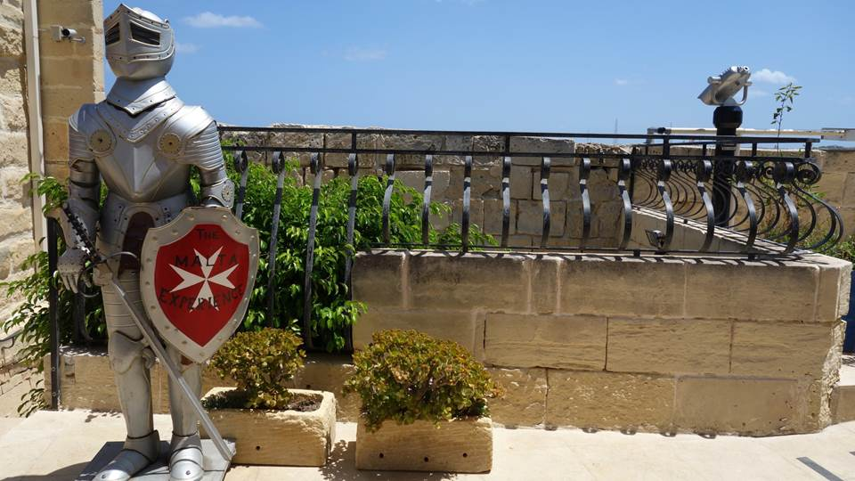

Malta

Slide 2
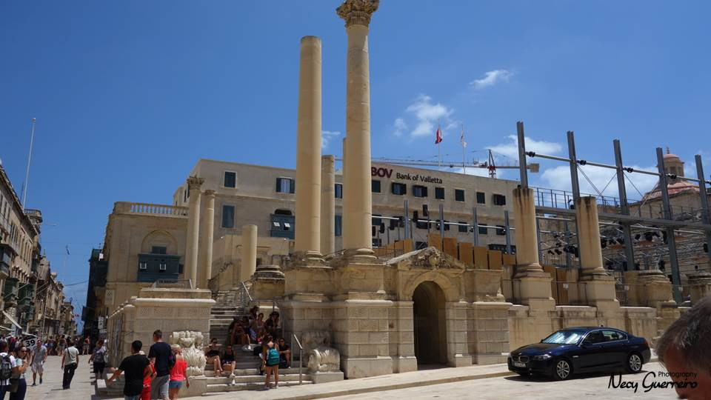
Valletta

Slide 3
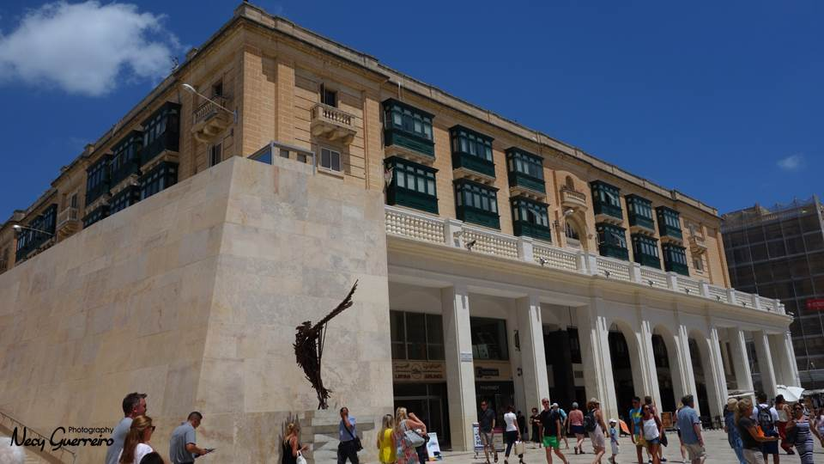
Valletta

Slide 4
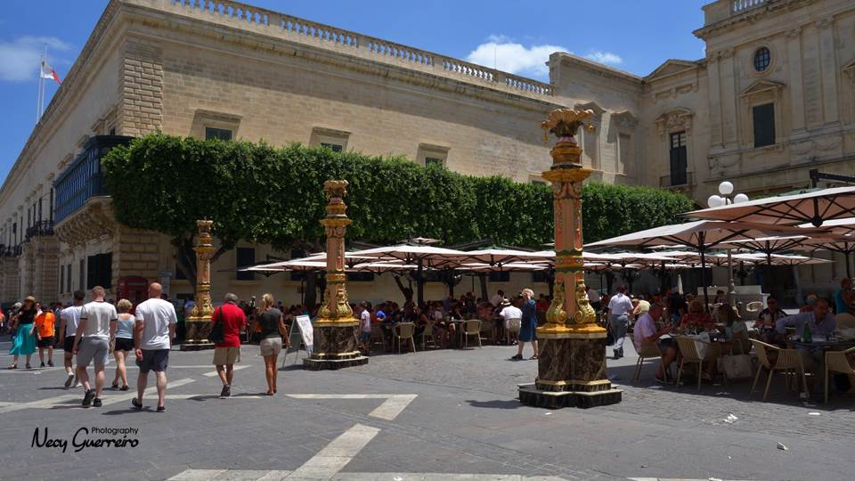
Valletta

Slide 5
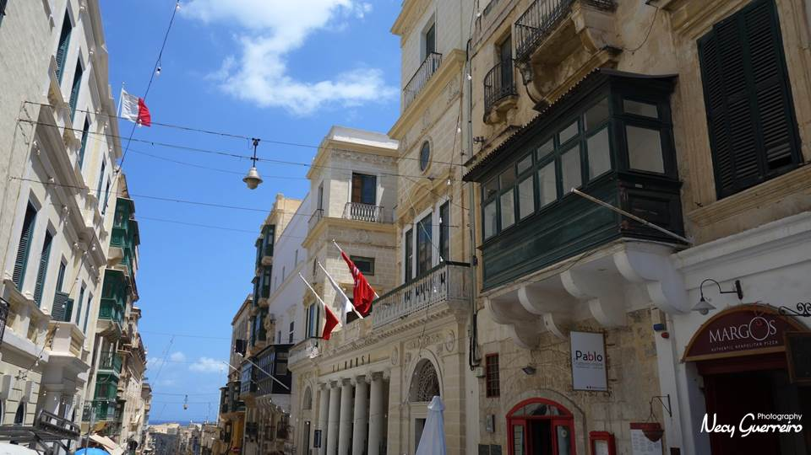
Valletta

Slide 6
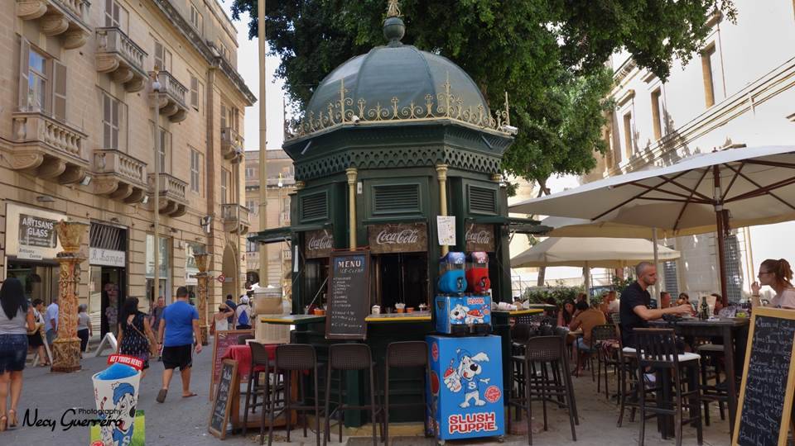
Valletta

Slide 7
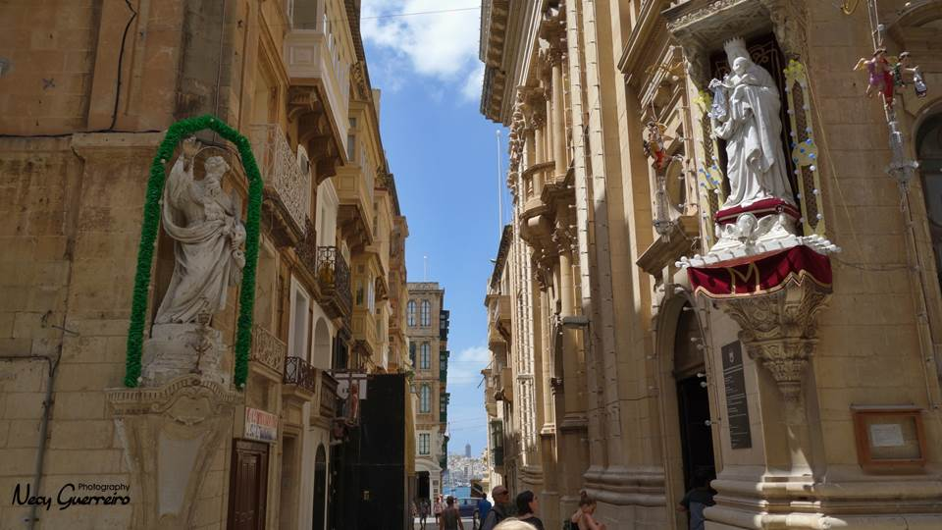
Valletta

Slide 8
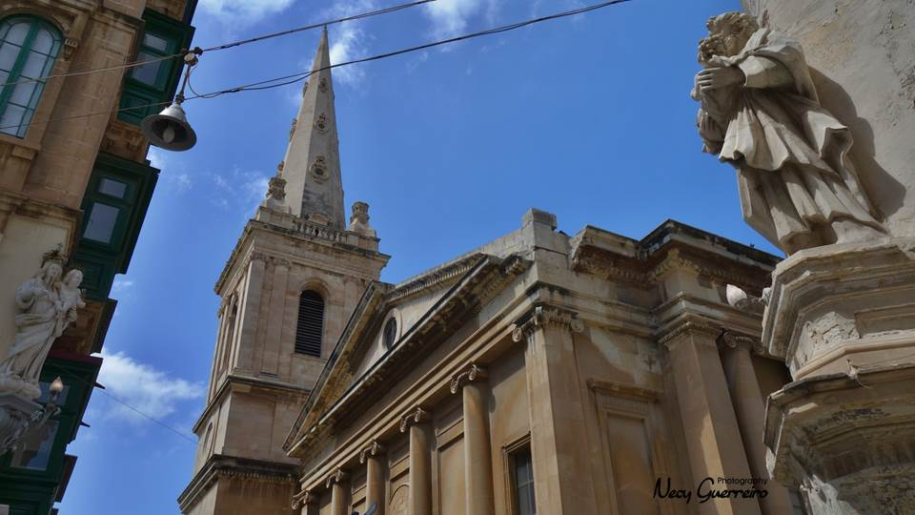
Valletta

Slide 9
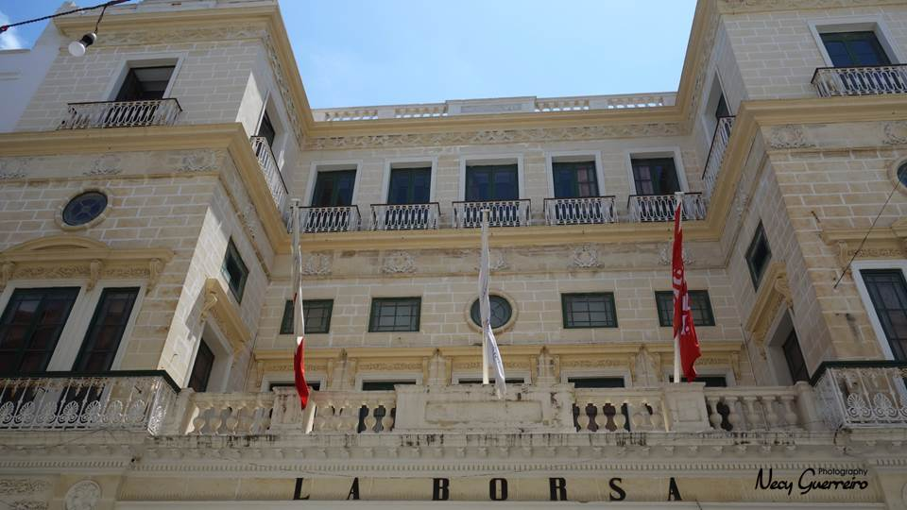
Valletta

Slide 10
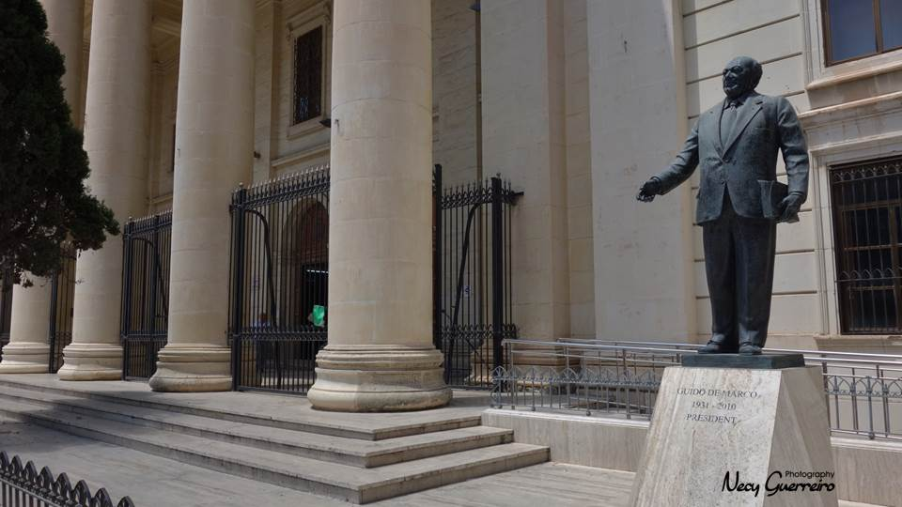
Valletta

Slide 11
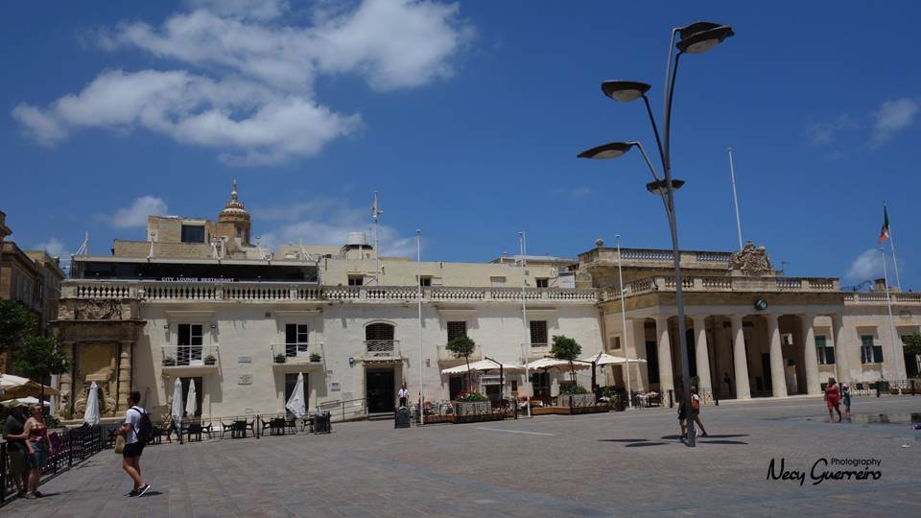
Valletta

Slide 12
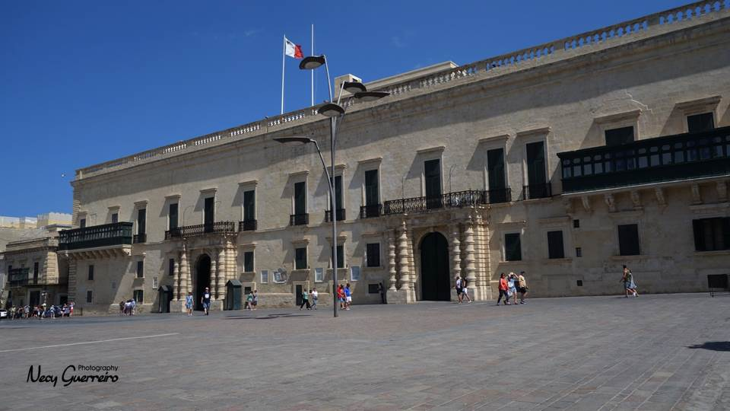
Valletta

Slide 13
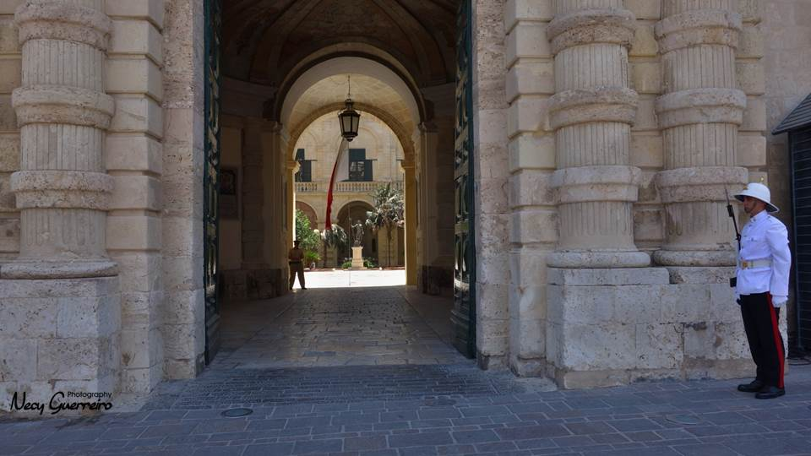
Valletta

Slide 14
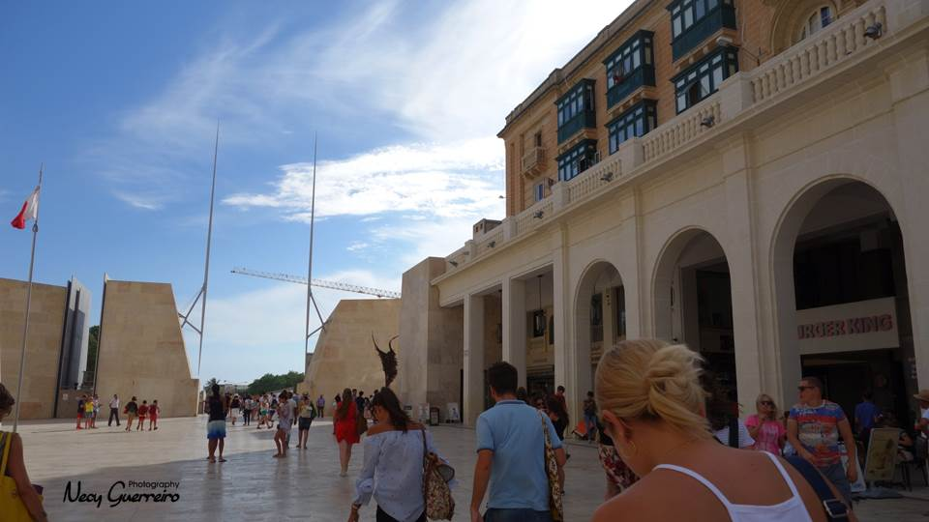
Valletta

Slide 15
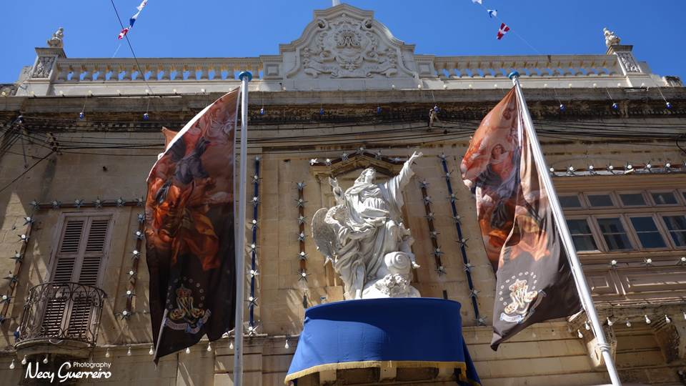
Mosta

Slide 16
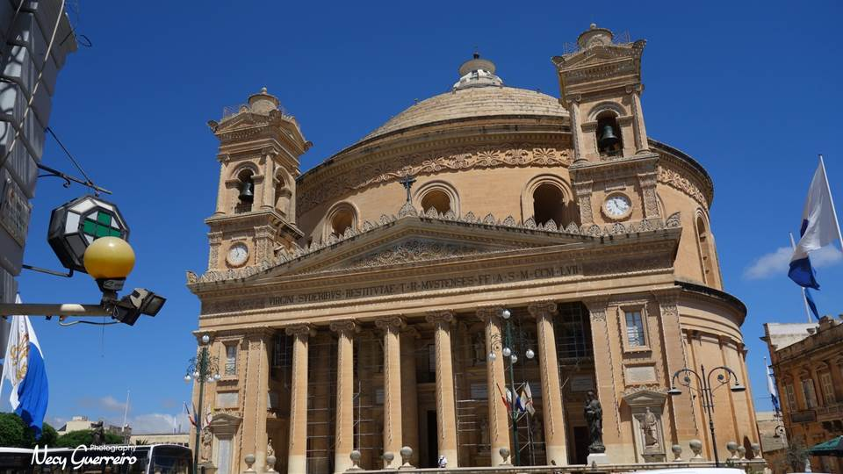
Catedral de Mosta

Slide 17
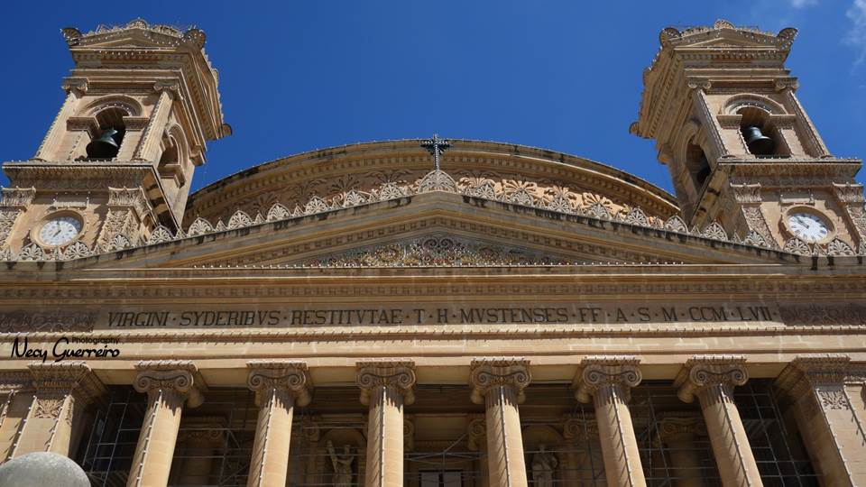
Catedral de Mosta

Slide 18
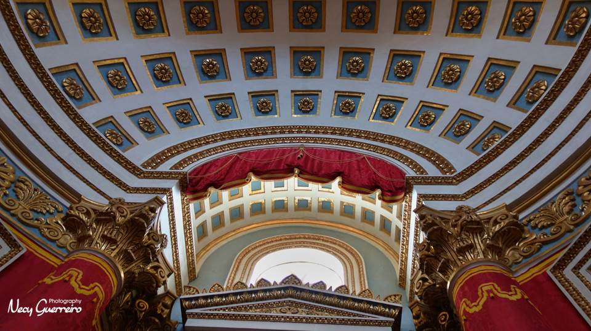

Slide 19
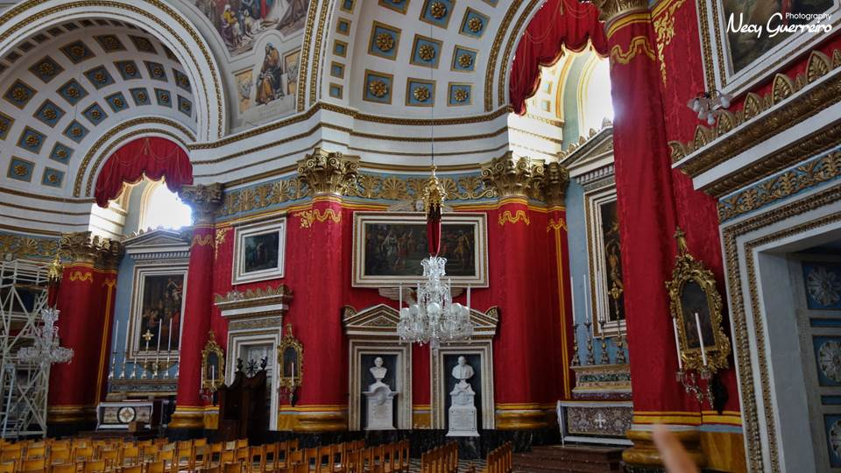

Slide 20
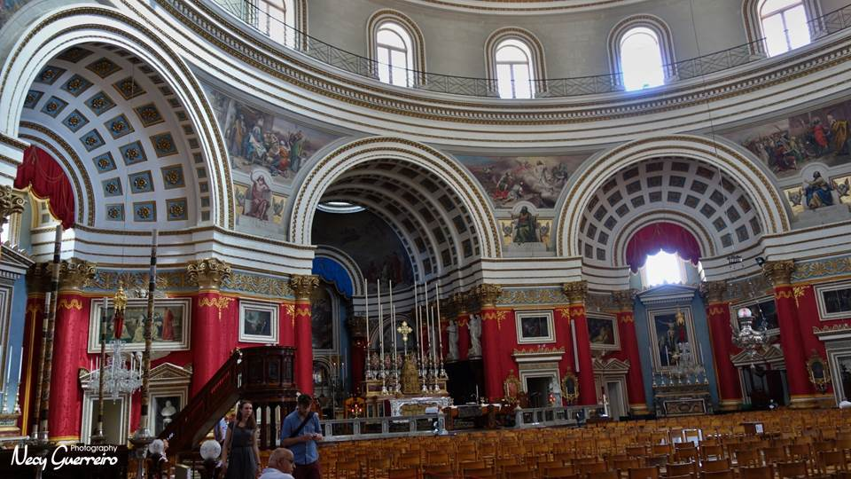

Slide 21
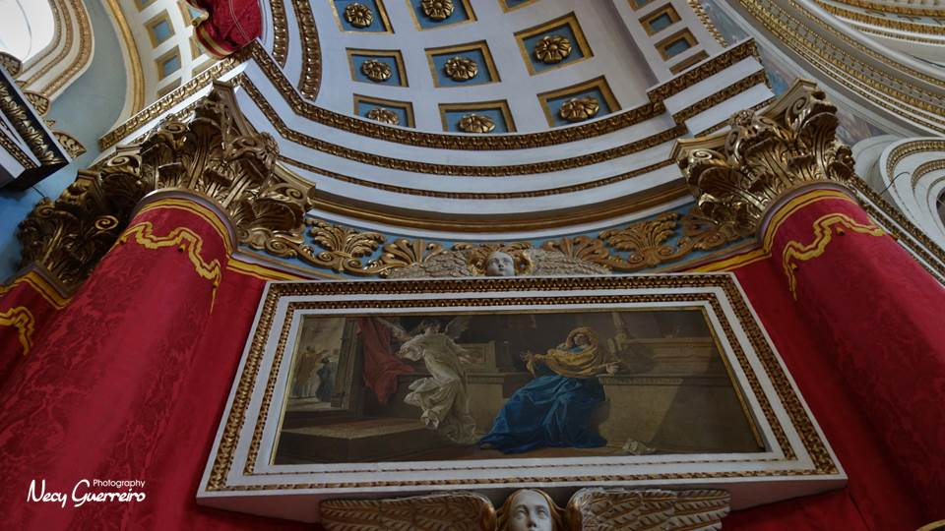

Slide 22
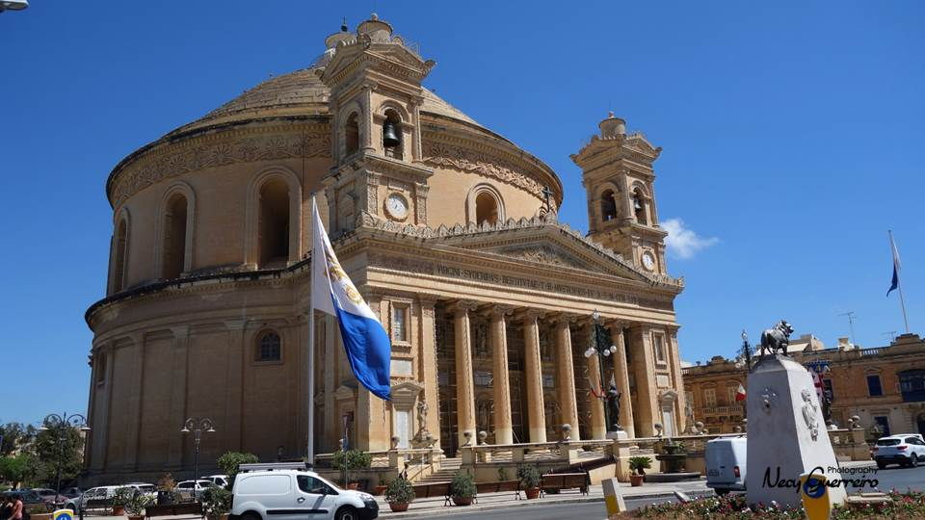
Catedral de Mosta

Slide 23
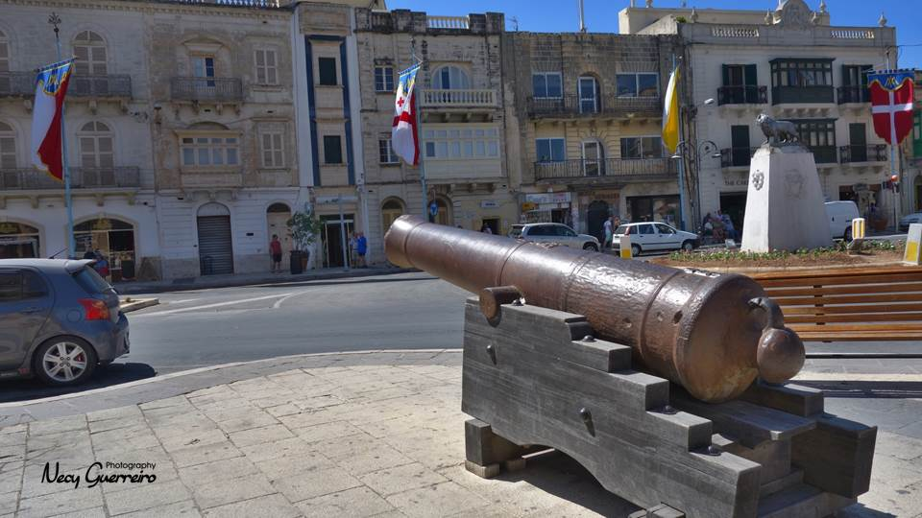
Rotunda de Mosta

Slide 24
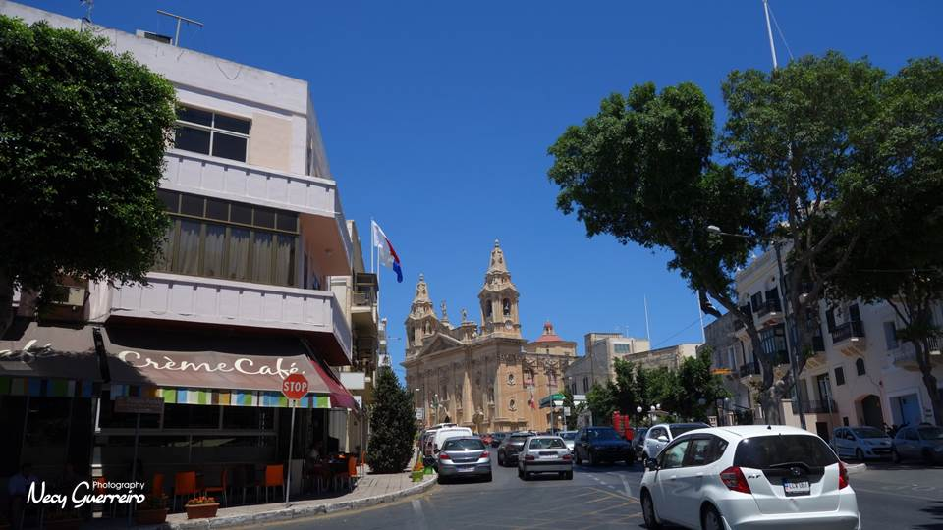
Naxxar

Slide 25
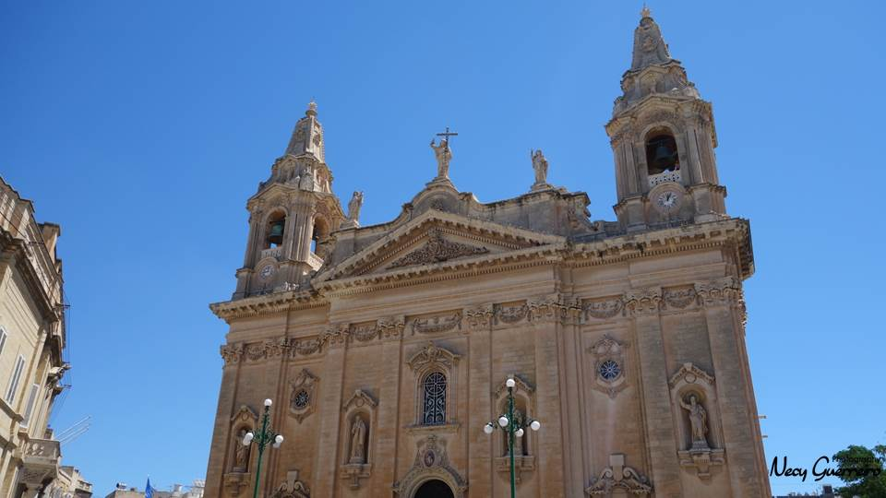
Naxxar Parish Church
(Igreja Naxxar)

Slide 26
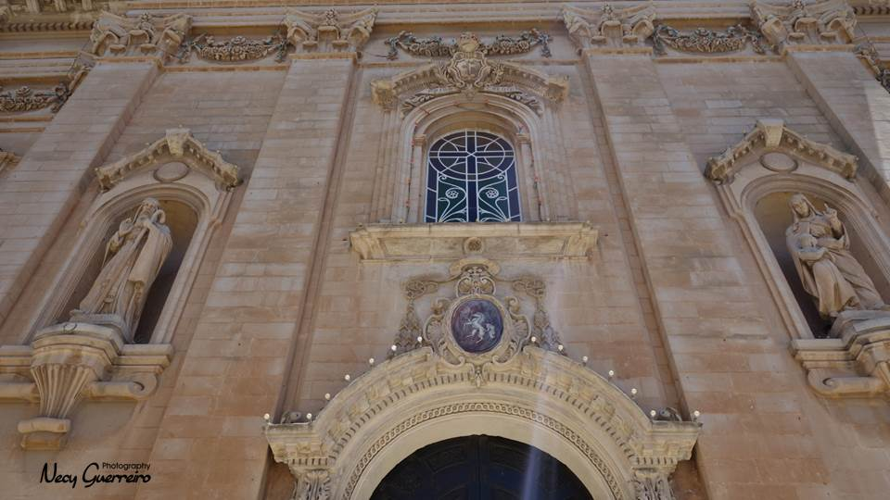

Slide 27
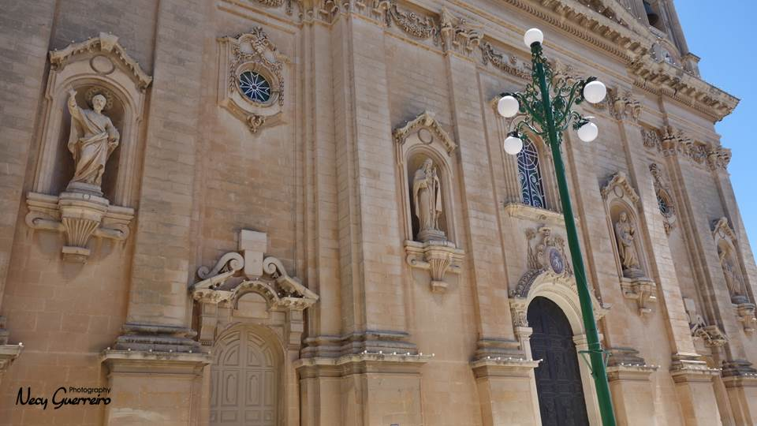

Slide 28
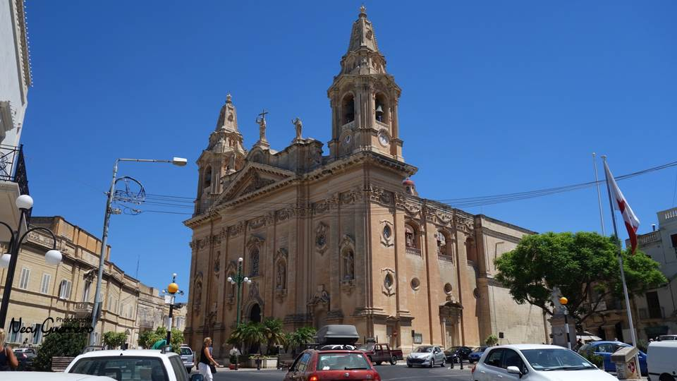
Naxxar Parish Church
(Igreja Naxxar)

Slide 29
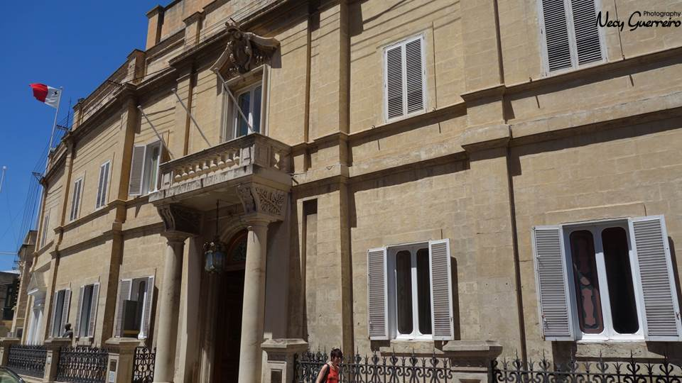
Palácio Parisio

Slide 30
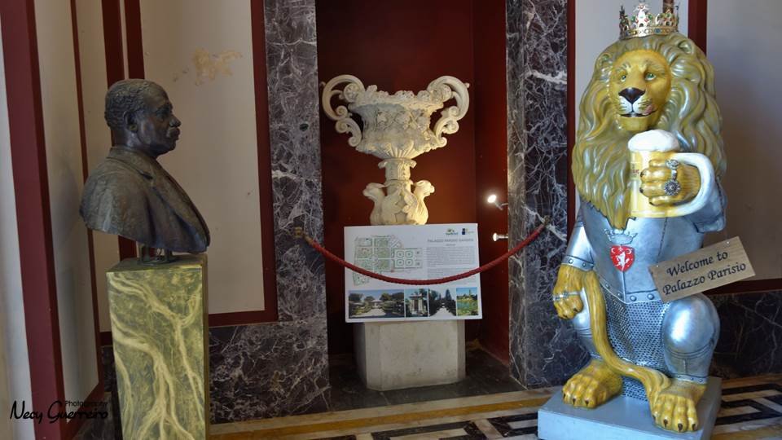

Slide 31
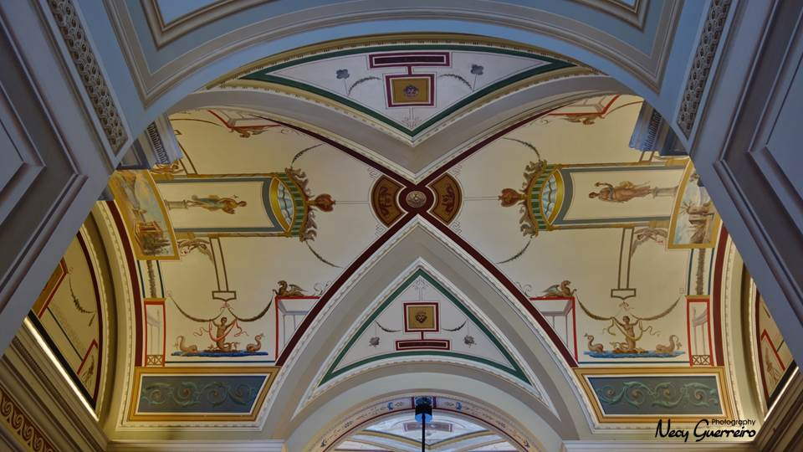
Palazzo Parisio

Slide 32
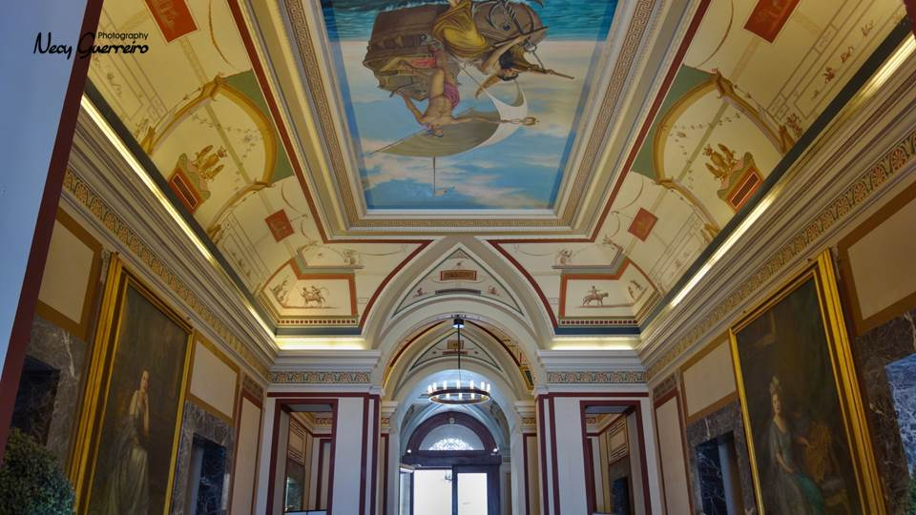
Palazzo Parisio

Slide 33
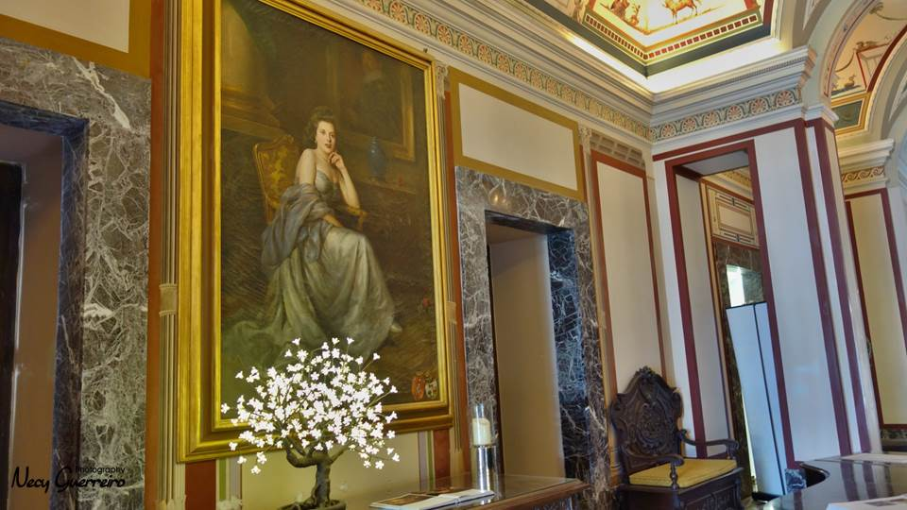
Palazzo Parisio

Slide 34
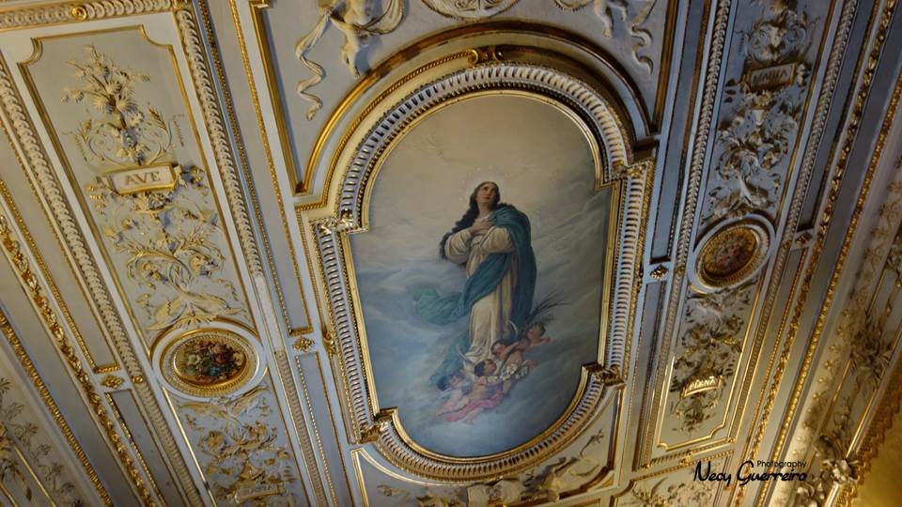

Slide 35
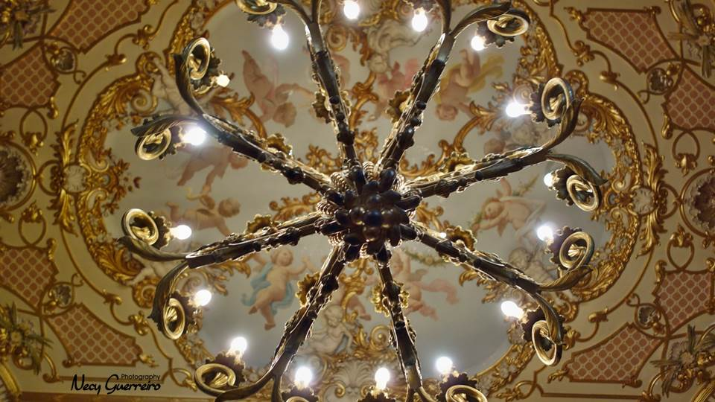

Slide 36
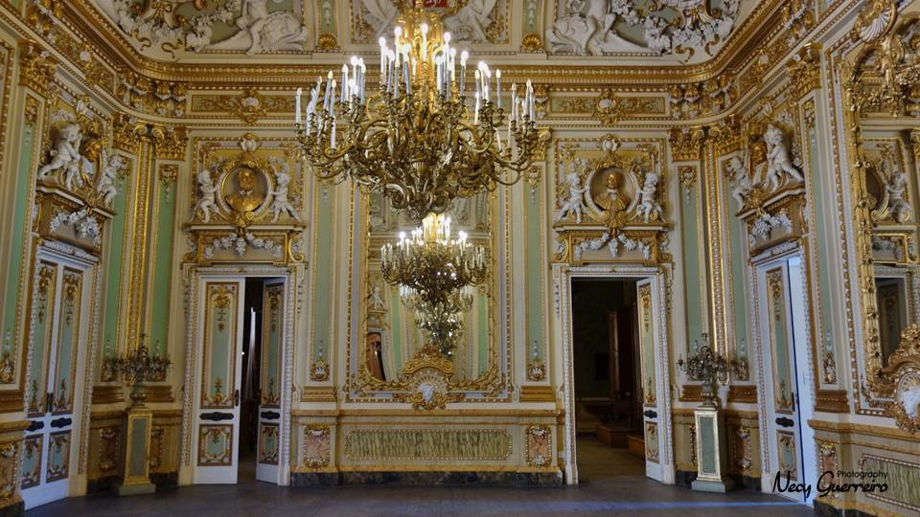

Slide 37
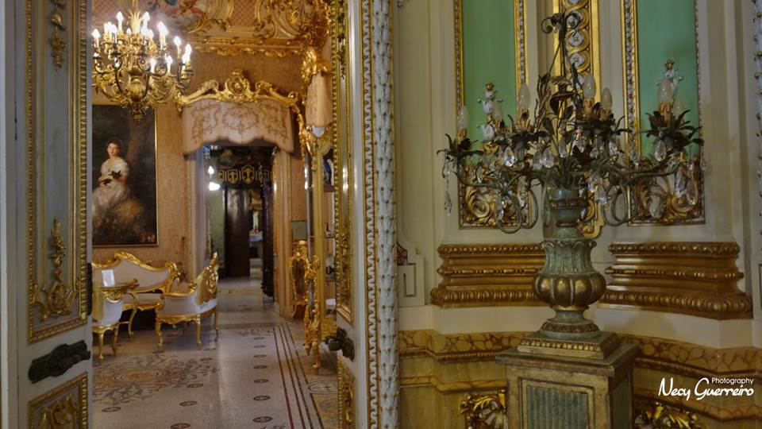

Slide 38
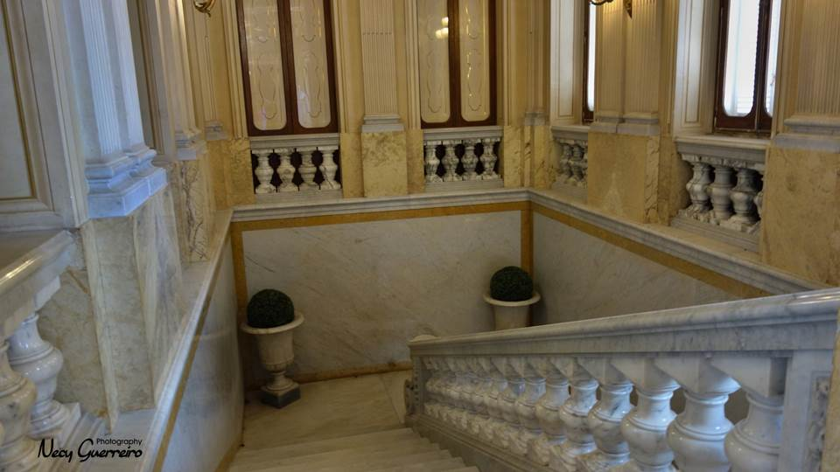

Slide 39
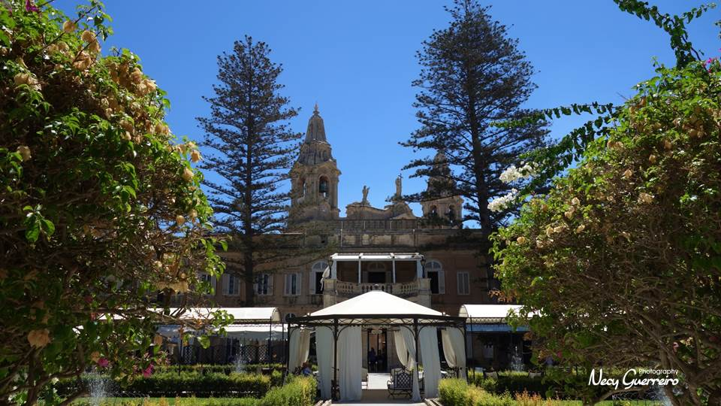
Palazzo Parisio

Slide 40
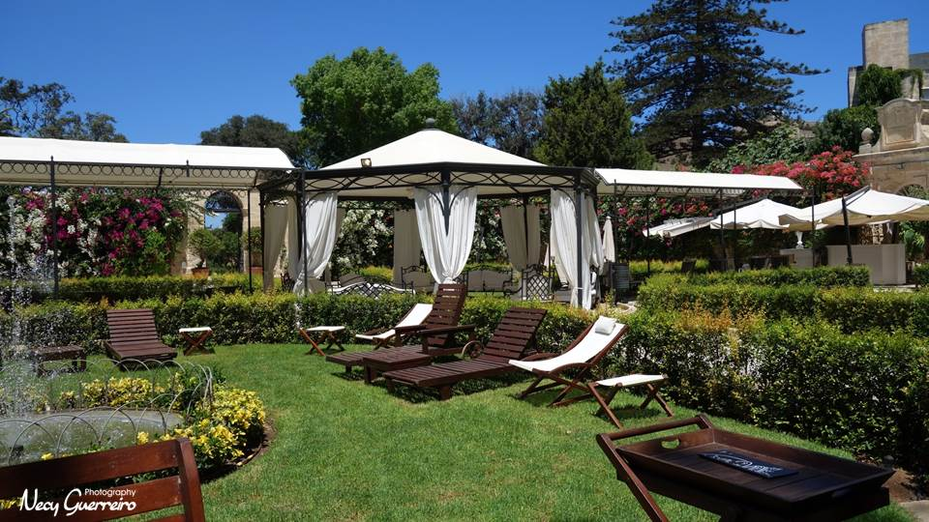
Palazzo Parisio

Slide 41
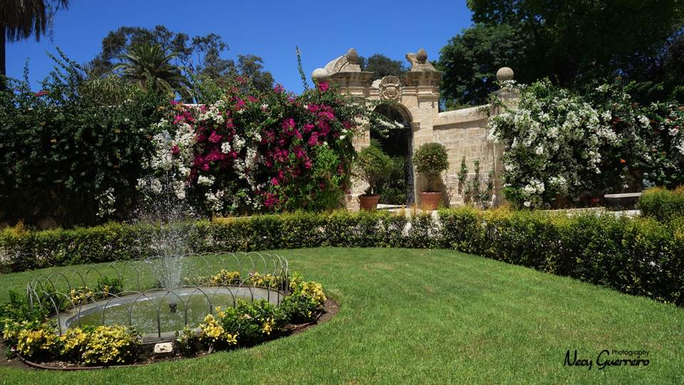

Slide 42
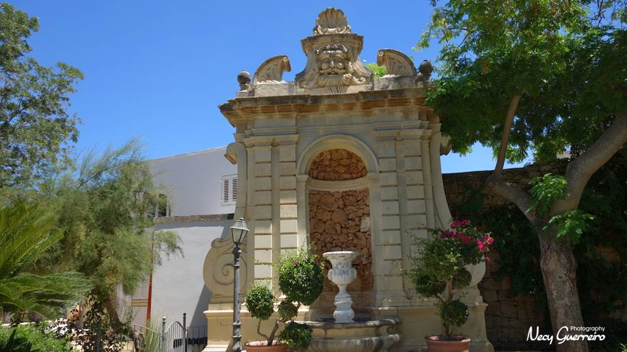

Slide 43
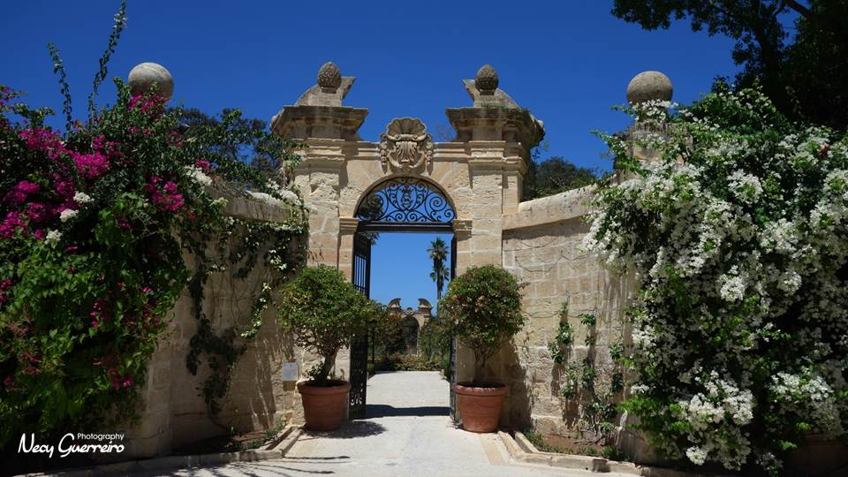

Slide 44
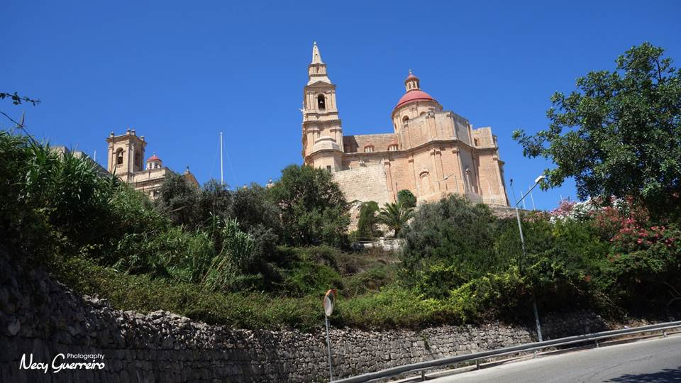
Sanctuary of our lady of Mellieha

Slide 45
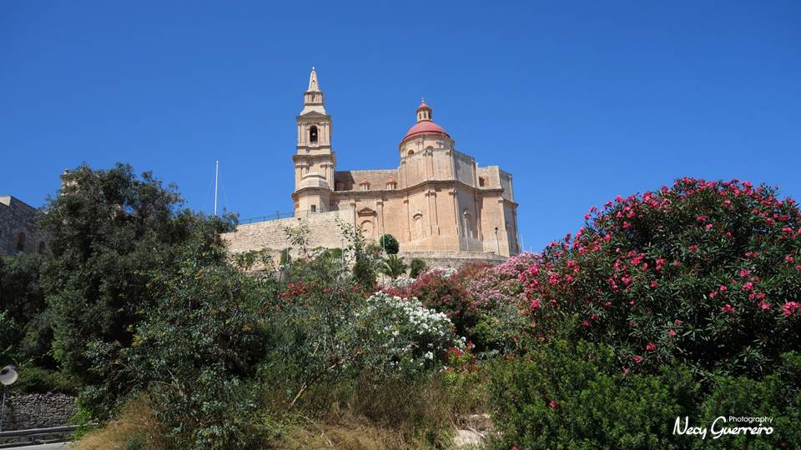
Sanctuary of our lady of Mellieha

Slide 46
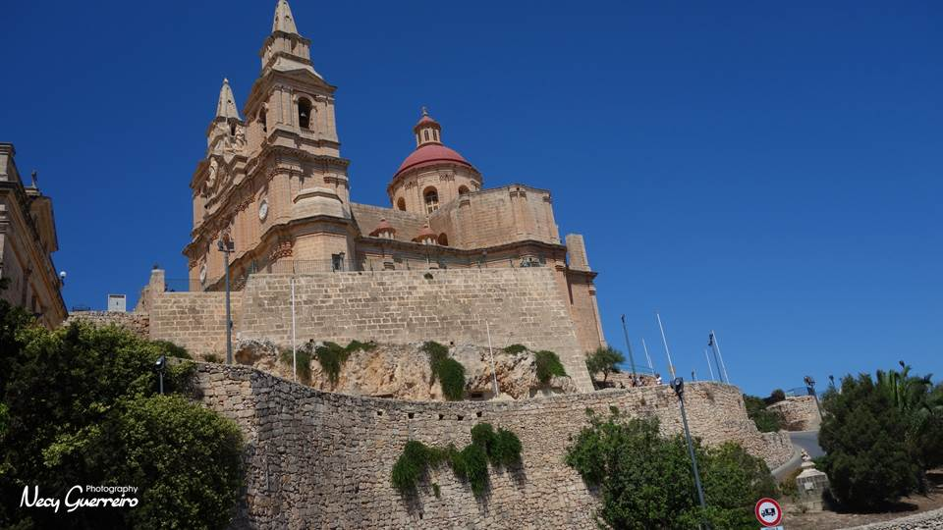
Sanctuary of our lady of Mellieha

Slide 47
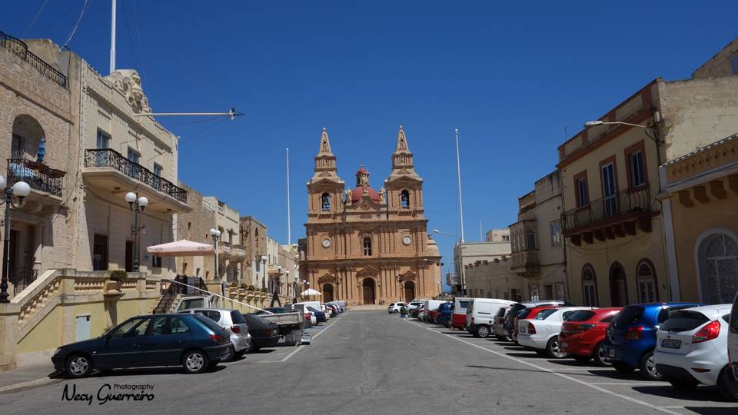
Sanctuary of our lady of Mellieha

Slide 48
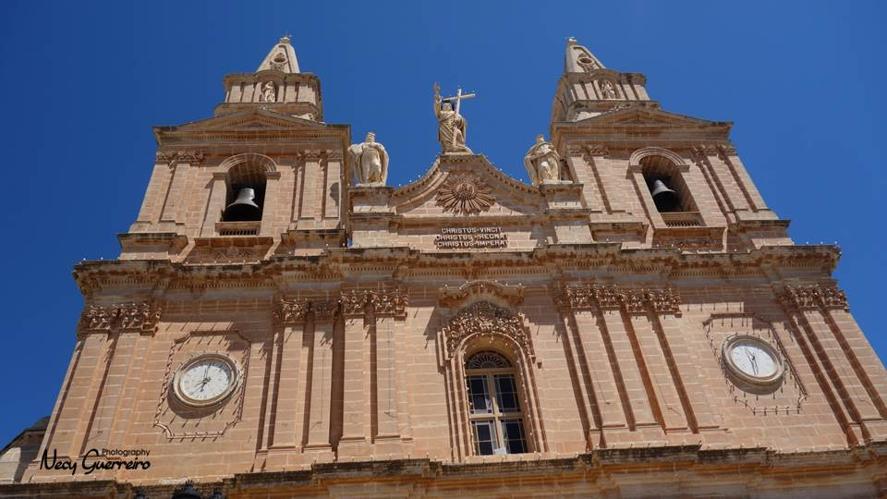

Slide 49
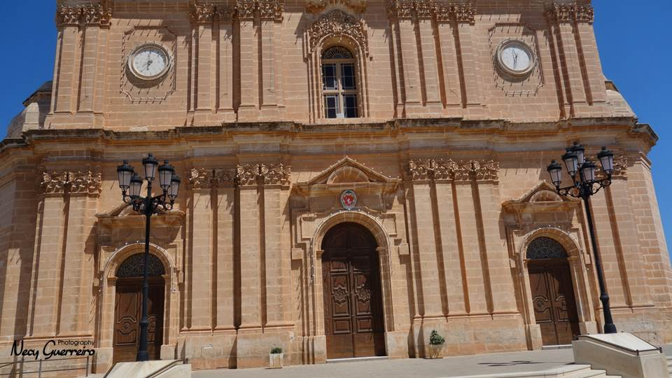

Slide 50
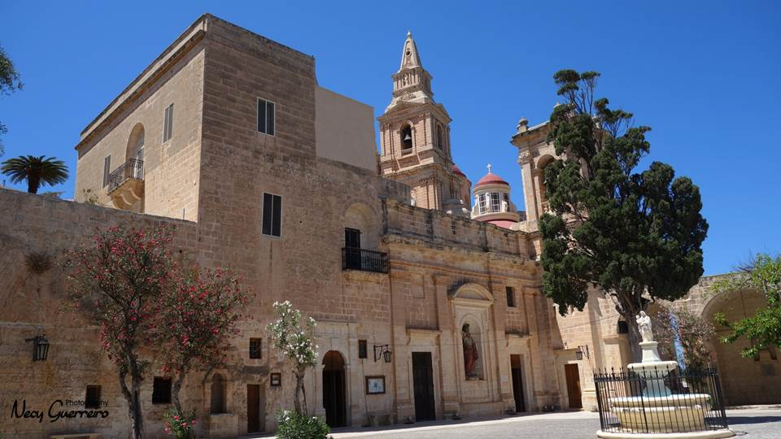

Slide 51


Slide 52


Slide 53

Mellieha

Slide 54

Mellieha

Slide 55

Mellieha Bay

Slide 56

Mellieha Bay

Slide 57

Mellieha Bay

Slide 58

Comino

Slide 59

Comino

Slide 60

Comino

Slide 61

Comino

Slide 62

Comino

Slide 63

Comino

Slide 64


Slide 65

Comino

Slide 66

Gozo

Slide 67


Slide 68

Gozo

Slide 69

Gozo
Cittadella

Slide 70

Catedral de Gozo

Slide 71


Slide 72


Slide 73

Gozo
Cittadella

Slide 74


Slide 75

Gozo

Slide 76

Gozo

Slide 77

Gozo

Slide 78


Slide 79


Slide 80


Slide 81

Gozo
Xlendi Bay

Slide 82

Gozo

Slide 83


Slide 84

Valletta
view from the sea

Slide 85



necyguerreiro@gmail.com
Lisboa – Portugal
“ Those were the days”

